Slide 1
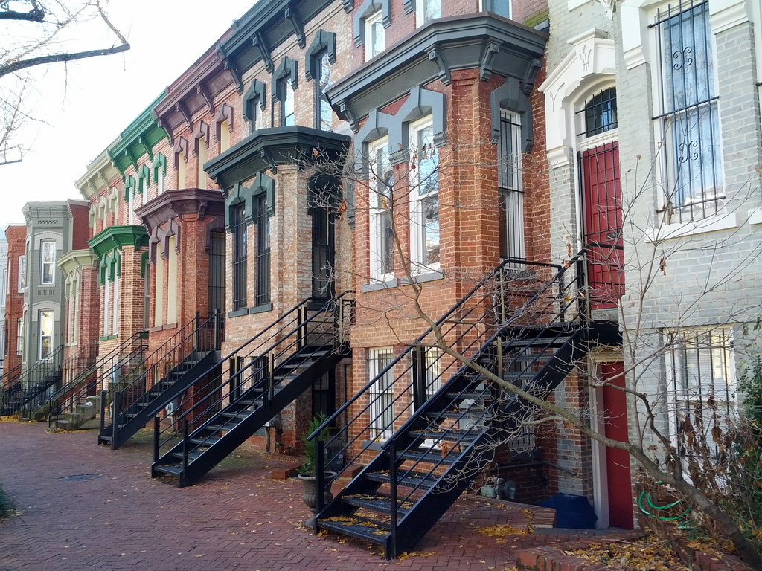
Washington, DC:
Our Changing City
Simone Zhang
NeighborhoodInfo DC
Notes:
Hi everyone, my name is Simone Zhang and today I will present Our Changing City, an interactive, data-driven web feature exploring a decade of demographic change in the District of Columbia. In the next five minutes, I’m going to provide you an overview of the story behind DC’s population growth in the past fifty years. I’ll also share some of the key lessons we at NeighborhoodInfo DC and the Urban Institute learned about what works in engaging key audiences with using data.

Slide 2
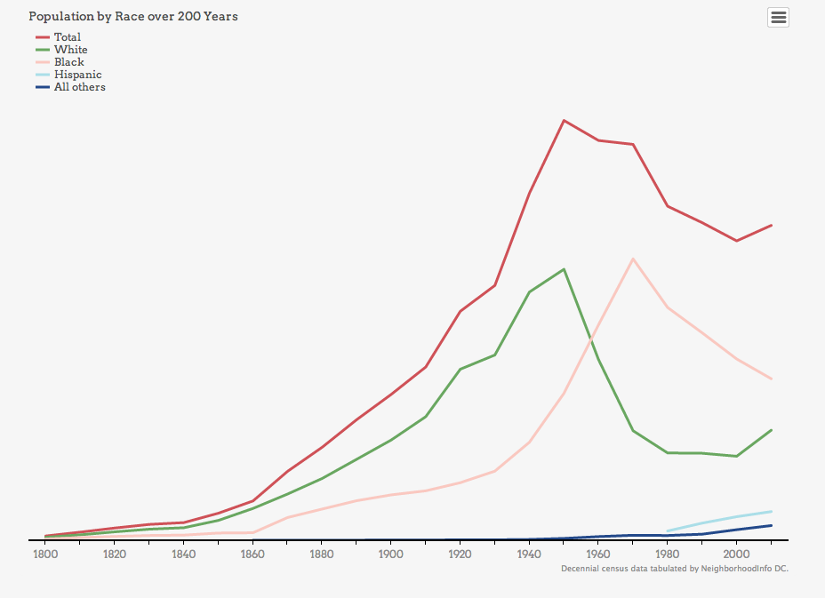
Washington, DC:
OUR CHANGING CITY
A history of change

Slide 3
Washington, DC:
OUR CHANGING CITY
A history of change

Slide 4
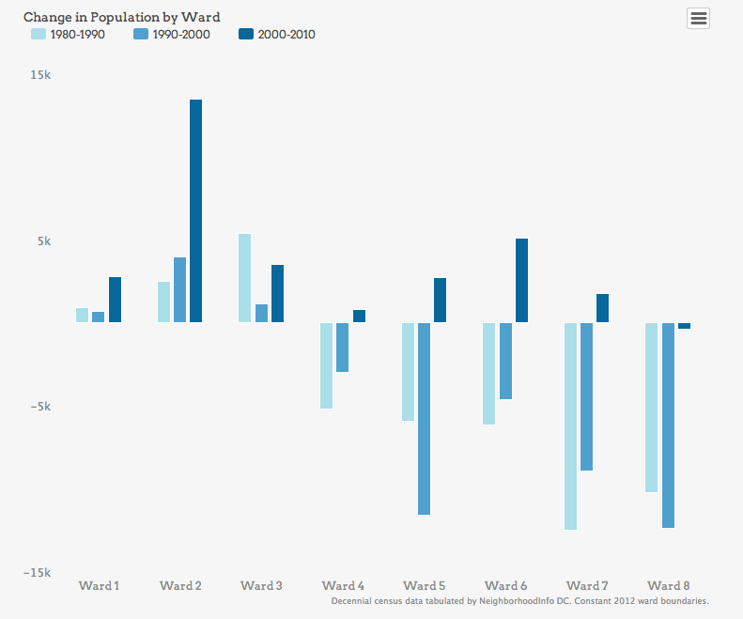
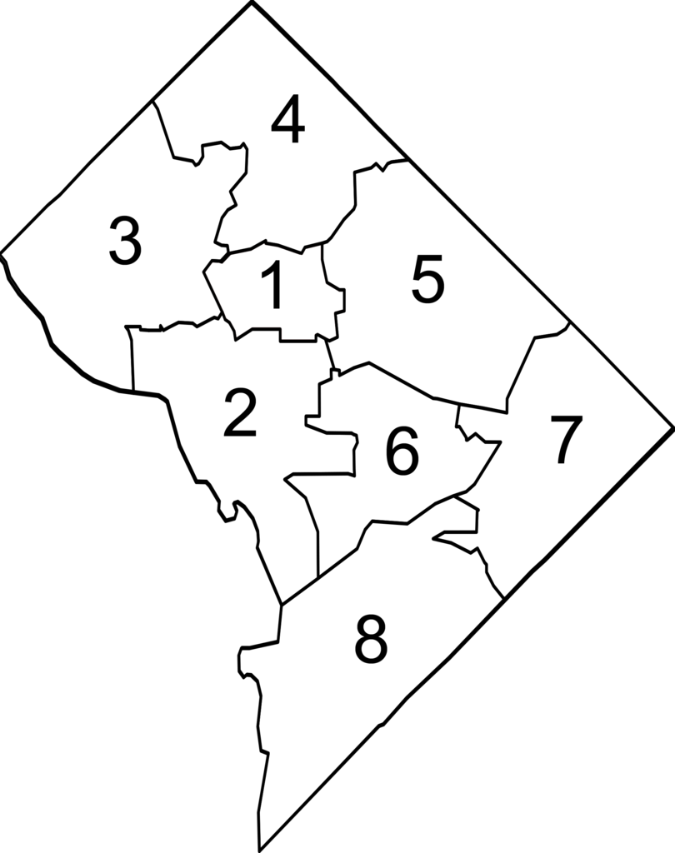
Washington, DC:
OUR CHANGING CITY
Wards 2 and 6 grew the most

Slide 5
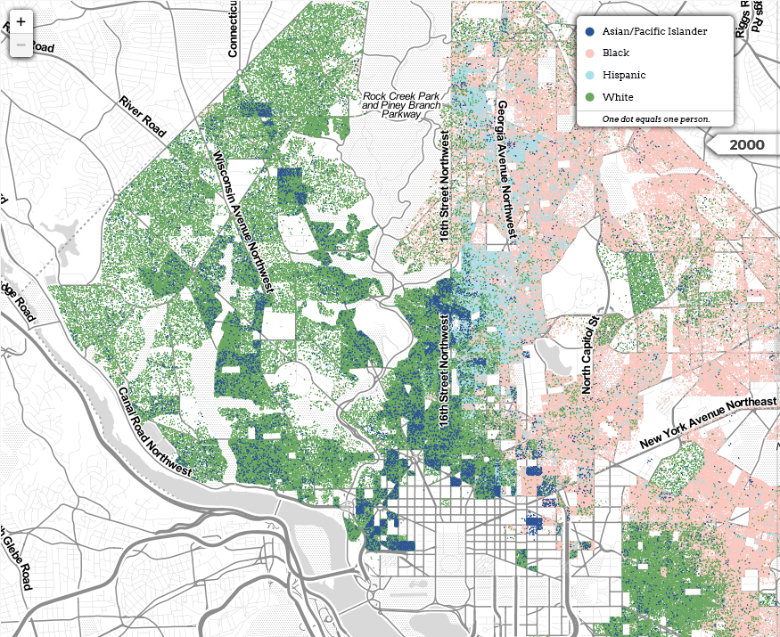
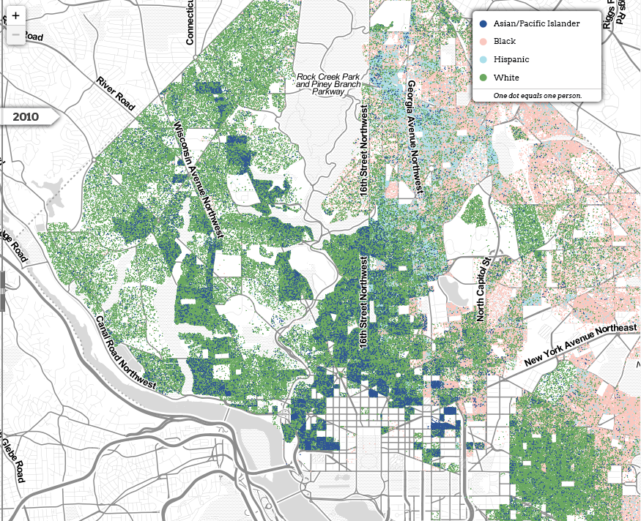
Washington, DC:
OUR CHANGING CITY
DC’s black population continues to shrink

Slide 6
Washington, DC:
OUR CHANGING CITY
DC’s black population continues to shrink

Slide 7
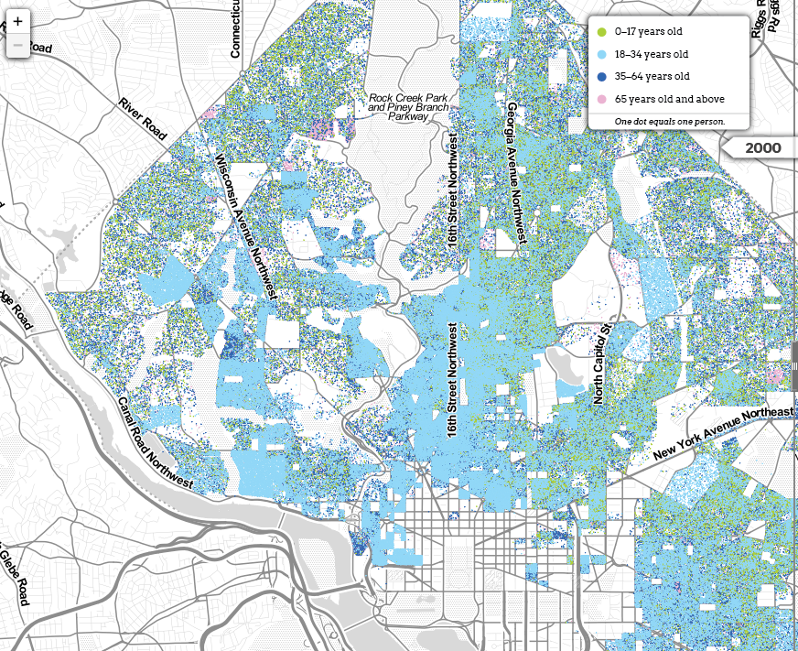
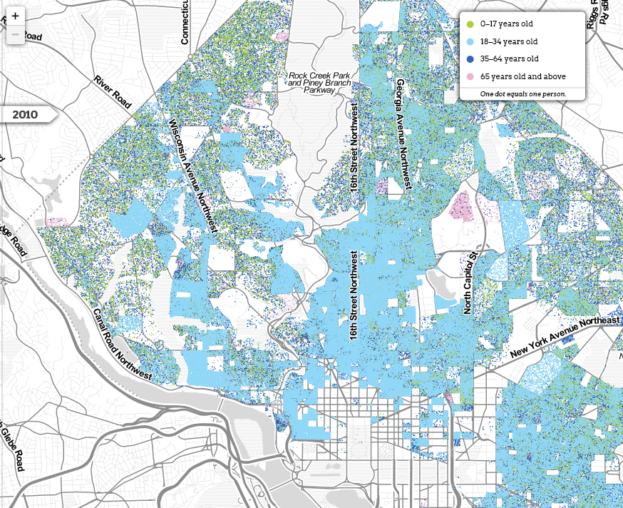
Washington, DC:
OUR CHANGING CITY
Millennials are driving DC’s growth

Slide 8
Washington, DC:
OUR CHANGING CITY
Millennials are driving DC’s growth

Slide 9
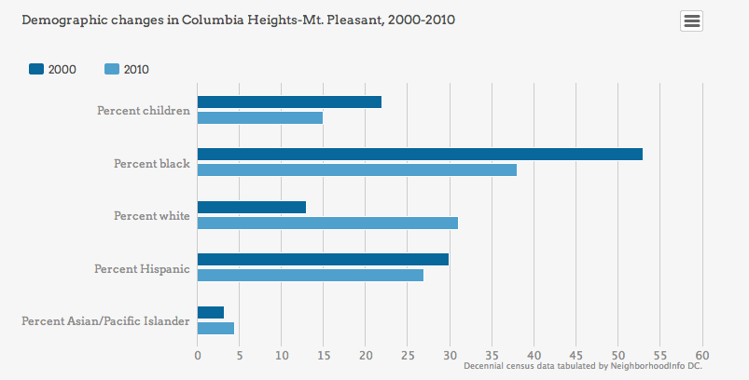
Washington, DC:
OUR CHANGING CITY
Zooming in: Columbia Heights and Mt Pleasant

Slide 10
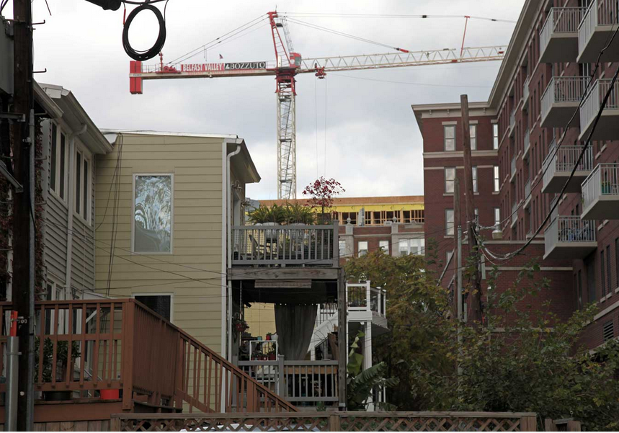
Washington, DC:
OUR CHANGING CITY
Growing pains

Slide 11
Washington, DC:
OUR CHANGING CITY
What we learned
There is public appetite for grounding discussions of community change in data and evidence
There is value in carefully testing and refining the story
You don’t always need hot new data to attract an audience

Slide 12
Washington, DC:
OUR CHANGING CITY
What we learned
There is public appetite for grounding discussions of community change in data and evidence
There is value in carefully testing and refining the story
You don’t always need hot new data to attract an audience

Slide 13
Washington, DC:
OUR CHANGING CITY
What Worked
Strong Narrative Frame
+
Interactive Features

Slide 14
Washington, DC:
OUR CHANGING CITY
What Worked
Strong Narrative Frame
+
Interactive Features

Slide 15
Washington, DC:
OUR CHANGING CITY
Visit Online
http://datatools.urban.org/features/changingcities/
NeighborhoodInfo DC http://www.neighborhoodinfodc.org/

