Slide 1
Camden City Land and Housing Survey
Josh Wheeling Program Manager

Slide 2
How Well is Camden Served by
Open Spaces ?
What We Do
GIS Analysis
Data & Reports
Mapping
Survey Design

Slide 3
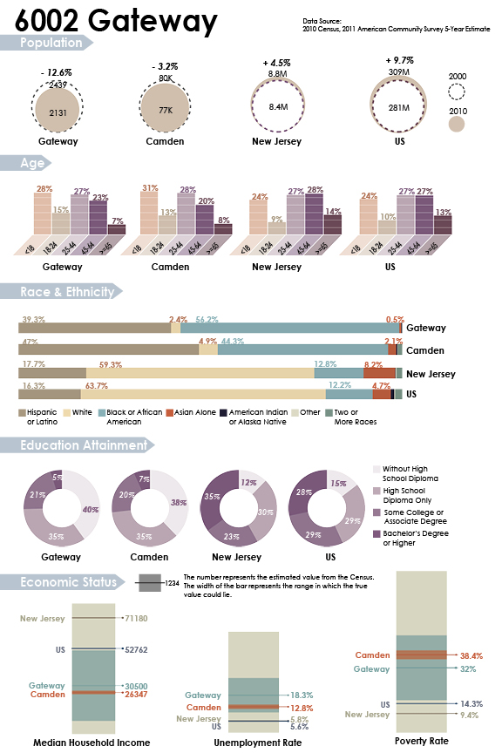
What We Do
GIS Analysis
Data & Reports
Mapping
Survey Design

Slide 4
What We Do
GIS Analysis
Data & Reports
Mapping
Survey Design

Slide 5
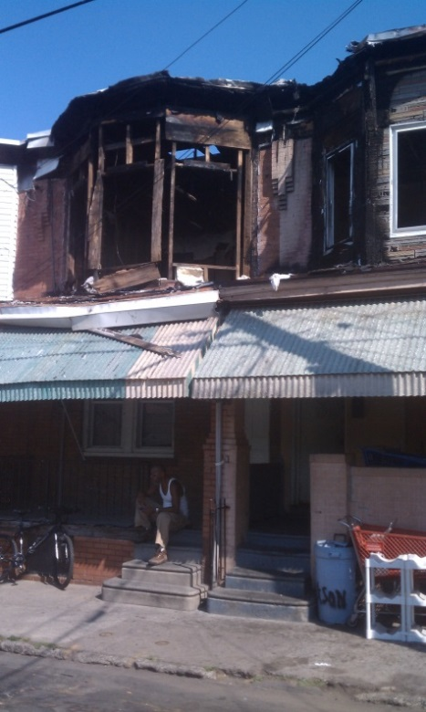
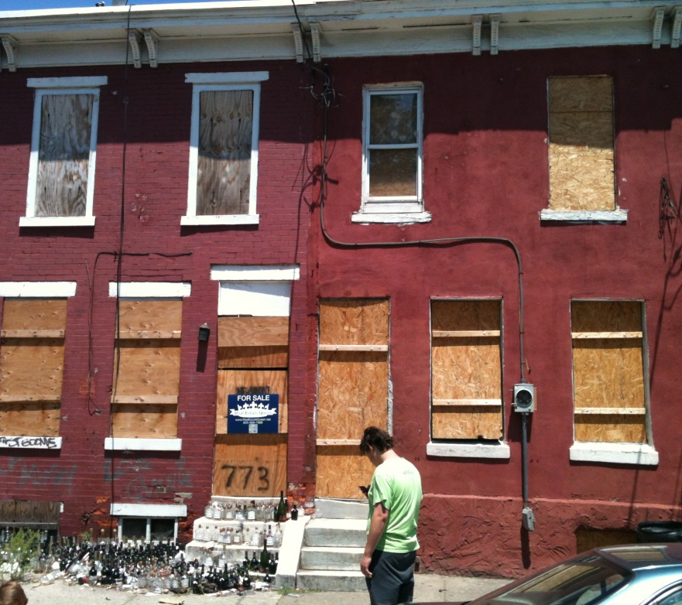
The Survey
Meaning of the Work
Survey Process
Mapping and Analysis
Online Application

Slide 6
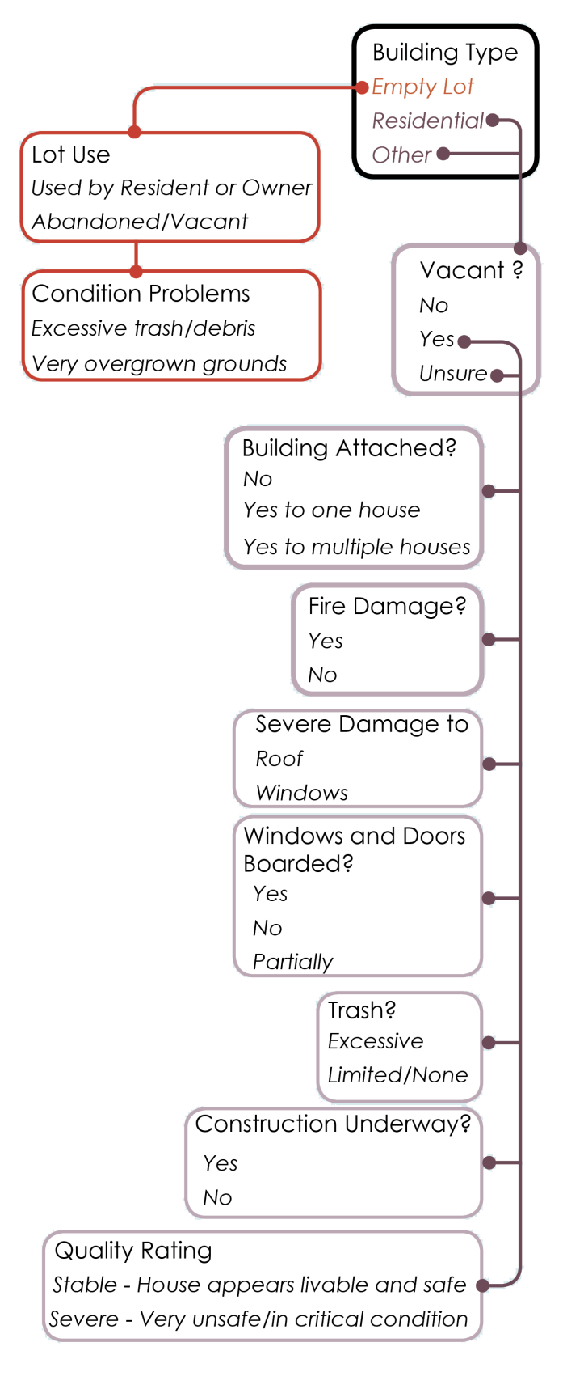
The Survey
Meaning of the Work
Survey Process – Survey Questions
Mapping and Analysis
Online Application

Slide 7
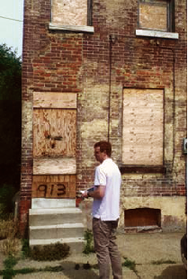
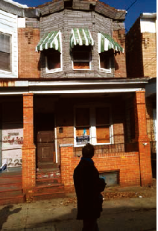
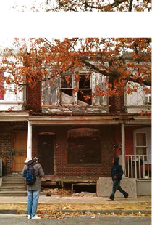
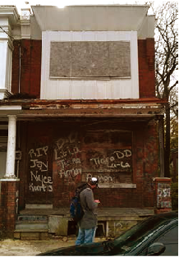
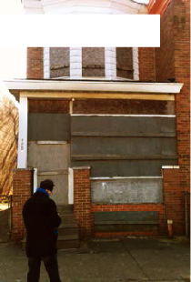
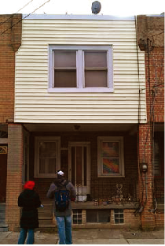
The Survey
Meaning of the Work
Survey Process – Survey Volunteers
Mapping and Analysis
Online Application
Over 80 people volunteered

Slide 8
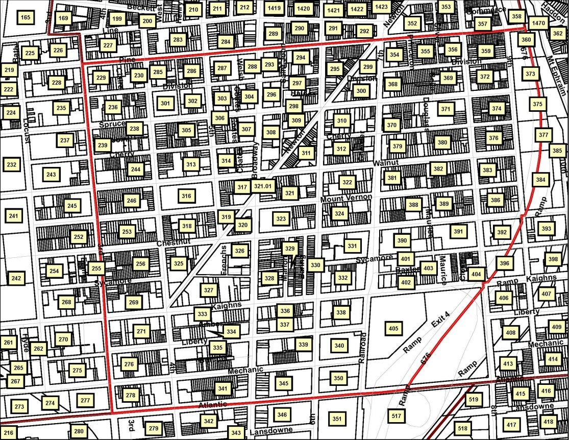
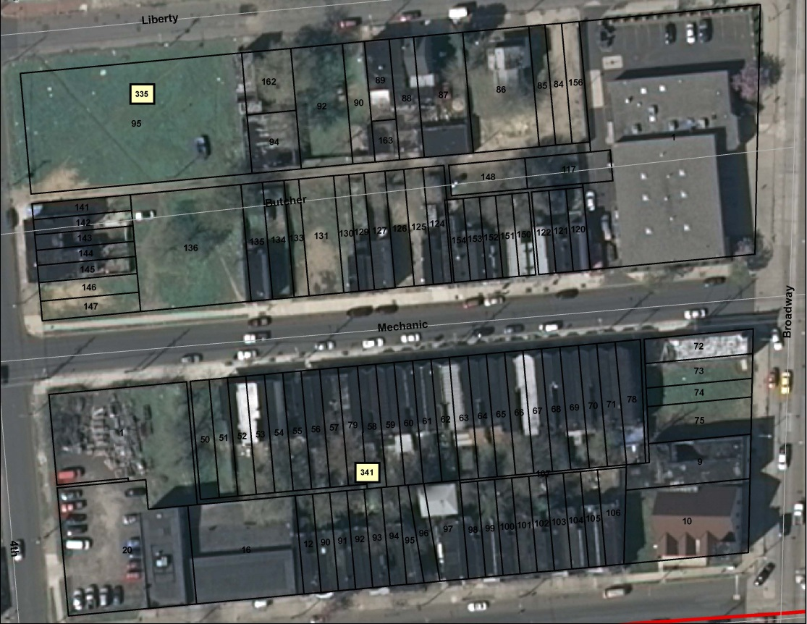
The Survey
Meaning of the Work
Survey Process – Aerial Map
Mapping and Analysis
Online Application

Slide 9
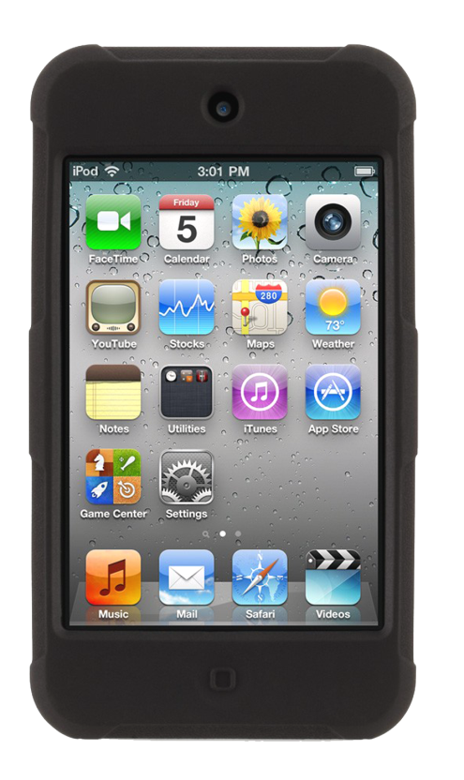
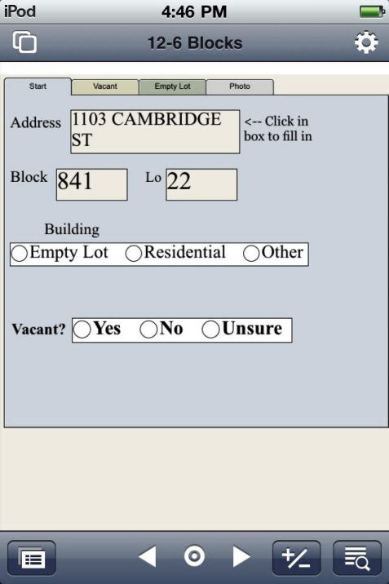
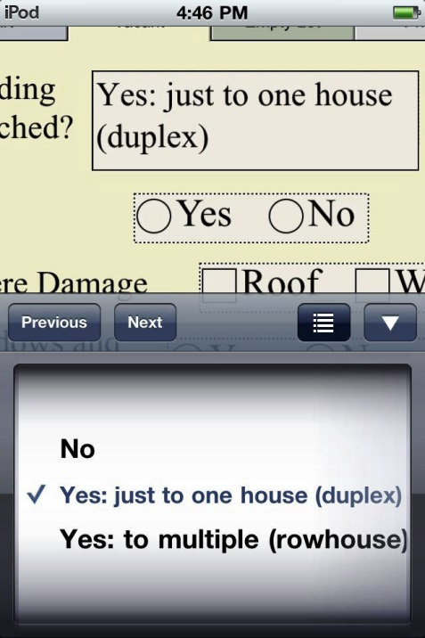
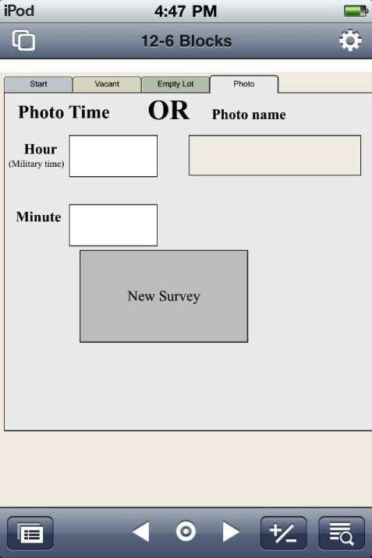
The Survey
Meaning of the Work
Survey Process – iPods
Mapping and Analysis
Online Application

Slide 10
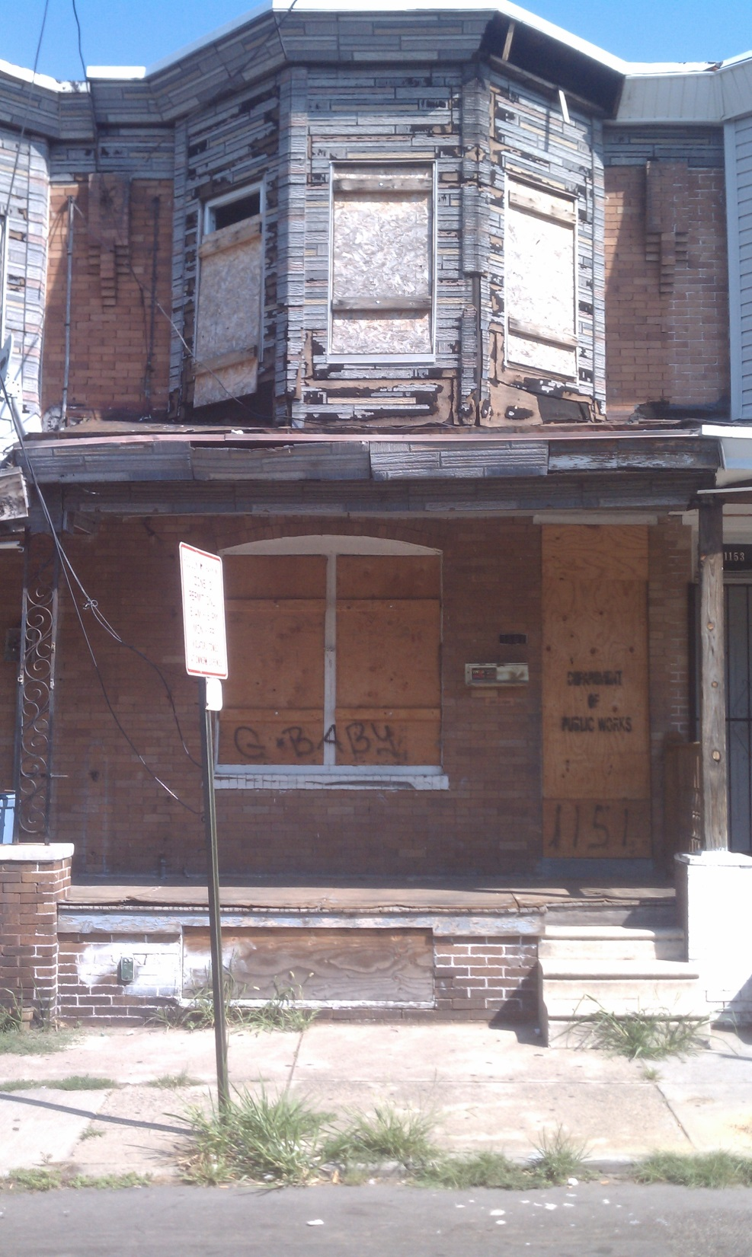
The Survey
Meaning of the Work
Survey Process – Photos
Mapping and Analysis
Online Application

Slide 11
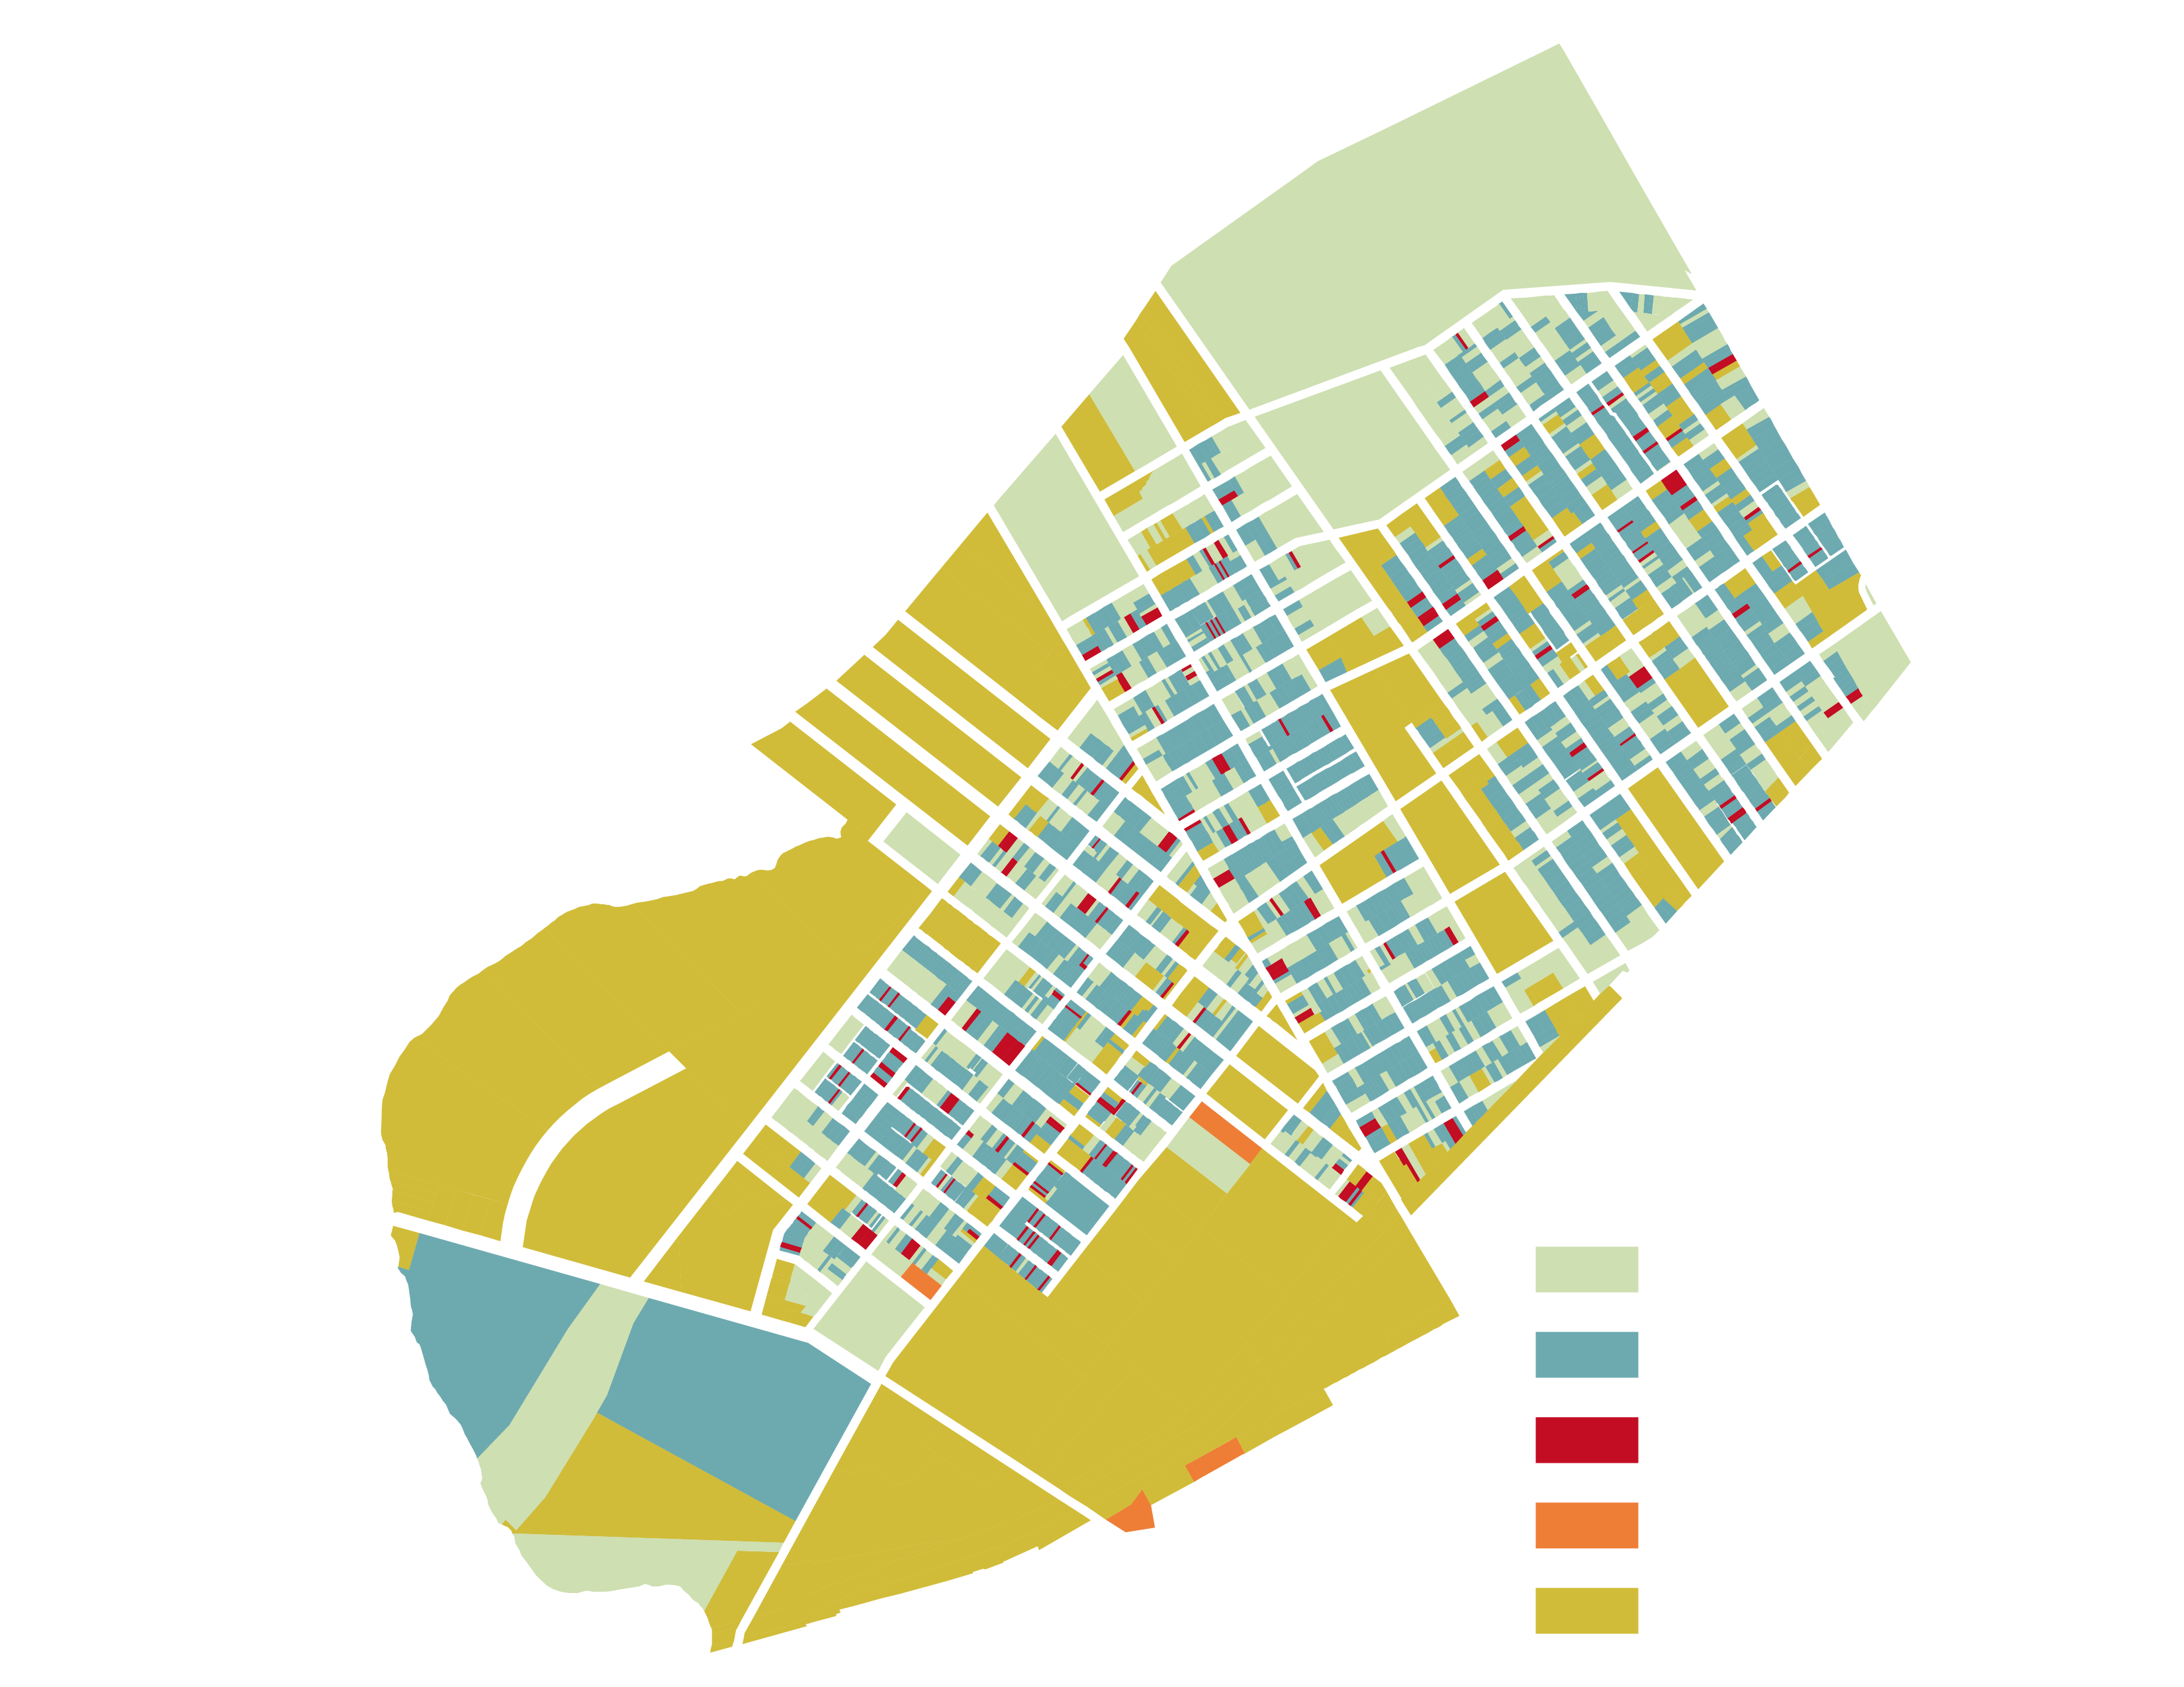
The Survey
Meaning of the Work
Survey Process
Mapping and Analysis
Online Application
Cramer Hill Area Survey
Empty Lot
Occupied Residential
Vacant Residential
Vacant Non-Residential
Occupied non-Residential

Slide 12
Parkside Vacant Building Density by Street
The Survey
Meaning of the Work
Survey Process
Mapping and Analysis
Online Application

Slide 13
Camden Interactive Housing Map
The Survey
Meaning of the Work
Survey Process
Mapping and Analysis
Online Application
Next Steps

Slide 14
What We Have learned
Have consistent surveyors
Safety:
  Use people who feel comfortable
  Morning surveying
  Groups
  Interactions with residents
  Photos
  Informal look
Pilot neighborhood
Learning on the fly
Don’t underestimate costs
Compare with available datasets
Interactive online mapping
Get advice

Slide 15
Programs used:
Filemaker Pro – survey interface
Filemaker Go – mobile app
Microsoft Excel – compatibility and analysis
Microsoft Access – comparing large datasets
ArcGIS – mapping
Google Fusion Tables – Interactive mapping
Adobe Creative Suites – design

