Slide 1
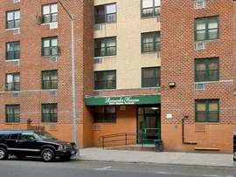
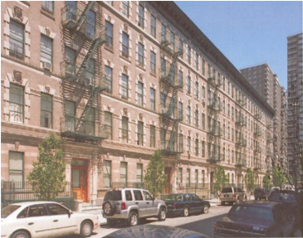
All Aboard!
A Look at New York City’s Subsidized Housing Information Project (SHIP)
Max Weselcouch
March 1, 2011
Notes:
1

Slide 2
Rental Housing in New York City

Slide 3
Subsidized Housing in New York City
National Programs
HUD Insurance
HUD Project Based Rental Assistance
LIHTC
State Programs
Mitchell-Lama
City Programs
Article 8A
Inclusionary Zoning

Slide 4
Problem: When do Subsidies Expire?

Slide 5
Publicly Available

Slide 6
Multiple agencies

Slide 7
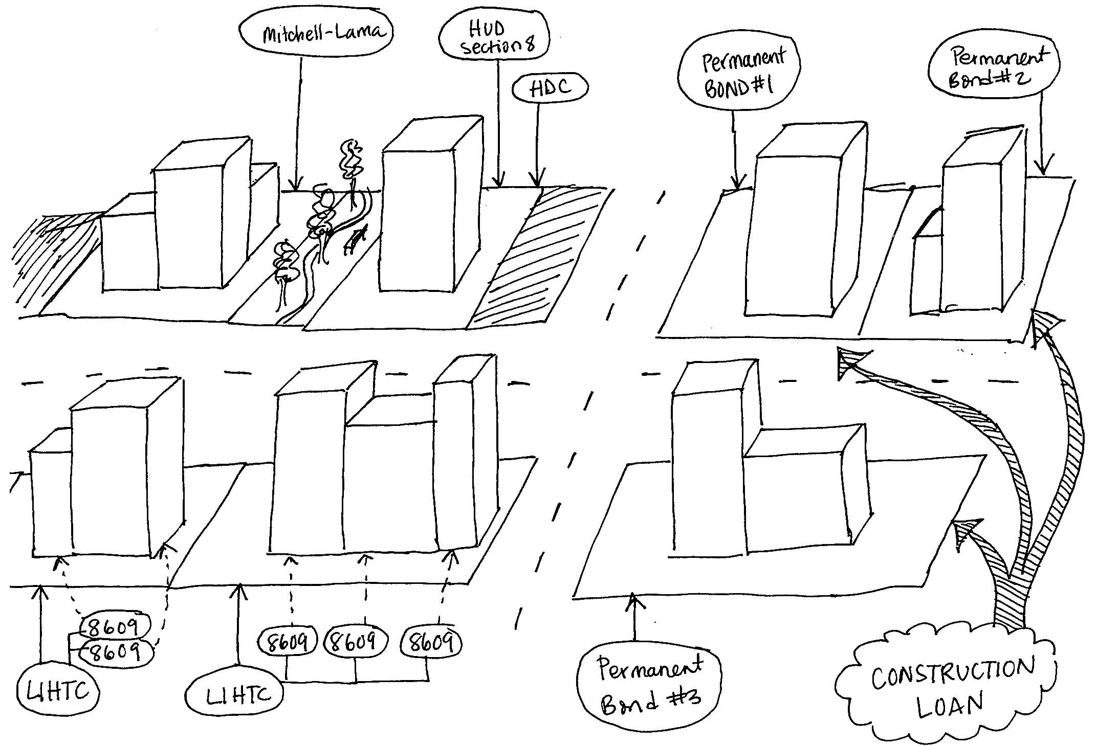
Multiple subsidy programs

Slide 8
Same Property: Different Names
Project 1
Canaan House
Canaan Houses Residential Project
Milbank Frawley, Site 1
Project 2
170 South Portland Avenue
Atlantic Terminal 1
First Atlantic Terminal

Slide 9
The SHIP! Subsidized Housing Information Project

Slide 10
A range of users
Researchers
Government Agencies
Non-profits
Community Groups
Tenants and Tenant Advocates

Slide 11
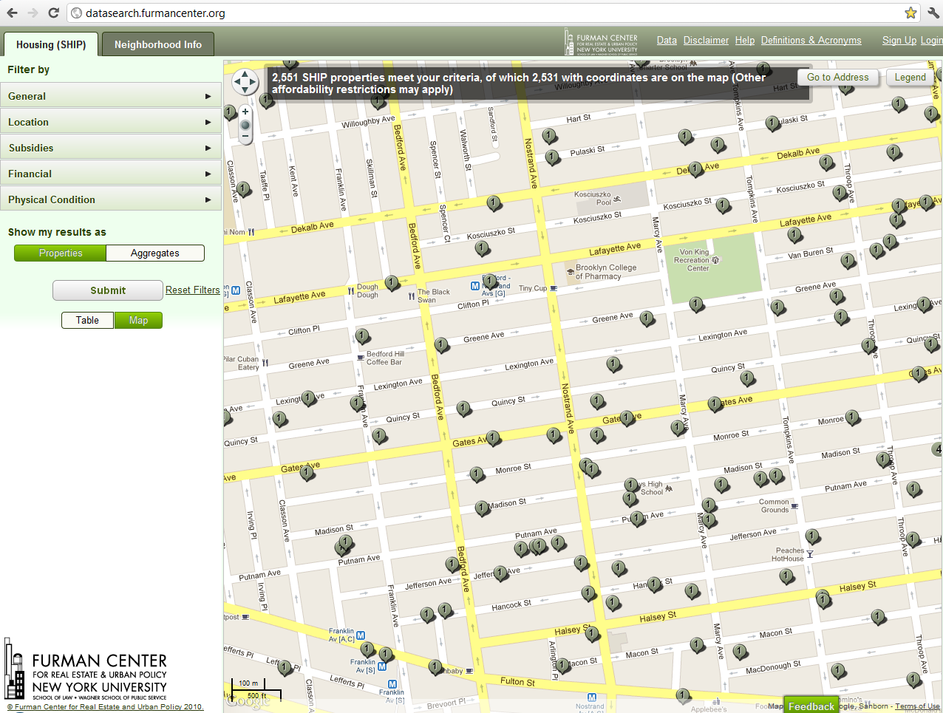

Slide 12
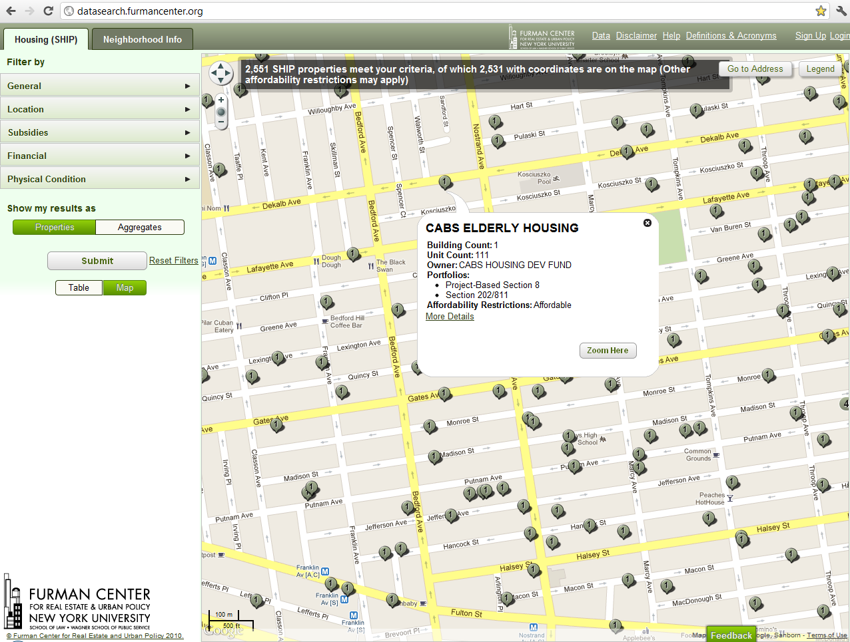

Slide 13
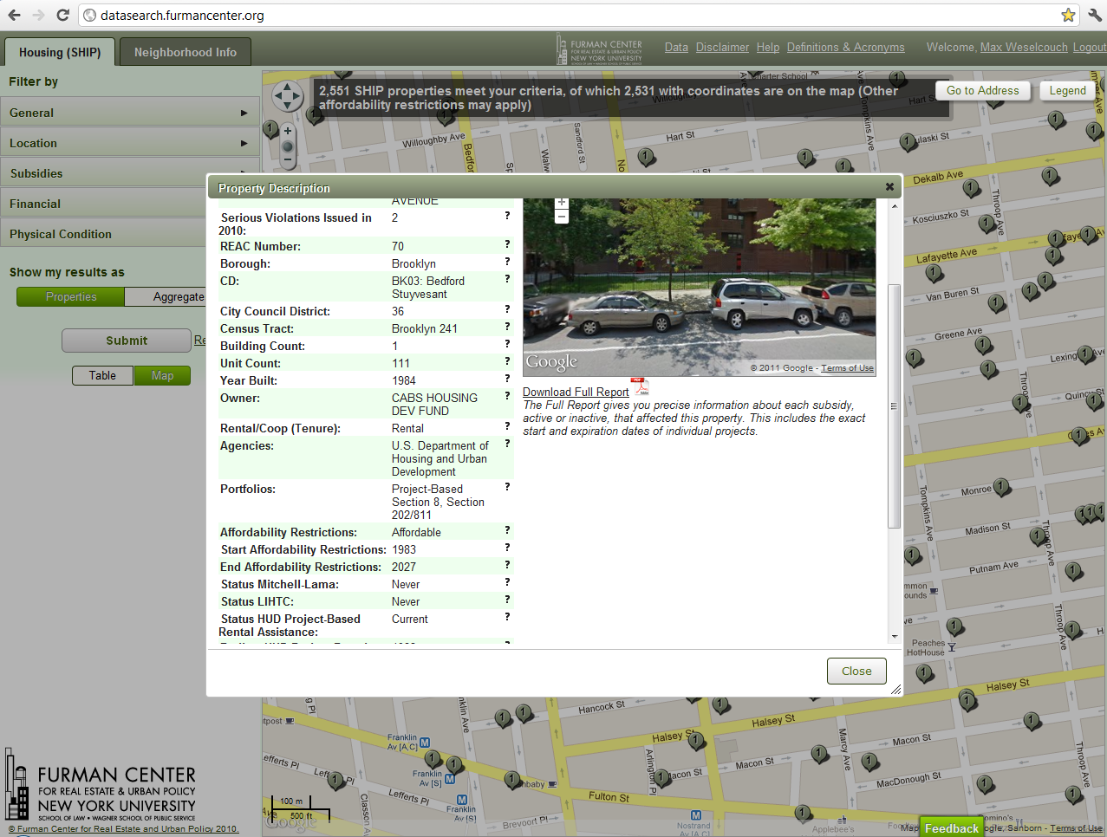
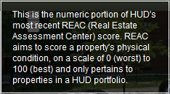

Slide 16
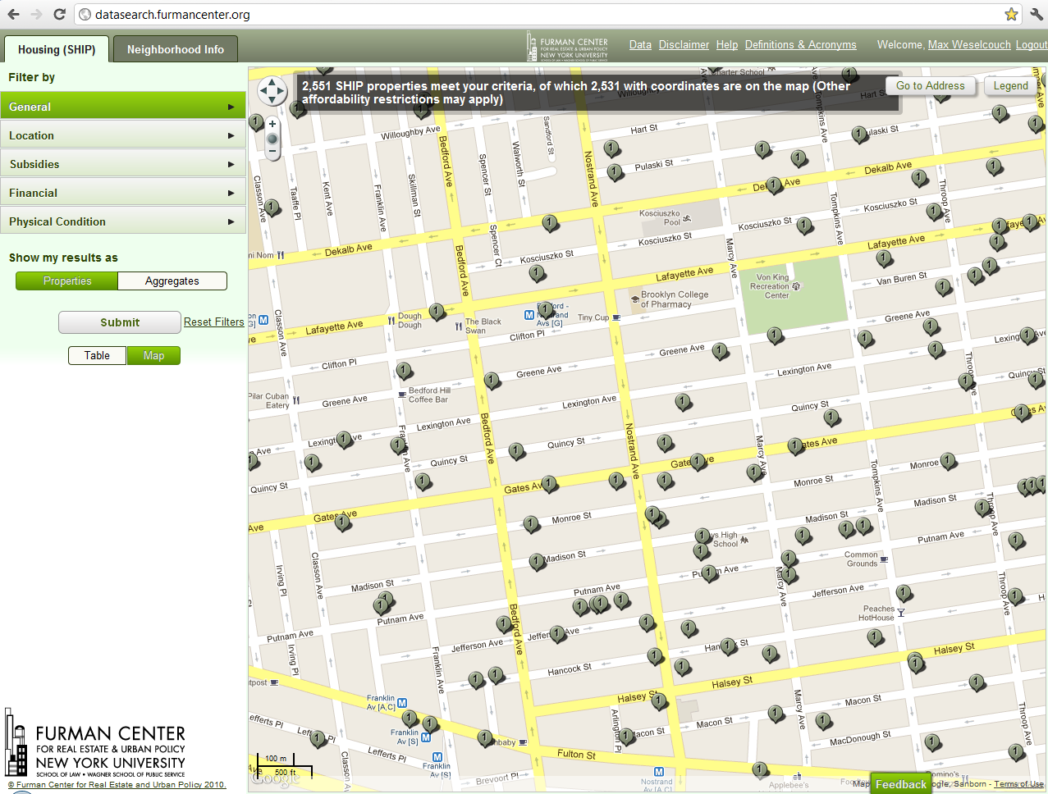
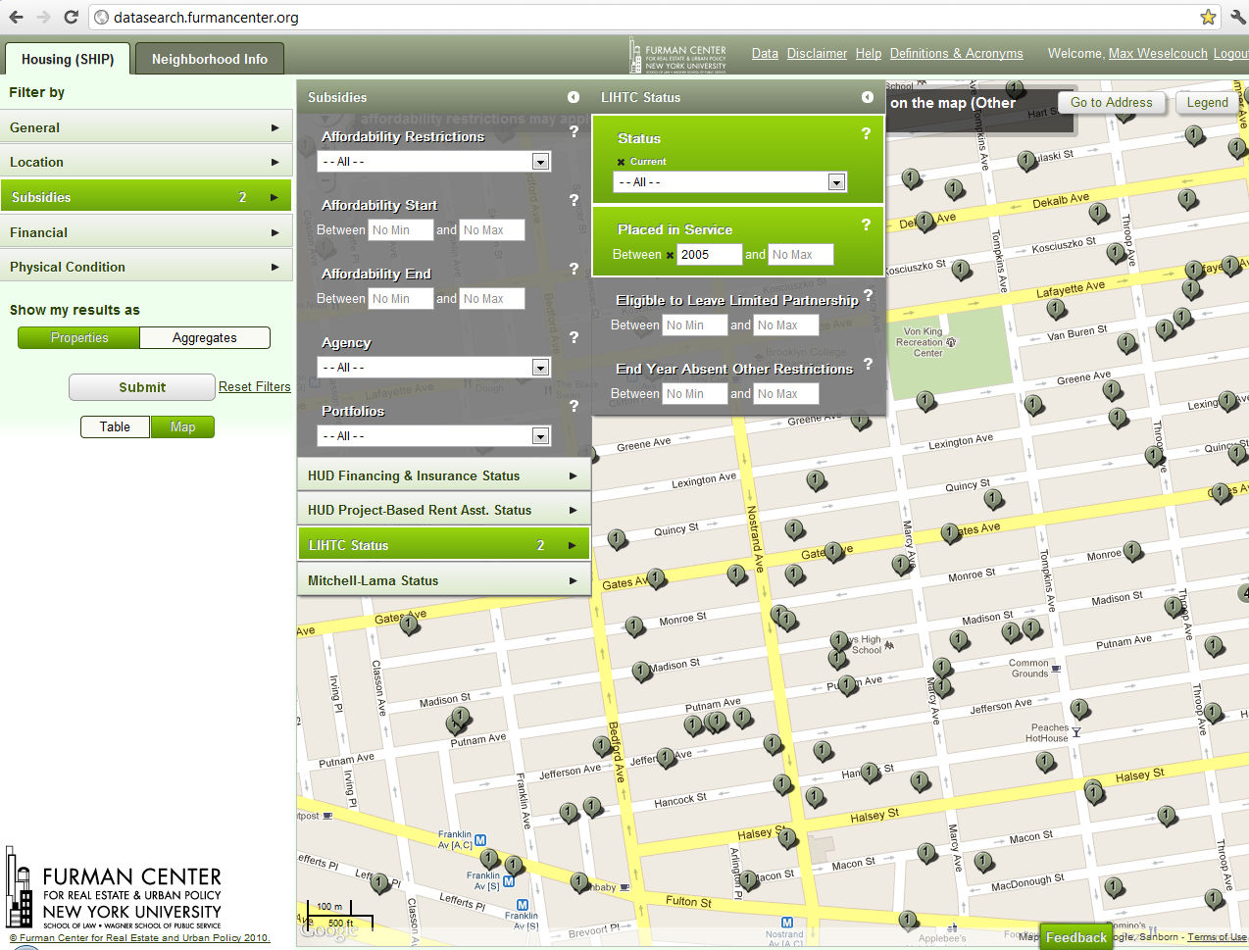
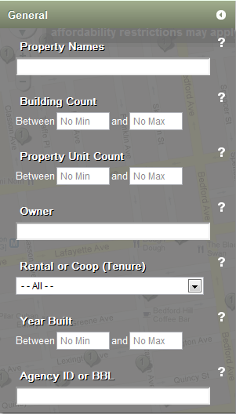
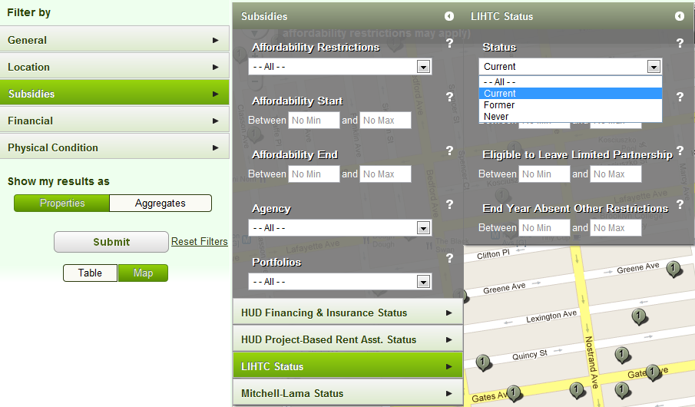

Slide 17
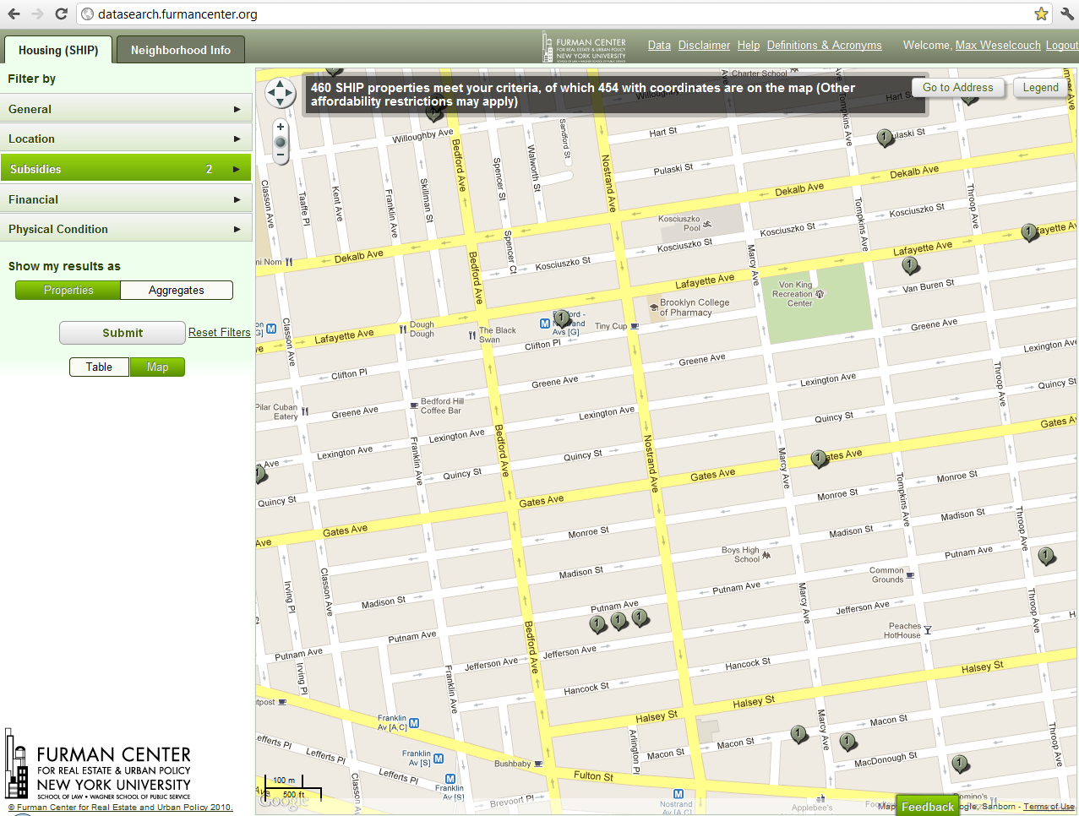

Slide 18
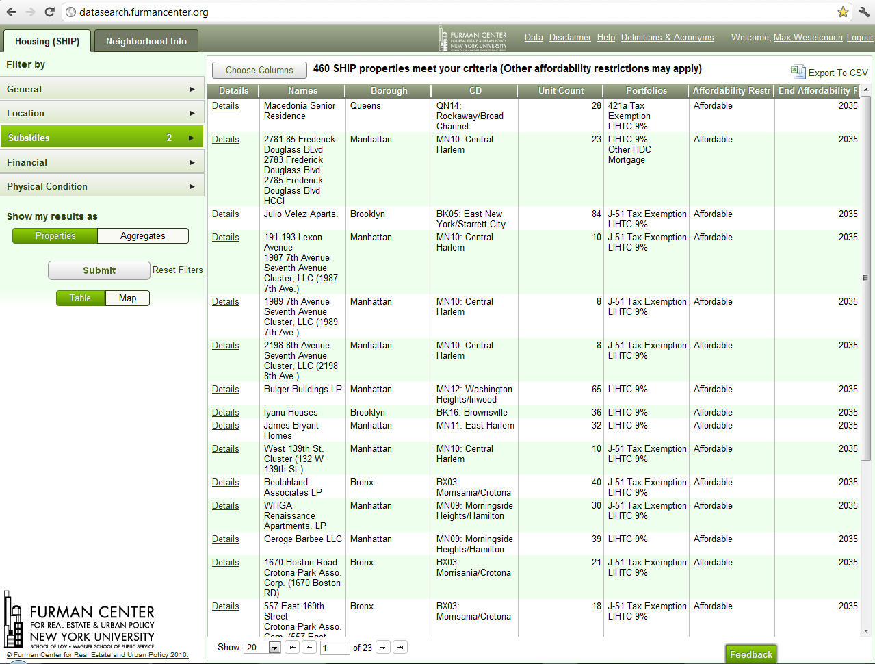

Slide 19
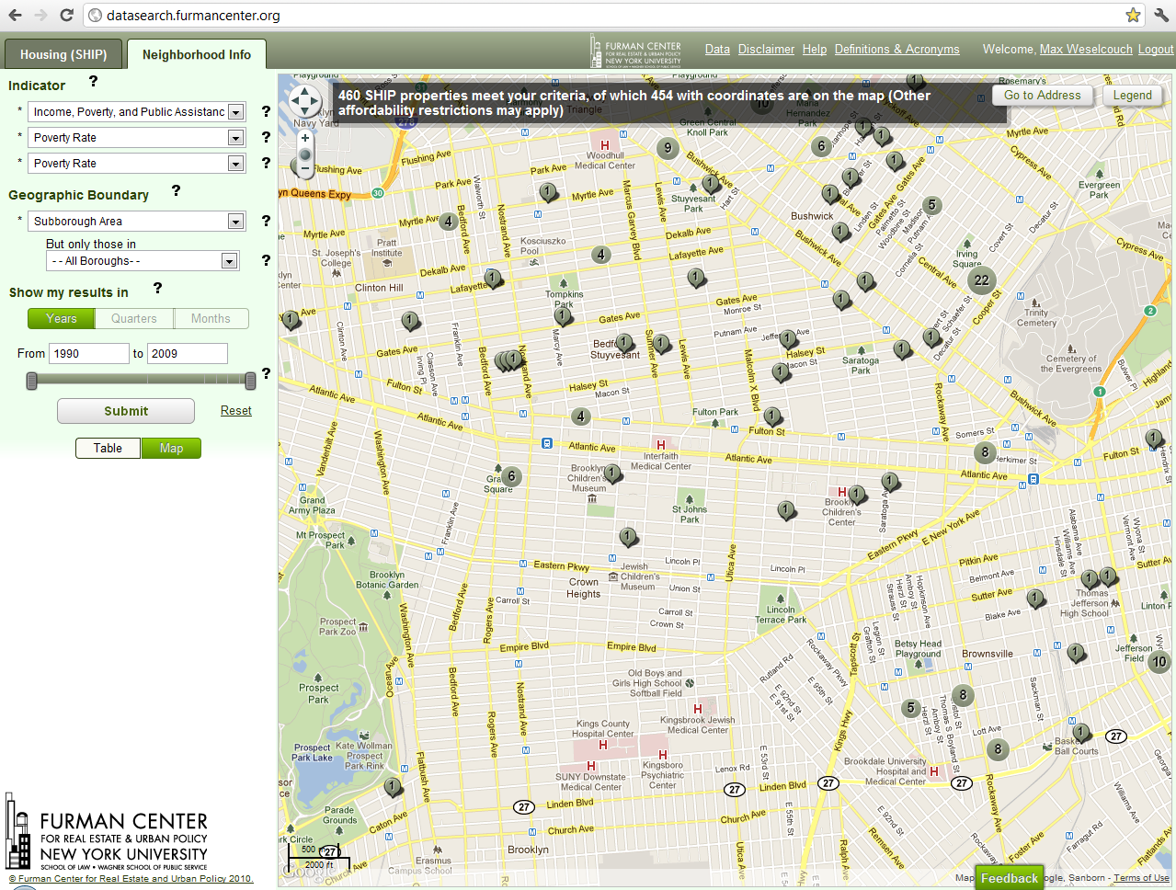
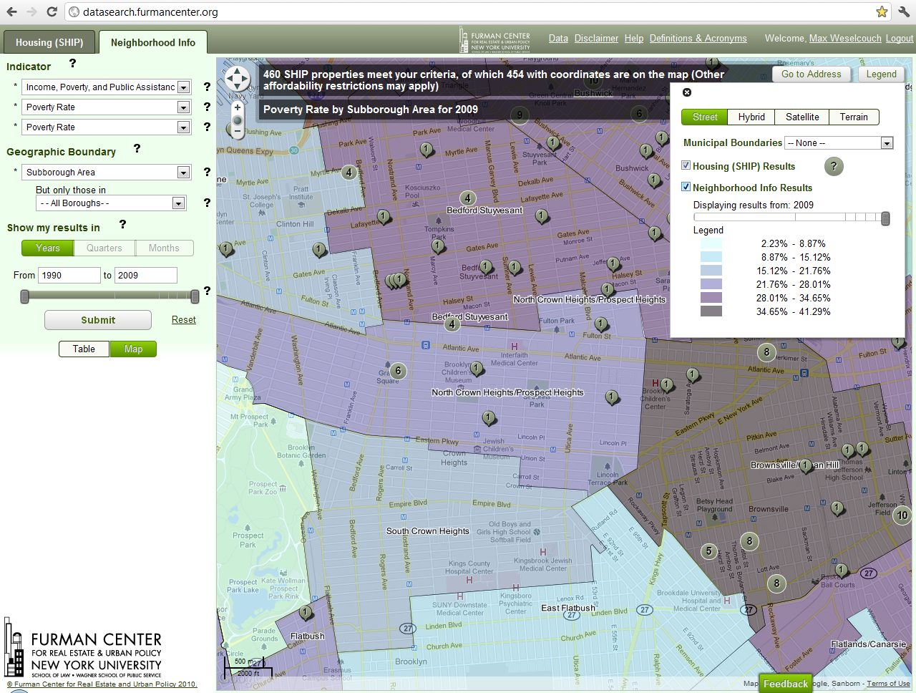

Slide 20
Thank you!
Max Weselcouch
212-998-6110
max.weselcouch@nyu.edu
http://datasearch.furmancenter.org/

