Slide 1
Who Owns New York?
Max Weselcouch | @thatgirlmax
April 2014

Slide 2
WHY DO WE CARE?

Slide 4
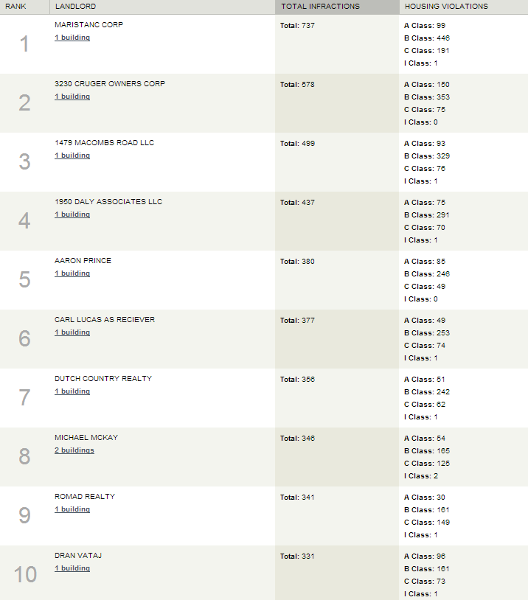
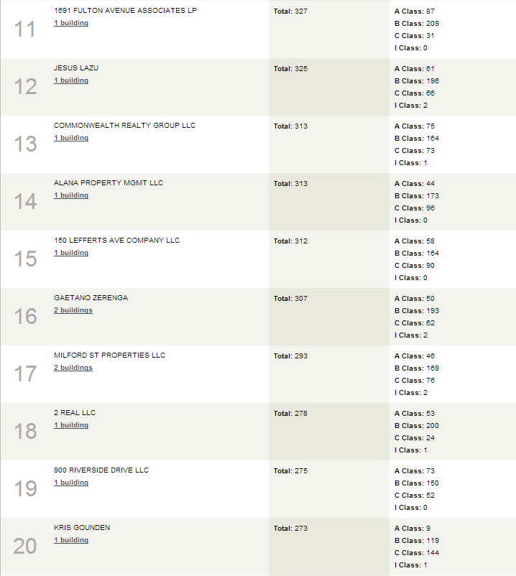
WORST LANDLORDS LIST
Notes:
BDB’s worst landlord list.
Can be misleading when the city is trying to enforce code, identify troubled properties, or protect tenants from eviction due to negligent landlords

Slide 5
Building 1
Building 2
Common Ownership!
Address: 139 Macdougal Street
Owner: Jane C. Owner
Address: 20 Bleecker Street
Owner: Jane C. Owner
Notes:
In theory, it should be easy.

Slide 6
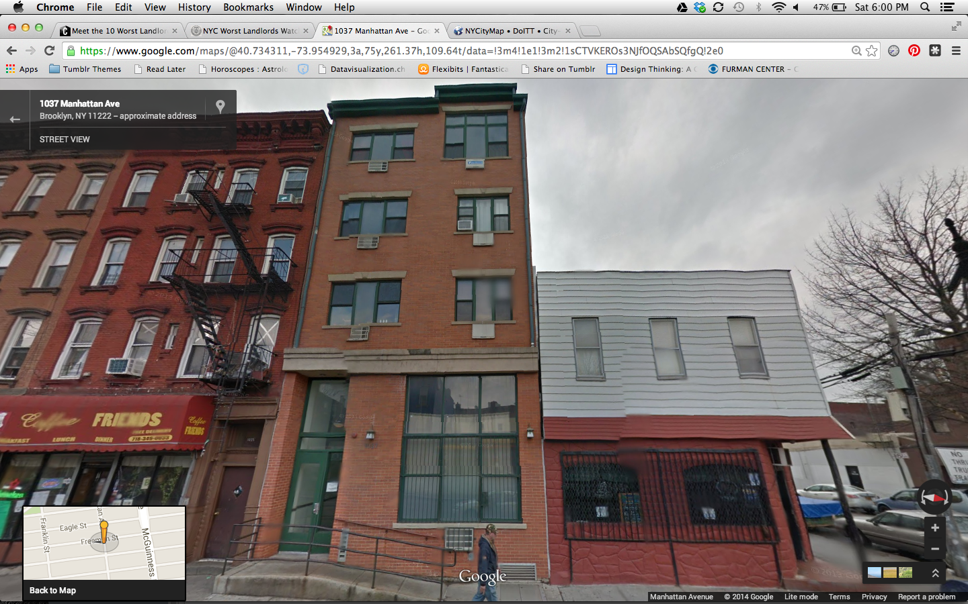
1037 Manhattan Ave
Common ownership structure and nothing inherently wrong with that
1037 Manhattan Avenue
Notes:
But in reality, most mutlifamily buildings look something like my first apartment in New York City

Slide 7
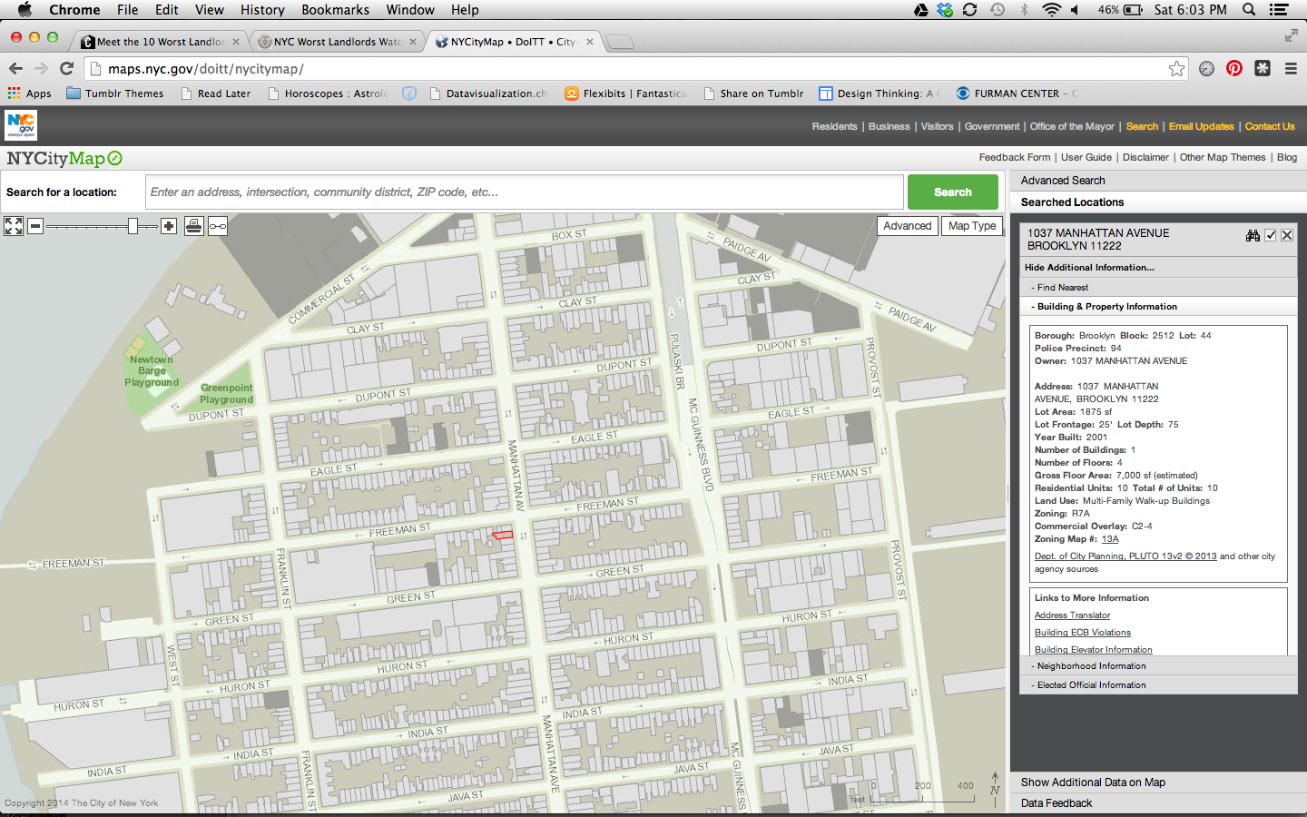
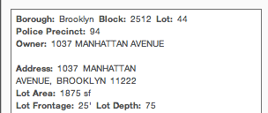
Notes:
I’m going to brag for a minute, New York City has made some really great data available. Including a database of property and ownership characteristics
And it’s owned by 1037 Manhattan Avenue LLC
So that’s weird, but not really a big deal for me. I knew who to call, Mitch, if anything went wrong. And there’s nothing inherently wrong with this

Slide 8
Building 1
Building 2
???
Address: 139 Macdougal Street
Owner: 139 Macdougal Street LLC
Address: 20 Bleecker Street
Owner: JCO LLP
Notes:
But, as a researcher, it’s infuriating, especially when you are trying to understand common ownership of properties

Slide 9
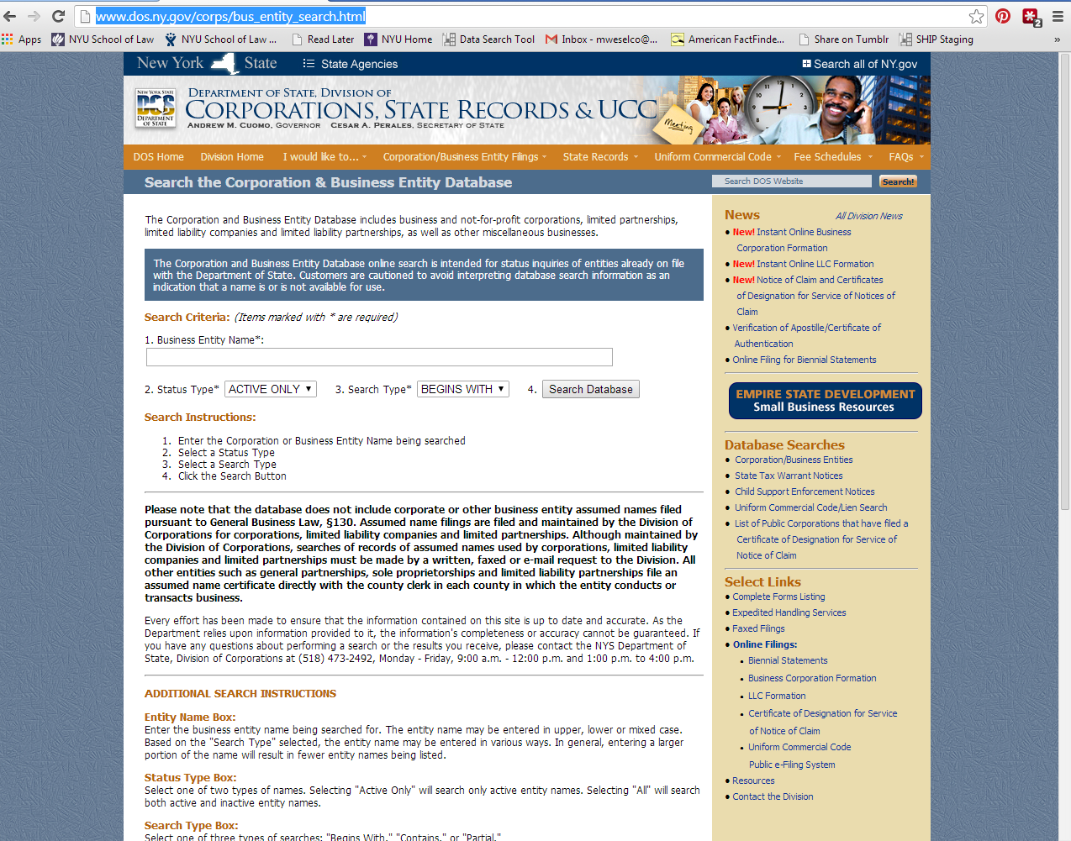
Notes:
So, we thought, well, maybe the state knows something, you must need to register these things.

Slide 10
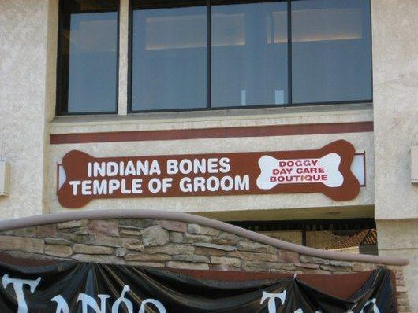
What you need to form an LLC
To form an LLC:
A unique name
A county location
Signature
An address where you can be served legal papers
$200

Slide 11
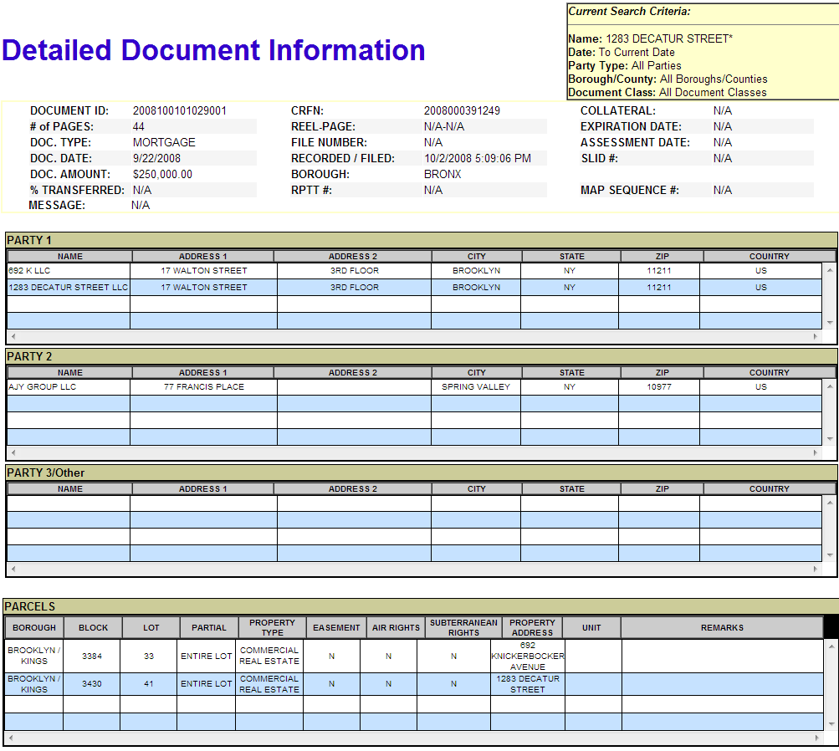
Deeds and Mortgages (Department of Finance)

Slide 12
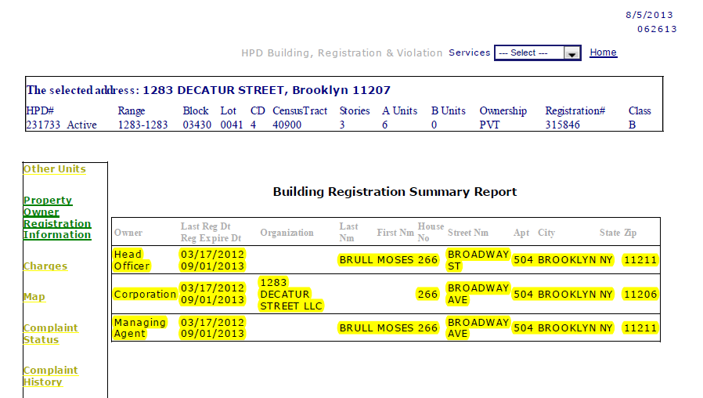
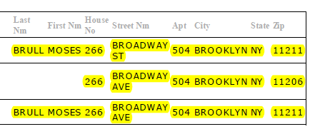
Rental Property Registration (HPD)

Slide 13
Building 1
Building 2
Address: 139 Macdougal Street
Owner: 139 Macdougal Street LLC
Address: 20 Bleecker Street
Owner: JFP LLP
12 Bank Street | Process Address | 222 2 95th Street
Josiah Madar | Registered Agent | John Infranca
145 8th Avenue | Party Address from Deed | 145 8th Avenue
80 Dekalb Street | Property Tax Billing Address | 12 Bank Street
Andrew Hayashi | Head Officer | Josiah Madar
145 8th Avenue | Officer Address | 12 Bank Street
Notes:
Just one connection here is usually not enough to persuade us of common ownership, but as the overlaps accumulate, we grow more confident that we are dealing with identical or closely related owners.
Each of these connections gives us more confidence that the owner of Building 1 is related/identical to the owner of Building 2
Each of these data points also gives us an opening to identify additional candidate buildings in the portfolio of Building 1’s owner

Slide 14
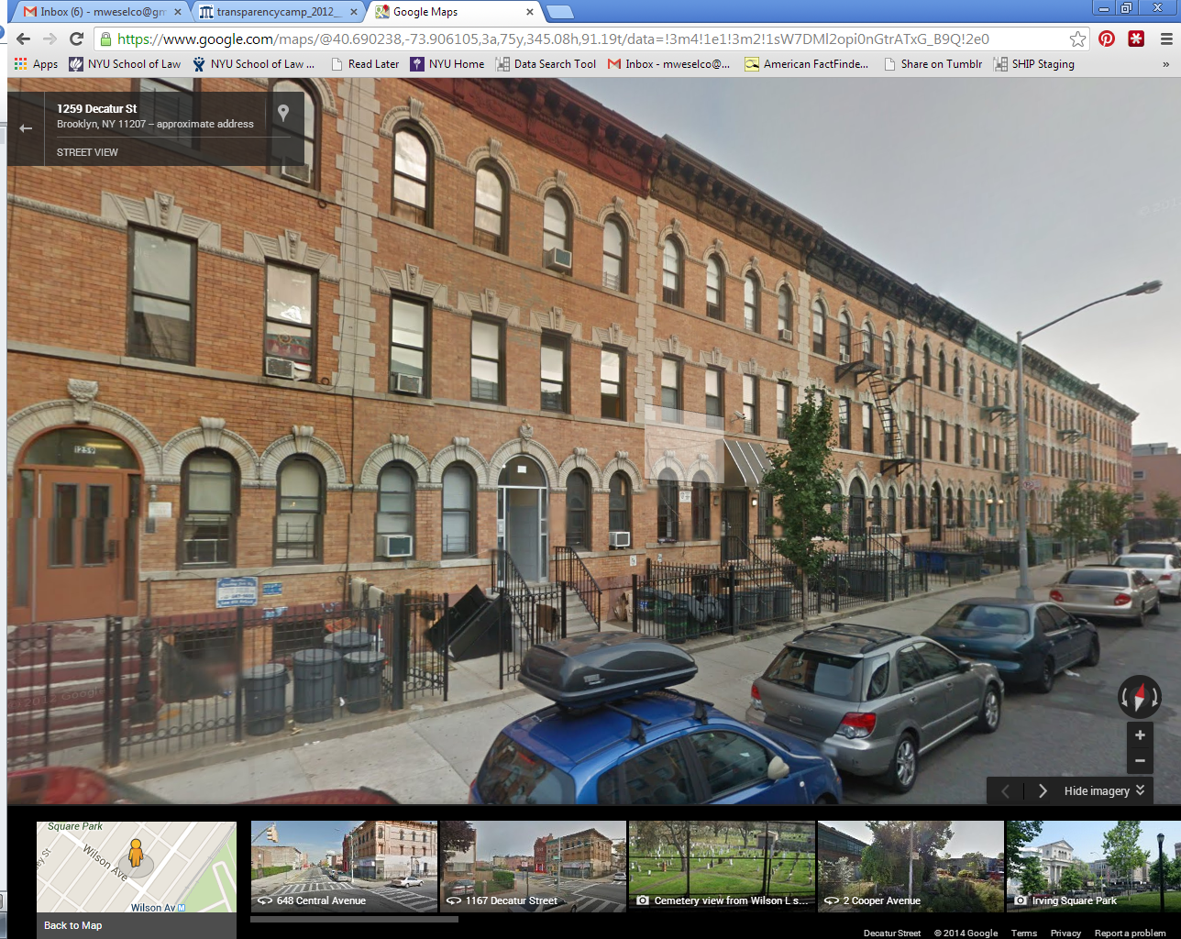
Notes:
So we started with a single block, we pulled all of the ownership and address information for every property on the block

Slide 15
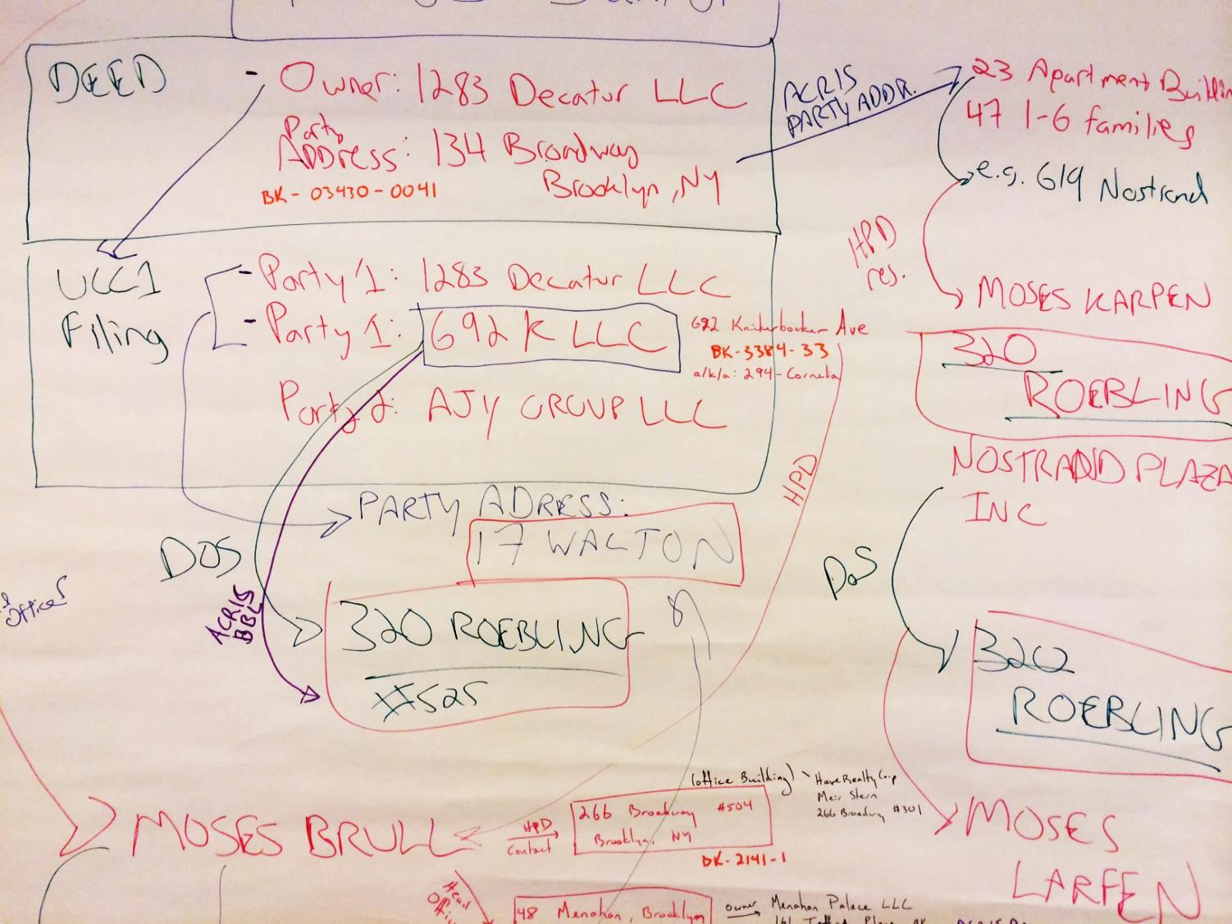

Slide 16
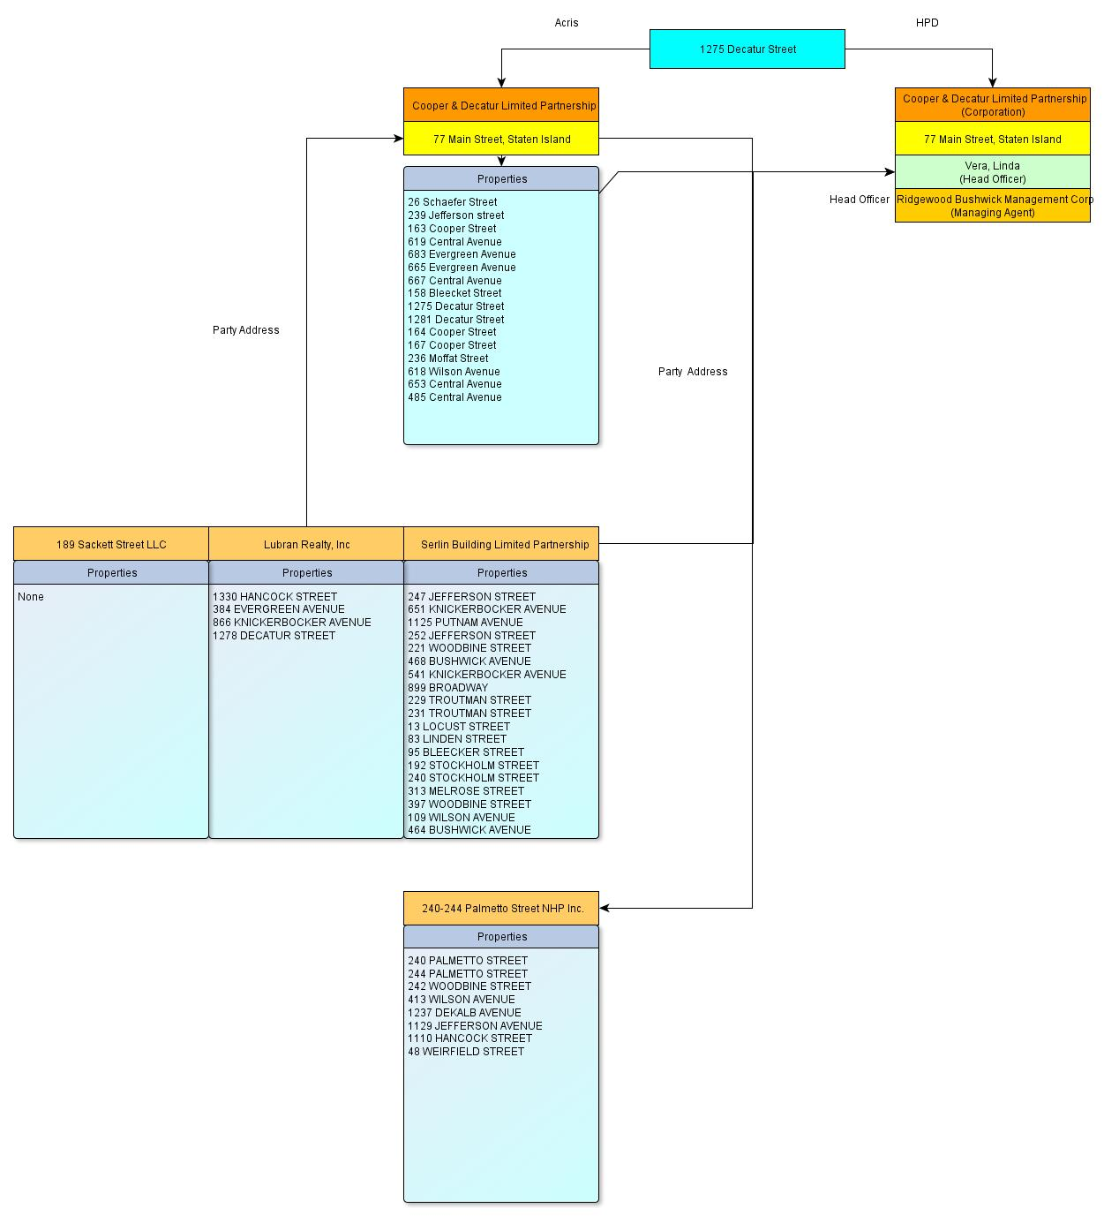
Notes:
So we hired a very organized (!) research assistant to start making visual representations of ownership clouds. This was sort of our proof of concept.

Slide 17
150
other properties using this address
0
other properties using this agent
12 Bank Street | Process Address | 222 2 95th Street
Josiah Madar | Registered Agent | John Infranca
145 8th Avenue | Party Address from Deed | 145 8th Avenue
80 Dekalb Street | Property Tax Billing Address | 12 Bank Street
Andrew Hayashi | Head Officer | Josiah Madar
145 8th Avenue | Officer Address | 12 Bank Street
18
other properties using this address
6
other properties registered with this name
Notes:
We quickly realized that this was beyond our level of expertise and enlisted the help of some of our colleagues in the computer science department at NYU Poly

Slide 18
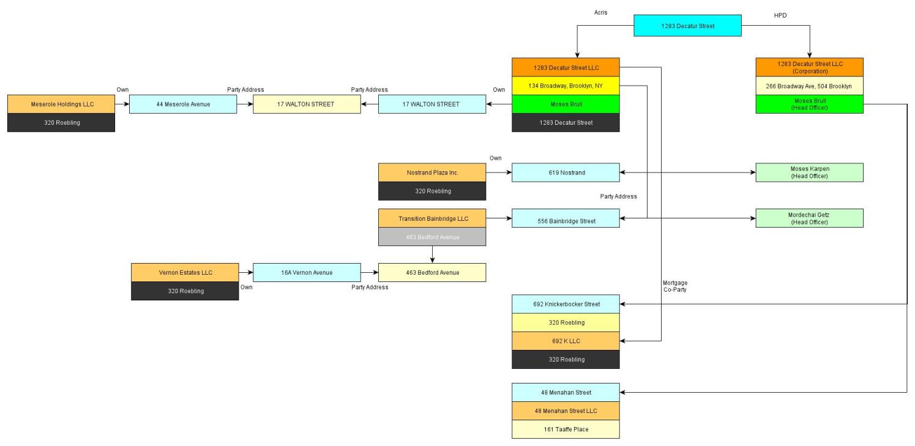
Ownership Clouds
Notes:
As we teach the software which relationships are important and iterates through the candidate buildings/relevant datasets, a picture of the “ownership cloud” emanating from each subject building will emerge
This is just a fraction of the true graph for this ownership conglomerate. Unpacking the full portfolio of the owner of this single building in Bushwick is next to impossible to do manually.

Slide 19
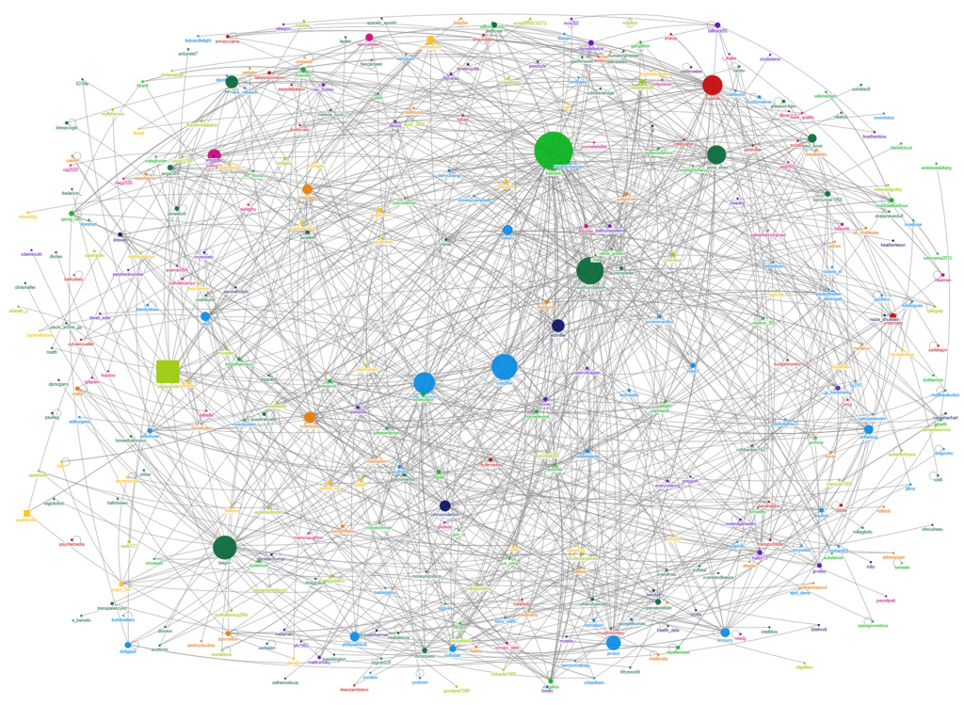
a graph database?

Slide 20
Thank you!
Max Weselcouch | @thatgirlmax

