Slide 1
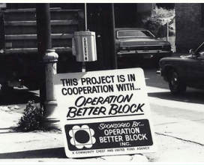
Operation Better Block, Inc.

Slide 2
Data-Driven Services
Neighborhood Revitalization
Homeowner Stabilization
Resident and Property Surveys

Slide 3
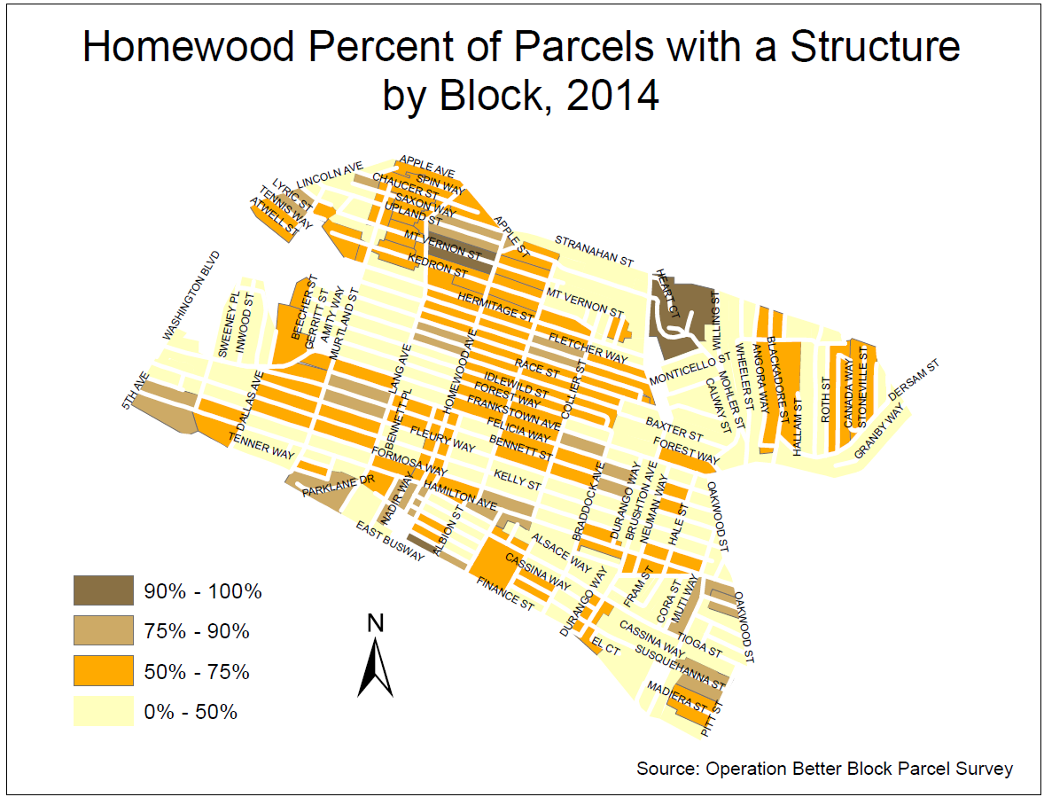
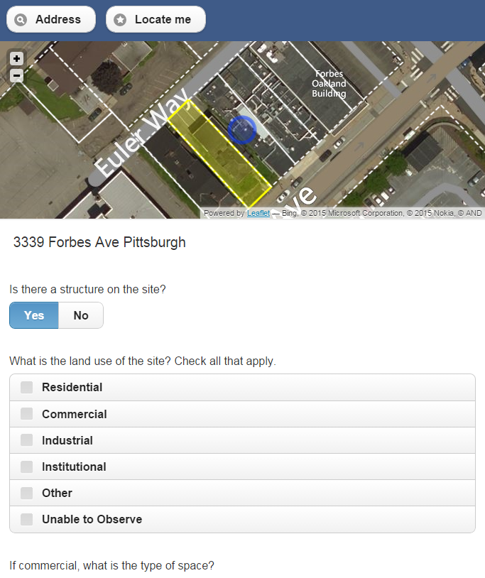
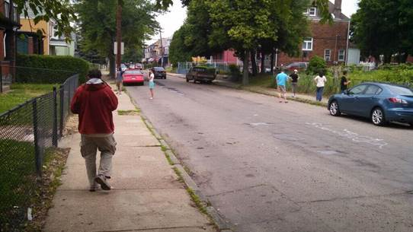
LocalData
Notes:
Bob fills in with maps

Slide 4
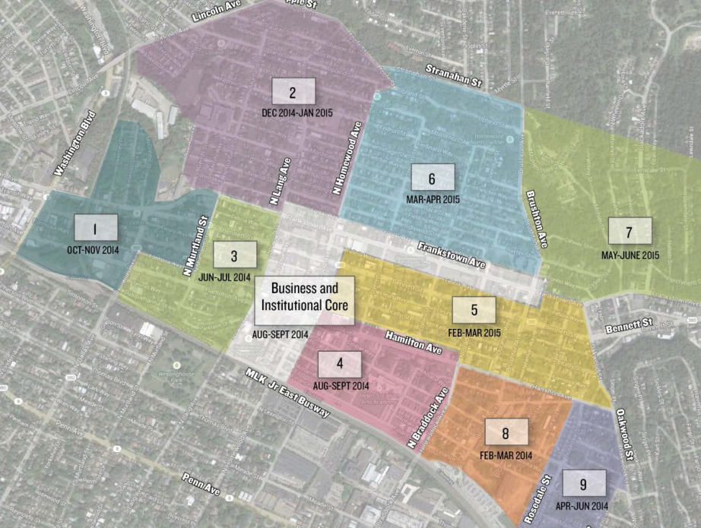
Cluster Planning Process
Notes:
Split into small micro neighborhoods to streamline service delivery and encourage attendance/buy-in

Slide 5
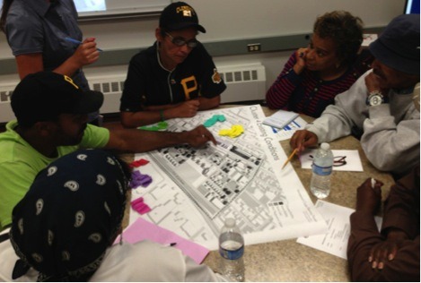
Notes:
Resident driven vision for their own block cluster

Slide 6
Cluster Planning Process
Notes:
Residents provided with a plan even if they didn’t come to the meeting

Slide 7
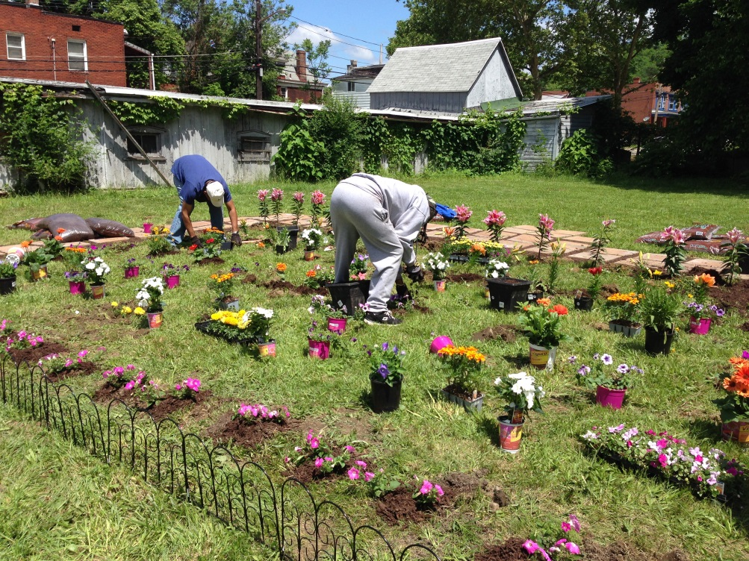
Notes:
Residents given resources on micro and macro level to enact their plans. –we do block level stuff and also individual homeowner and resident services

