Slide 1
Getting to Know Your Pittsburgh NNIP Partner
Bob Gradeck
@BobGradeck
rmg44@pitt.edu

Slide 2
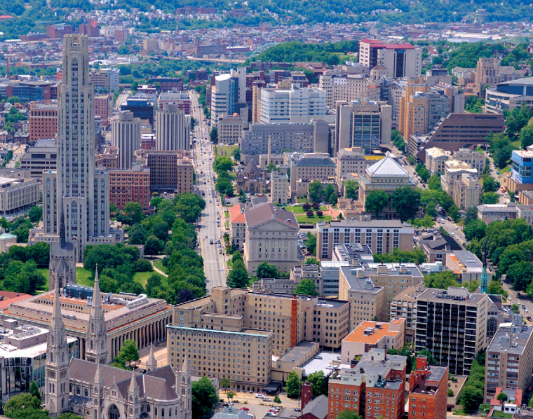
University of Pittsburgh
Center for Social and Urban Research
Notes:
Provide services to campus and broader community
http://www.communications.pitt.edu/Graphic-Standards.pdf

Slide 3
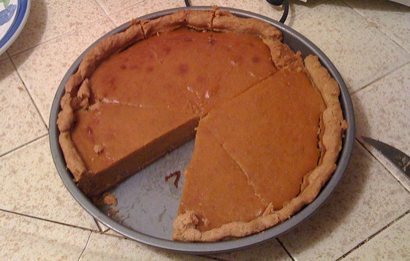
Support
Notes:
https://www.flickr.com/photos/alexik/3017609495/in/photolist-5AE3aV-9KVNUt-fBUVuE-rz6dDf-pi8tcw-8q55mP-7C1Gxf-dKvqT9-5hZjVQ-91Ro1C-3N83Sr-4aAKCz-7C1FSw-dKvrzu-p1d1hG-p3cW1j-7M4eTe-aouiq3-4jaayj-kPdp2h-4ppffj-8tDLyQ-5SU6Qq-aBqakq-5DwzNw-e8aFDQ-7QvGn8-9SRLmH-o5ws6v-dHW753-coCYP5-7C1GiJ-7BWTE4-x7o4w-nq8Lb6-5WHjMV-DMFcK-8d77BJ-8d3Pgt-8d77fm-aBdGWX-4x93Vk-cYwL8m-47jY25-8WaNgC-3cmRzC-7fxGu-8d77FG-8d3Pkn-CX79F

Slide 4
Background as an NNIP Partner
Notes:
GIS data viewer, projects, technical assistance - community development/property data focus ad-hoc

Slide 5
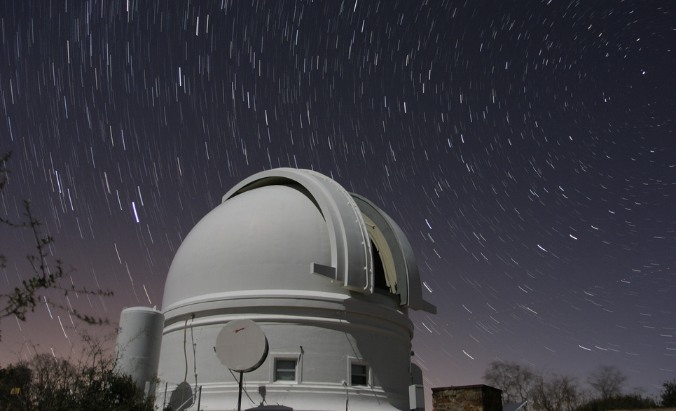
Reflections and Observations
Notes:
Growing demand for information
Raw data
Aggregate data (reports)
Publishers not equipped to respond to data requests,
Knowledge of data use not always shared
Ad-hoc development of data ecosystem - few strategic capacity investments and lack of infrastructure
http://hpwren.ucsd.edu/a_and_d.html

Slide 6
Community Profiles
Notes:
https://creativecommons.org/licenses/by-nc-sa/2.0/

Slide 7
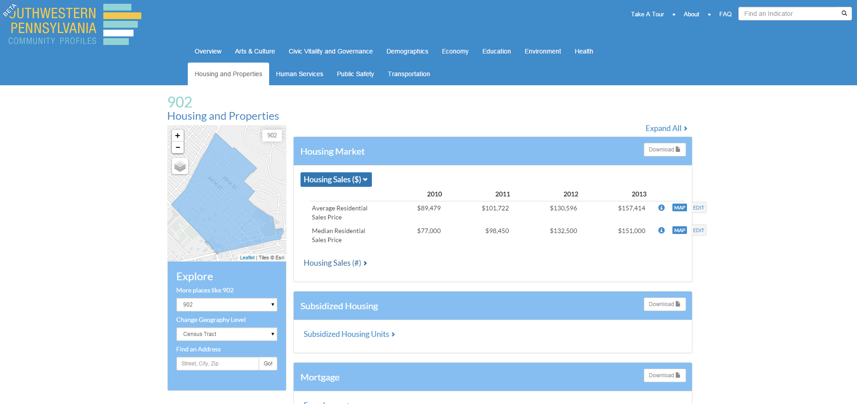

Slide 8
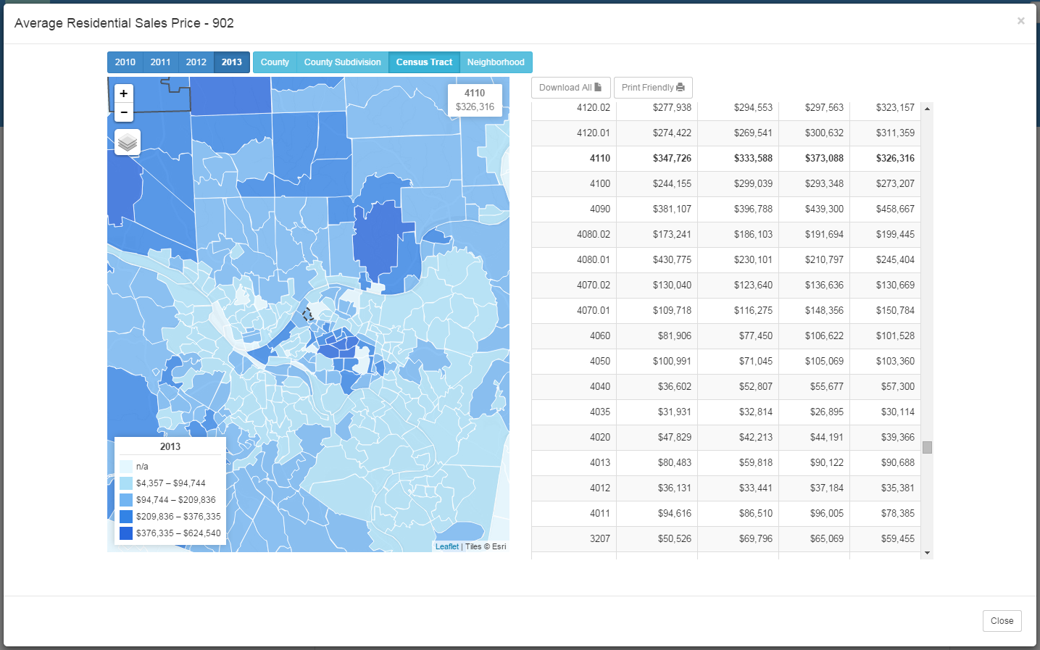

Slide 9
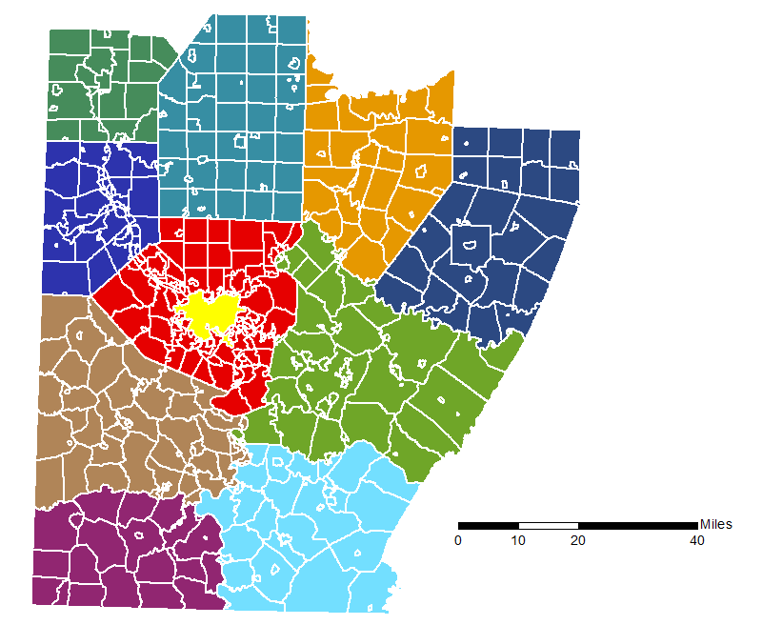
Regional Data Center: Regional Open Data
Notes:
Focus on government, nonprofit, and academic users (funders focus) - Performance measures driven by our ability to meet the needs of these users
Regional collaboration - City is small, overlapping governments, problems cross borders - vacant property, stormwater, etc.
Build ecosystem

Slide 10
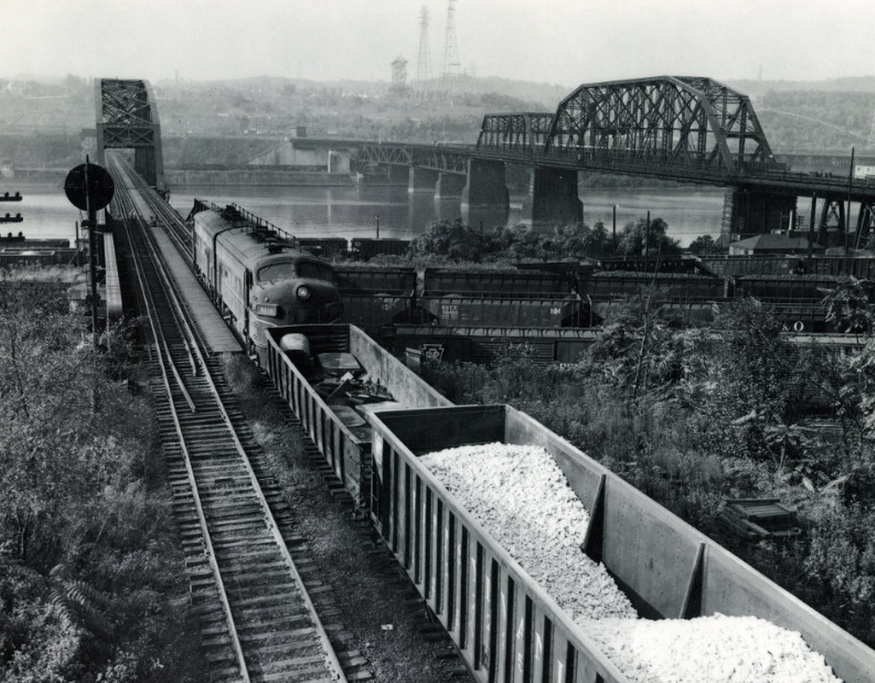
Values and Philosophy
Notes:
Data as regional infrastructure,Tie intermediary model to the infrastructure, Invest in people, Support publishers and users

Slide 11
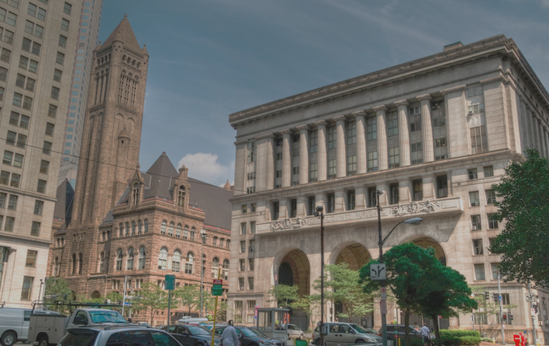
Our Partners
Notes:
Add links for

Slide 12
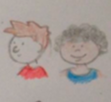
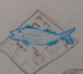
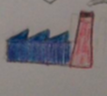
Regional Data Center Model
Data
Government
Residents
Government
Journalists
Non-Profit
Non-Profit
Portal
Businesses
Colleges & Universities
Colleges & Universities
Notes:
My crappy art.

Slide 13
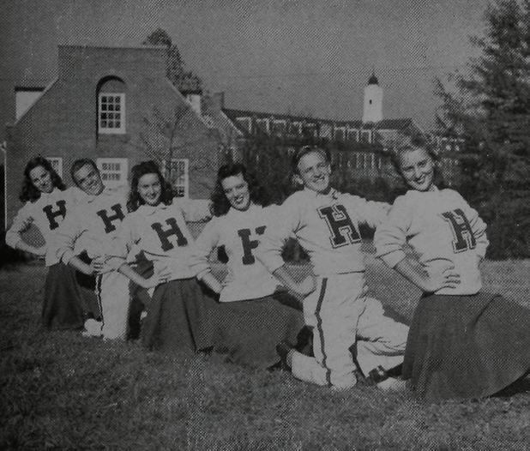
Data Providers: Cheerleading for Data and Standards, Training & Technical Assistance
Notes:
Support from Pitt Digital Scholarship is HUGE - training & T/A training, licensing, uploads, management

Slide 14
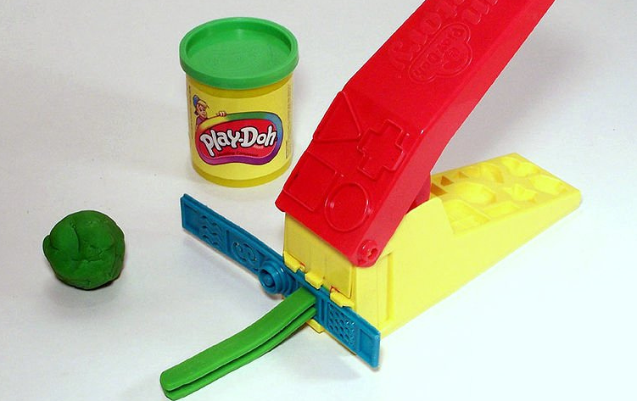
Automating Data Export
Notes:
This is where we want to put a big chunk of staff resources. We want to give shape to data to make it more-digestible and predictable.

Slide 15
Data Portal: Federated Model
Notes:
Search process based on fit with RDC federated model and long-term sustainability. Partners may each want to make their own front door...

Slide 16
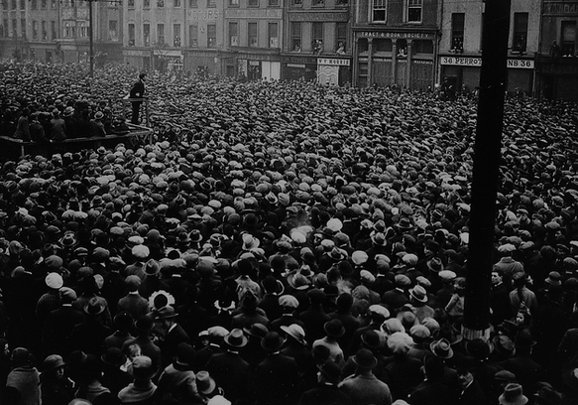
Building Community of Data Users: Training, Events, User Groups, User Guides, and Technical Assistance
Notes:
Building the ecosystem - intermediary role -

Slide 17
Our team
Regional Data Center Staff
Other UCSUR Staff
Carnegie Mellon Friends
Allegheny County Government Solutions Engineering Team
City of Pittsburgh Government Solutions Engineering Team
Pitt Digital Scholarship Team
Notes:
Partnership model

Slide 18
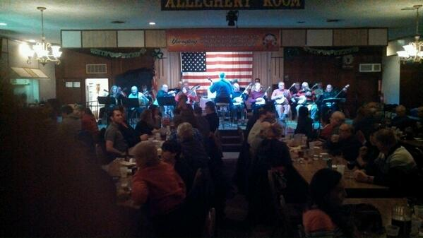
Pittsburgh Banjo Club: 8 pm Tonight
(Leaving from the Reception)

