Slide 1
Providence Plan and Partners
Next Frontiers in Moving from Data to Action

Slide 2
Information for Change: The Evolution
Early parcel GIS system
Commerce Grant for COZIN
Providence Neighborhood Profiles
Mapper 1.0 (ArcIMS)
Steady increase in technical capacity
NIJ Mapper Grant: First foray into open source programming
SDFS Grant from RIDE: Stepping up to IDS
DataHUB, New Profiles, New Mapper

Slide 3
Linking Data from Education Policy: Two RI DataHUB Examples
Rebecca Boxx Project Director for the Mayor’s Children and Youth Cabinet
Janet Durfee-Hildago Director, PK-20 Affairs, Rhode Island Board of Governors for Higher Education

Slide 4
Health Partnerships for Healthy Housing
Dr. Robert Vanderslice Team Lead, Healthy Homes and Environment RI Department of Health
Nancy A. Sutton Manager, Asthma Control Program RI Department of Health

Slide 5
Rebecca Boxx, MCYC Director
Providence Mayor’s Children and Youth Cabinet (MCYC)

Slide 6
Mayor’s Children and Youth Cabinet
Formed by Mayor Cicilline in 2010 and reauthorized and developed by Mayor Tavares
The City mechanism for cradle to career collective impact work.
Over 100 members, five working groups
Early on, the Data Working Group commissioned two data stories around absenteeism
Findings confirmed chronic absenteeism as major issue

Slide 7
Historical Context
Establishment of the Mayor’s Children and Youth Cabinet (2/2010)
Mayor Tavares elected (November 2010) Superintendent Lusi appointed (summer 2011)
District includes chronic absence as key accountability metrics in school improvement plans
State legislates not allowable to suspend for attendance infractions
Chronic absence included as key indicator in District Strategic Plan
Attendance Work Group of CYC conducting detailed policy review to make further recommendations
Data workgroup commissions attendance data story
(late 2010)
Development of core working groups – Attendance Working Group formed (January 2012)
CYC adopts and champions focus on chronic absence
Notes:
Waiver
PLAs

Slide 8
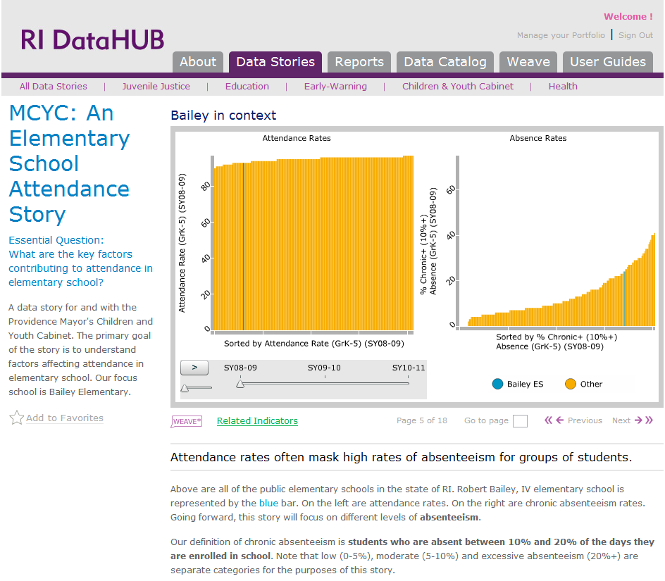

Slide 10
Policy Changes
Shifted city conversation from attendance to chronic absenteeism (one of 5 workgroups focused on issue)
School policy – robust attendance teams required at each school, systems established to provide accessible data for schools and partners
District policy – accountability metrics now focus on chronic absence rather than ADA, Chronic Absence a key indicator for District Strategic Plan
State policy – no longer allowable to suspend for absenteeism

Slide 11
Janet Durfee-Hildago, RIBGHE
Linking K-12 to Higher Ed

Slide 12
Linking K-12 to Higher Ed
Need to answer questions around college access, persistence, and success
First time ever: even among the three higher education institutions
Culture change around data sharing
Working closely with Institutional Researchers
First Data Story complete, more on the way

Slide 13
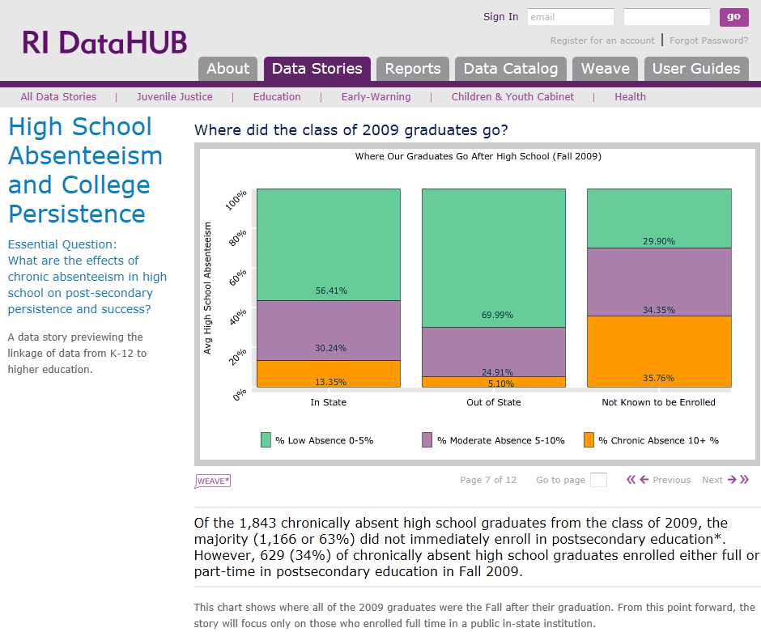

Slide 15
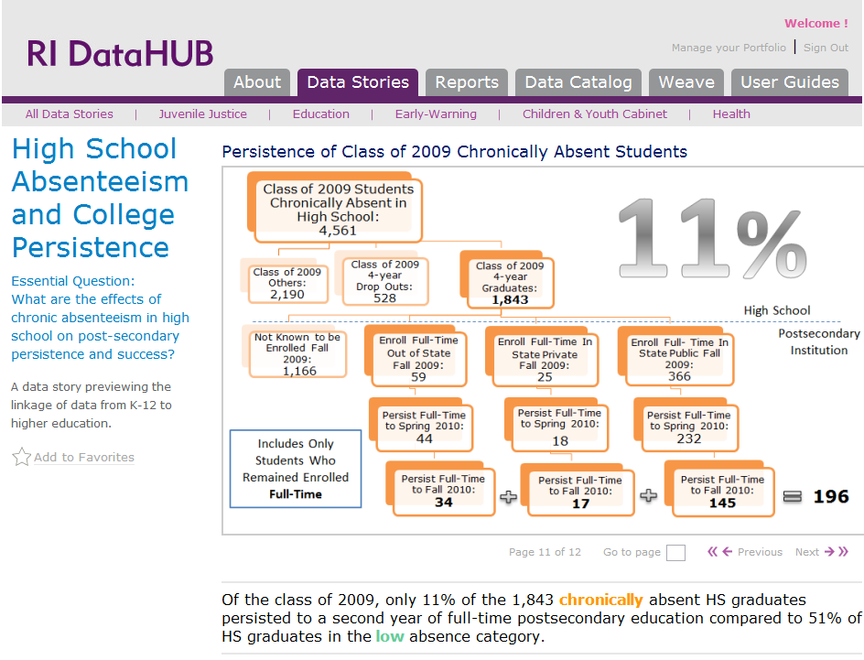

Slide 16
Action Steps
At the Federal Level:
Establish attendance as a priority goal in such Federal initiatives as Race to the Top and I3 grant applications, ESEA waivers, and Title I monitoring.
At the State Level:
Develop an early warning system and appropriate responses.
At the Local Level:
Create a local inter-agency task force to prevent and combat absenteeism.
Summarized from “The Importance of Being in School” (Balfanz, 2012)

Slide 17
Policy Changes
An Act Relating to Education - compulsory attendance
(d) This act would prohibit schools from considering a students truancy or absenteeism as a basis for using an out-of-school suspension as a disciplinary action.

