Slide 1
Center on Urban Poverty and Community Development
Jack, Joseph and Morton Mandel School of Applied Social Sciences
Case Western Reserve University
April Hirsh, MSSA

Slide 2
Code Enforcement Partnership
Housing context in Cleveland
Foreclosure
Bank/investor ownership
Property abandonment, irresponsible ownership
Code enforcement, housing court as tools to stem the rising tide

Slide 3
Code Enforcement Partnership
Notes:
Partnership between Community Development Corporations (CDCs) and City of Cleveland Department of Building and Housing
Traditionally had more adversarial relationship
Increase transparency in process and activities

Slide 4
Resources
Homeowner
CDC
Notes:
Program theory: CDCs have better opportunity to achieve Voluntary housing code compliance
Friendly face
Connection with resources

Slide 5
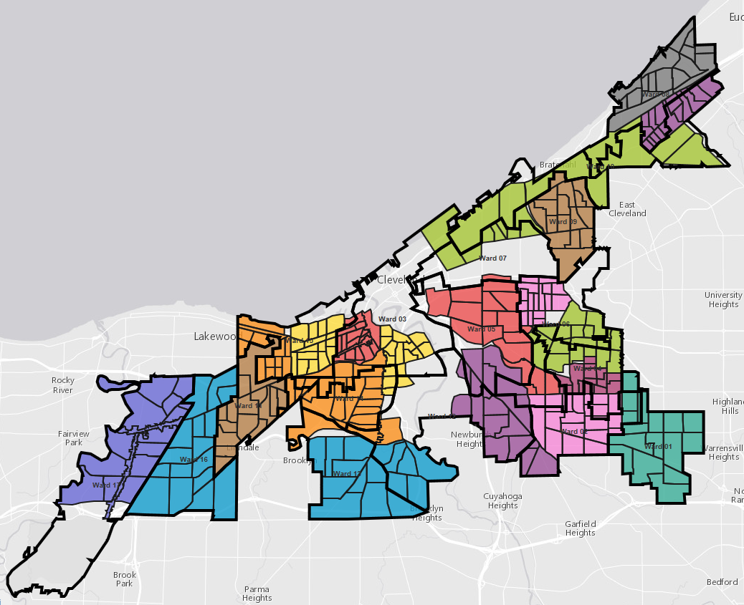
Notes:
Locally prioritized
Geographically concentrated

Slide 6
Our Role
Share B&H data in Neighborhood Stabilization Team Web Application
Meeting with partners to understand data needs
Processing data to meet data needs

Slide 7
Code Enforcement Data
B&H and CDC Code Enforcement data on Neighborhood Stabilization Team Web Application
B&H data:
Complaints
Inspections
Violations
Condemnations
Demolitions
Prosecution
Permits
All information is viewable, searchable, filterable, sortable, mapable, downloadable at parcel level

Slide 8
Example

Slide 10
Our Role
Build, host, maintain platform for CDC inspection information
Facilitates information sharing
Better data management- integrated (simple) tools
CDBG/HUD reporting
Accountability!

Slide 11
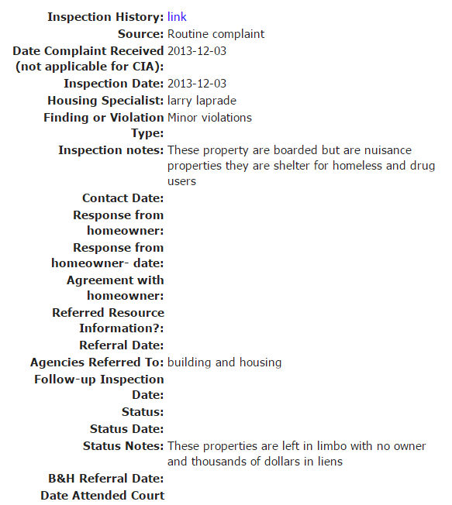

Slide 12
Example

Slide 13
Results
Property ownership, transfers, tax status, foreclosure filing, sheriff’s sale, and detailed code enforcement information in ONE location
Facilitates nuisance abatement
Demo info facilitates clumping
Data is great!

Slide 14
Contact
April Urban
Center on Urban Poverty and Community Development
http://povertycenter.case.edu
april.urban@case.edu

