Slide 1
Building a Culture of Data Use
Innovations in Program Planning and Evaluation
Kelly Davila, Senior Research Analyst

Slide 2
Expectations for program planning and evaluation are changing – demand is high for holistic analysis.
How do we adapt to meet that demand?

Slide 3
IndyVitals
What is it?
One of the four elements of the Indianapolis’ bicentennial plan (Plan 2020)
Measure the neighborhood-level impact of the plan activities
Helps users and policymakers tell a common story about a particular neighborhood and make meaningful comparisons

Slide 4
IndyVitals
Approach
Present data in a common framework (STAR community rating system)
Simplify access while still providing for powerful data exploration
Reveal the areas of critical need and opportunity to guide more successful and collaborative endeavors
Notes:
STAR rating for cities – we brought that down to neighborhoods

Slide 5
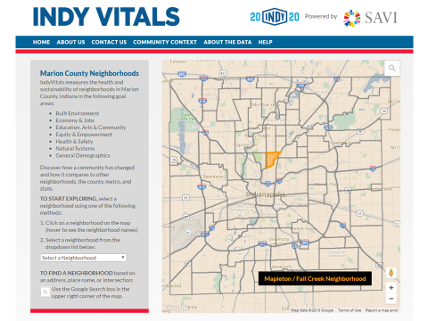
IndyVitals

Slide 6
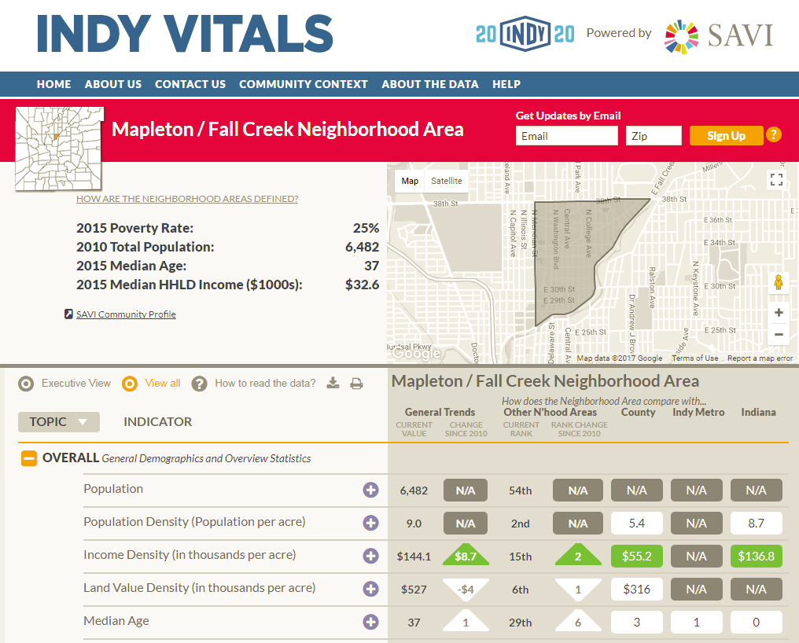
IndyVitals

Slide 7
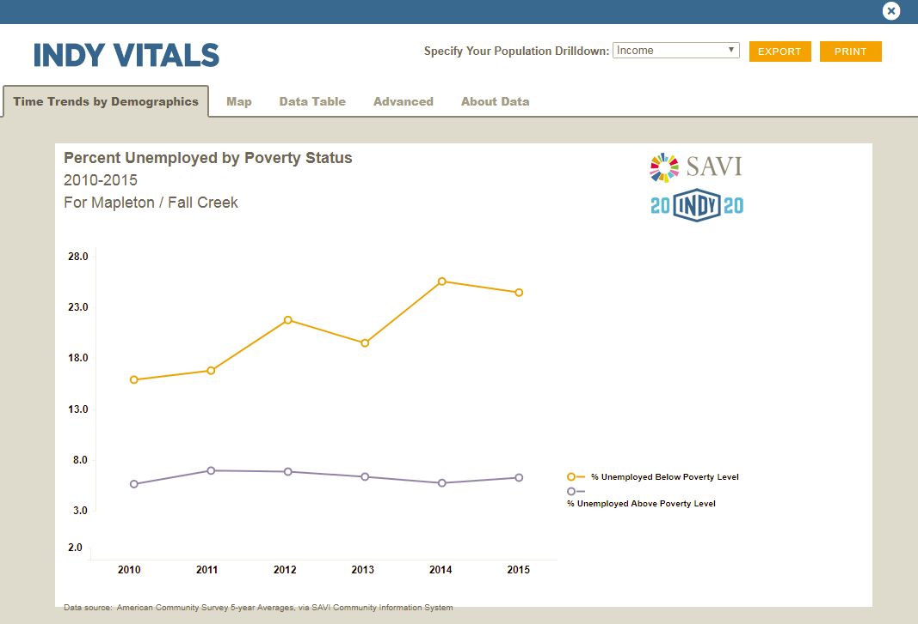
IndyVitals

Slide 8
IndyVitals
Challenges
Defining a “neighborhood area”
Aligning data to those custom areas
Integrating developer tools to meet data visualization requirements

Slide 9
IndyVitals
Innovations and Building a Culture of Data Use
Data management system built for analysts, not programmers
More data on the back end to allow for meaningful, dynamic visualizations
Merged disparate data and technologies into unified, place-based, decision-making platform

Slide 10


IndyVitals
Where we are now
Launched in June 2016, continuously updated
Nominee – MIRA Awards (Best of Indiana Tech)
Winner – URISA Exemplary Systems in Government

Slide 11
SAVI Expansion to Support
United Way Data Integration
What is it?
United Way of Central Indiana wants to shift its funding and decision-making to a data-informed process.
How well is UWCI meeting its strategic goals? How can it improve its efforts?

Slide 12
SAVI Expansion to Support
United Way Data Integration
Approach
Develop an integrated database of client outcomes and programmatic data across UWCI agencies
Build and expand web tools to explore those data
Redesign our training program to emphasize data literacy
Notes:
Which combinations of services lead to improved outcomes
How can United Way and Polis work together to change the culture of data use among community organizations and the broader public?

Slide 13
SAVI Expansion to support
United Way Data Integration
Needs
Decision Support
Training & Support Services
Better Decisions
Community Resources
People Served
Notes:
Describe "client data" as "information about client demographics and outcomes“
Describe "program data" as "information about the type of service, a program's service area, or number of sessions required to complete the program"

Slide 14
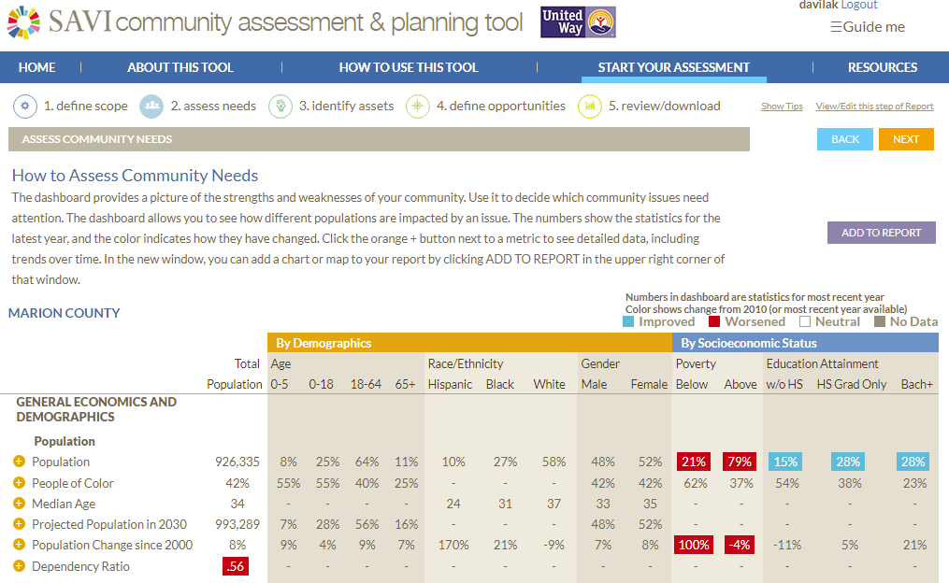
SAVI Expansion to Support
United Way Data Integration

Slide 15
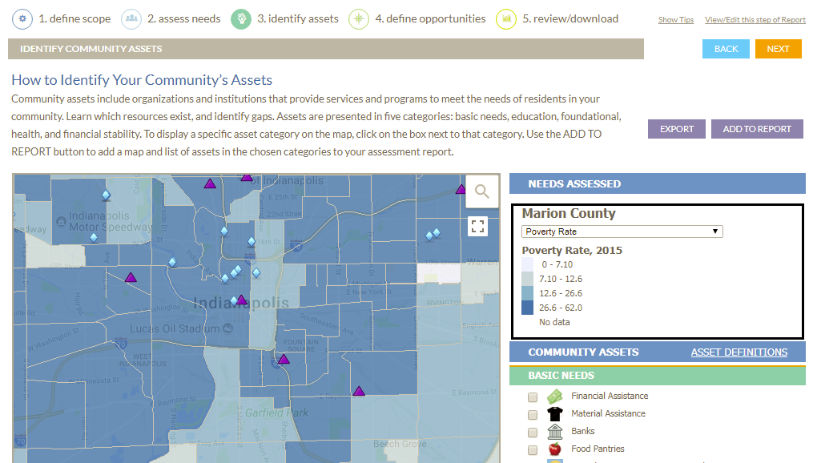
SAVI Expansion to Support
United Way Data Integration

Slide 16
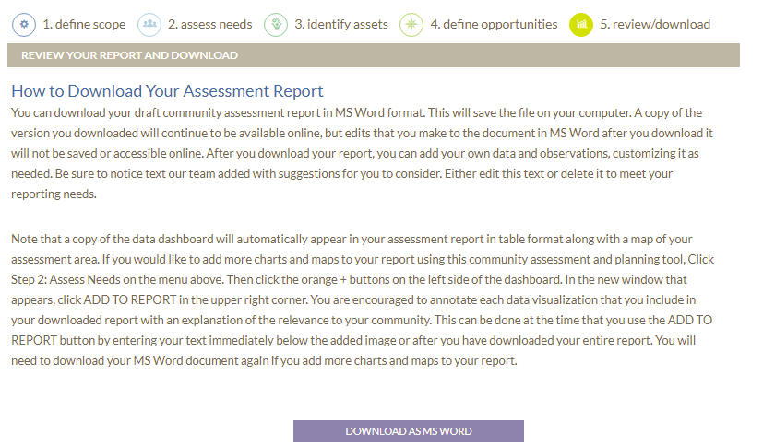
SAVI Expansion to Support
United Way Data Integration

Slide 17
SAVI Expansion to Support
United Way Data Integration
Challenges
Some technological hurdles to export web content as MS Word document in assessment tool
Reaching collective data sharing agreements is an exercise in diplomacy
Complicated contractual and legal limitations
Notes:
Reaching a collective data sharing agreement is an exercise in diplomacy
Complicated contractual and legal restrictions surrounding data sharing across multiple sectors

Slide 18
SAVI Expansion to Support United Way Data Integration
Where we are now
SAVI Community Assessment Tool online
Redesigned community asset system in development
In pilot phase of data collection project
Developing new SAVI education curriculum
Working towards full integration with 80+ agencies

Slide 19
SAVI Expansion to Support United Way Data Integration
Innovations and Building a Culture of Data Use
Assessment tool allows users to think through a community assessment, analyzing trends and needs
Training and outreach program emphasize practical applications for data users
First nonprofit client data IDS on this scale
Integrating client and program data will allow us to study trends in social services and outcomes

Slide 20
Parkview Health CHNA
What is it?
Community Health Needs Assessments are documents required under the Affordable Care Act
Assess health needs, include information on implementation, evaluation
Notes:
Nonprofit hospitals
CHNA are tools designed to help those hospitals make more data-informed decisions
compile information needed to improve the health of their communities and offer opportunities for institutional and cross-sectional collaboration.
Guidance so hospital staff can select the best strategies to address current and emerging health concerns and measure progress towards their goals

Slide 21
Parkview Health CHNA
Approach
Analyze local data in the context of the region
Suggest strategies to address health concerns that align with existing hospital programs
Provide a framework to evaluate cost, feasibility
Leverage local partnerships
Make it replicable
Notes:
Using primary and secondary data
Supply data relevant to each individual county hospital in the context of the regional assessment
Evidence-based programs – peer reviewed and determined to be effective
Replicable – this is a baseline, and the hospitals can use the same tool to build the next CHNA and track progress

Slide 22
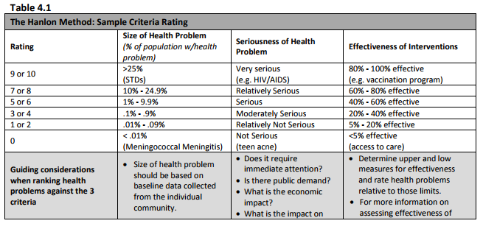
Parkview Health CHNA
Source: National Association of County and City Health Officials
Notes:
Hanlon method allowed us to take an objective approach
Suggest strategies to combat health concerns that align with existing hospital and community programs, especially those that are popular or well attended

Slide 23
Parkview Health CHNA
Challenges
Collecting the right kind of data for Hanlon method
  Primary data sample sizes
  Secondary data timeliness
Leaving clear instruction to replicate analysis
Notes:
Collecting the right kind of data for Hanlon method, citing what it is and where it came from. Data can be hard to track down.

Slide 24
Parkview Health CHNA
Where we are now
CHNA documents and implementation supplement delivered
Developing implementation strategy, including feasibility analysis and evaluation framework
Notes:
Currently working on building a feasibility framework for evaluating the cost, scope, and impact of implementation

Slide 25
Parkview Health CHNA
Innovations and Building a Culture of Data Use
CHNA encourages collaboration
Implementation encourages creative approaches to addressing health needs
Parkview’s proactive approach to this CHNA allows for better incremental analysis in the future

Slide 26
Great Families 2020
What is it?
Social Innovation Fund: What works, and how can we make it work for more people?
Use 2-Gen approach to improve family outcomes in five neighborhood areas in Indianapolis
Evaluate programs outcomes with scientific rigor
Notes:
evidence-based programs and interventions are used to enable social innovation
Generate new sources of evidence on what works best to solve specific social problems
Five components of the 2-gen approach:
Post-secondary education and workforce, early childhood education, economic supports, health and wellbeing, social capital

Slide 27
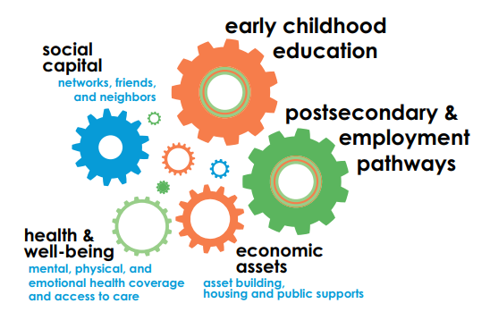
Great Families 2020
Source: Aspen Institute Two-Generation Playbook
Notes:
evidence-based programs and interventions are used to enable social innovation
Generate new sources of evidence on what works best to solve specific social problems
Five components of the 2-gen approach:
Post-secondary education and workforce, early childhood education, economic supports, health and wellbeing, social capital

Slide 28
Great Families 2020
Approach
Leverage existing, evidence-based programs as core services
Provide guidance on appropriate wraparound services
Ongoing technical and programmatic assistance to participating social service agencies
Notes:
How do we evaluate client outcomes using scientifically rigorous methodologies without denying services to anyone?
Leverage other SIF resources to spark new innovations

Slide 29
Great Families 2020
Challenges
Establishing Great Families as more than the sum of its parts
Will we enroll and maintain enough families?
Federal resources diminishing

Slide 30
Great Families 2020
Where we are now
Ongoing technical preparation and onboarding
Proposed evaluation plan submitted to federal agency, pending approval
Collecting programmatic baseline data
Clients enrolling in core programs
Clients consent to participate in research, Jan. 2018

Slide 31
Great Families 2020
Innovations and Building a Culture of Data Use
High-touch guidance and support allow agencies to turn data into action in near-real time
Resources empower agencies to be innovative in service delivery
Potential to replicate in other areas

Slide 32
Thank You.

Slide 33
Panelists
Moderator:
David Bodenhamer, PhD: Executive Director, The Polis Center
Panelists:
Denise Luster: Vice President of Impact Research and Analytics,
United Way of Central Indiana
Sue Ehinger, PhD: Chief Experience Officer,
Parkview Health System
James Taylor: Chief Executive Officer,
John Boner Neighborhood Centers
Brad Beaubien, AICP: Administrator for Long-Range Planning, Indianapolis Department of Metropolitan Development

