Slide 1
NNIP Technology & Social Media Update
Rob Pitingolo
NNIP Partnership Meeting
Pittsburgh, Pennsylvania
May 2015

Slide 2
Activity at @NNIPHQ
Tweets: Network content and updates
Weekly #NNIPChat
Live tweeting from NNIP meetings

Slide 3
@NNIP Statistics
575+ followers (and growing)!
3 tweets per day (average)
New Twitter lists for NNIP Partners

Slide 4
#NNIP Hashtag
Tag any NNIP related content
Can be used by anyone*
Use #NNIP for all Pittsburgh meeting tweets
New for Pittsburgh: post photos to Instagram!
*Including German bankers

Slide 5
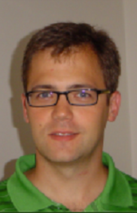
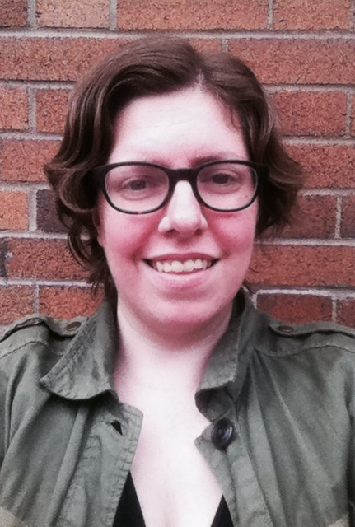
Weekly #NNIPChat
Held every Thursday, 4pm ET
Different topic each week
We need volunteer hosts (don’t be scared)!
Spearheaded by these two:

Slide 6
Weekly #NNIPChat
Past topics include:
Affordable housing preservation (Peter T.)
Local community surveys (Mark A.)
Telling stories with data (Eleanor T.)
High opportunity neighborhoods (Max W.)
Storify recaps posted on the NNIP Website

Slide 7
Introducing the NNIP App
Hat-tip to Edwin Q. for proof of concept
Thanks to Katya for building the app!
Meeting agenda, announcements, camp information, Twitter

Slide 8
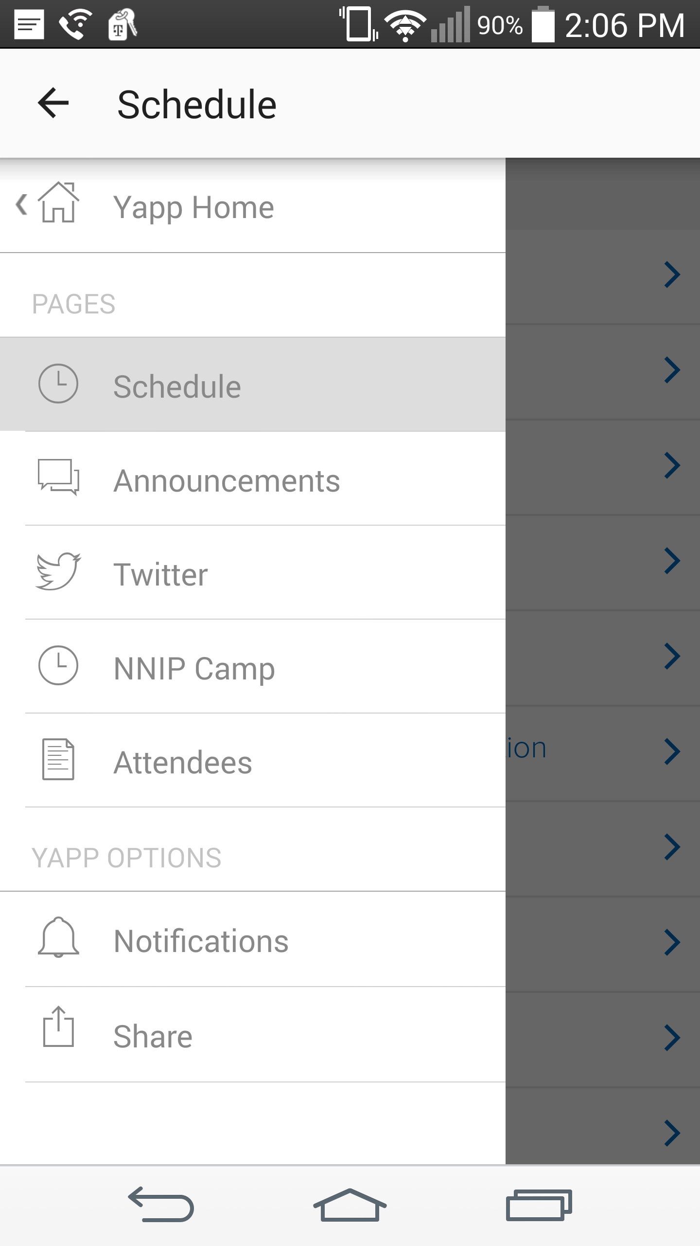
NNIP App: Push Notifications
Highly recommend turning ON push notifications!
Get updates directly from NNIP HQ
Find Rob or Katya if you need help

Slide 9
NNIP App: Agenda
Abridged version of the packet agenda
Camp sessions on a separate tab
Click into a session for more information / speakers, etc.

Slide 10
NNIP App: Announcements
Great way to communicate with each other during the meeting
No need to fumble w/ phone numbers, texts, address books, etc.
Please use good judgment

Slide 11
NNIP App: Twitter
View tweets from @NNIPHQ
Useful way to follow the meeting live
Need a separate app to tweet out

Slide 12
NNIP App: NNIP Camp
Best way to keep track of camp sessions
Information on session topics, room locations, and times
Updated by Maia in real-time

Slide 13
NNIP App: Attendees
Name and Twitter handle for everyone in attendance
Stay in touch!

Slide 14
NNIP Highlight Video
New for Pittsburgh!
Smile for the camera
Rob will be filming the meeting with a GoPro camera
Short (~3 minute) highlight video to follow

Slide 15
THANK YOU!
Questions? Complaints?
Contact Rob Pitingolo (rpitingolo@urban.org)

