Slide 1
Welcome to the #NNIP Pittsburgh Meeting!
KATHY PETTIT
MAY 6, 2015
Notes:
Welcome – introduce myself.
Few opening remarks before introductions (heads up on icebreaker question).

Slide 2
Defining Functions of NNIP Partners
Build and operate information systems with recurrently updated data on neighborhood conditions
Facilitate the direct use of indicators for community building and local policy making
Emphasize the use of information to build the capacities of low-income neighborhoods
Notes:
Many attended the intro session, but we always start out by reminding ourselves of what we have in common.
- assemble and collect ngh data
- work with local groups to USE the data
- make sure everyone has access – esp communities of color and distress that have traditionally not had access to data.
First, thanks to all the partners attending – about 60 staff from 28 cities
Also 8 alumni

Slide 3
NNIP Network Supporters: Funders And Colleagues
Notes:
None of this would be possible without dedicated funders
Cindy Guy & Alaina Harkness – really partners in thinking about new directions

Slide 4
Thanks to Local Sponsors
Notes:
Also want to recognize our local partners. Bob, Sabina, Jen and whole team have done an enormous amount of work.
Local funders listed here made tours and receptions possible

Slide 5
NNIP Leadership: Guiding the Agenda
Executive Committee 2015
Mark Abraham, New Haven
Bob Gradeck, Pittsburgh
Sheila Martin, Portland
Jeff Matson, Minneapolis
Eleanor Tutt, St. Louis
Max Weselcouch, NYC
Recent Members, 2011-14
Kurt Metzger, Detroit
Todd Clausen, Milwaukee
Dave Bartelt, Philadelphia
Matthew Kachura, Baltimore
Notes:
[Don’t read all the names] Would the Exec Comm please stand…. These are your representatives – they meet with us monthly and helped a lot with putting the program together.
Tom Kingsley, Leah and I are also part of the Executive Committee. Tom can’t be with us in person because of health reasons, but is watching from home

Slide 6
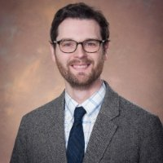
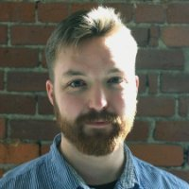
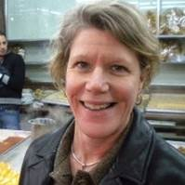
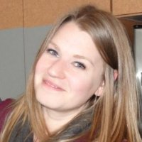
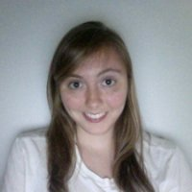
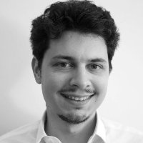
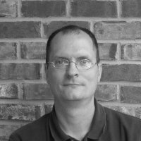
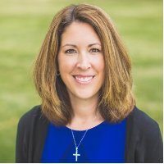
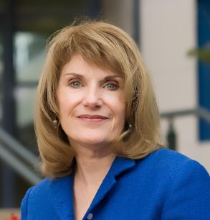
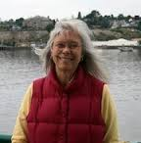
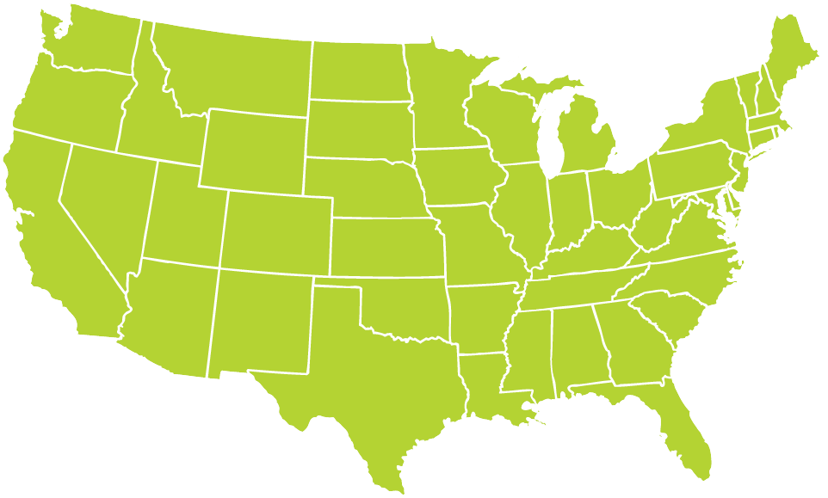
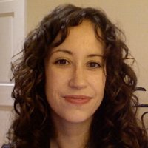
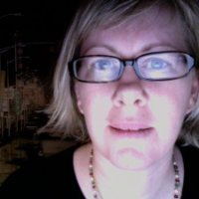
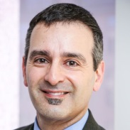
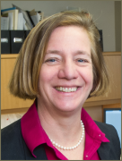
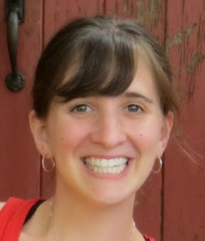
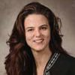
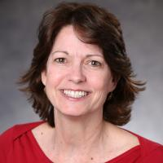
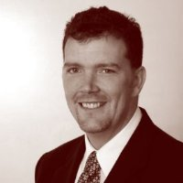
Thanks to Partner Speakers
Notes:
Our lives are made easier and the wealth of expertise in the network and generosity of sharing. Here’s the partners that you’ll hear from over the next 3 days.
Encourage you to thank them over the next three days together

Slide 7
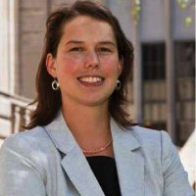
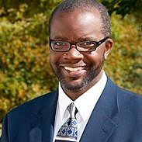
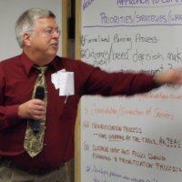
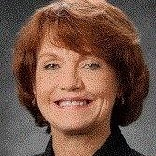
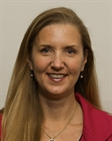
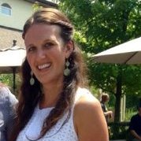
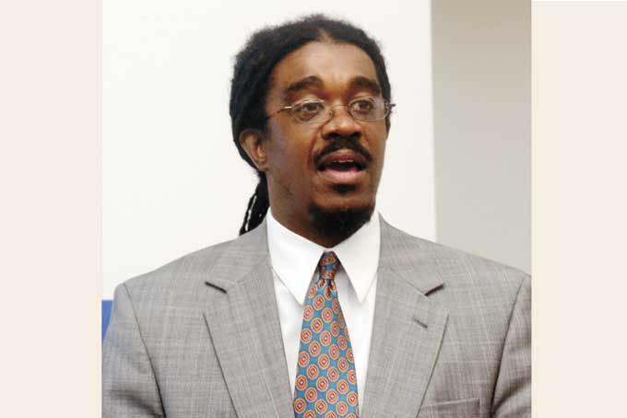
Thanks to Guest Speakers
Notes:
Another part of NNIP’s value is bringing outside expertise to the network.
This afternoon – lucky to hear about the great work in Homewood: Dr Wallace and Teixeira from University of Pittsburgh & WV and Operation Better Block
Joe (alumni) will be presenting tomorrow on IDS – Vickie Boothe from CDC, Mallory O’Brien from DataShare in Milwaukee
And be sure to thank your tour guides for tonight

Slide 8
Welcome Guest Cities!
Chicago, IL
Durham, NC
Los Angeles, CA
Newark, NJ
Salt Lake City, UT
Notes:
Part of the network’s mission is to foster NNIP capacities in new cities – welcome them – answer questions - ask about their work….
Mention Milwaukee application and Katie and Michael

Slide 9
Welcome National Organizations!
Centers for Disease Control and Prevention
Code for America
Data Quality Campaign
Federal Reserve Banks
LISC
Living Cities
Open Society Foundations
Open Technology Institute
Sunlight Foundation
Notes:
Finally, welcome to friends from national organizations
One of the pieces of the work plan I’ll talk about tomorrow is being smarter about how we connect with national groups.
- connect with them at meals and reception
- some helped out at presession yesterday
Several chances to exchange ideas with them through Camp sessions
Code for America & Living Cities are working with us on the civic tech cross-site project – framework session
Group of Fed Reserve folks, Jacob and Lisa are alumni – Naomi proposed a session
Encourage you to tap expertise of Sunlight and Open Tech Institute
LISC work on ngh indicators

Slide 10
Introductions
Notes:
Move to introductions – keep it short
Name, org, and favorite indicator or data set

Slide 11
Agenda Review
Leah Hendey

Slide 12
NNIPCamp Pittsburgh
Peter Tatian

Slide 13
NNIPCamp Rules
Set your own agenda.
Avoid planned speeches & PPTs.
Be creative!
COME AND GO AS YOU PLEASE.
Contribute & allow other to contribute.
Tweet!
Introduce yourself
Assign a note-taker
Notes:
Go over schedule/timing
Rules are posted everywhere…
UNCONFERENCE 101 – Sunlight Foundation
https://www.youtube.com/watch?v=iUEt0xOysr4

Slide 14
Welcome to the #NNIP Pittsburgh Meeting!
KATHY PETTIT
MAY 6, 2015

