Slide 1
Community Profiles: A Brief Overview of Transferring Technologies across Partnerships

Slide 2
The Tool
2013 Providence Plan Launched Rhode Island Community Profiles
A tool to present data using interactive tables, maps, graphs, and charts at varying geographic scales.
Adopted by University of Pittsburgh Center for Social and Urban Research (in partnership with the Allegheny County Department of Humans Services) for use in Southwestern PA.

Slide 3
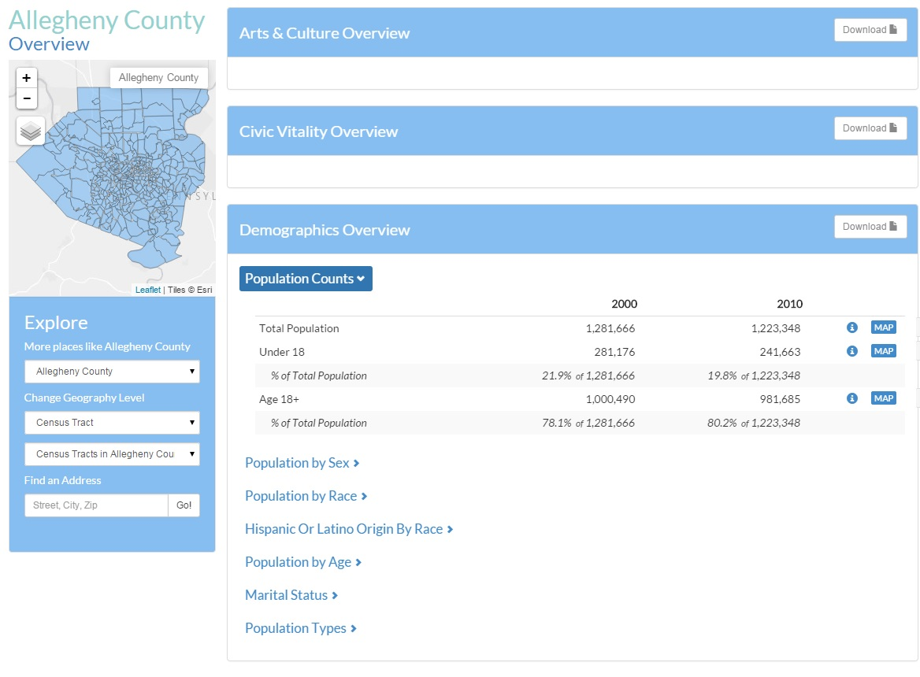
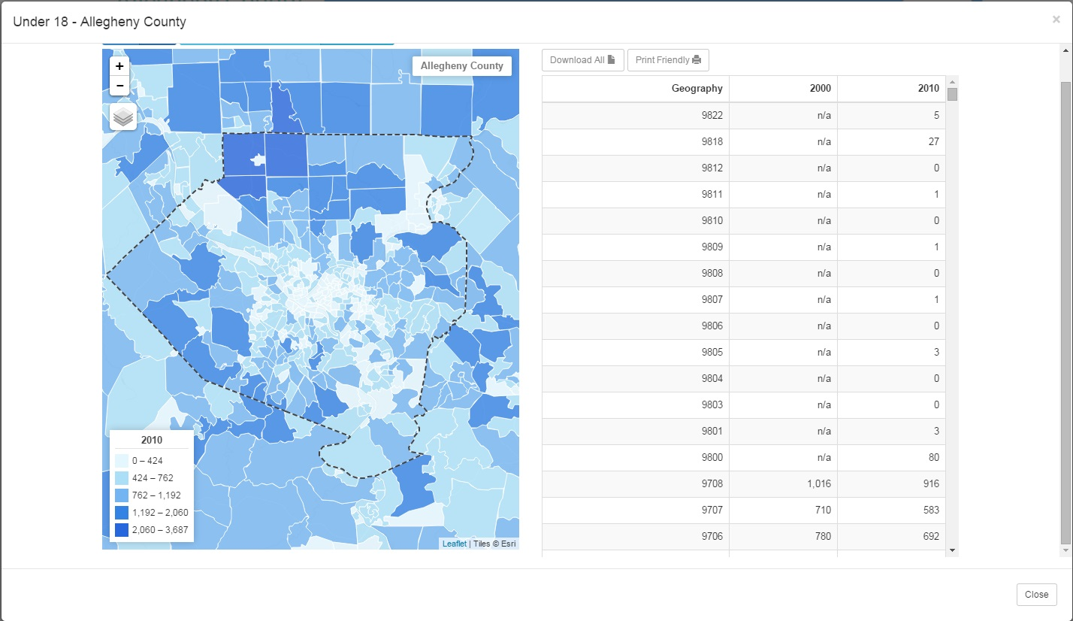
Domains
Sub-Domains
Groups
Indicators
Multiple Geographies
Download
Print

Slide 4
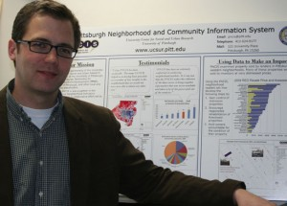
Community Profile Tool
Incorporates APIs for the Census Data – with built in margin of error reporting.
Allows for the incorporation of locally-sourced data (upload as CSV).
It has an administrative interface to allow for any old fool to upload data and manage the site.
We can add data for non-census geography – neighborhoods, council districts, etc.

Slide 5
Indicator Creation
Handled through the administrative console
Multiple years and geographies at the same time
Several denominators for same indicator
Metadata

Slide 6
Initial Adoption Process
Developing SWPA Profiles
Investment ($$)
Collaborative work – conference calls, emails, meeting at NNIP
New features developed and tailored to SWPA
Developed on Providence Plan server, then transferred to UCSUR

Slide 7
Transferring the Tool
Server Environment
• Linux OS (Ubuntu preferred, but should work with all distributions)
- SWPA Profiles uses RedHat
• Built using the Python language and the Django framework
• Uses PostgreSQL with PostGIS enabled as the database

Slide 8
Transferring the Tool
Capacity:
Programmer on staff
Staff to maintain the front end
Time:
Initial set up < 1 day (if familiar with Django and Python)
Budget time for maintenance

Slide 9
Advantages
Program is already built for you
Resources available
Experience and advice from Providence Plan as well as the experience of UCSUR adopting the site
Opportunity to continue cross city collaboration

Slide 10
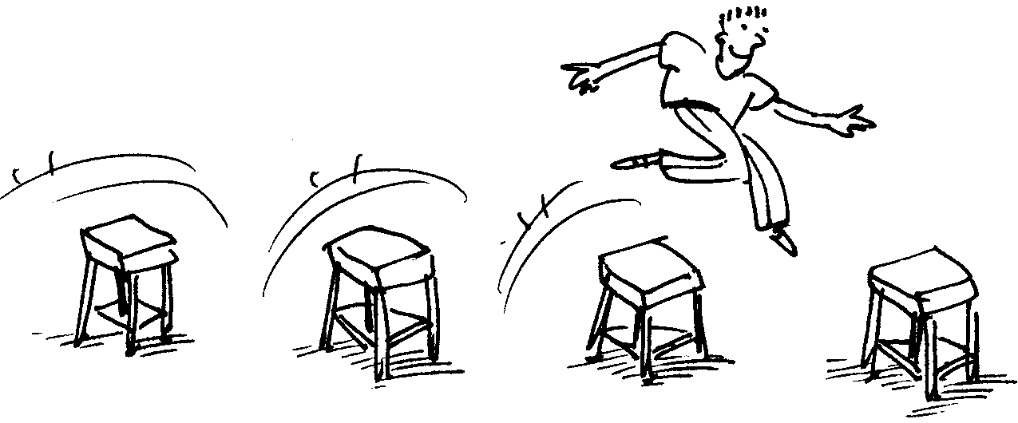
Hurdles
Documentation
Troubleshooting
University of Pittsburgh Security Requirements

Slide 11
Want to know more?
Talk with UCSUR and/or Providence Plan before leaving Pittsburgh or call after the conference.
The code is also available on GitHub.

