Slide 1
Welcome to the
#NNIP San Antonio Meeting!
April 6, 2016
Notes:
Welcome – introduce myself.
Start with logistics
Welcome live-stream audiences, cameras are rolling and will be posted afterwards. We’ll be tweeting using hashtag NNIP.
Few opening remarks before introductions (heads up on icebreaker question).

Slide 2
Defining Functions of NNIP Partners
Build and operate information systems with recurrently updated data on neighborhood conditions
Facilitate the direct use of indicators for community building and local policy making
Emphasize the use of information to build the capacities of low-income neighborhoods
Notes:
Many attended the intro session, but we always start out by reminding ourselves of what we have in common.
- assemble and collect ngh data
- work with local groups to USE the data
- make sure everyone has access – esp communities of color and distress that have traditionally not had access to data.
First, thanks to all the partners attending – more than 44 staff from 29 cities and about ¼ of them here for the first time (11).
And 4 alumni
Charlie Bruner
Jim Farnam
Charlotte-Anne Lucas
Jacob Wascalus

Slide 3


NNIP Network Supporters:
Funders and Colleagues
Notes:
None of this would be possible without dedicated funders
Cindy Guy– really partners in thinking about directions (Ji Won Shon)
News about Alaina Harkness, lucky to have Craig Howard be program officer for NNIP and CTDC (can’t be here this time)
Kresge – new funder of Turning the Corner project with D3 that Maia will tell you about in Ignite on Fri
Microsoft – email from before - note Elizabeth

Slide 4

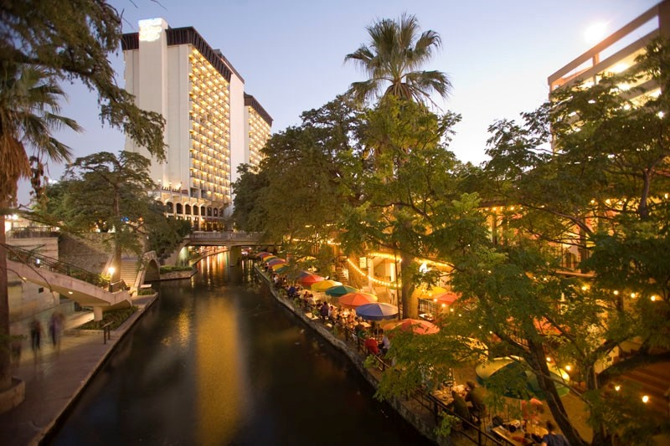
Thanks to
Photo Credit: Tim Thompson
Notes:
Also want to recognize our local partners., Laura, Clarire, Norma, Stephanie, Courtney
Local funders made tours and receptions possible – NAMES?

Slide 5
NNIP Leadership:
Guiding the Agenda
Executive Committee 2016
Mark Abraham, New Haven
Bob Gradeck, Pittsburgh
Sheila Martin, Portland
Jeff Matson, Minneapolis
Laura McKieran, San Antonio
April Urban, Cleveland
Recent Members, 2012-15
Eleanor Tutt, St. Louis
Max Weselcouch, NYC
Todd Clausen, Milwaukee
Kurt Metzger, Detroit
Notes:
[Don’t read all the names] Would the Exec Comm please stand…. These are your representatives – they meet with us monthly and helped a lot with putting the program together.
Tom Kingsley, Leah and I are also part of the Executive Committee.
PLUG for running

Slide 6
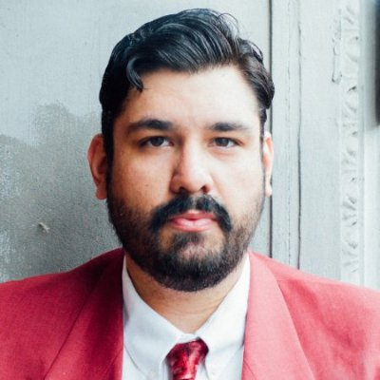
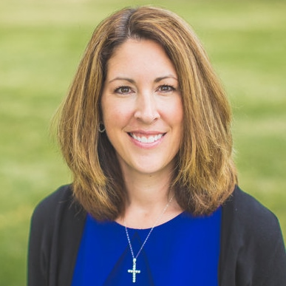
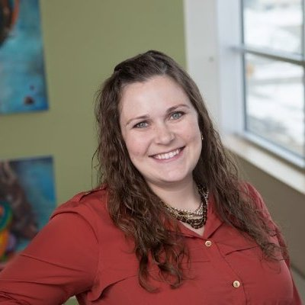
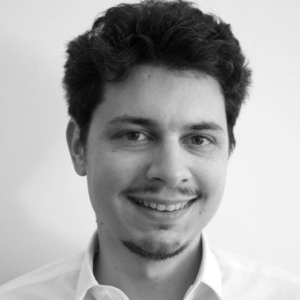
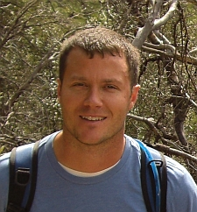

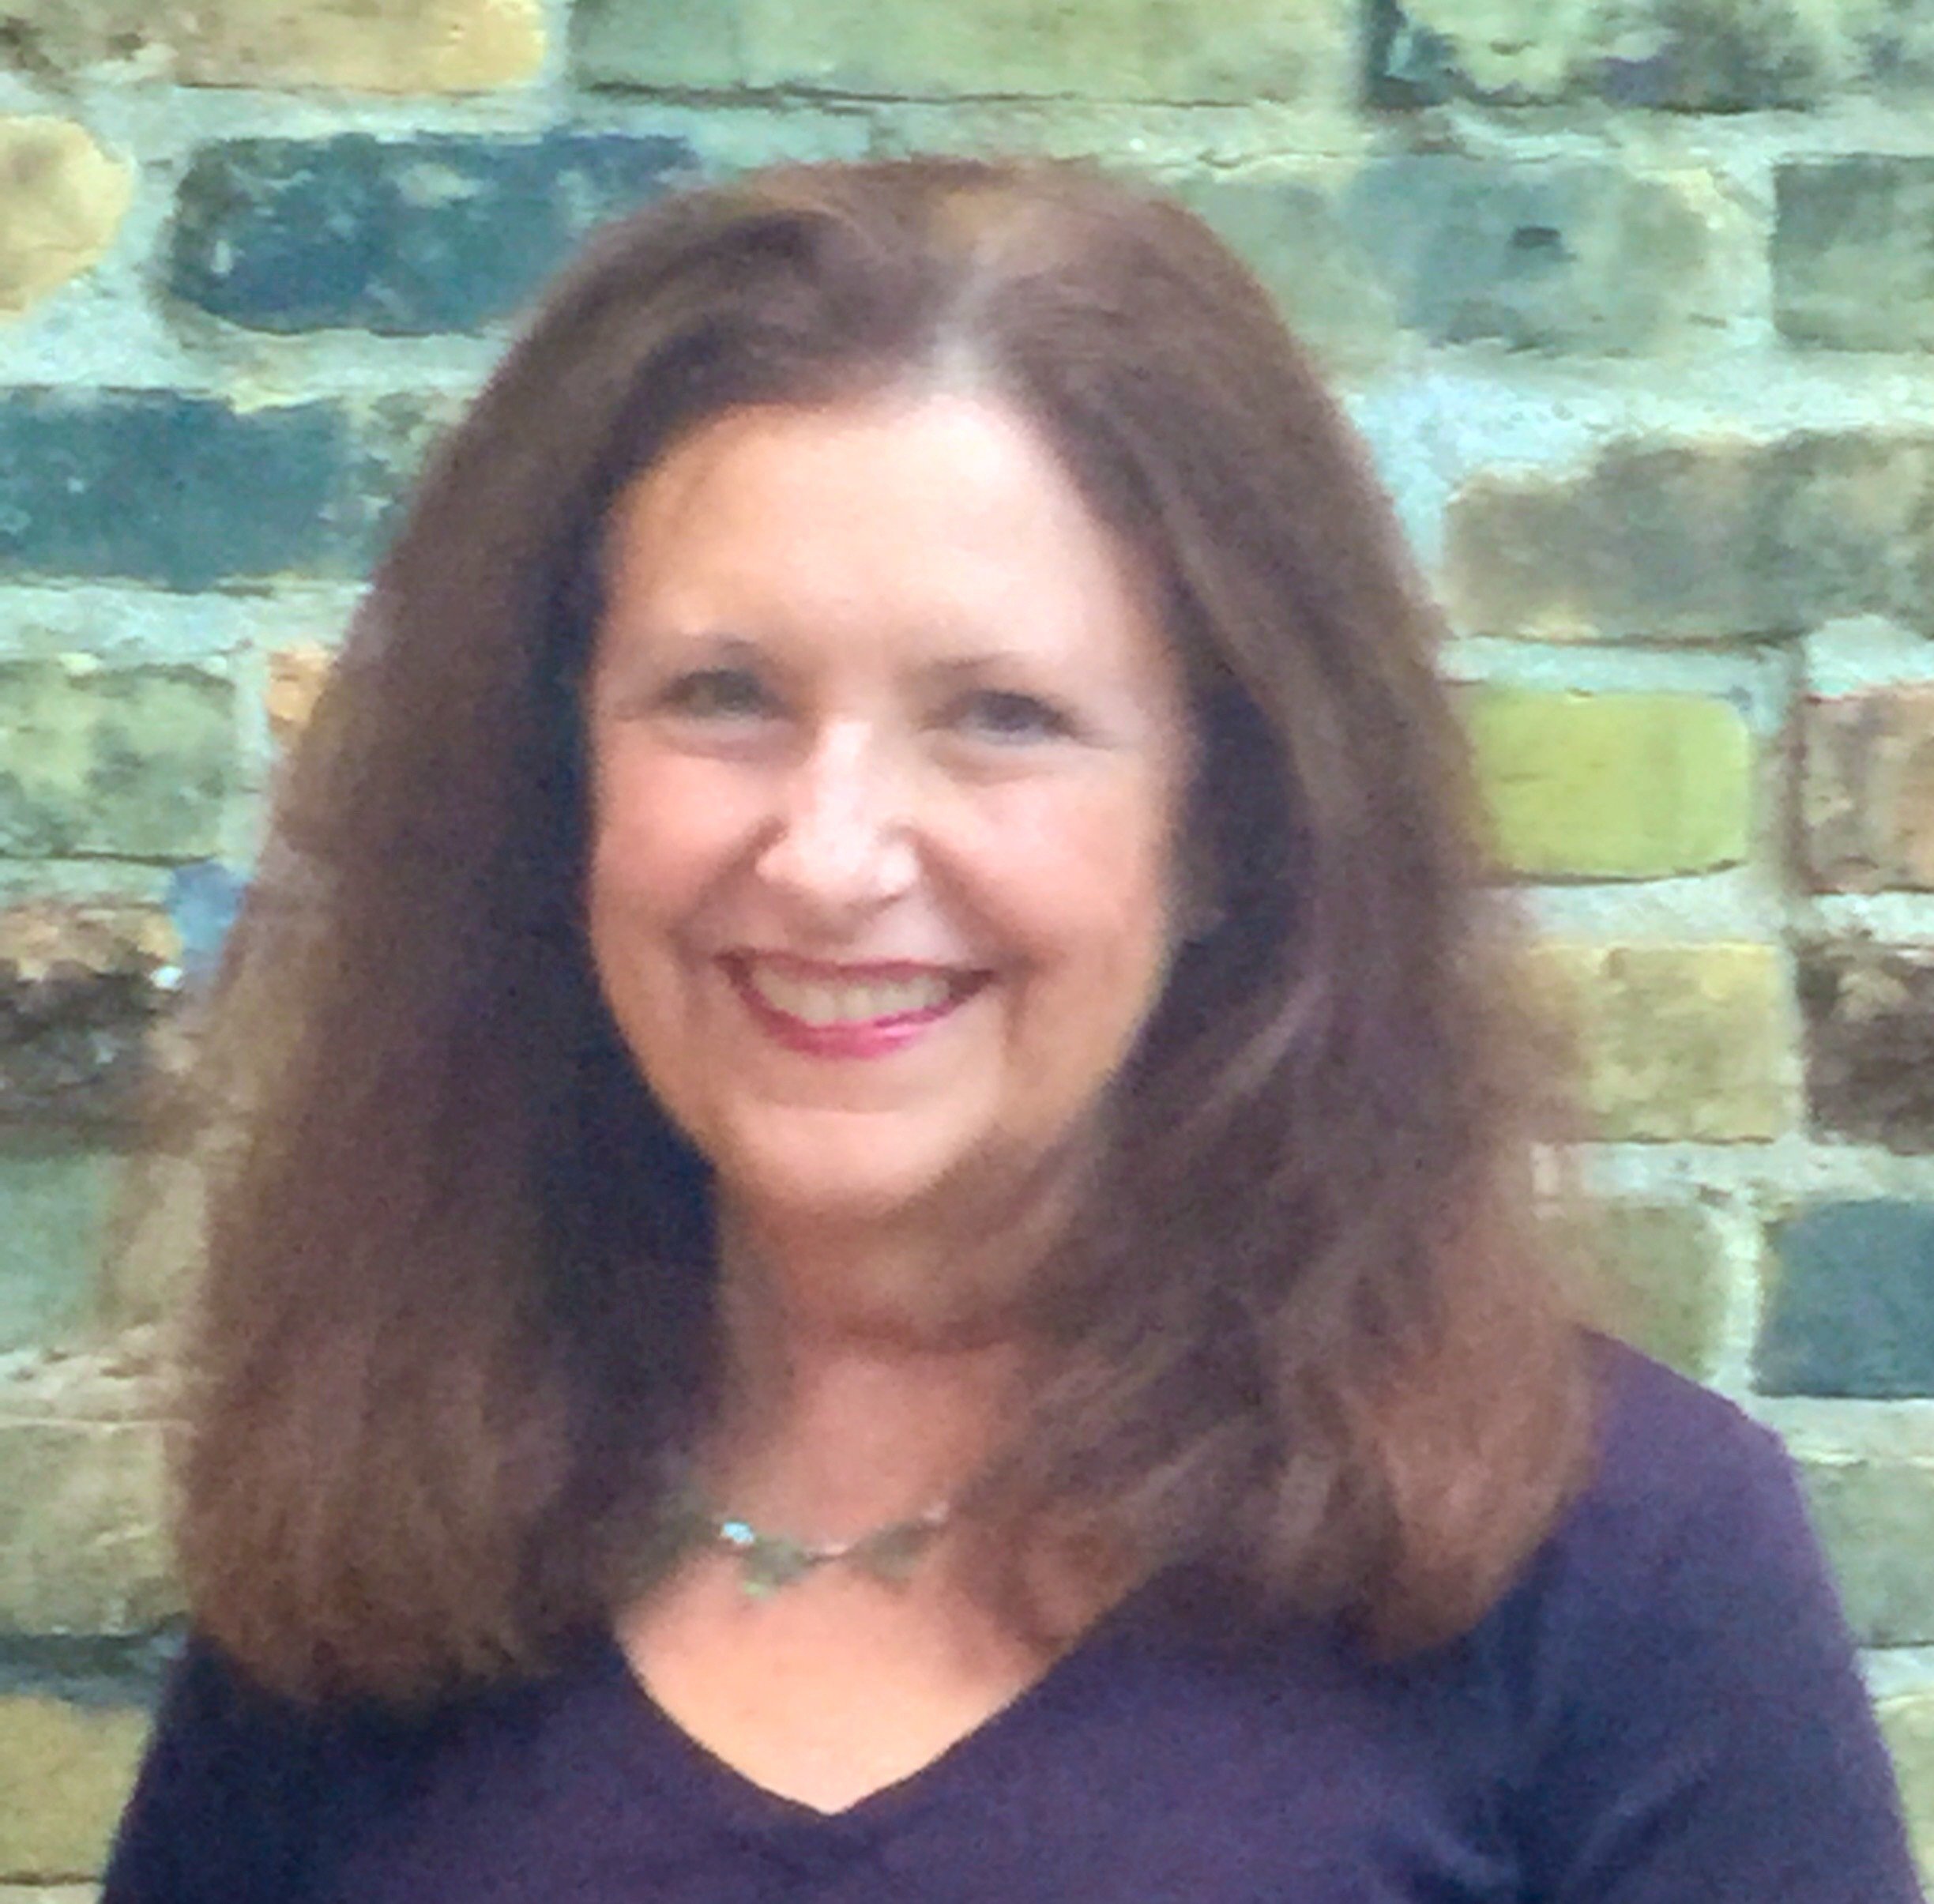
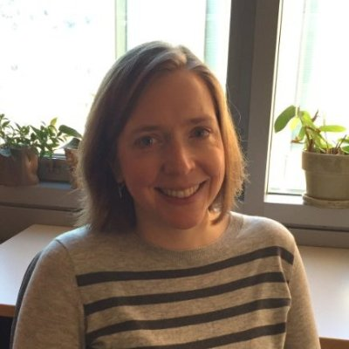
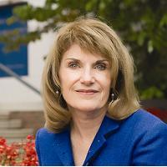
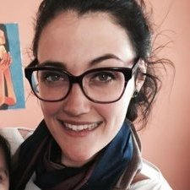
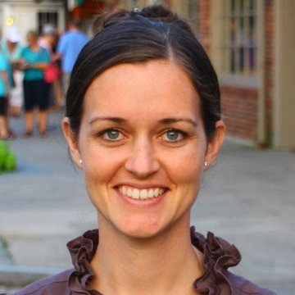
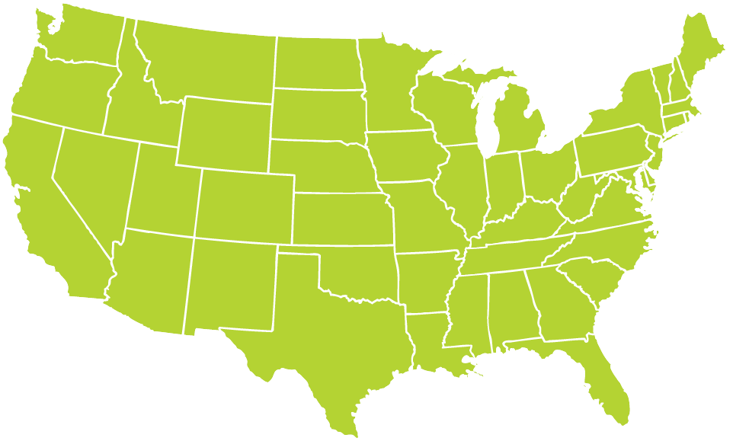
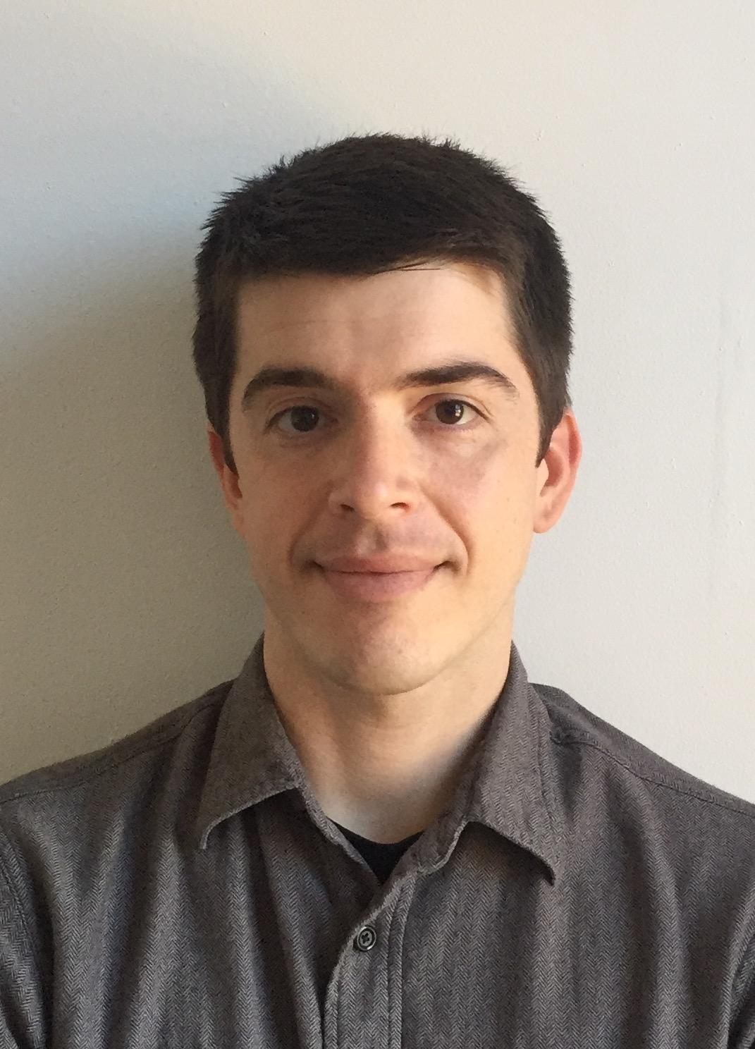

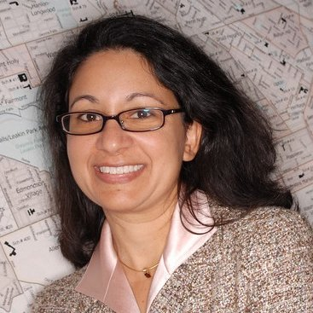
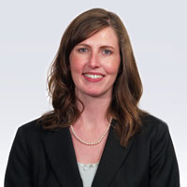
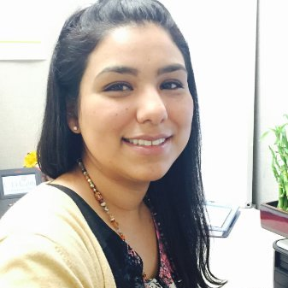
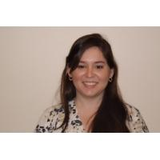
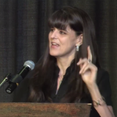
Thanks to Partner Speakers
Notes:
Missing Davin Reed
Our lives are made easier and the wealth of expertise in the network and generosity of sharing. Here’s the partners that you’ll hear from over the next 3 days.
Encourage you to thank them in person while we’re together
Particularly Jason from Portland, John from StL, Davin from NYU, Nina from Cleveland – presenting on their first time to the meeting.

Slide 7
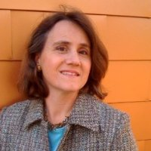
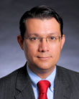
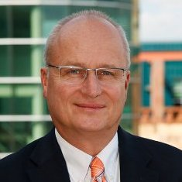
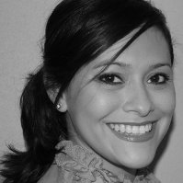
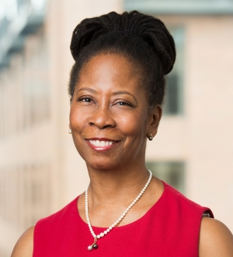
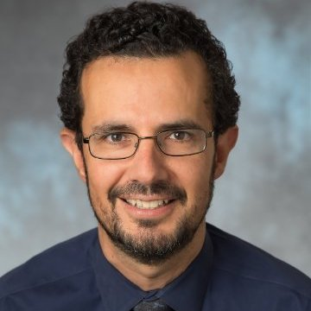
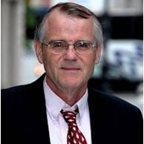
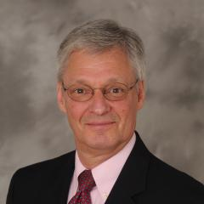
Thanks to Guest Speakers
Notes:
Another part of NNIP’s value is bringing outside expertise to the network.
This afternoon – lucky to hear about the great work in San Antonio– all listed in your agenda
Our Urban Institute colleague Kilolo Kijakazi and MaTEEas Valenzuela will be here later from King County to help us on the equity panel
Charlie and Spencer will be doing Ignites
And be sure to thank your tour guides for tonight.

Slide 8
Welcome Guest Cities!
Chicago, IL
Durham, NC
Houston, TX
Los Angeles, CA
Memphis, TN
Notes:
Part of the network’s mission is to foster NNIP capacities in new cities – welcome them – answer questions - ask about their work….

Slide 9
Welcome National Organizations!
Ash Center at Harvard Kennedy School
Child Trends
Code for America (national and Open Austin)
Data Quality Campaign
Federal Reserve Banks of Atlanta and Minneapolis
Living Cities
Robert Wood Johnson Foundation
W.K. Kellogg Foundation
Notes:
Finally, welcome to friends from national organizations
Several chances to exchange ideas with them through panels and Camp sessions. Please welcome them at meals and reception.

Slide 10
Introductions
Notes:
Move to introductions – large group so keep it short
Name, org, and favorite indicator or data set

Slide 11
Agenda Review
Leah Hendey
Notes:
Mention code of conduct somewhere? LEAH TO UPDATE
Note availability of app with the overall schedule
Stay up to date on new NNIPCamp unconference sessions
Post announcements to all meeting attendees
Post crowd pictures during (and after) each day’s events
Answer daily polls
Walk through what is in the packet - Note framing pages and participant list
Break out rooms logistics
Tours – FIND OUT mobility requirements
Reception: If you are arriving late Wednesday afternoon, we will be departing for the neighborhood bus tour at 4:15 pm from the lobby, which will run until 6:00. The evening reception will be held from 6:00 – 8:00 p.m. at Continental Avenue Bridge. If you want to meet us there, you should take a short taxi or Uber from the hotel (there’s not a traffic-safe walking route).
Light reception – expect people to go out afterwards [Is this true?] Point to restaurant list.
How to get back – Taxi/Uber? OR do we have buses?
NNIPHQ staff - please stand up – we’re here to make your next 3 days go smoothly , so just let us know if you need anything.

Slide 12
NNIPCamp San Antonio
Maia Woluchem and Rob Pitingolo

Slide 13
What is an unconference?
Informal gathering of collaborators
Participants set the agenda
Focused on discussion
Notes:
Go over schedule/timing
Rules are posted everywhere…
UNCONFERENCE 101 – Sunlight Foundation
https://www.youtube.com/watch?v=iUEt0xOysr4

Slide 14
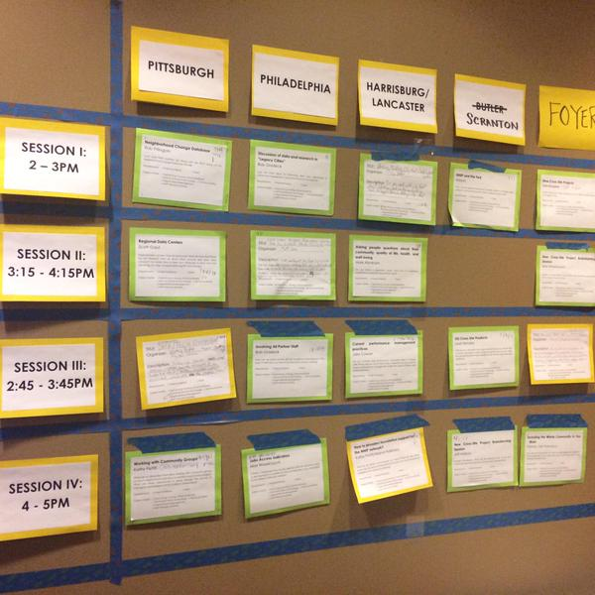
Together we build the wall
Submit an idea
Vote on your favorites
Volunteer to lead if necessary
On Wednesday and Thursday we build our wall
Check the app and #nnip for the schedule

Slide 15
Voting?
Virtual wall v. Physical wall – how does voting work?
Votes from home helped us prime the pump and identify early topics of interest
Votes on-site are critical so we can make final choices
Make sure to visit the wall today and tomorrow and vote to help finalize camp sessions

Slide 16
NNIPCamp Rules
Set your own agenda.
Introduce yourself.
Assign a note-taker.
Avoid planned speeches & PPTs.
Contribute & allow other to contribute.
Tweet!
COME AND GO AS YOU PLEASE.
Notes:
Go over schedule/timing
Rules are posted everywhere…
UNCONFERENCE 101 – Sunlight Foundation
https://www.youtube.com/watch?v=iUEt0xOysr4

Slide 17
Most Importantly
Be creative
Hallway conversations count
Have fun!

Slide 18
Welcome to the
#NNIP San Antonio Meeting!
April 6, 2016

