Slide 1
Welcome to the #NNIP Dallas Meeting!
October 21, 2015
Notes:
Welcome – introduce myself.
Few opening remarks before introductions (heads up on icebreaker question).

Slide 2
Defining Functions of NNIP Partners
Build and operate information systems with recurrently updated data on neighborhood conditions
Facilitate the direct use of indicators for community building and local policy making
Emphasize the use of information to build the capacities of low-income neighborhoods
Notes:
Many attended the intro session, but we always start out by reminding ourselves of what we have in common.
- assemble and collect ngh data
- work with local groups to USE the data
- make sure everyone has access – esp communities of color and distress that have traditionally not had access to data.
First, thanks to all the partners attending – more than 40 staff from 23 cities
Also 8 alumni

Slide 3
NNIP Network Supporters: Funders And Colleagues
Notes:
None of this would be possible without dedicated funders
Cindy Guy & Alaina Harkness – really partners in thinking about new directions
Alaina can’t be here and sends best wishes

Slide 4
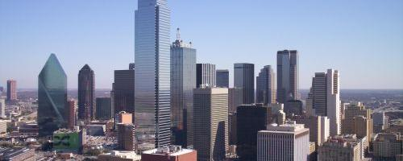
Thanks to Dallas!
Notes:
Also want to recognize our local partners. Tim, Anthony, Sara ANYONE ELSE?
Local funders listed here made tours and receptions possible

Slide 5
NNIP Leadership: Guiding the Agenda
Executive Committee 2015
Mark Abraham, New Haven
Bob Gradeck, Pittsburgh
Sheila Martin, Portland
Jeff Matson, Minneapolis
Eleanor Tutt, St. Louis
Max Weselcouch, NYC*
Recent Members, 2011-14
Kurt Metzger, Detroit
Todd Clausen, Milwaukee
Dave Bartelt, Philadelphia
Matthew Kachura, Baltimore
Notes:
[Don’t read all the names] Would the Exec Comm please stand…. These are your representatives – they meet with us monthly and helped a lot with putting the program together.
Max- stepped down in June when she joined the Hilary campaign and is now an NNIP Alumni -
Tom Kingsley, Leah and I are also part of the Executive Committee.
PLUG for running?

Slide 6
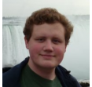
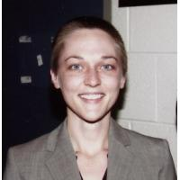
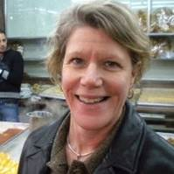
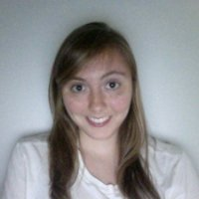
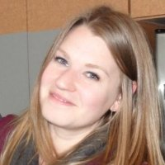
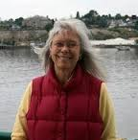
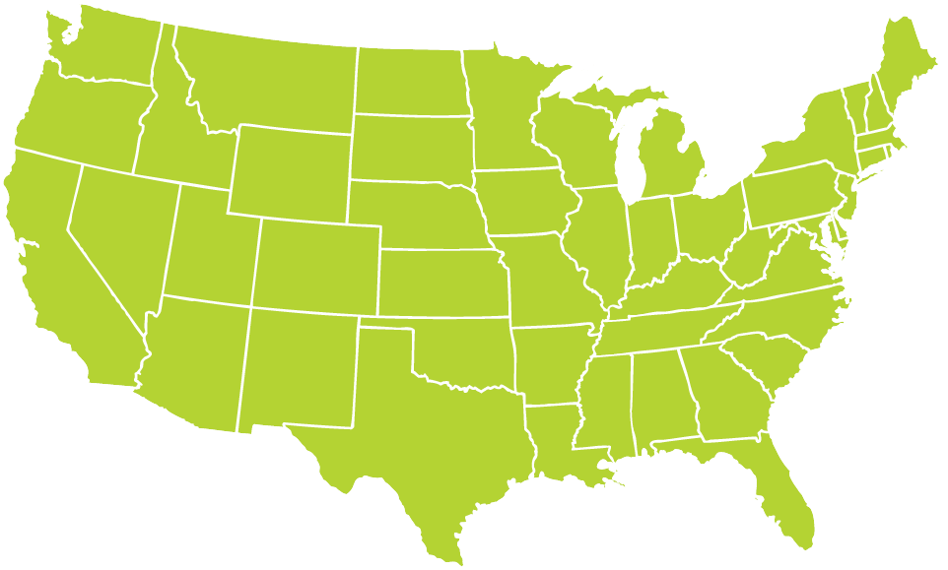
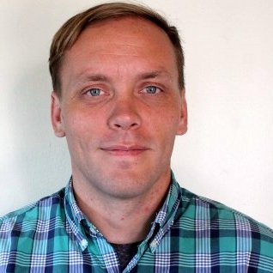
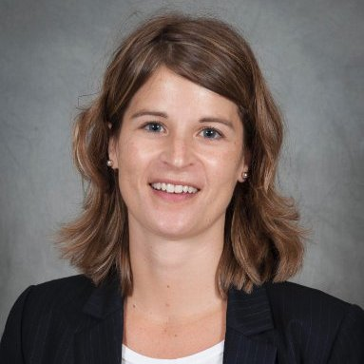
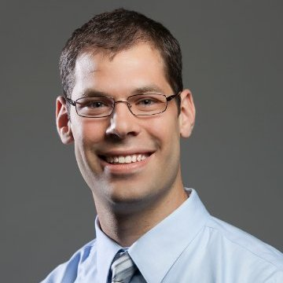
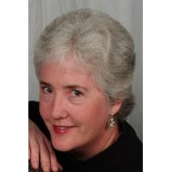
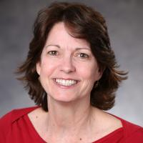
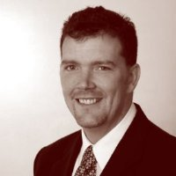
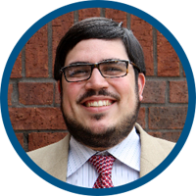
Thanks to Partner Speakers
Notes:
Our lives are made easier and the wealth of expertise in the network and generosity of sharing. Here’s the partners that you’ll hear from over the next 3 days.
Encourage you to thank them over the next three days together
Particularly Joel and xx from Providence, xxx from Columbus, Andrew from Charlotte. Jessie from Boston?

Slide 7
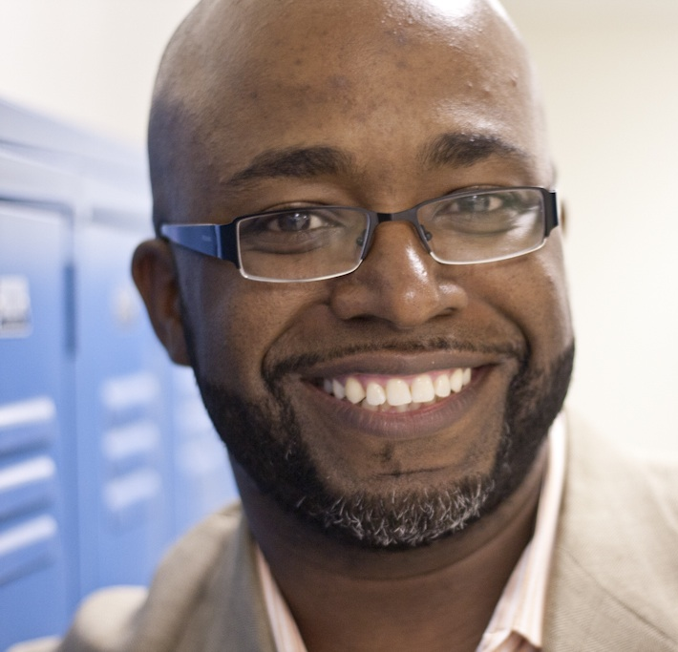
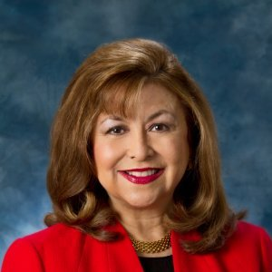
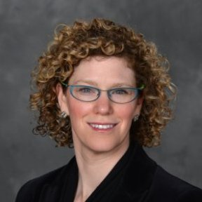
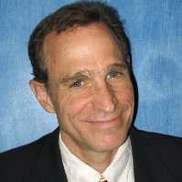
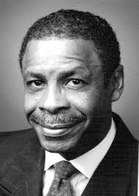
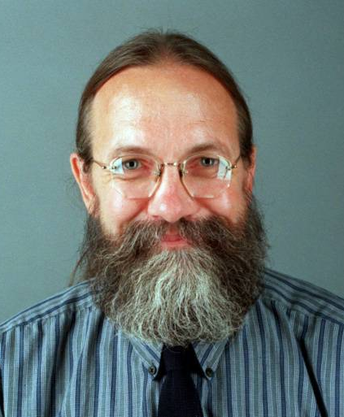
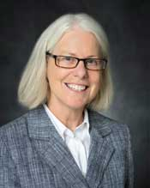
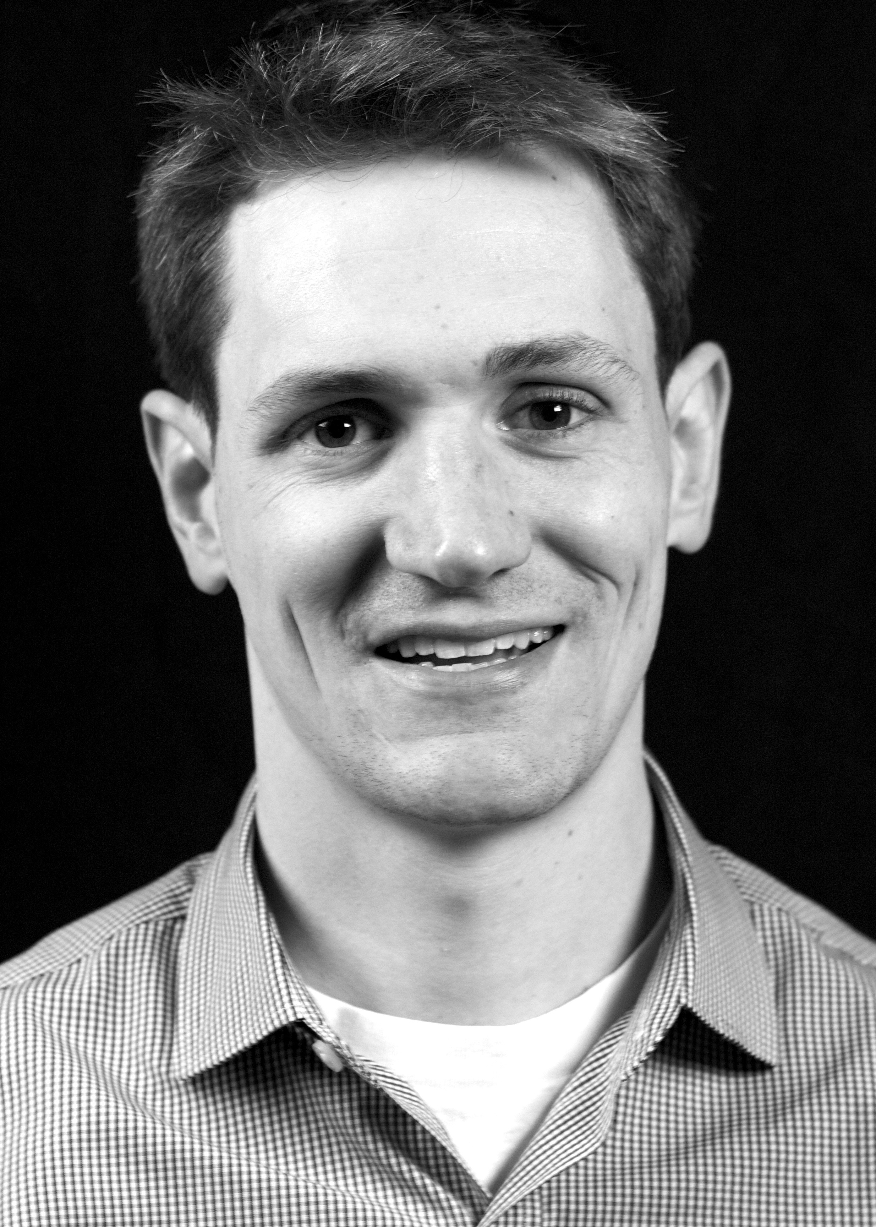
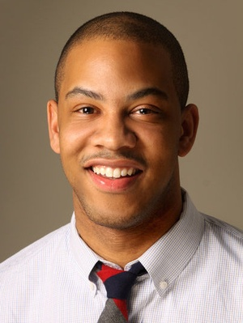
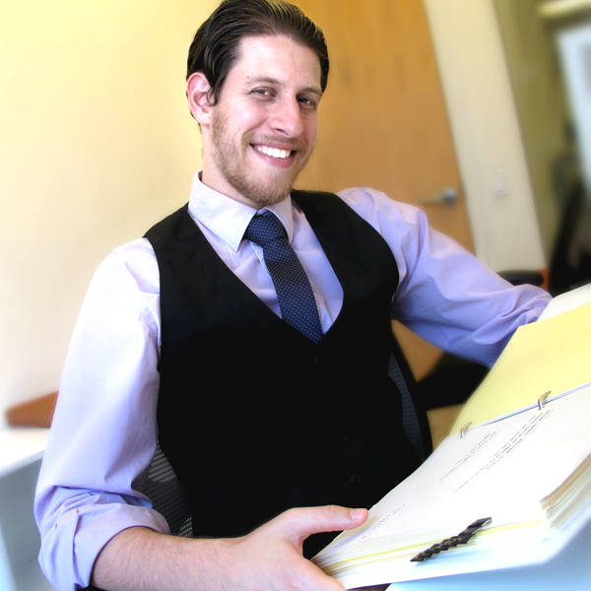
Thanks to Guest Speakers
Notes:
Another part of NNIP’s value is bringing outside expertise to the network.
This afternoon – lucky to hear about the great work in Homewood: Dr Wallace and Teixeira from University of Pittsburgh & WV and Operation Better Block
Joe (alumni) will be presenting tomorrow on IDS – Vickie Boothe from CDC, Mallory O’Brien from DataShare in Milwaukee
And be sure to thank your tour guides for tonight

Slide 8
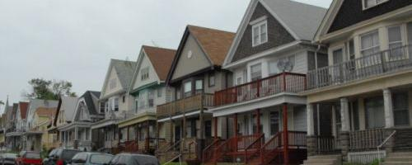
Welcome Milwaukee!
Notes:
Katie and Salma

Slide 9
Welcome Guest Cities!
Chicago, IL
Durham, NC
Houston, TX
Los Angeles, CA
Newark, NJ
Salt Lake City, UT
Notes:
Part of the network’s mission is to foster NNIP capacities in new cities – welcome them – answer questions - ask about their work….

Slide 10
Welcome National Organizations!
Ash Center at Harvard Kennedy School
Code for America
Data Quality Campaign
Federal Reserve Banks of Richmond and Dallas
Living Cities
Notes:
Finally, welcome to friends from national organizations
One of the pieces of the work plan I’ll talk about tomorrow is being smarter about how we connect with national groups.
- connect with them at meals and reception
- some helped out at presession yesterday
Several chances to exchange ideas with them through panels and Camp sessions.

Slide 11
Introductions
Notes:
Move to introductions – keep it short
Name, org, and favorite indicator or data set

Slide 12
Agenda Review
Leah Hendey

Slide 13
NNIPCamp Dallas
Rob Pitingolo and Maia Woluchem

Slide 14
What is an unconference?
Informal gathering of collaborators
Participants set the agenda
Focused on discussion
Notes:
Go over schedule/timing
Rules are posted everywhere…
UNCONFERENCE 101 – Sunlight Foundation
https://www.youtube.com/watch?v=iUEt0xOysr4

Slide 15
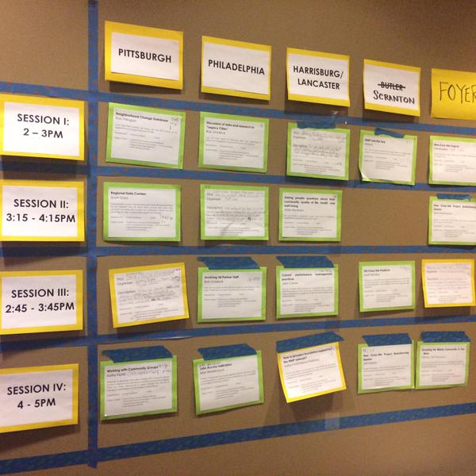
Together we build the wall
Submit an idea
Vote on your favorites
Volunteer to lead if necessary
During lunch – we’ll build our wall
Check the app and #nnip for your favorites

Slide 16
NNIPCamp Rules
Set your own agenda.
Introduce yourself.
Assign a note-taker.
Avoid planned speeches & PPTs.
Contribute & allow other to contribute.
Tweet!
COME AND GO AS YOU PLEASE.
Notes:
Go over schedule/timing
Rules are posted everywhere…
UNCONFERENCE 101 – Sunlight Foundation
https://www.youtube.com/watch?v=iUEt0xOysr4

Slide 17
Most Importantly
Be creative
Hallway conversations count
Have fun!

Slide 18
Welcome to the #NNIP Dallas Meeting!
October 21, 2015

