Slide 1
Indianapolis Neighborhoods
4 Neighborhood Histories in Five Minutes

Slide 2
Indianapolis
1830 to Present

Slide 3
Origin Story
Founded in 1820 as state capitol
Hub for agriculture, manufacturing, and transportation
Unigov merged city and county in 1970s

Slide 5
People
Unigov
Continuous growth, thanks to city-county merger

Slide 6
People - Age
Tons of kids
Age curve evening out

Slide 7
People - Race
Grown much more diverse

Slide 8
People - Immigrants
Foreign-born share is small but growing fast

Slide 9
Downtown
1940 to Present

Slide 10
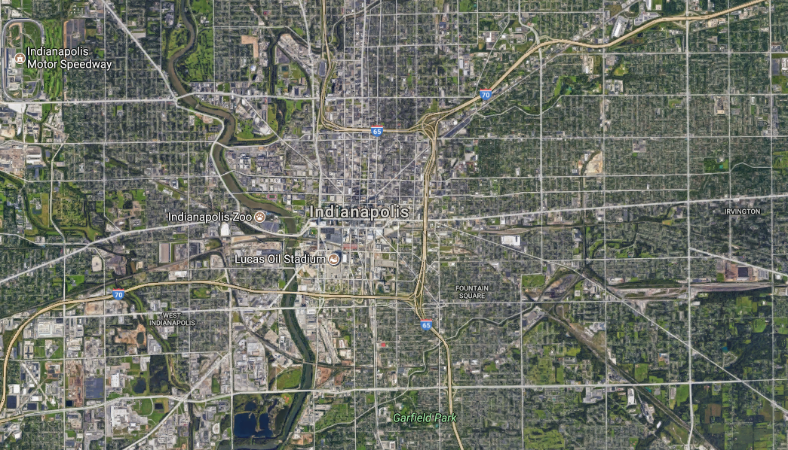

Slide 11
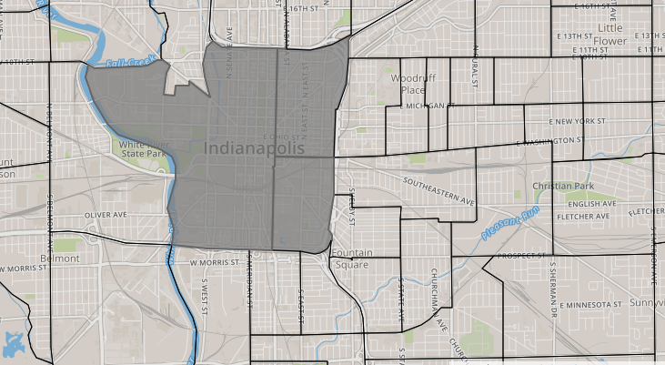

Slide 12
People
Huge decline, but 60% growth since 1990

Slide 13
People - Age
At first, even distribution
Less old, more young
Look at all those millennials

Slide 14
People - Race

Slide 15
Non-Data Perspective
New apartments, high rents
Places I might take my wife on a date
Stunning public spaces
Megablocks, 90s redevelopment

Slide 16
Fountain Square
1940 to Present

Slide 18
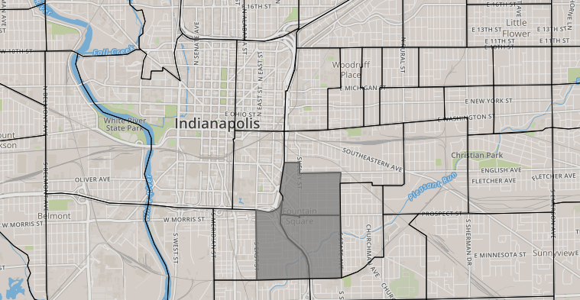

Slide 19
Origin Story
Streetcar turnaround built 1864
Settled by mostly Germans, also Italians, Irish, Danes
Post WWII decline
Interstate construction in 1960s

Slide 20
People
Constant decline, despite revitalization

Slide 21
People - Age
Concentration of millennials
Growing older
Concentration of kids

Slide 22
People - Race
Has stayed fairly white

Slide 23
Non-Data Perspective
Hipster shows
The bars I leave my neighborhood for
Art in the Murray Building

Slide 24
Cottage Home & Holy Cross
1940 to Present

Slide 26
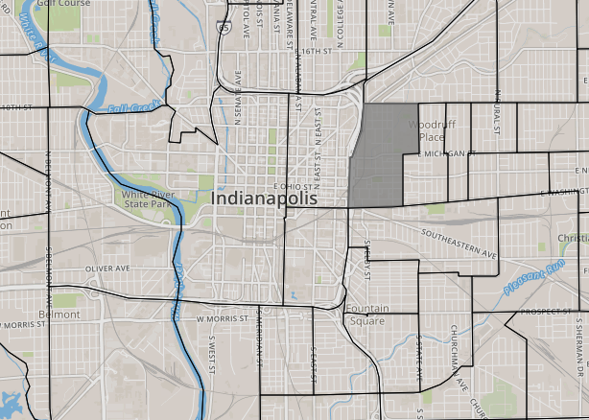

Slide 27
Origin Story
Cottage Home
Settled 1870-1892 by many German-Americans
Holy Cross
Irish Catholics settled area in 1880s
Decline after WWII, interstate built in 1970s

Slide 28
People
75% decline since 1940

Slide 29
People - Age
Now more college age/middle-aged
Concentration of kids
Then millennials

Slide 30
People - Race
More diverse, but growing whiter

Slide 31
Non-Data Perspective
Nice antiques
Great dive bar
Pretty good beer
Real fancy meat

Slide 32
Englewood
1940 to Present

Slide 34
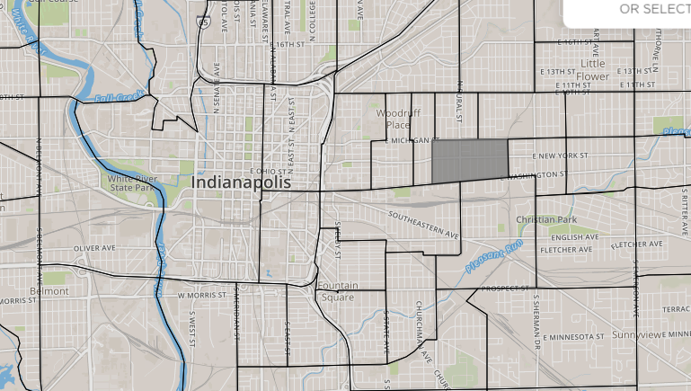

Slide 35
People

Slide 36
People - Age
But now kids are rebounding
Kids galore
Millennial share peaks in 1990

Slide 37
People - Race
Changed later than other neighborhoods

Slide 38
People - Immigrants
1970: 1-in-50 foreign-born
2010: 1-in-5 foreign-born

Slide 39
Non-Data Perspective
Christian community development
Tamales!
Best bourbon selection
Grass-roots redevelopment

