Slide 1
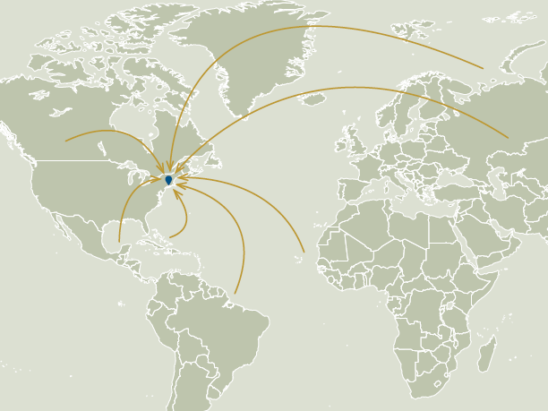
Welcome Home:
Immigrants in Greater New Haven
DATAHAVEN
Mary Buchanan, Project Manager
Notes:
Hi, I’m Mary and I’m going to talk about foreign-born people and the impact immigration has in New Haven and Connecticut.
We’re a region that since its founding in the 1600s has depended on immigration to stimulate growth and traditions.
We’ll look specifically at how recent immigrants have changed the area’s social, economic, and demographic structures.

Slide 2

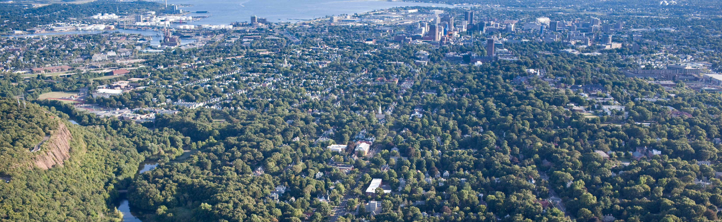
Regional Population Growth, 2000 to 2012
SOURCE: DataHaven analysis of 2008-2012 Census data available at census.gov
New Haven, American Society of Landscape Architects
Notes:
This community, since its founding, owes much of its development and traditions to immigrants:
in the 18^{h} century - the Brits;
The 19th century – the Irish,
the 20th century – the Italians and Southern Europeans;
now – a diverse group of immigrants from all corners of the world make their homes in Greater New Haven.
And they all have a lot to contribute.
In the past decade, Greater New Haven was one of the fastest-growing regions in the state.
The foreign-born population steadily rose.
Even while the native-born population hardly grew.
75 percent of the population growth in Greater New Haven was due to foreign-born residents
100 percent of growth in New Haven was due to immigrants over this period

Slide 3

74,670 Immigrants in Greater New Haven in 2012
Green Card Holder
Visa Holder
Refugee
Asylee
SOURCE: DataHaven analysis of 2008-2012 Census data available at census.gov and Center for Applied Research in Apostolate 2013 data available at cliniclegal.org
Fair Haven Day of the Dead Parade, Chris Randall
Notes:
So who are we talking about?
An immigrant to the US is anyone who lives here, who was not born an American citizen.
There are many ways to categorize immigrants: permanent /temporary, citizen/non-citizen, documented /undocumented, naturalized citizen, green card holders, visa holders, undocumented immigrants, and refugees or asylees.
In Greater New Haven there are nearly 75,000 immigrant residents.
About 50 percent are naturalized US citizens
About 30 percent are not citizens but have authorization to live in the country
About 20 percent are undocumented immigrants

Slide 4
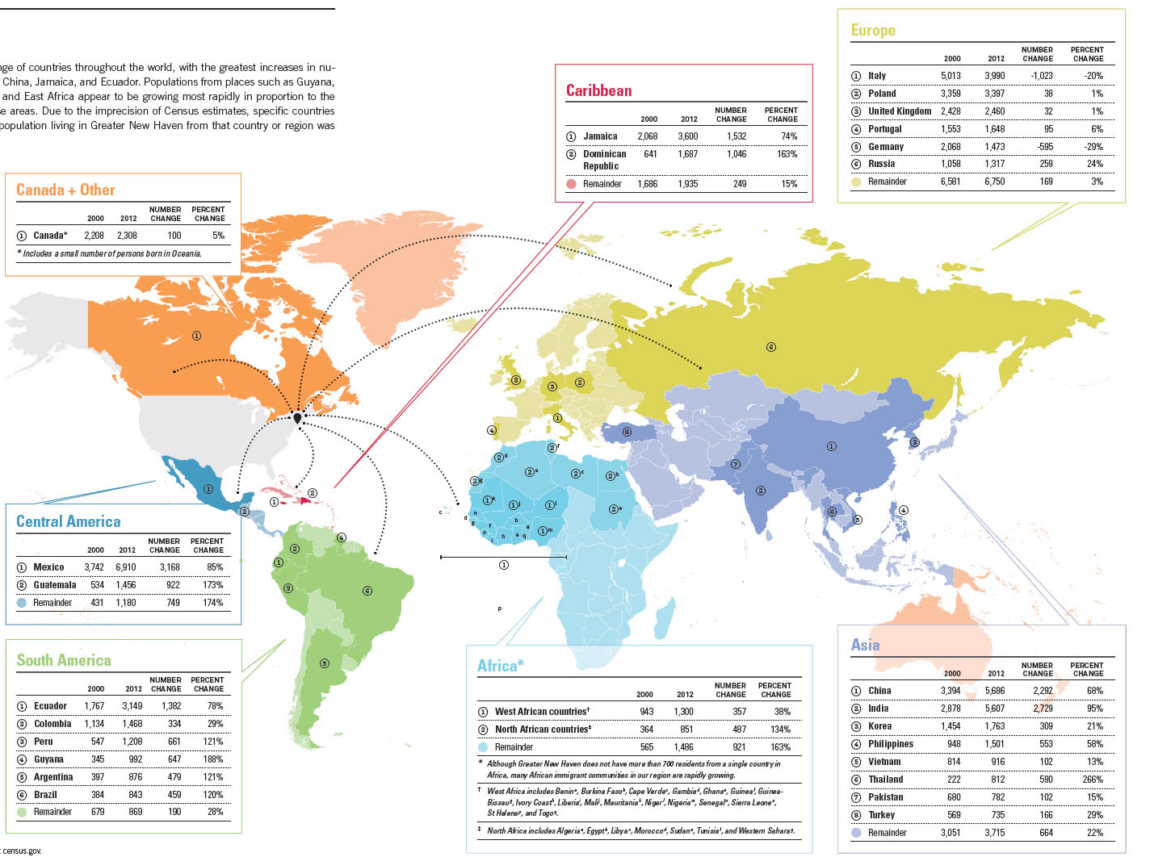
Origins and characteristics of Greater New Haven immigrants
SOURCE: DataHaven analysis of 2008-2012 Census data available at census.gov
Notes:
Immigrants to Greater New Haven were born around the world.
Mexico, China, India, Italy, Jamaica, and Ecuador are the most represented
Thailand, Dominican Republic, Guyana, and Guatemala have experienced the most growth
Compared to native residents,
more immigrants identify as racial or ethnic minorities
they have larger families
more immigrants do not have a high school education
AND more have at least a bachelors degree

Slide 5

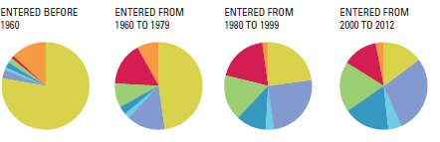
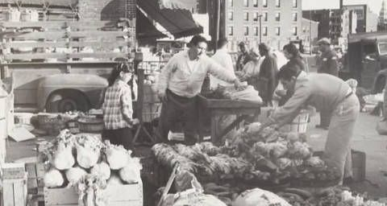
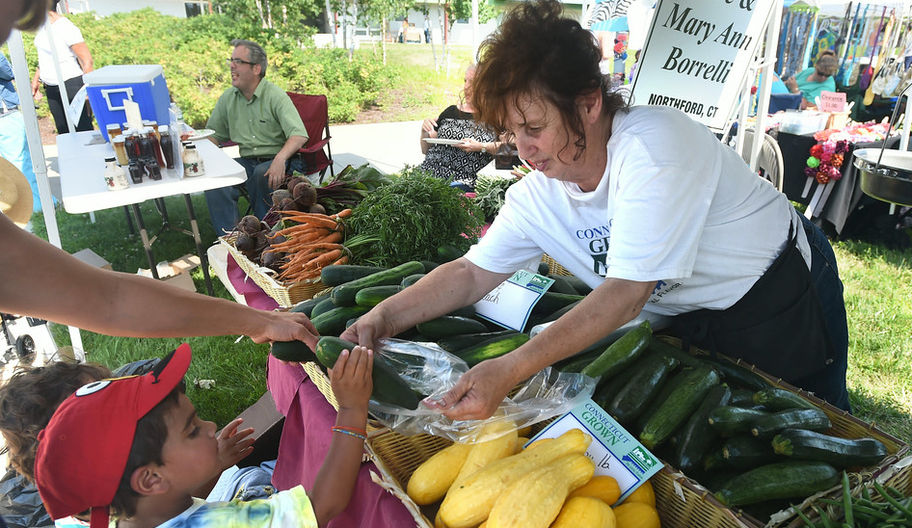
Connecticut Immigrants by Origin & Period of Arrival
SOURCE: DataHaven analysis of 2008-2012 Census PUMS, available at census.gov
Church Street South Market, New Haven Museum and Historical Society
New Haven Farmers Market, New Haven Register
Notes:
Immigration to Connecticut has changed in the past half century
Of immigrants who came to the US before 1960, more than three quarters were European.
Between 1960 and 1979, about half were from Europe and half were from other regions.
Compared to the period 2000 to 2012: No majority, the largest share of immigrants came from Asia.

Slide 6
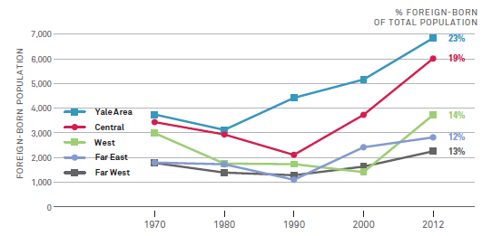
New Haven Foreign-born Population by Neighborhood, 1970 to 2012
SOURCE: DataHaven analysis of 1970-2012 Tract-level Census data provided by Neighborhood Change Database and census.gov
Notes:
Immigrants invest in this community in many ways…
They’ve moved into urban areas that had been in decline since the mid-twentieth century…
Over the past few decades these neighborhoods have experienced renaissances, like Fair Haven in New Haven
Also, by owning homes.
In New Haven, naturalized citizens are more likely than native-born people to be homeowners

Slide 7
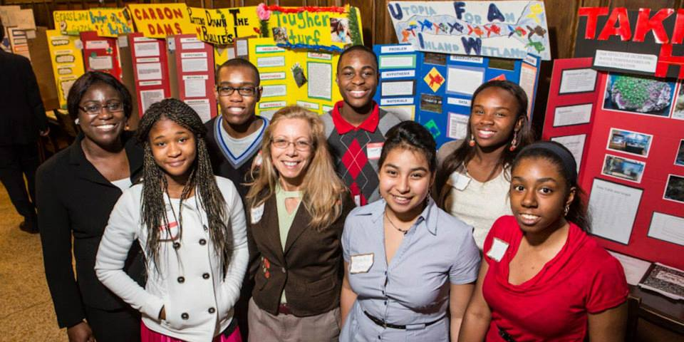

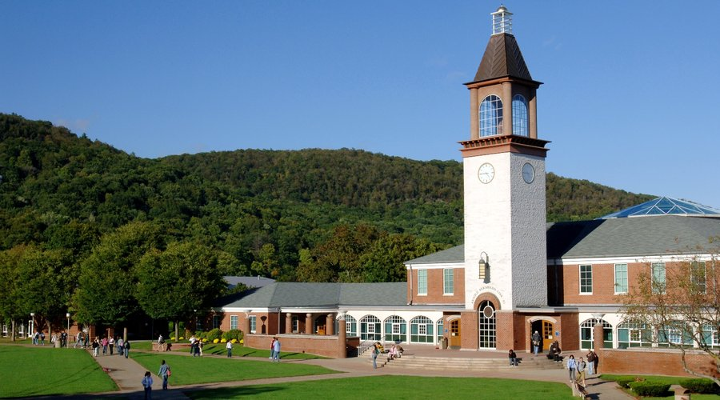
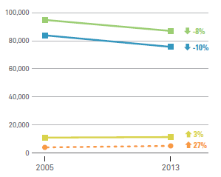
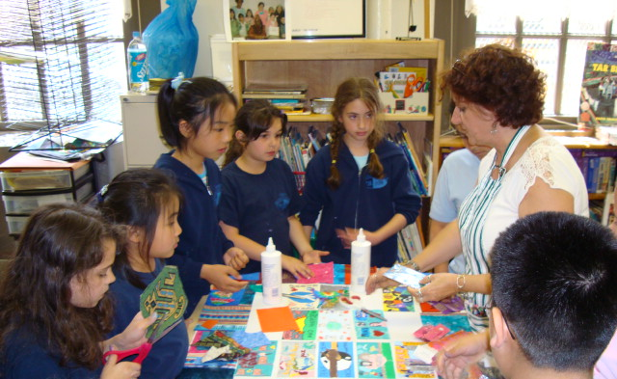
Greater New Haven Students:
Primary Language & English Language Learners 2005 to 2013
Hillhouse students at science fair, Chris Volpe
Quinnipiac University campus, Hamden Times
SOURCE: DataHaven analysis of 2005-2013 Connecticut State Department of Education data
John S. Martinez students, Inter Relations
Notes:
Immigrants and their children enroll in our schools
Overall public school enrollment decreased from 2005 to 2013
BUT among students who speak a foreign language at home, enrollment grew
In 2013, students spoke over 100 languages natively
And there were 3,800 international students at local universities

Slide 8
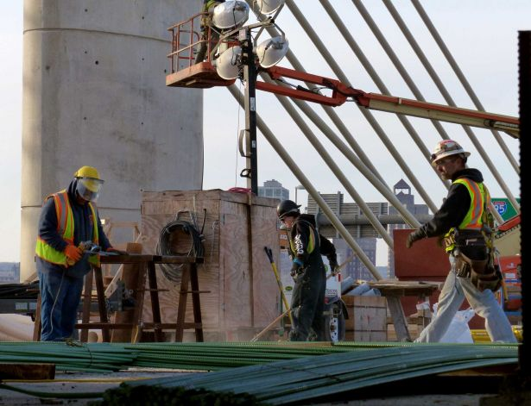
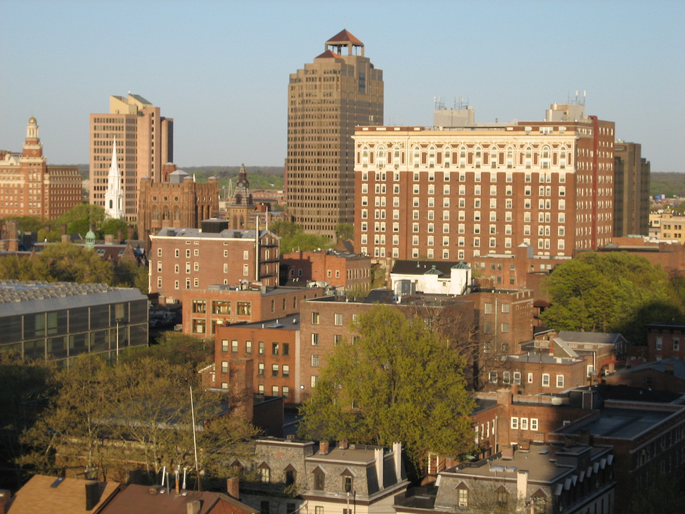
Ratio of High and Low-Skilled Immigrant Workers, 2012
Construction in New Haven, CT Post
SOURCE: DataHaven analysis of 2008-2012 Census data available at census.gov using Brookings Institute Methodology
Downtown New Haven, Flickr
Notes:
Immigrants contribute vitally to the economy
They are more likely than native-born residents to be employed
AND they are also more likely to be in the labor force
The region’s immigrant labor force is highly educated
There are about two high skilled workers for every one low skilled worker
And nationally the ratio is one to one
Technical, health, financial, and academic are high-skilled work
Construction, manufacturing, agriculture, and service are low-skilled jobs
and all work supports the local economy

Slide 9
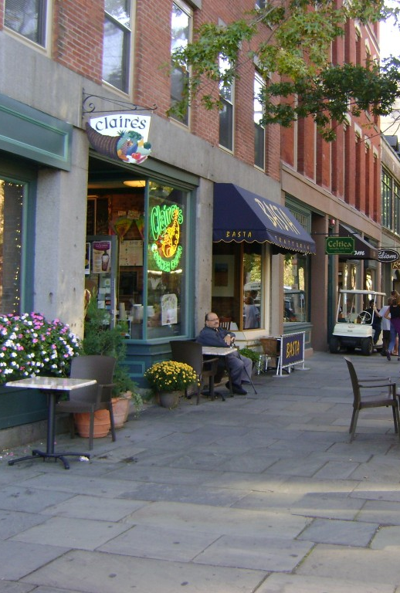
Taxes Paid (in millions),
Connecticut Immigrants, 2012
SOURCE: DataHaven analysis of 2008-2012 Census PUMS available at census.gov
Chapel Street Shops, Out and About Mom Blog
Notes:
Besides working, immigrants
Support local business, buying goods and services
Link our economy to foreign economies
Contribute to the health care system
And pay taxes: income, property, and sales…
In Connecticut in 2012, they paid over $2.2 billion in federal and state income tax and property tax alone

Slide 10
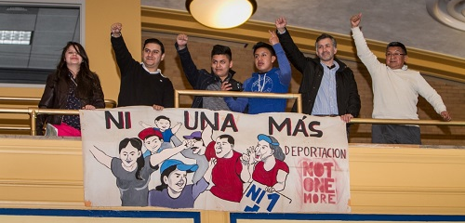
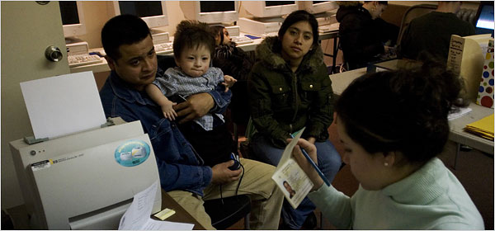
Economic Contributions of Undocumented Immigrants
Ni Una Mas Banner, CT Latino News
Paying taxes, New York Times
Notes:
All immigrants contribute in these ways
Undocumented immigrants pay sales and property tax, too.
Most undocumented adults are employed
And at least half of workers pay income tax, despite legal status
Connecticut’s tax revenue would increase by about $28 million per year if undocumented workers could work legally

Slide 11
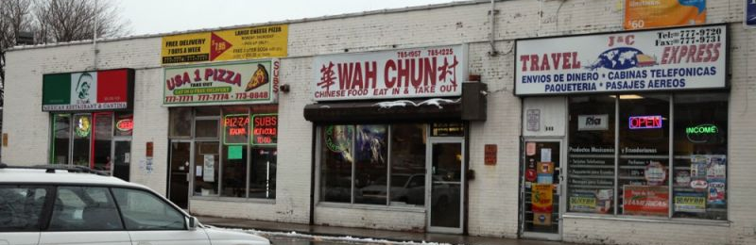
23,400 Immigrant-owned
Businesses, in Connecticut in 2007
22,050
Small businesses
47,000
Employees
$1.7 billion
In paid salaries
SOURCE: DataHaven analysis of Census 2007 Survey of Business Owners PUMS available at census.gov
Grand Avenue New Haven, Next City
Notes:
Immigrants are more likely to own businesses than native-born people
In 2007 in Connecticut there were over 23,000 businesses owned by immigrants
They employed 47,000 people
They paid over 1.7 billion dollars in wages
They earned almost $17 billion dollars in annual receipts

Slide 12
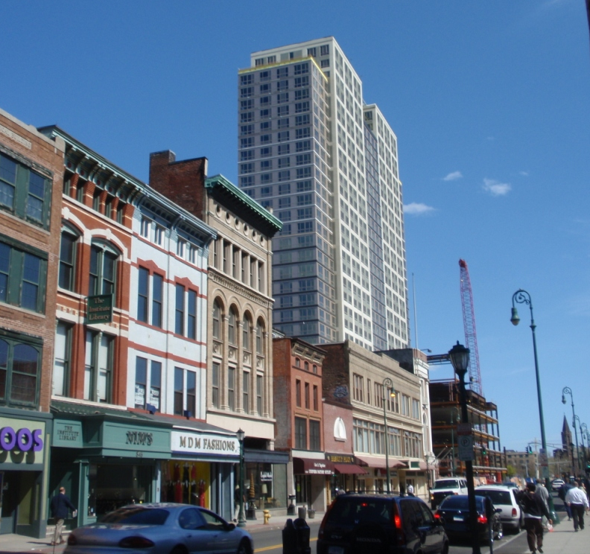
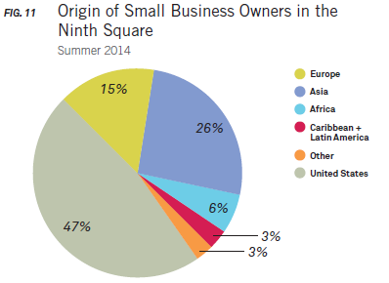
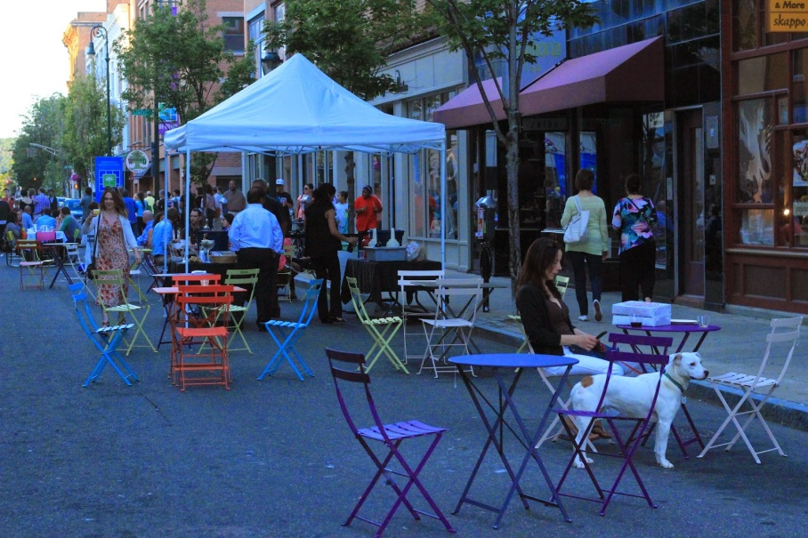
Origin of Small Business Owners,
New Haven’s Ninth Square, Summer 2014
Ninth Square Chapel Street, City of New Haven
SOURCE: Summer 2014 DataHaven analysis of Ninth Square businesses
Ninth Square Orange Street, Yancey Hitt
Notes:
And, immigrant business owners are also more likely to own small businesses, to open new business, and to employ others at the business
In New Haven’s 9th Square, over half of business owners are immigrants or immigrants’ children
Operating a variety, including restaurants, clothing and beauty shops, art studios, and general retail

Slide 13
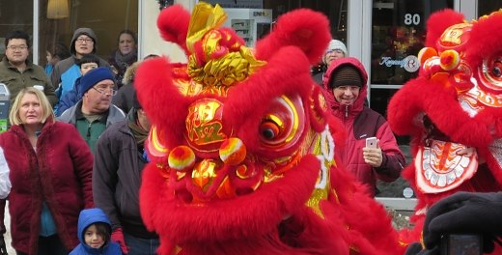

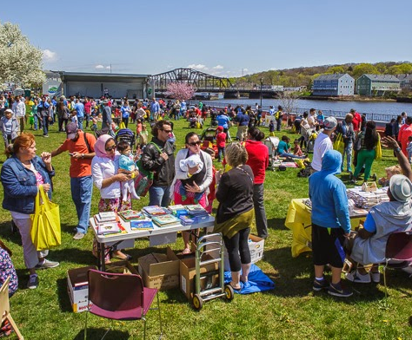
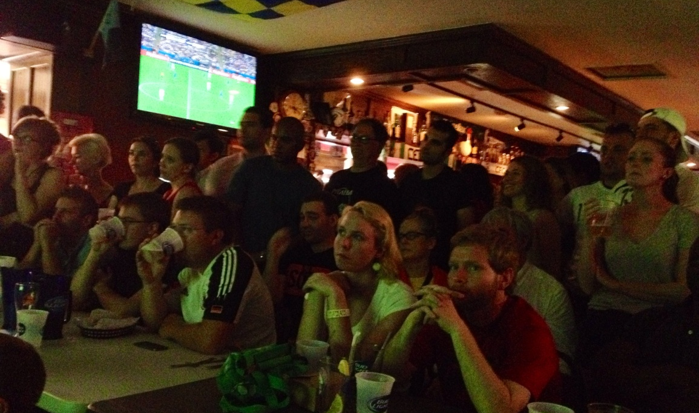
New Haven Lunar New Year Parade, New Haven Independent
Festival of Arts & Ideas, Community Foundation for Greater New Haven
Fair Haven, Ian Christman
World Cup Finale at Pitkin Plaza, Mary Buchanan
Notes:
According to a survey of Greater New Haven residents, our community widely agrees that foreign-born people contribute in other ways, too…
Three quarters thought that diversity due to immigration enriches the culture
84 percent thought that immigrants contribute to innovations in technology, businesses, health, science, and art

Slide 14
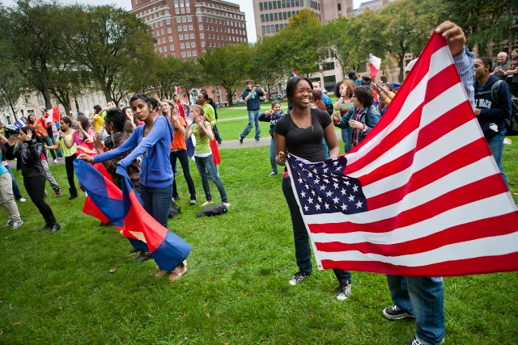
Students from the Cooperative International Studies Program, Elm City Express
Notes:
Immigrants join our neighborhoods and schools, open businesses, work at our companies, and enrich our culture
They are diverse in every way – from origin and age to personal experience.
The surge of immigration recently shows us yet again how important immigration is to our growth and success as a region in Greater New Haven.

Slide 15
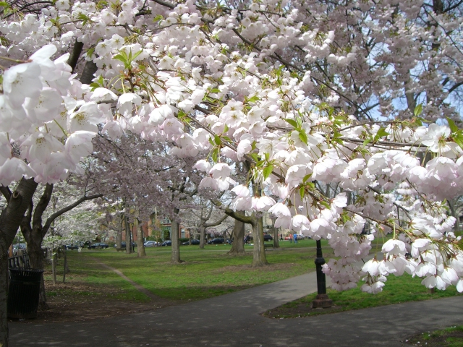
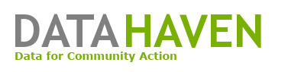
Visit our website at ctdatahaven.org
Wooster Square cherry blossoms, Yale University
Notes:
DataHaven wrote this report for the Community Foundation of Greater New Haven
We makes data more useful for communities in Greater New Haven and Connecticut
Recent projects include reports on regional transportation and job access; and on aging
The 2015 Community Wellbeing Survey will interview 15,000 people across the state and will collect quality of life data

