Slide 1

Rebound Neighborhoods in St. Louis: Causes and Consequences
Todd Swanstrom, University of Missouri-St. Louis
Hank Webber, Washington University in St. Louis
With the assistance of
Laura Jenks, Dean Obermark, Leslie Duling & Derrick Redhead
National Neighborhood Indicators Partnership Meeting
St. Louis, Missouri
April 2-4, 2014

Slide 2
Research Focus: Dynamics of Neighborhood Change
Two primary questions:
Why do some neighborhoods rebound in the wake of urban decline while others continue to decline or stagnate?
Do rebound neighborhoods in St. Louis fit the pattern of gentrification or do they vary in significant ways both in the path to revitalization and the impact on previous residents of the neighborhood and surrounding areas?

Slide 3
Plan for Today
Quantitative analysis identifying rebound neighborhoods and some of their effects (Todd)
Case studies of the drivers of neighborhood revitalization with a focus on one neighborhood, the Central West End (Hank)

Slide 4
St. Louis: A Slow-Growth Region

Slide 5

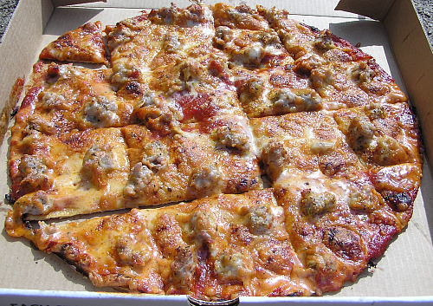
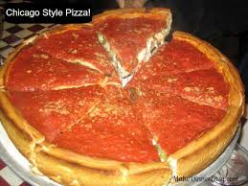
St. Louis: A Thinning Out Region

Slide 6
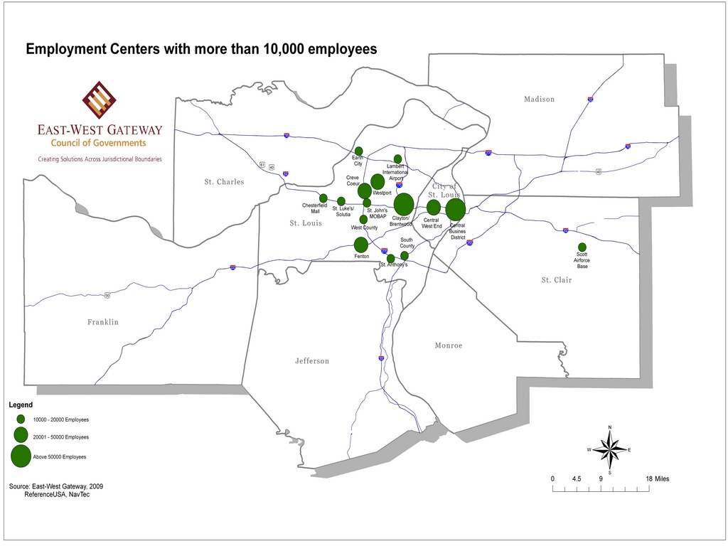
Decentralized Job Clusters

Slide 7
Overbuilt Housing

Slide 8
Study Area
218 census tracts in “urbanized area” of St. Louis as defined by the U.S. Census Bureau in 1950
Total population of study area in 1970: 1.3 million
Notes:
The urbanized area generally consists of contiguous territory that is part of a metropolitan area of at least 50,000 people that has a density of at least 1,000 persons per square mile. We only included census tracts that were wholly within the urbanized area as of 1950; small parts of the urbanized area in 1950, therefore, are not included in our data set

Slide 9
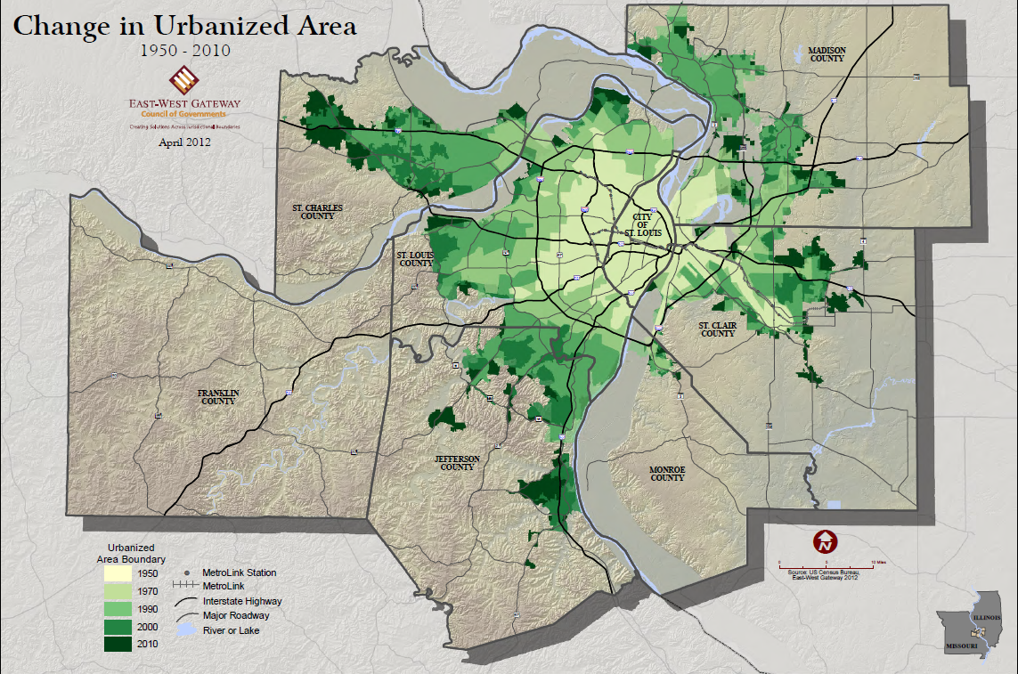
Regional Sprawl

Slide 10
Population Decentralization

Slide 11
Falling Occupancy Rates, Especially in Older Areas

Slide 12
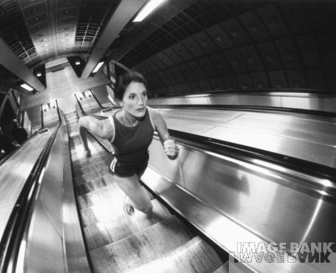
Older Neighborhoods – Running Up the Down Escalator

Slide 13
Neighborhood Vitality Index (NVI)
Three variables:
Economic (Per Capita Income)
Social (Poverty Rate)
3. Physical (Vacancy Rate)
NVI measures the performance of each census tract relative to the mean for the study area in each decade.
Notes:
For each variable, a standardized score (Z) is computed by subtracting the variable’s mean value (x̄) from the variable’s observed value (x) and dividing by the standard deviation (s). Z=(x-x̄)/s
The resulting standardized scores are then summed, so that for every tract:
NVI= Zi+Zp+Zo

Slide 14
Neighborhood Vitality Index Tract Rankings by Decade, 1970-2010

Slide 15
Identifying Rebound Neighborhoods
Basic idea: neighborhoods that bounced back from decline (U-shaped)
We define a “rebound tract” as any census tract that moved up at least 10 percentile points in the rankings from 1990-2000 or 2000-2010
Eliminated tracts that were never in the bottom half of the distribution at some point between 1970 and 2000
Of the 218 tracts in our study area, 38 (17%) are rebound tracts

Slide 16
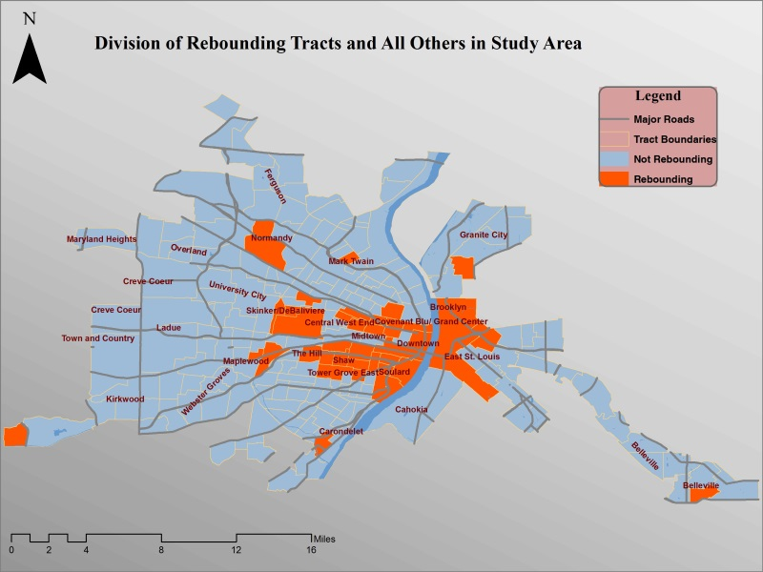

Slide 17
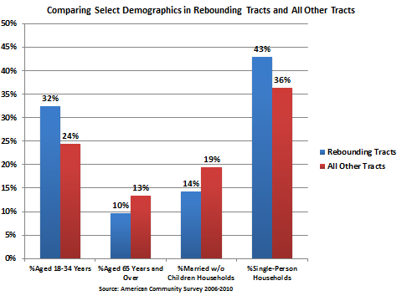
Rebound Census Tracts Fit the Demographic Profile of Gentrifying Neighborhoods

Slide 18
Surprising Finding
  In contrast to conventional wisdom on gentrifying neighborhoods, rebounding tracts, overall, had significantly higher levels of racial/ethnic and economic diversity than non-rebounding tracts.

Slide 19
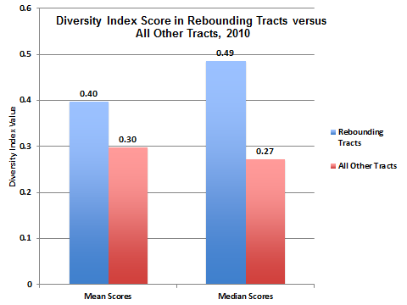
Racial/Ethnic Diversity
Diversity Index = 1 - %white² + %black² + %Hispanic² + %other²

Slide 20
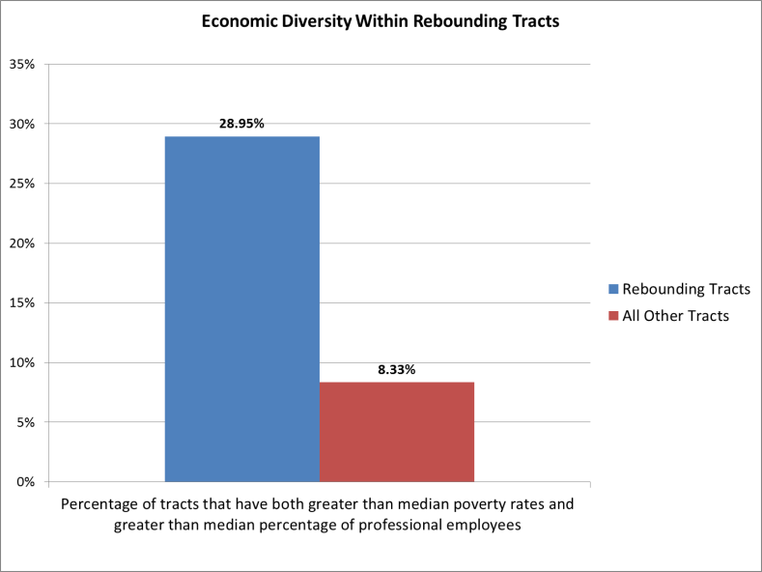
Economic Diversity

Slide 21
What Are the Drivers of Rebound Neighborhoods?
Economic Theory
Sociological Theory
Political/Institutional Theory

Slide 22
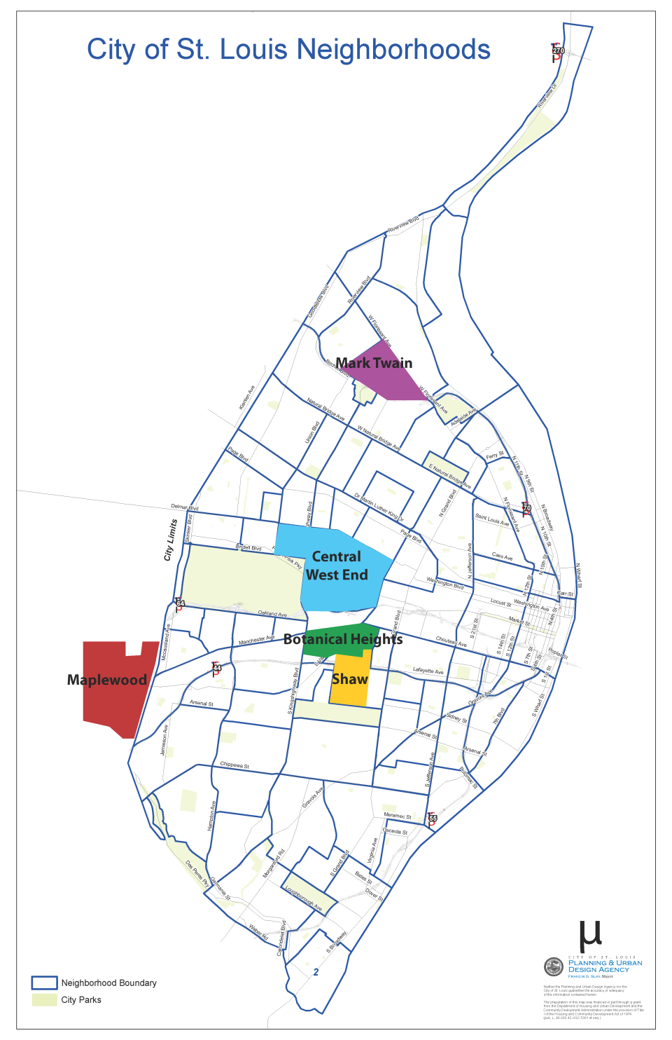
Five Case Studies: Exploring the Drivers of Success

Slide 23
Performance of Case Study Neighborhoods

Slide 24
Racial Diversity of Case Study Neighborhoods

Slide 25
Case Studies: Key Success Factors
Success Factor | Central West End | Botanical Heights | Shaw | Mark Twain | Maplewood
Strong Anchor Institutions | X | X | X | X
Excellent Housing Stock | X
Thoughtful Commercial Development | X |  |  |  | X
Thoughtful Residential Development | X | X |  | X
Resident Civic Engagement | X | X | X | X | X
Good Location | X | X | X |  | X
Successful Public Policy | X |  |  |  | X
Strong Public Schools |  |  |  |  | X

Slide 26
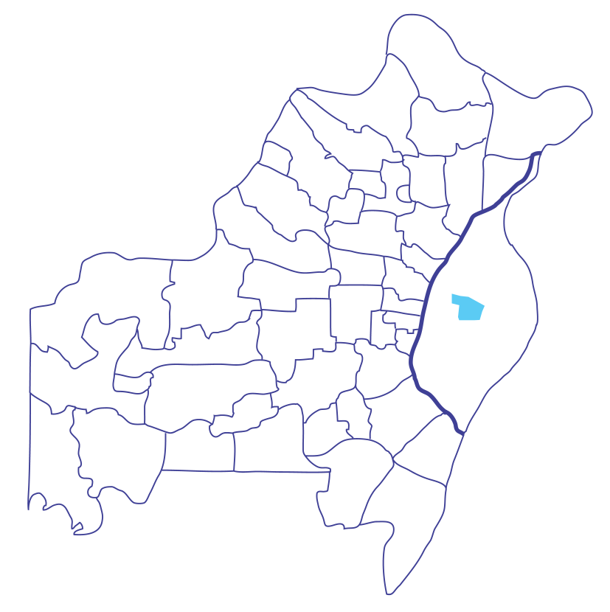
Central West End – Location
St. Louis City, County, and Region

Slide 27
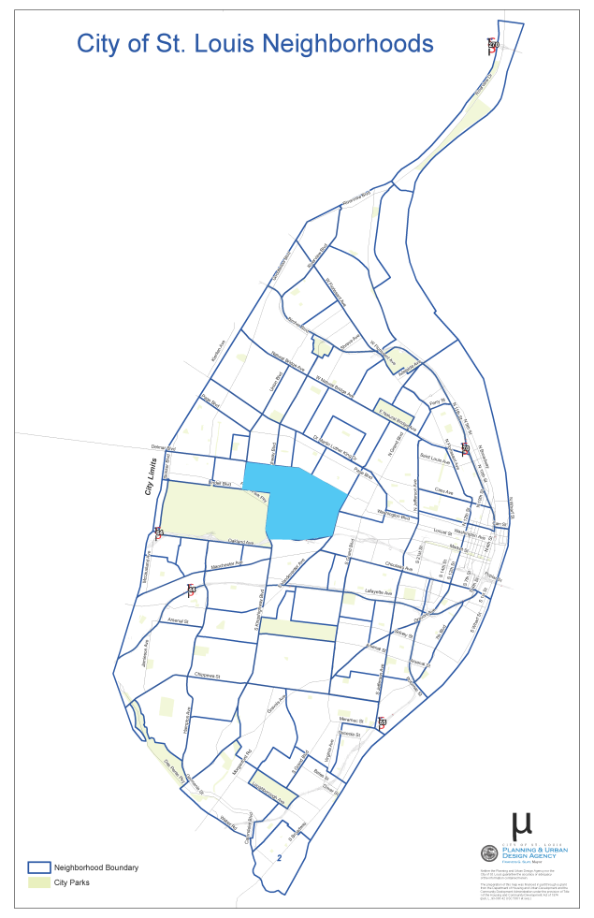
Central West End – Location

Slide 28
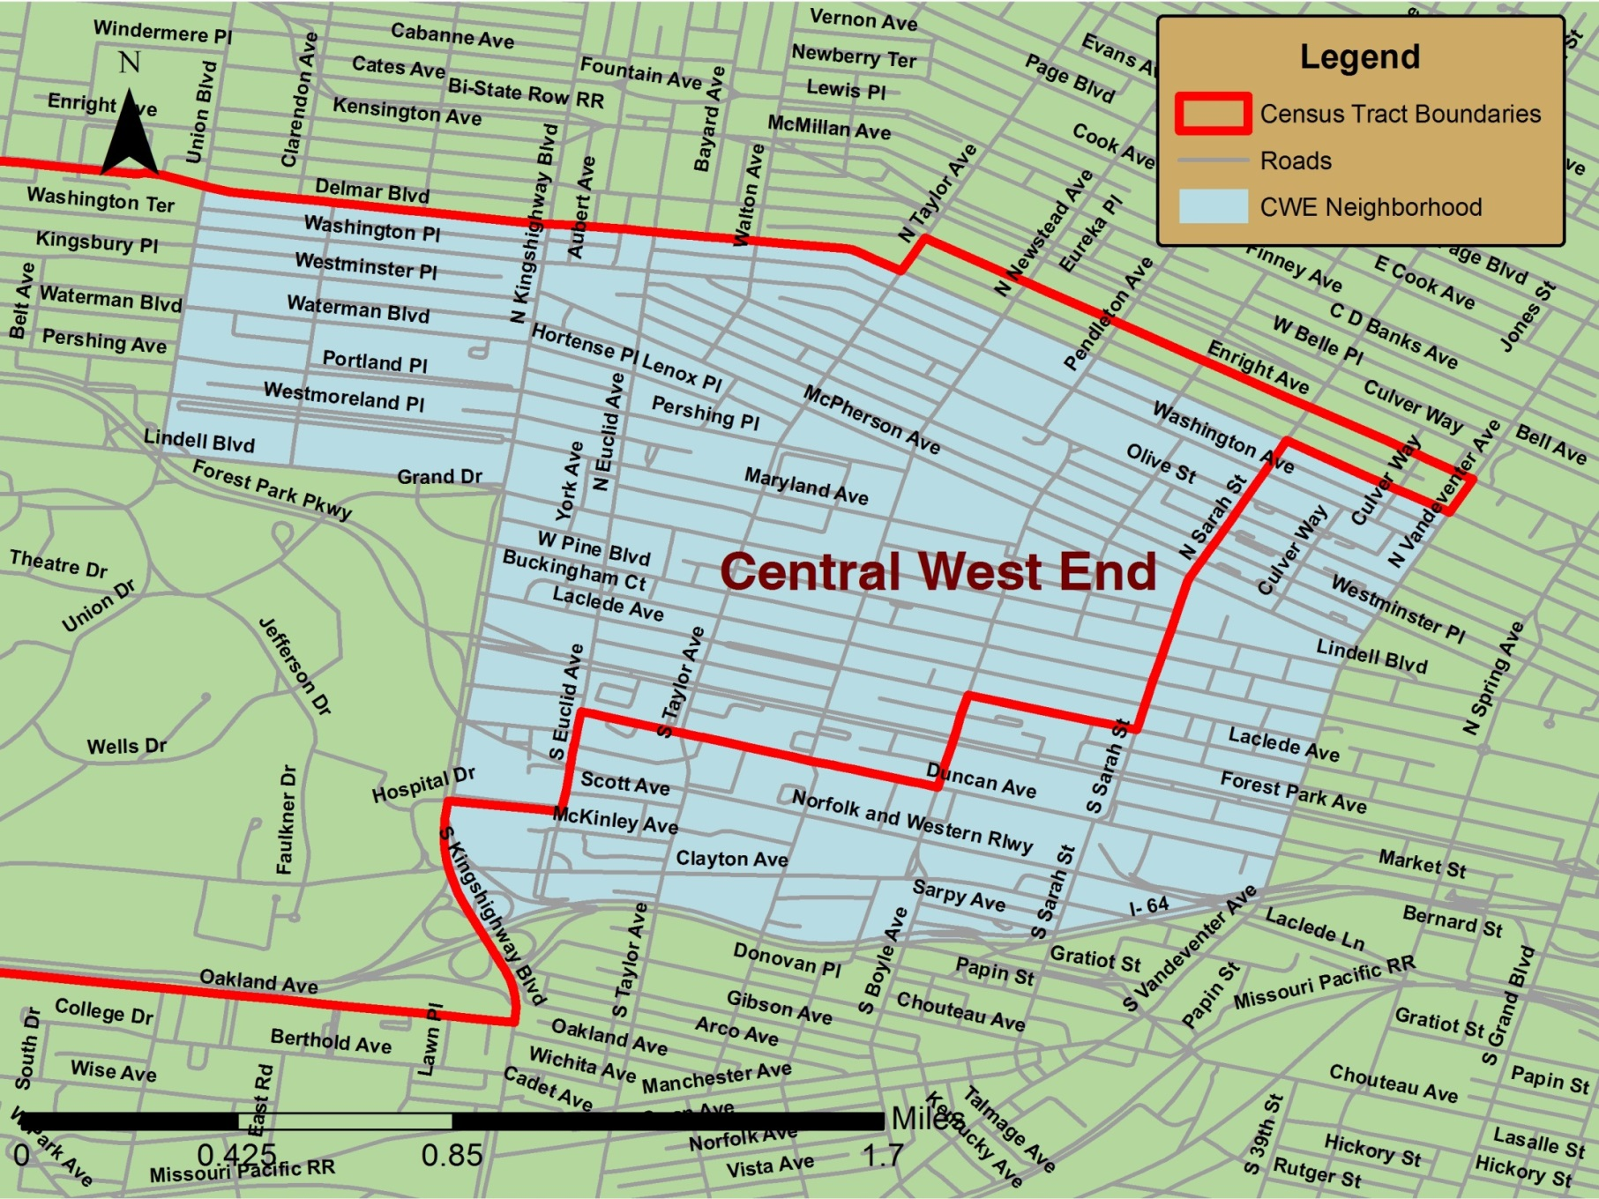
Central West End – Borders

Slide 29
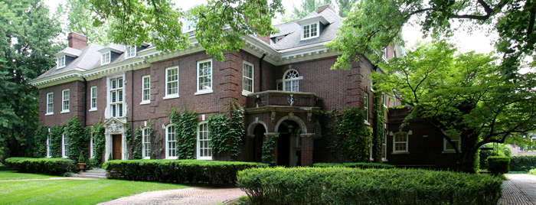
Central West End – Housing

Slide 30
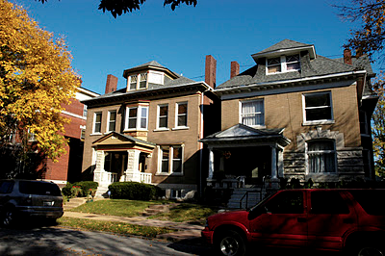
Central West End – Housing

Slide 31
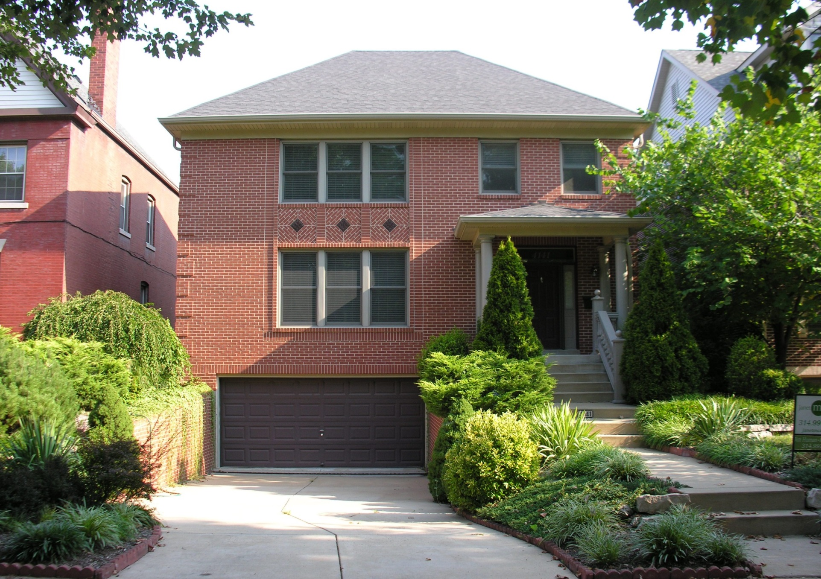
Central West End – Housing

Slide 32
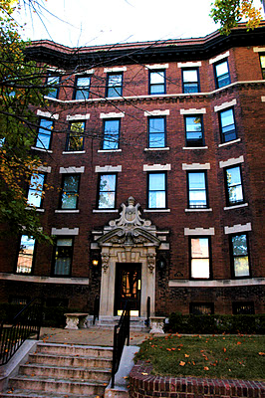
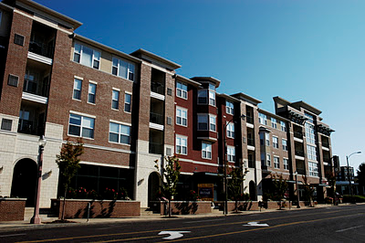
Central West End – Apartments

Slide 33
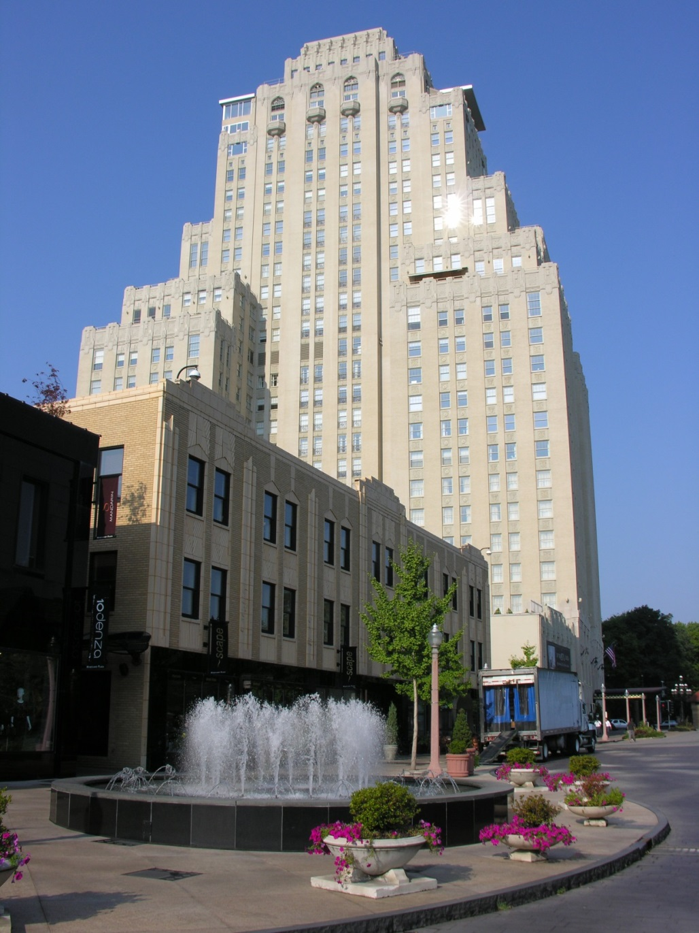
Central West End – Chase Park Plaza

Slide 34
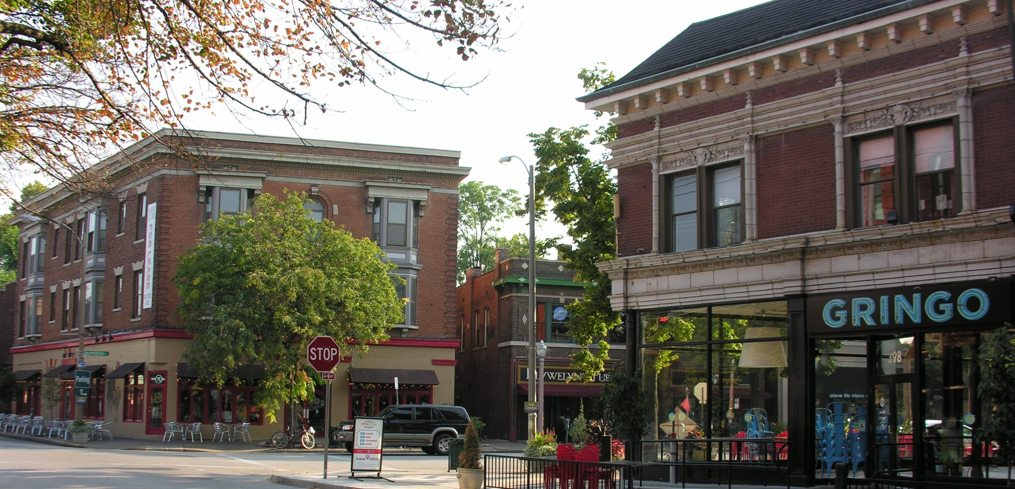
Central West End – Euclid Avenue

Slide 35
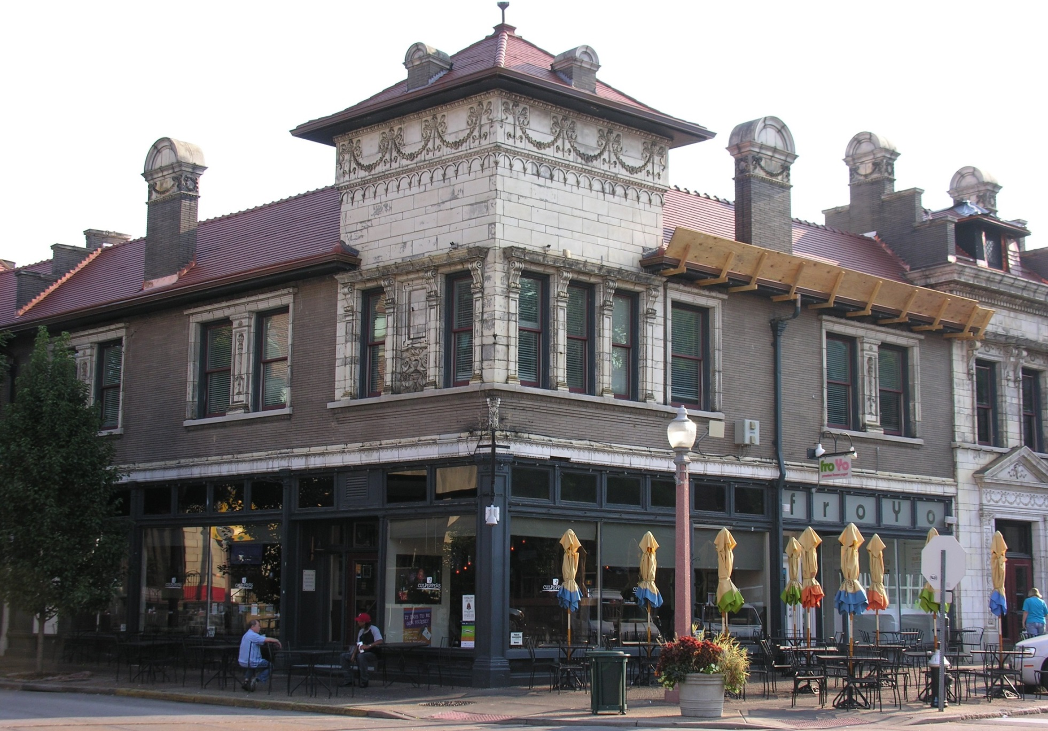
Central West End – Euclid Avenue

Slide 36
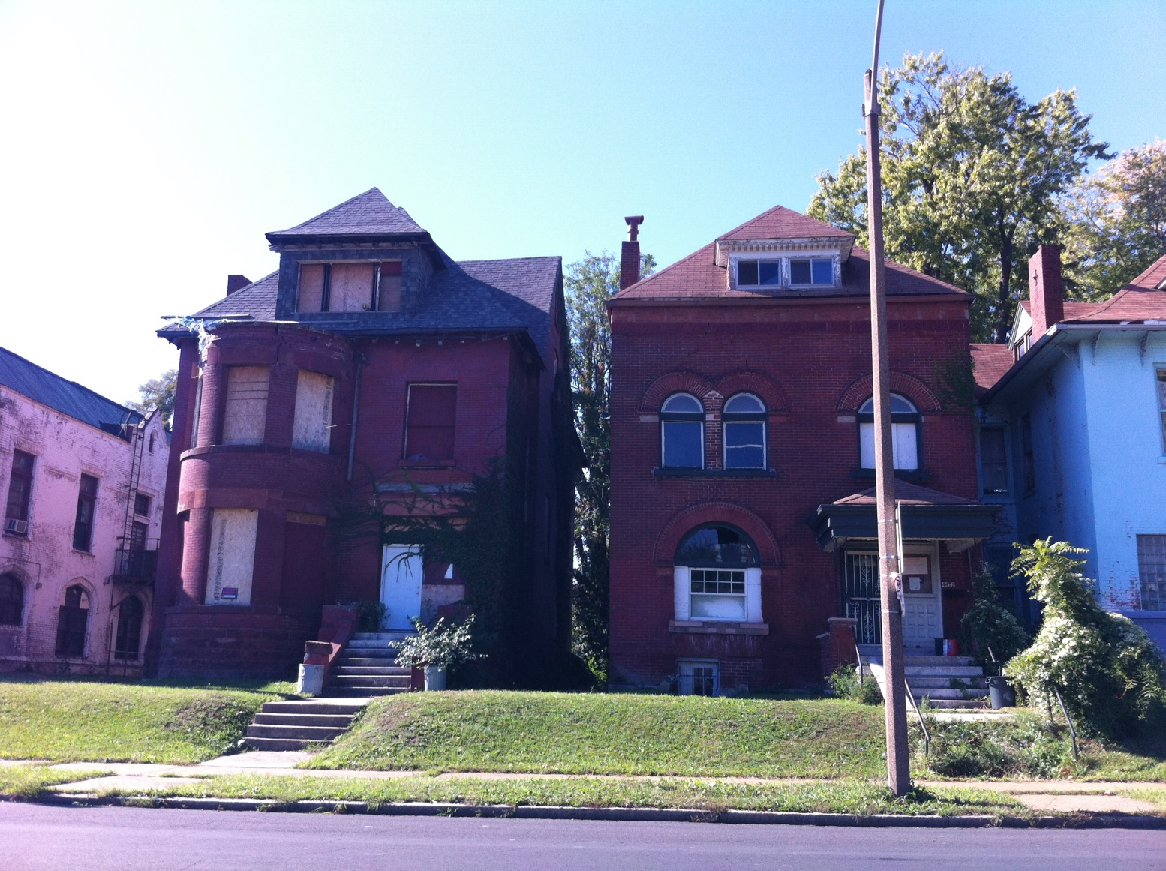
Central West End – Weak Housing

Slide 37
Central West End – 1970-2010
 | 1970 | 1990 | 2010
Population | 25,859 | 17,282 | 15,589
Poverty Rate | 24% | 22% | 24%
Per Capita Income* | $23,078 | $38,690 | $43,406
Occupancy | 85% | 86% | 86%
% Under 18 | 20% | 10% | 7%
% 18-34 | 28% | 35% | 44%
% White | 54% | 59% | 58%
Index Score | 100.84 | 164.15 | 192.12
*in 2012 dollars

Slide 38
Central West End – The 1970s
Assets
  Excellent housing stock
  Great location
Threats
  Housing and commercial areas in state of disrepair
  Weakening public schools
  Exodus of families
Notes:
Exodus of families was a particular problem given the housing stock- most houses are too large for couples without children

Slide 39
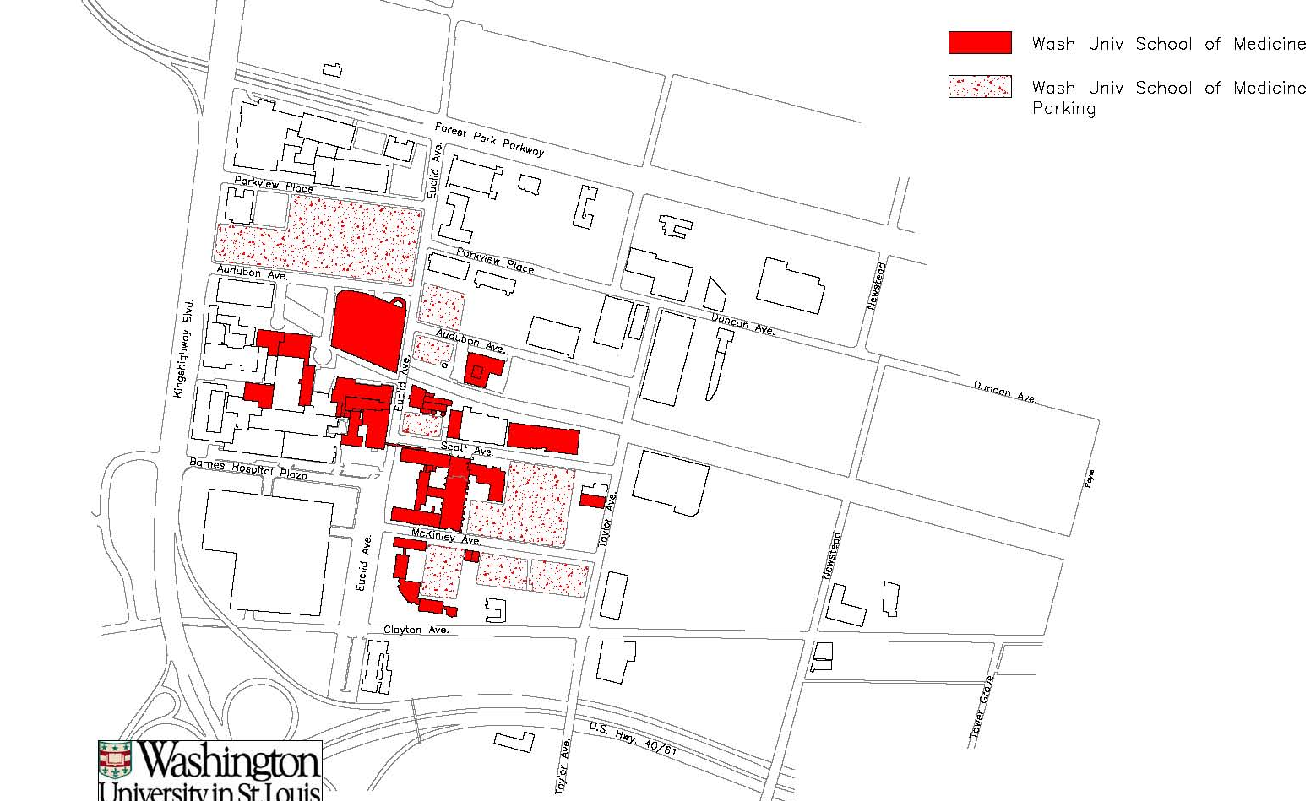
Key Success Factor – Growth in Anchor Institutions
Washington University Medical Campus, 1970
2.0 million square feet

Slide 40
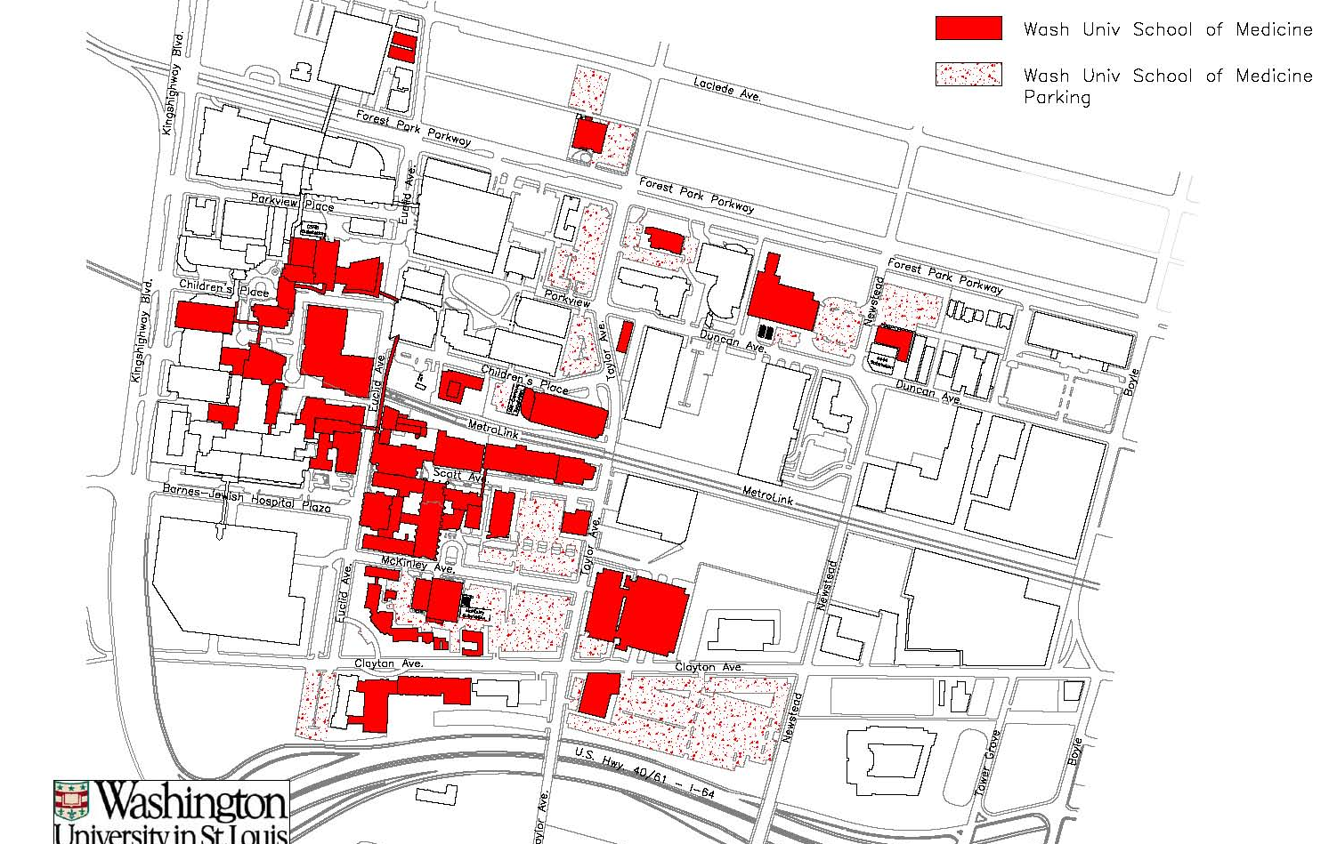
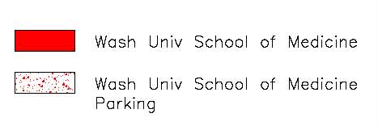
Key Success Factor – Growth in Anchor Institutions
Washington University Medical Campus, 2008
5.6 million square feet
Notes:
This physical growth was matched by a growth in employment. WUSTL employment numbers:
1960- 4,439
1985- 8,304
2010- 12,236
2013- 14,091

Slide 41
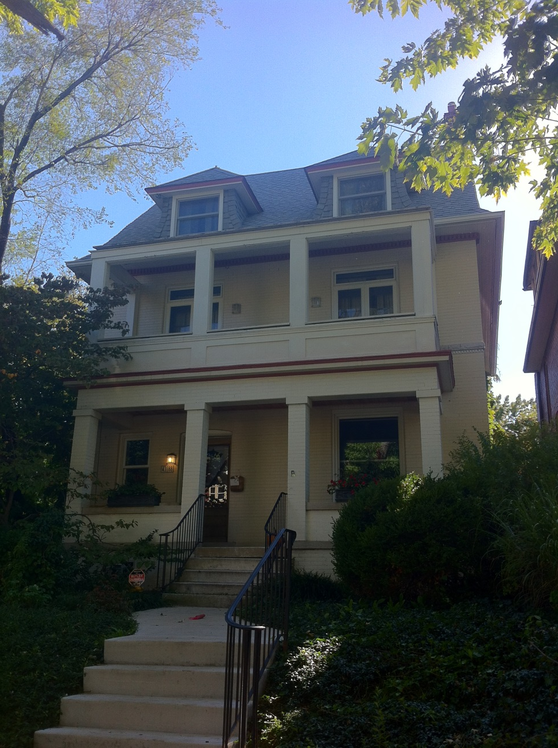
Central West End – Case Study: 4388 Waterman
Notes:
Purchased house in 1978 for $17.5K. It was then a rooming house configuration.
Now valued at approximately $500K

Slide 42
Central West End – Success Factors
Strong anchor institutions in growing industries
Excellent housing stock
Supportive public policy
Resident civic engagement
Thoughtful and contextual commercial and residential development

Slide 43
Central West End – What Did Not Happen
No great transformative change in low-income and minority population
No significant change in building stock
Limited spill-over effects north of Delmar
Notes:
This was evolution not revolution

Slide 44
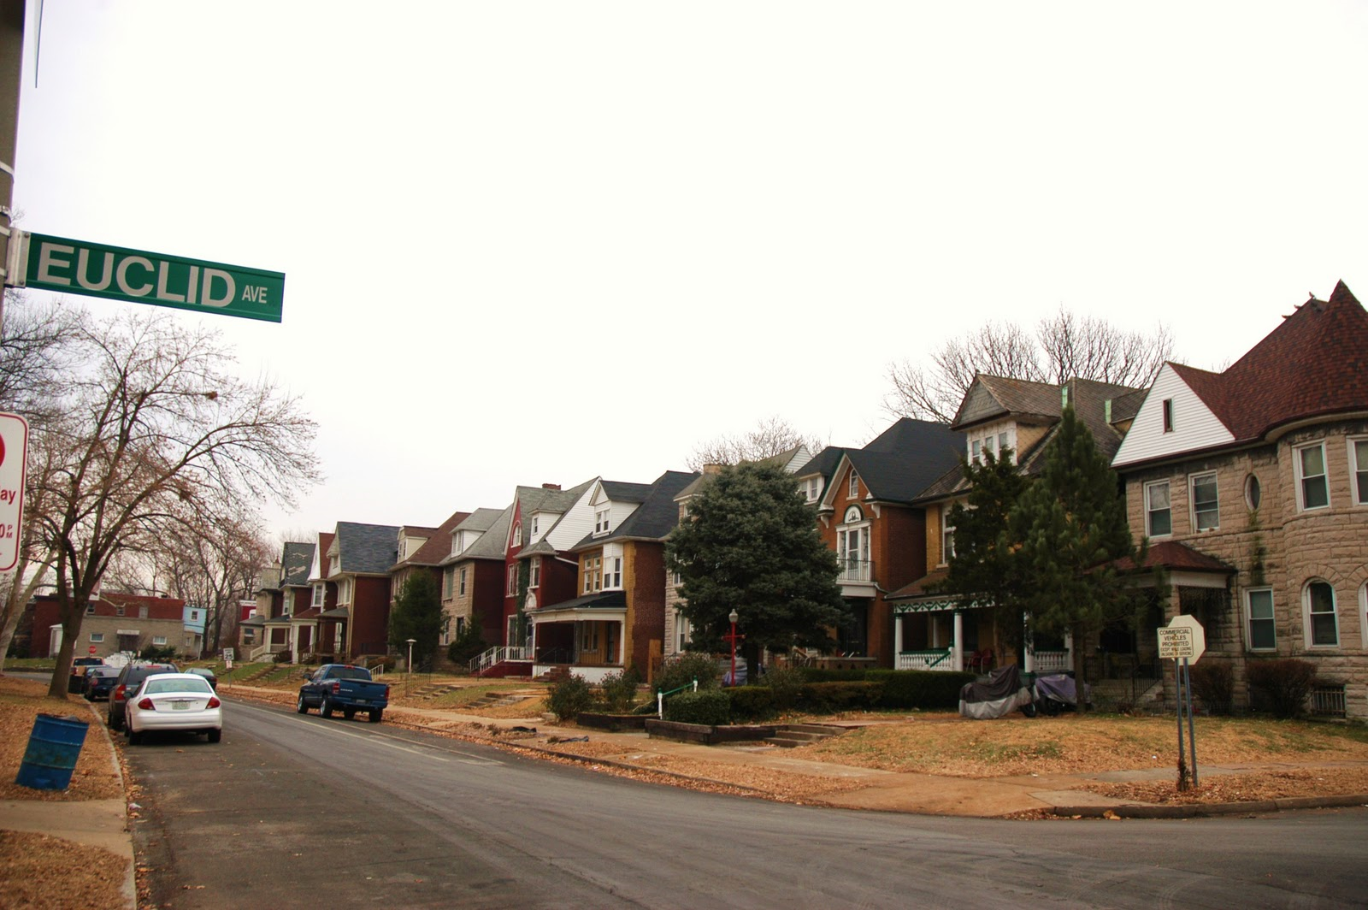
Central West End – Fountain Park

Slide 45
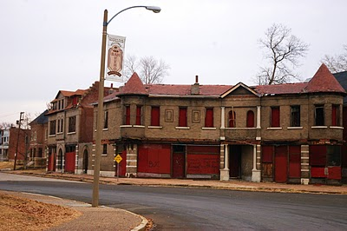
Central West End – Fountain Park

Slide 46
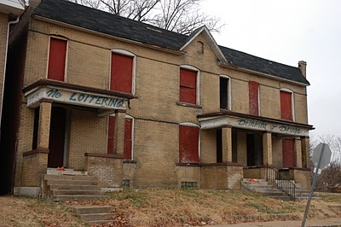
Central West End – Fountain Park

Slide 47
Conclusions
Neighborhoods with strong anchor institutions and high levels of civic capacity are better able to utilize the public policy tools for revitalization (tax credits, special taxing districts, overlay zoning districts, etc.)
Location, Location, Location
  Proximity to growing job centers is key
  In the central corridor or well-located suburbs considerable success is possible
  It is very difficult for all-black neighborhoods to rebound; in North St. Louis, stability is a victory
Diversity is now an asset to community revitalization

Slide 48
Remaining Questions
Is St. Louis an outlier, or can neighborhoods in other weak market cities rebound without significantly displacing low-income and minority residents?
Are rebound neighborhoods in St. Louis simply the first stage on route to classic gentrification as found in strong market cities?
Are diverse rebound neighborhoods the result of a significant attitudinal change, especially by Millennials? If so, will this preference for diversity endure as Millennials age or will they revert back to attitudes of earlier generations?

Slide 49
We would like to thank the many people and organizations that shared their experiences and history with us. We commend the hard work and dedication of those who have contributed to the revitalization of neighborhoods in St. Louis and elsewhere.
Questions?

