Slide 1
MECKLENBURG COUNTY
2012 Charlotte-Mecklenburg Quality of Life (QoL) Study NNIP Ignite Session
June 19, 2013

Slide 2
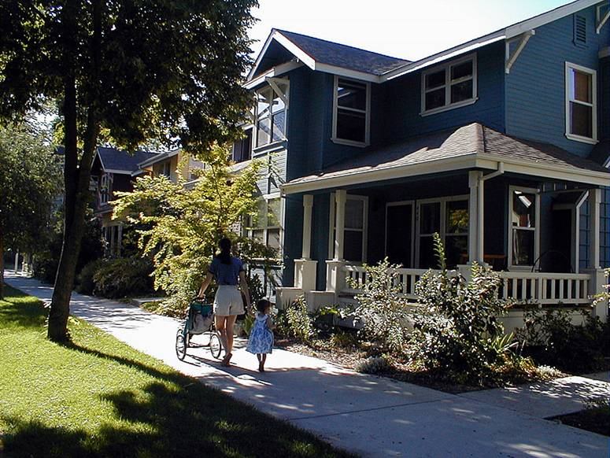
Presentation
Quality of Life Study
History
What’s new in 2012
Dashboard features

Slide 3
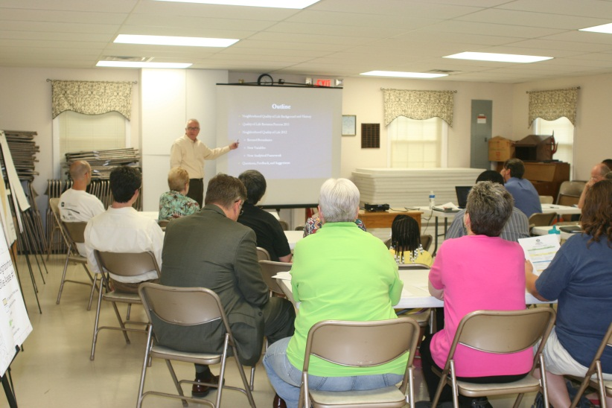
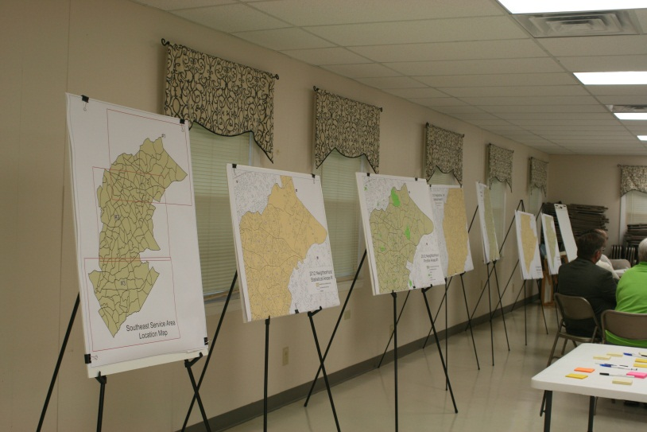
Goals
Create a framework to help:
Neighborhoods understand themselves and plan for their future
City, County, and Town staff analyze neighborhood issues and opportunities
Service providers assess needs in the community

Slide 4
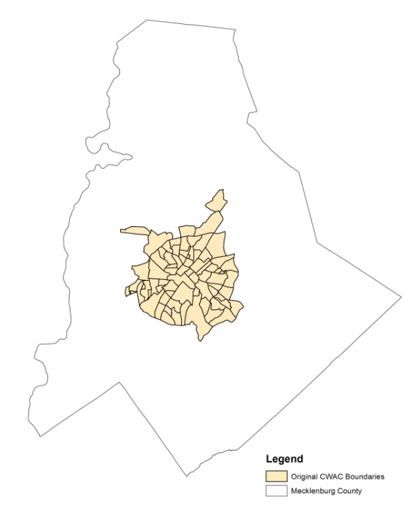
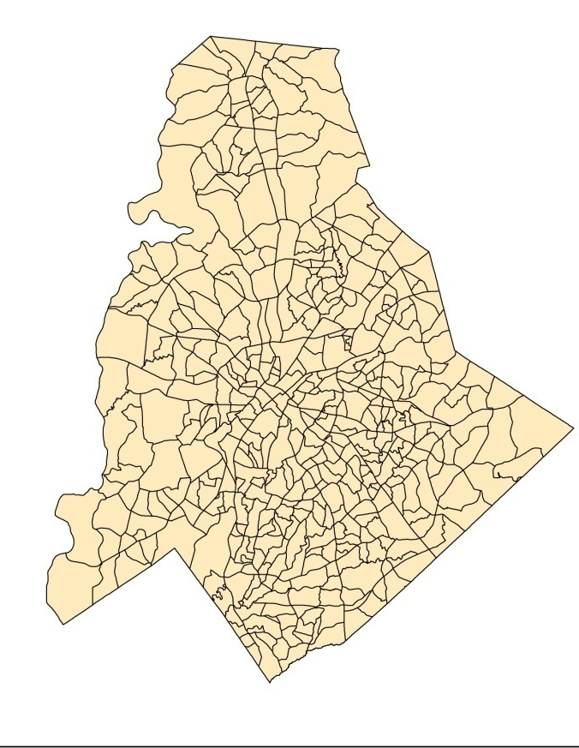
History
1993
2012
73 City Within a City neighborhoods
4 Dimensions
20 variables
Relative ranking
Printed document
464 City + County Neighborhood Profile Area (NPA’s)
8 Dimensions
80 Variables
Enhanced maps and new charts
Interactive web user dashboard

Slide 5
Partnerships
Study Team
City (NBS)
County (GIS)
UNC-C
Focus Groups
Neighborhood residents
Service providers

Slide 6
2012 Study Update: What’s New?
More Categories
Previous
Dimensions
Social
Crime
Physical
Economic
2012 Dimensions
Community Character
Community Engagement
Community Economics
Community Health
Community Safety
Education
Environment
Housing

Slide 7
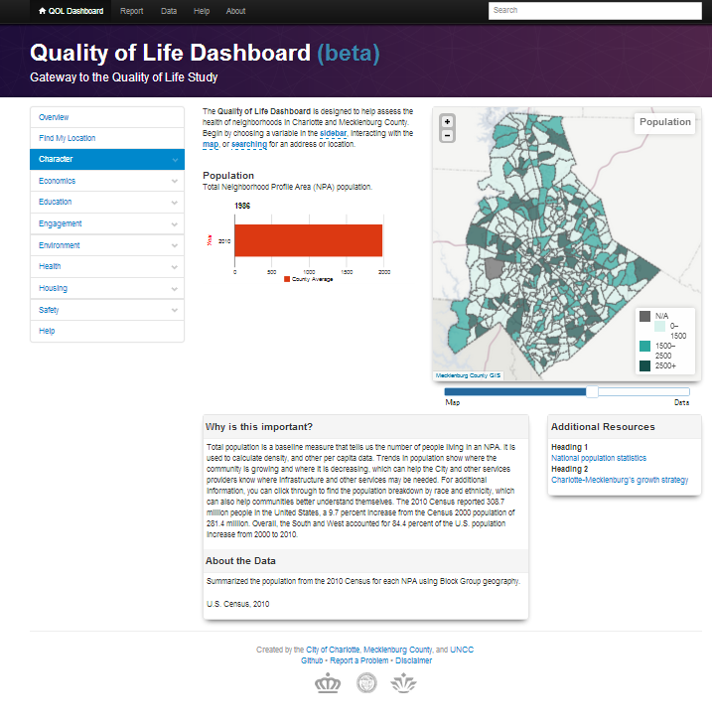
2012 Study Update: What’s New?
Better Data
80 variables are now available
Interactive ‘Dashboard’
FREE access to data and maps
Customizable reports
Print 1 to 80 variables
2012 is the new data baseline
Previous reports still available

Slide 8
Dashboard Features
Tool Bar
NPA Search Box
Dimensions and Variables Menu
NPA Map
Variable Descriptions
Map Opacity
Resources
Data Notes
Notes:
Dashboard demo here.

Slide 9
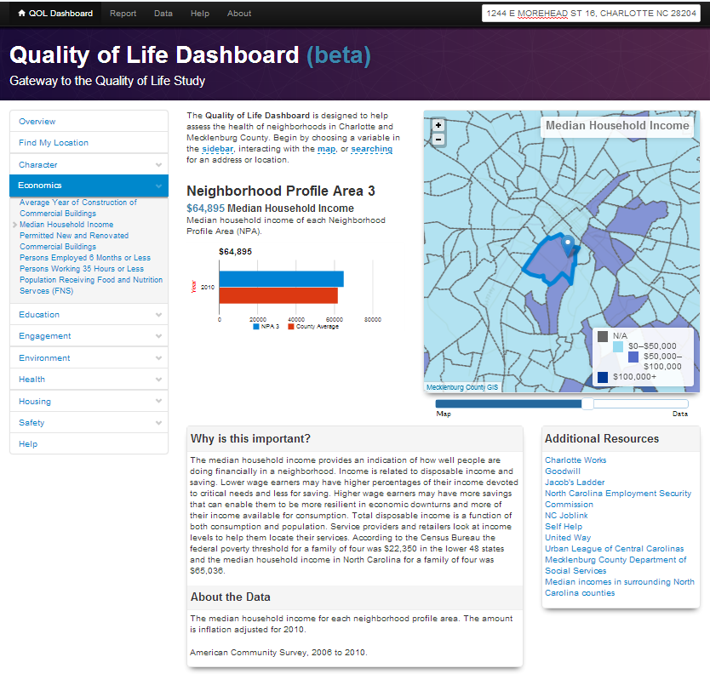
Economics

Slide 10
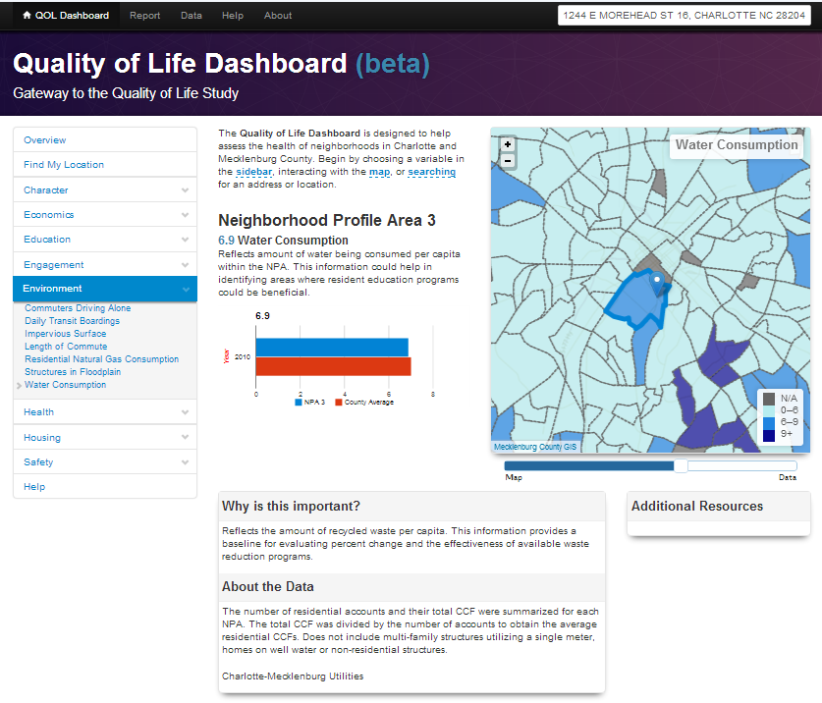
Environment

Slide 11
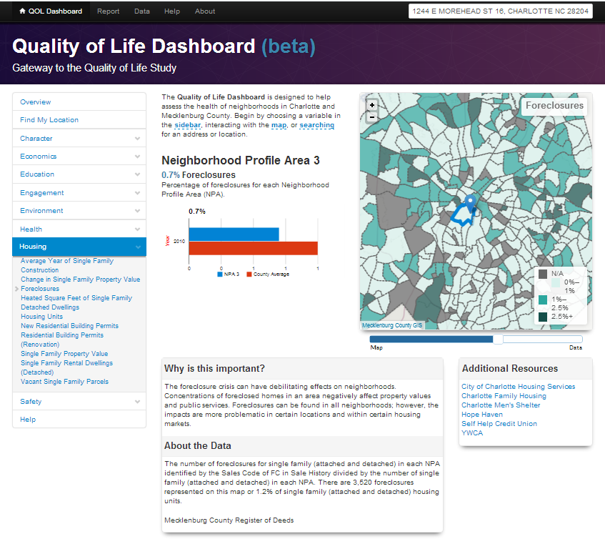
Housing

Slide 12
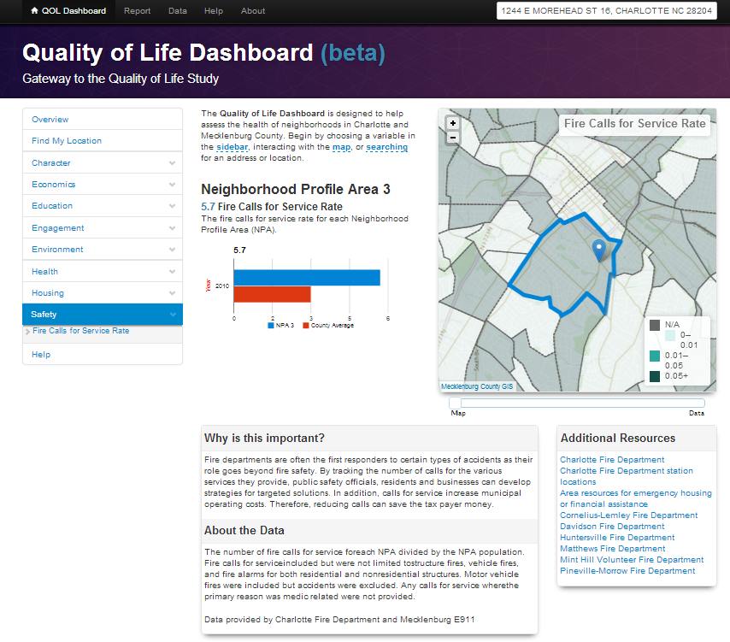
Safety

Slide 13
Path Forward
Refine descriptions and enrich links
Connect data outcomes to department goals
Collaborate with other agencies for data collection and research
Staff training and public education

Slide 14
Contact Us
Quality of Life Link:
http://qol.charmeck.org
Additional Questions/Comments:
Tom Warshauer
Community Engagement Manager
twarshauer@charlottenc.gov
(704) 336 – 4522
Nicole Storey – Environmental Data
Community Energy Conservation Coordinator
nrstorey@charlottenc.gov
(704) 336 - 2929
Timmothy M. Tibbs
Assistant to the County Manager
Timmothy.Tibbs@MecklenburgCountyNC.Gov
(704) 432 - 2163

