Slide 1
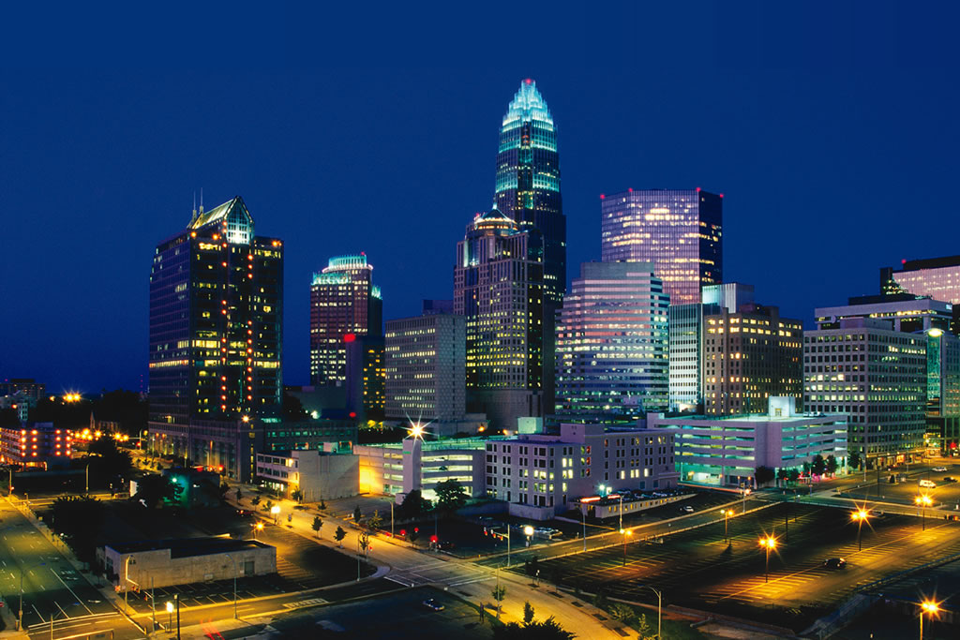
USING ENVIRONMENTAL DATA
TO INFORM AND ENGAGE COMMUNITIES IN SUSTAINABILITY
Tom Warshauer, Community Engagement Manager – CITY OF CHARLOTTE NC

Slide 2
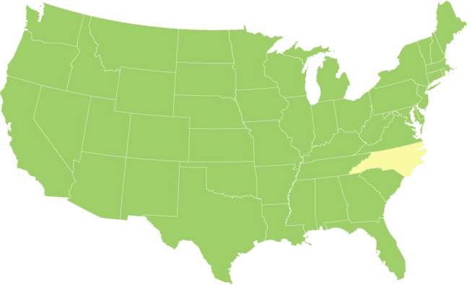
CHARLOTTE, NORTH CAROLINA
Population: 770k+
Nation’s Fastest Growing Metro Area at 3.4% Annual Growth Rate (2000-2010)
Median Household Income: $55,666 (2010)
2nd Largest Financial Center
Increasing VMT per capita
Increasing air pollution
Increasing land consumption per capita

Slide 3
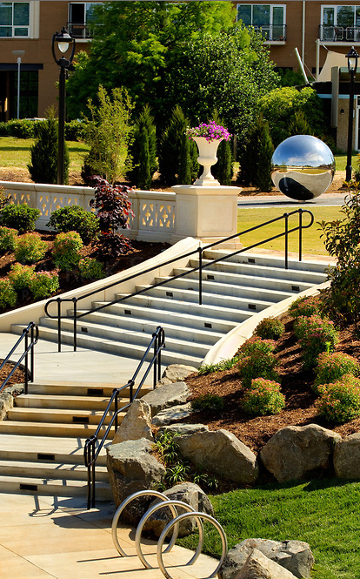
BACKGROUND
2007 – Council Adopts 1st Focus Area
Plan for the Environment
“Lead by Example”
2009 – Mayor Foxx Signs US
Conference of Mayors Climate Action
Agreement
2009 – $6.8 M Energy Efficiency &
Conservation Block Grant (EECBG)

Slide 4
DATA
Create
ENGAGEMENT
Inspire Action
RESOURCES
Programs
Compile
Refine
Assess
Maintain
Bright Spots
Partnerships
Boots on the Ground
Policies

Slide 5
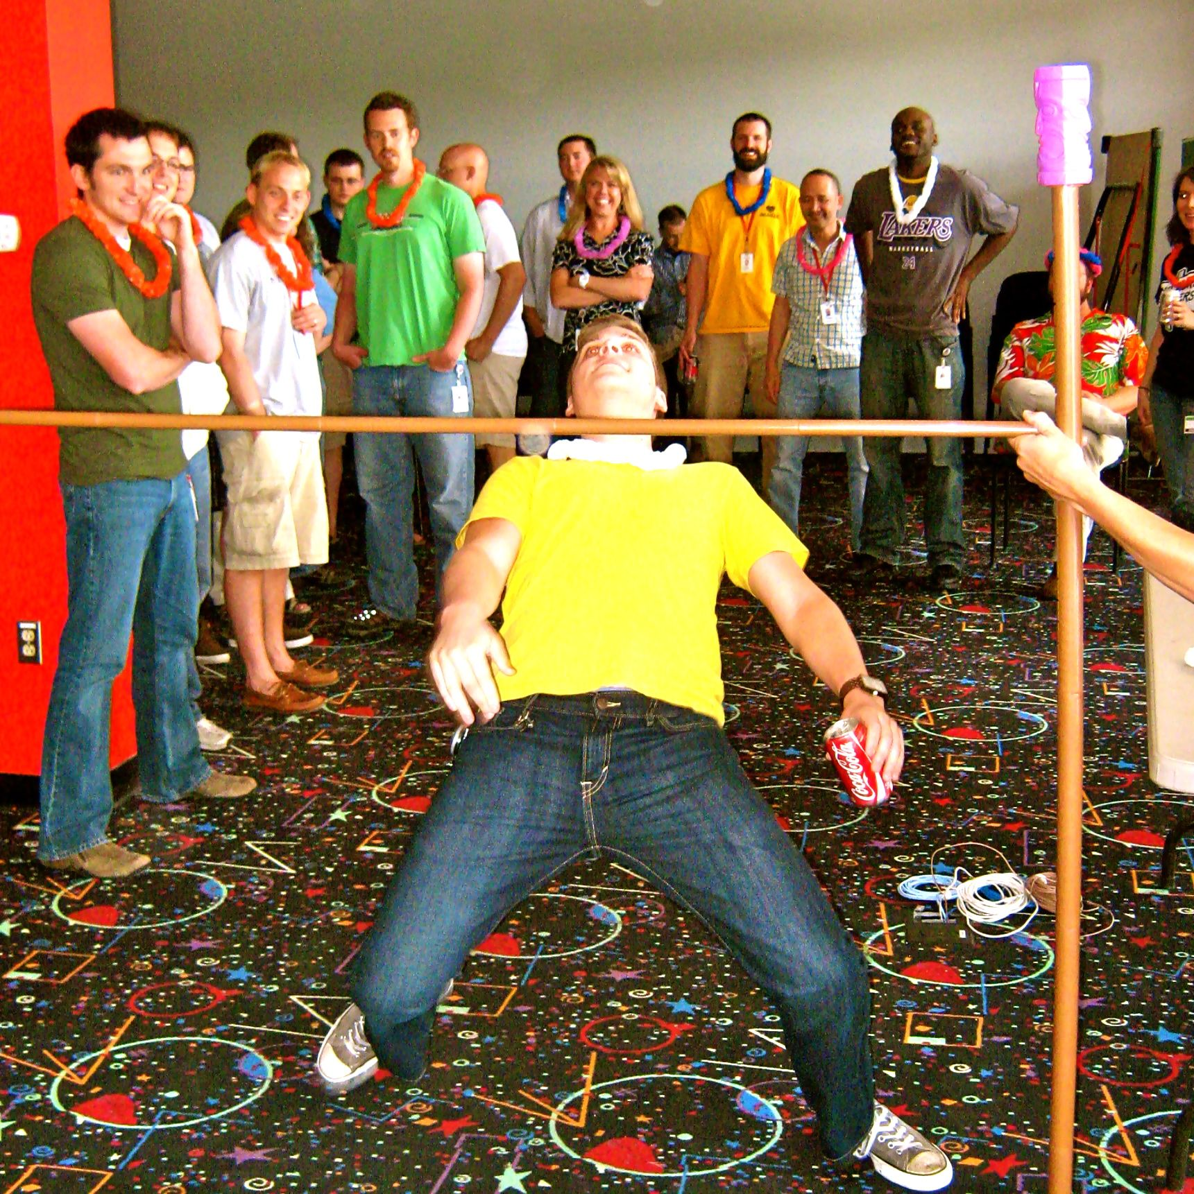
HOW ARE WE SETTING THE BAR??

Slide 6
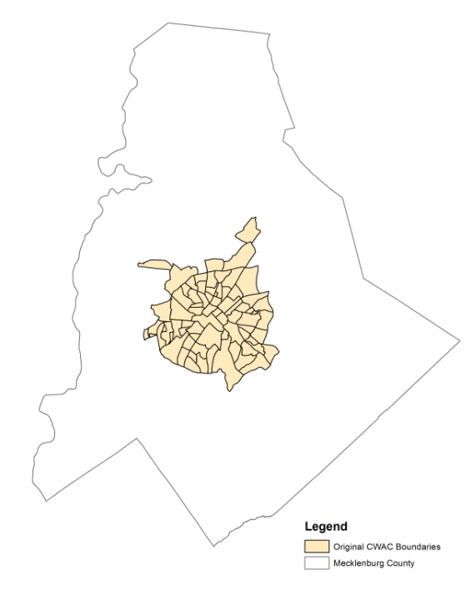
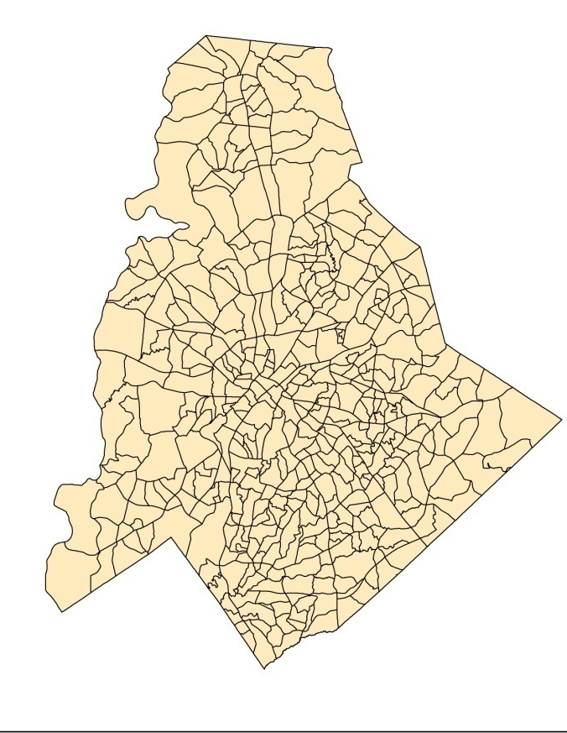
Quality of Life History
1993
2012
73 City Within a City neighborhoods
4 Dimensions
20 variables
Relative ranking
Printed document
464 City + County Neighborhood Profile Area (NPA’s)
8 Dimensions
80 Variables
Enhanced maps and new charts
Interactive web user dashboard

Slide 7
Quality of Life History
More Categories
Previous
Dimensions
Social
Crime
Physical
Economic
2012 Dimensions
Community Character
Community Engagement
Community Economics
Community Health
Community Safety
Education
Environment
Housing

Slide 8
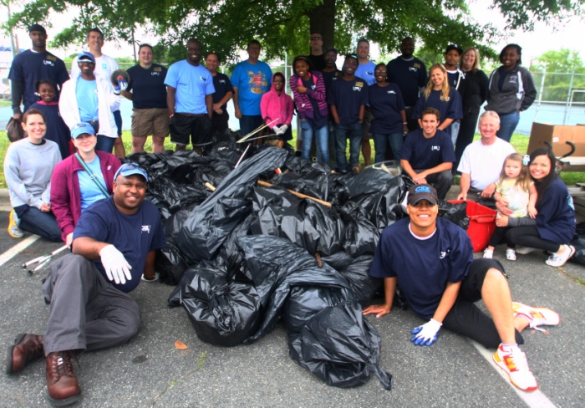
ENVIRONMENTAL INDICATORS
Mobility
Commuters Driving Alone
Length of Commute
Avg # of Daily Transit Boardings
Bicycle Friendliness
Street Connectivity
Built Environment
Total Impervious Surface
# Structures in Floodplain
Tree Canopy % (Res. & Non-Res)
Paved Streets w/ Sidewalks %
Waste
Diversion Rate
Recycling Participation
Water
Adopt-A-Stream Participation
Residential Water Consumption
Energy*
Electric Consumption
Natural Gas Consumption
(*Avg Monthly Residential/Household)

Slide 9
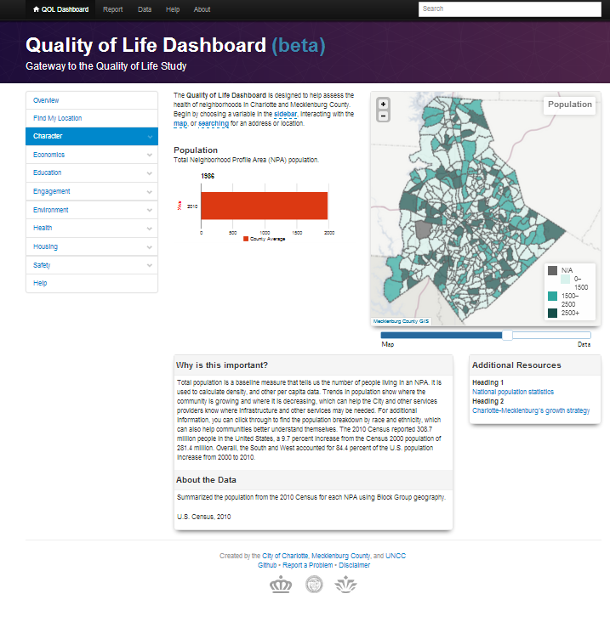
Dashboard Features
Tool Bar
NPA Search Box
Dimensions and Variables Menu
Map
Variable Descriptions
Map Opacity Tool
Resources
Data Notes

Slide 10
Redefining Neighborhood Value
“Do standard measures of income really capture inequalities in living standards? Not really…
…higher incomes don’t necessarily translate into higher living standards.”
Dr. Robert Lerman, Fellow – Urban Institute
Redefining Inequality So It Actually Means Something

Slide 11
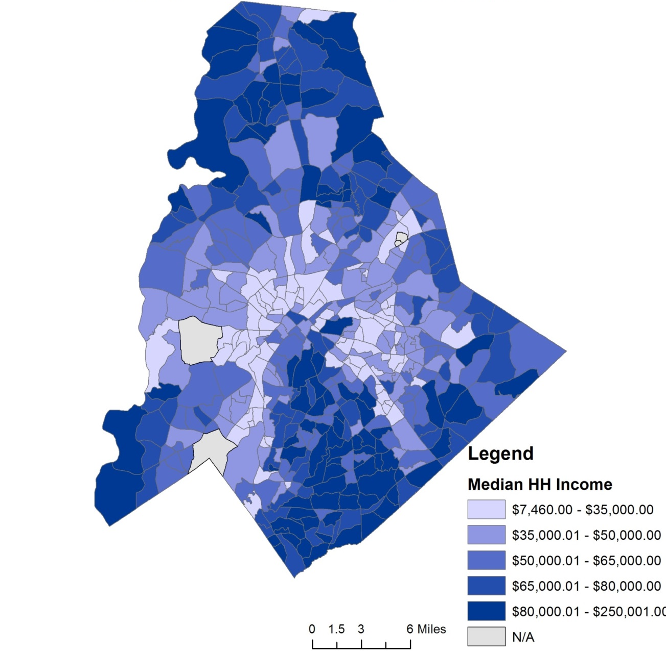
Median Income

Slide 12
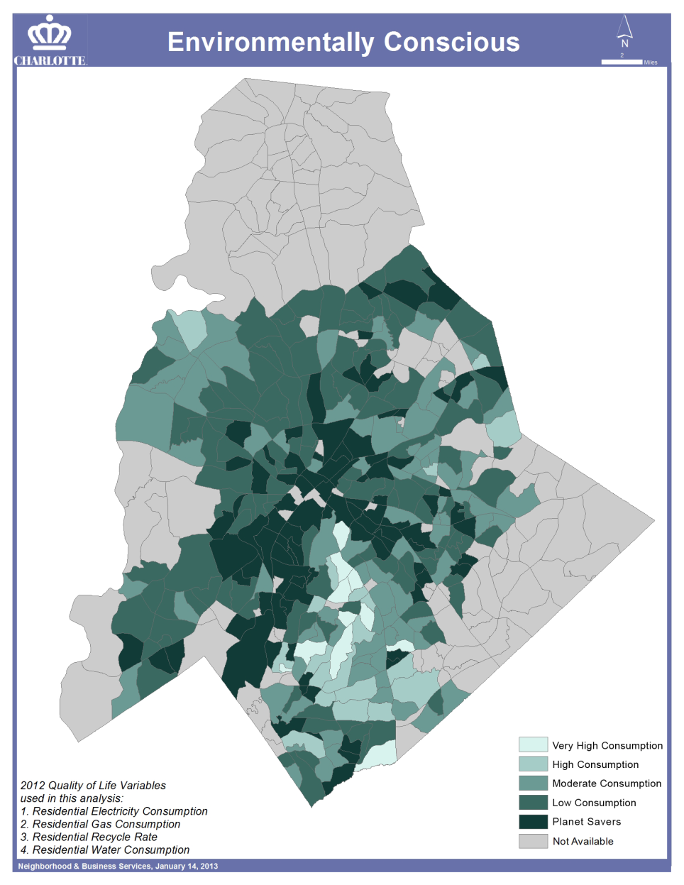
Environmental Friendliness
Use multiple data points:
Energy consumption
Gas consumption
Recycle rate
Water consumption
Others

Slide 13
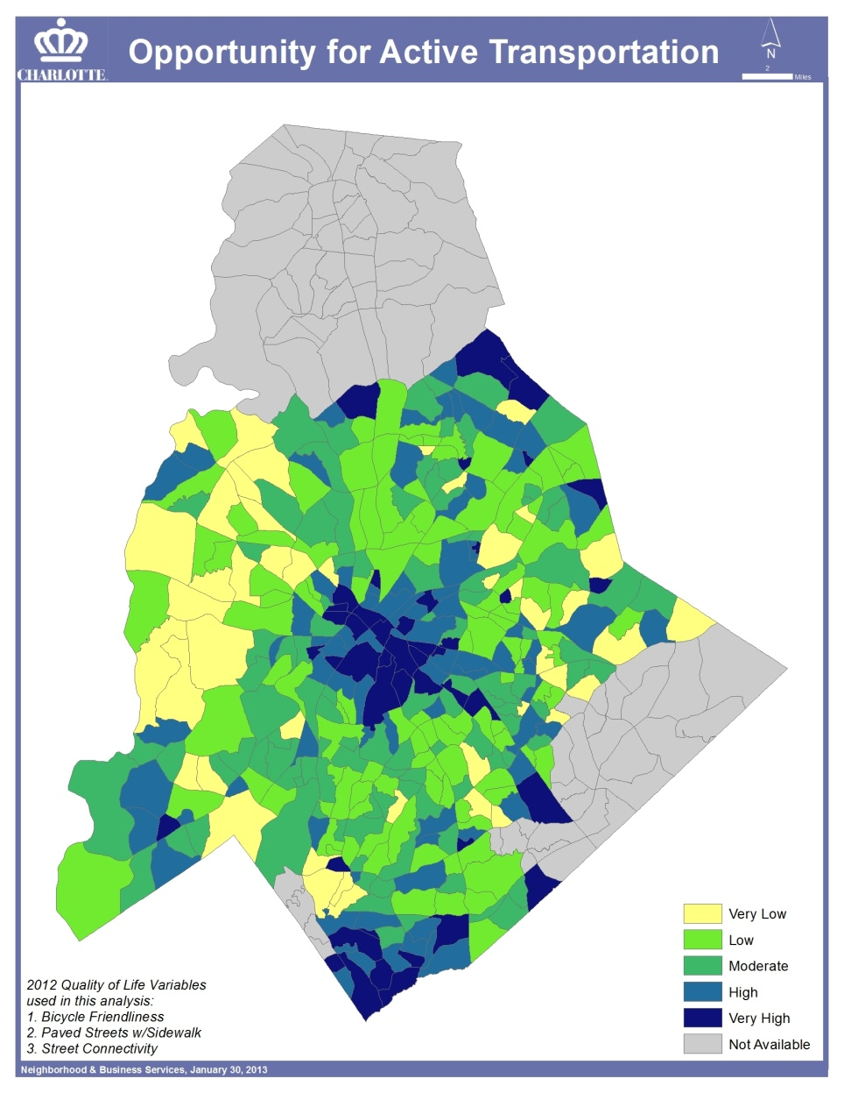
Pedestrian/Bike Friendliness
Use multiple data points:
Bicycle friendliness
Paved streets with sidewalks
Street connectivity
Others

Slide 14
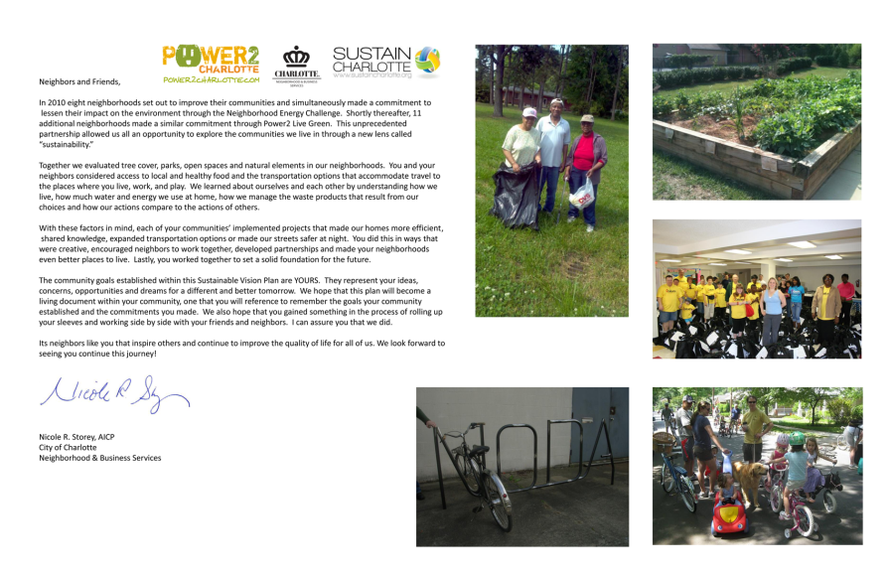
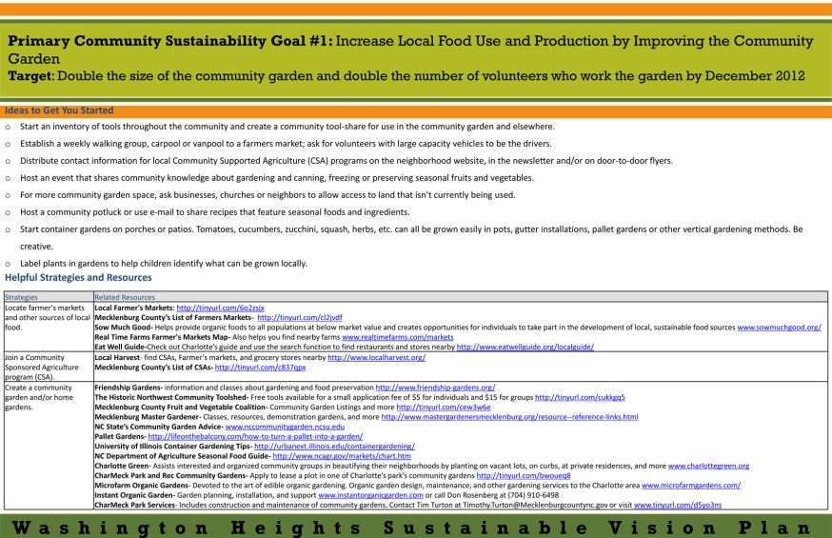
COMMUNITY ENGAGEMENT
Sustainable Vision Plans (SVP)
Show Communities Where they Are
Ask What They Want or Need
Goals, Targets & Strategies
Lower Energy Usage
Conserve Water
Increase Local Food Access/Use
Increase Use of Alt Transit
Increase Use of Rec Areas
Provide Resources
Identify Barriers
11 Neighborhoods

Slide 15
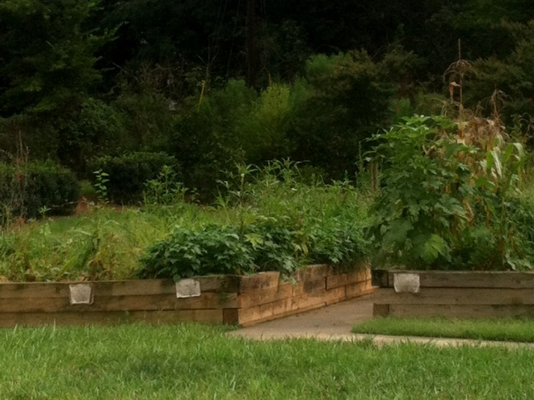
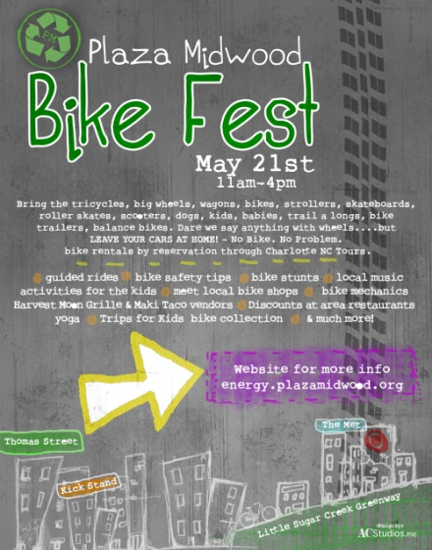
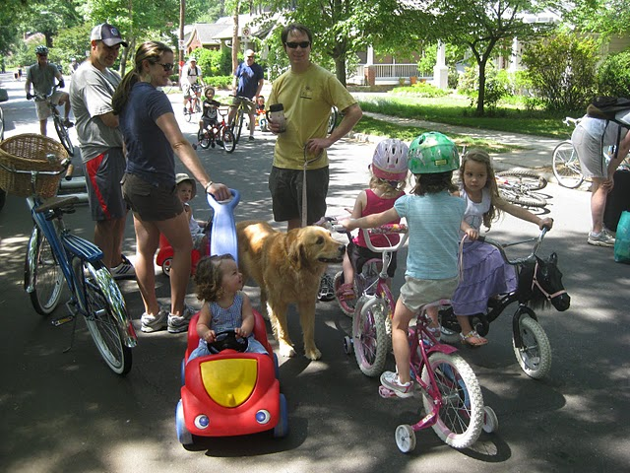
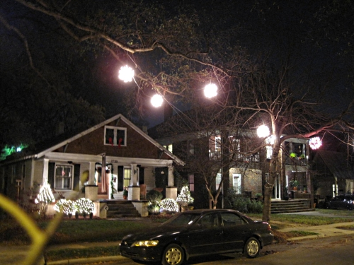
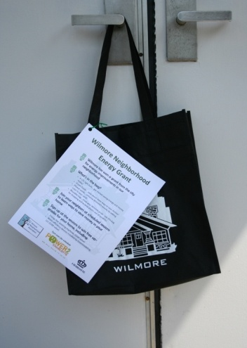
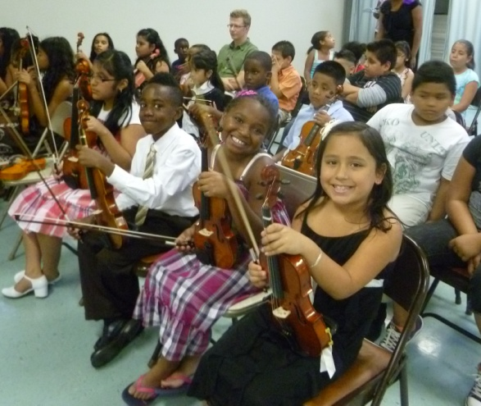
COMMUNITY ENGAGEMENT
Neighborhood Matching Grants
< $25k to Neighborhoods
Match Required
THEIR Projects & Ideas
Community Gardens
School Partnerships
Monumentation & Signage
Traffic Calming
Now Environment!

Slide 16
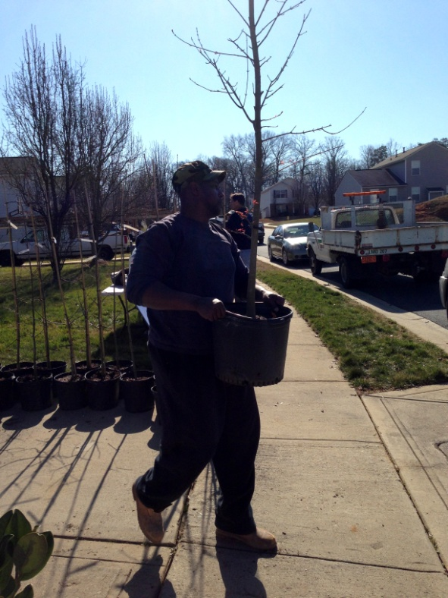
RESOURCES
Programs
Neighborhood Energy Challenge
Water Conservation Pilot Program
Bike Rack Installation Program
Partnerships
TreesCharlotte - NeighborWoods
50% Canopy by 2050 , 15,000 trees/year
Utilities
Data (Electricity, Natural Gas )
Keep Charlotte Beautiful
Adopt a Street

Slide 17
A FEW REFLECTIONS
Promoting Your Work is as Important as Doing Your Work
There are Some Things You Can Initiate Today, Others are Going to Take Some Time. It’s OK.
Do Fewer Things, Do Them Well
Proactive Engagement is Key
Participants Resist Things that are Done TO Them, Value Things that are Done WITH Them
Measure, Educate, Collaborate…
Ink is Cheap – Thank people!

Slide 18
Questions?
Tom Warshauer
Community Engagement Manager
City of Charlotte
704 336 4522
Twarshauer@charlottenc.gov

