Slide 1
Urban Affairs Association “Using Neighborhood Data to Reimagine Cities in the Post-Industrial Era” Pittsburgh Neighborhood and Community Information System
4/19/2012

Slide 2
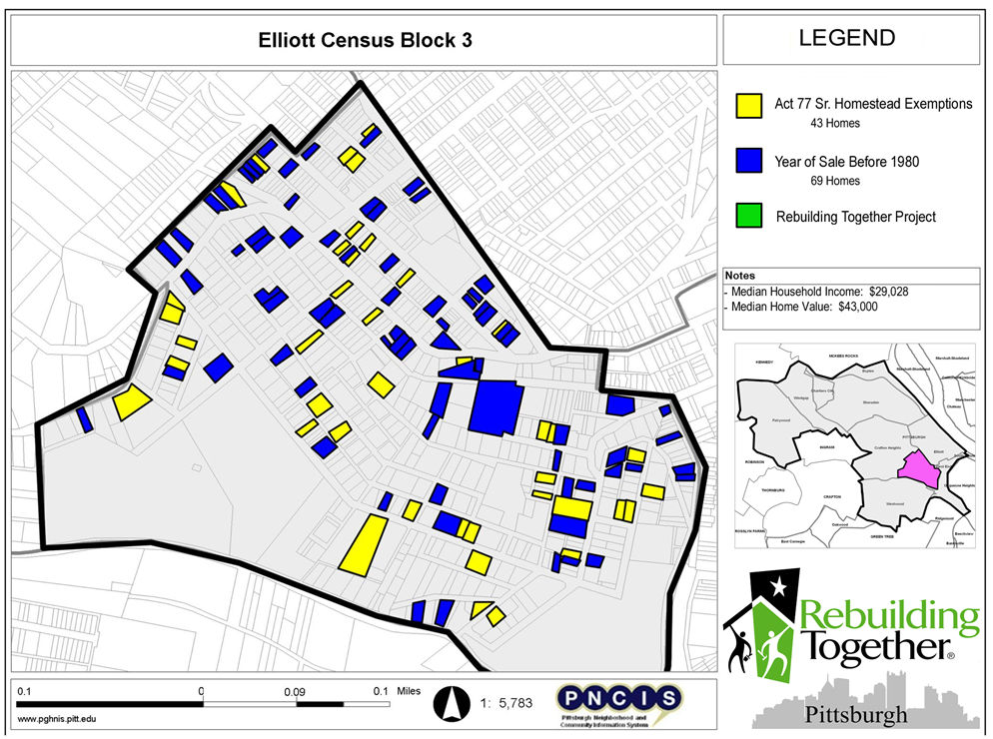
Targeted outreach

Slide 3
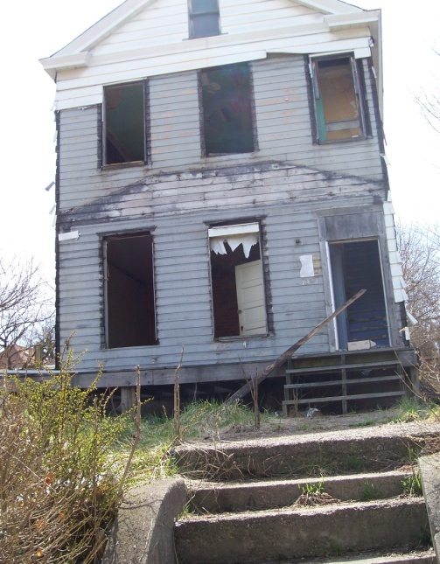
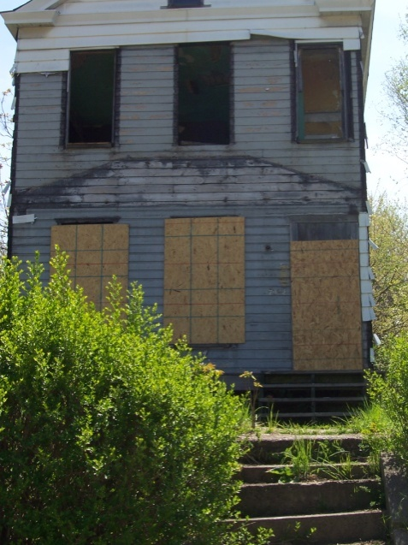
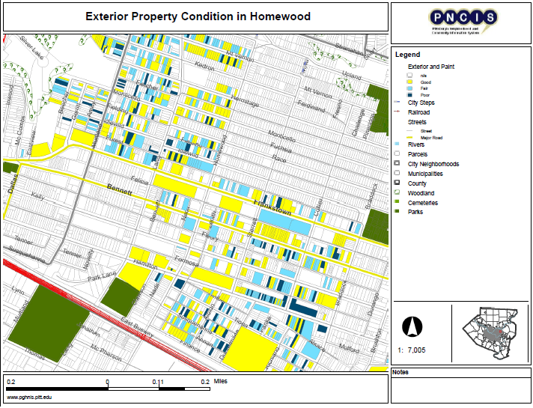
Community organizing

