Slide 1
Connecting People to Place:
Improving Communities through Integrated Data Systems
Leah Hendey
March 20, 2014
Urban Affairs Association Annual Conference

Slide 2
What are IDS used for?
Case management
Policy and program planning
Program evaluation
Performance measurement
Fraud detection
Notes:
IDS can be and are used for many different things, those some are intended primarily for one purpose or another. Several of our partners were operating these systems and a number of others are in localities or states that had them, as we learned more about the powerful information that they contained we began to think about what added value NNIP could bring to the conversation .
For example, IDS largely only contain data about people and don’t have any information about the neighborhoods people are living in. The neighborhood indicators NNIP partners produce could provide important context to case managers and improve case management.
NNIP partners background and neighborhood knowledge could help localities using IDS to push program planning and targeting efforts down to neighborhood level to improve service delivery.
NNIP adds data not found in many IDS – data related to community and economic development, like housing and property data,
On program evaluation – IDS is invaluable as they track residents over time, but NNIP partners could assist agencies in exploring neighbohrood effects on program outcomes for residents (such as the impact of housing redevelopment initiative on resident outcomes in high crime areas versus low crime areas.).

Slide 3
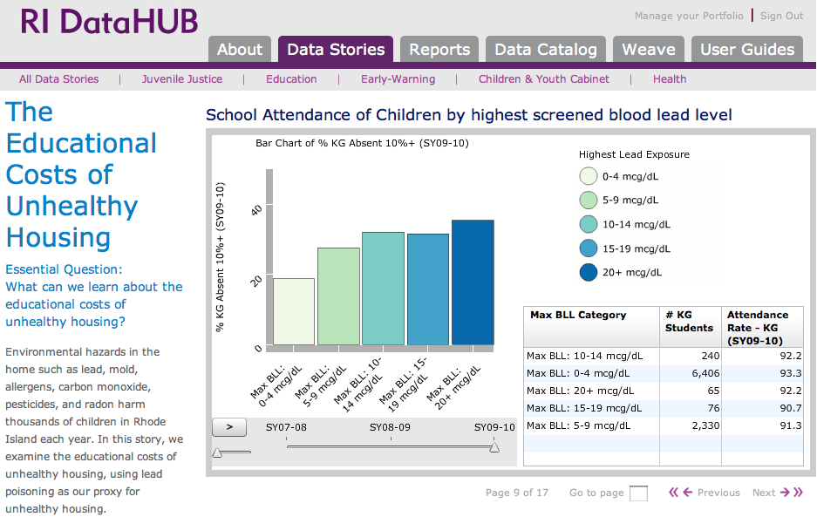
Source: Providence Plan
Notes:
Linking data across-sectors can bring stakeholders together and illuminate new policy solutions, that wouldn’t be found when operating with only one source of information.
For example, people look to principals and school district officials to address the problem of chronic absenteeism. But one of the big reasons kids miss school is because they are sick, often with chronic conditions like asthma. Lead exposure had been found to be a reliable proxy for unhealthy housing conditions that may exacerbate asthma.
Our partner, the Providence Plan has built an IDS called the Rhode Island DataHUB and worked with state and local agencies to bring together information about children in Rhode Island into one place.
Combining the data allowed them to look beyond school-based factors for student absenteeism and begin to explore the Educational Costs of Unhealthy Housing.
This graph shows the percentage of kindergarteners that are chronically absent from school by the lead levels found in their blood stream during screenings. Those with the highest lead exposure are more likely to be chronically absent than children with lower levels. This graphic suggests that the school system cannot solve the problem of chronic absenteeism without working with community organizations and city officials to address social and environmental determinants of health.

Slide 4
Connecting People to Place: Improving Communities through Integrated Data
Link data from IDS to local admin. data held by NNIP partners to address a local or neighborhood policy problem.
Build relationships between NNIP partners, IDS agencies and community partners.
Increase exchange of information.
Notes:
Annie E. Casey Foundation, a long time supporter of NNIP, also became interested in how to increase access to the insights one could learn from integrated data systems and decided to support a cross-site project in 6 NNIP sites. The projects are focused on demonstrating how data from IDS could be connected with contextual information on place from an NNIP partner to improve local- and neighborhood-level policy and program-related decisionmaking.
The project began last fall and sites are just beginning to implement their analysis after a planning period.
Each project links data from an IDS to local administrative data from the NNIP’s partners data warehouse in order to address a specific local or neighborhood policy problem.
The goals for the project are to establish and build up relationships between NNIP partners and agencies hosting IDS and community partners.
We hope that the projects result in a two-way exchange of information – that NNIP partners would provide contextual indicators to IDS agencies to aid in the work of the IDS agency and the IDS agency could work with NNIP partners to address neighborhood concerns and potential provide neighborhood-level indicators created from IDS data.

Slide 5
Additional Projects and Topics
Baltimore: Equity in access to energy assistance programs
New York City: Neighborhood and building effects on homeless episodes
Pinellas County: Child, family, school and community influence on chronic absenteeism
Providence: Education and employment outcomes and civic engagement levels
Visit NeighborhoodIndicators.org for more!

Slide 6
Where do IDS exist?
Visit our IDS catalog and resource page http://neighborhoodindicators.org/resources-integrated-data-systems-ids
Notes:
Our techincal advisors on this project include:
AISP peer network for agencies hosting IDS – learn from each other on the technical, legal, analytic and ethical challenges.
Data Quality Campaign has been a leader in advocating for better data in the education arena through State Longitudinal Data Systems like the one that Claudia spoke about in Ohio. They are also doing a lot of good work around privacy concerns in these systems.
National League of Cities- Institute for Youth, Education and Families….(vulnerable youth). the integration of data related to children and families, including IDS, across levels of government and allow each of these players to leverage one another’s knowledge and resources.
We worked with these organizations to develop a catalog of systems across the country and an IDS resource page. k

Slide 7
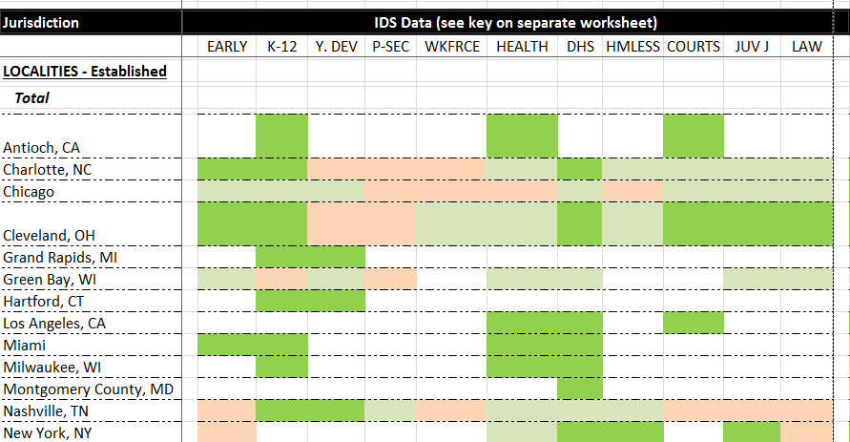
Where do IDS exist?
Established IDS:
Localities: 24
States: 6
Emerging IDS:
Localities: 18
States: 1
Questions or edits to the IDS catalog? Email Alexandra Derian at aderian@urban.org
Notes:
We found 24 IDS in various localities and 6 in states across the country, some of which have been operating for two decades. But there are many cities and counties working to develop new systems as we speak.
A lot of the work in building these systems is about establishing relationships between government agencies and working out the legal details around sharing data. And a lot of thought is put into protecting privacy and obtaining proper consents depending on what the data is being used for.
In the end, each IDS is pretty unique from others depending on its purpose, the agency operating the system, and the data it includes. Some systems are focused on integrated data for only children while others deal primarily with adult populations.
As our project proceeds we and our partners hope to document more stories on the uses of integrated data and maintain this catalog overtime.
If you are familiar with any of these systems or become if you have any questions or want to update an entry in the catalog.
Over the next year and a half the local projects will implement their research ideas and work with community partners to craft solutions and disseminate findings from their work.

