Slide 1
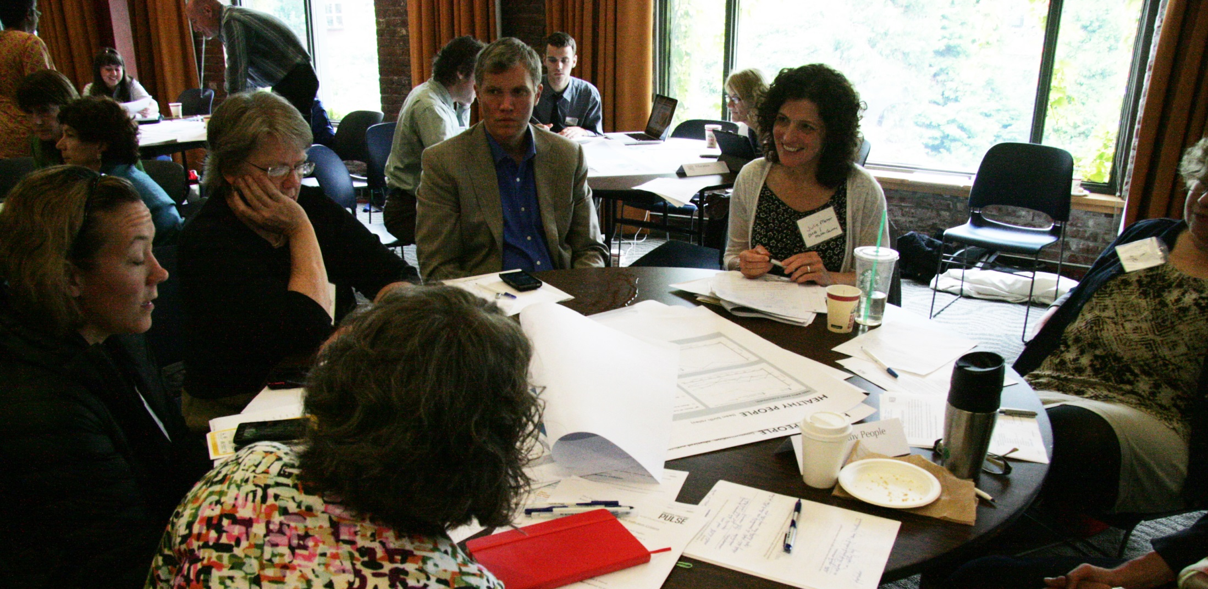
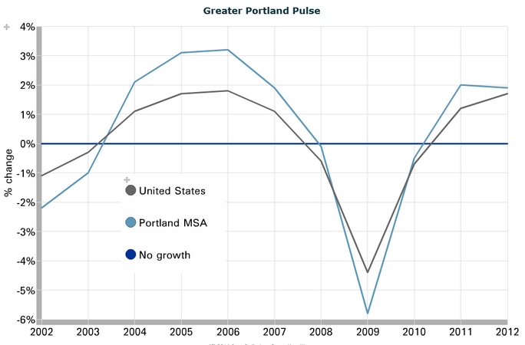
Moving from Measurement to Action:
A Reexamination of Greater Portland Pulse
Meg Merrick, Ph.D.
Institute of Portland Metropolitan Studies, Portland State University

Slide 2

What is “the Pulse”?
A regional, bi-state, 4-county initiative to develop a set of measurable, consensus-based outcomes and provide and maintain the associated indicators
A partnership between Metro (Portland area’s regional government), Portland State University
Original vision:
“Measuring Results/Inspiring Action”
  Data (9 outcome categories)
  Dialogue

Slide 3
Development Process
Advisory Team (PSU president, Wim Wiewel and Hispanic Metropolitan Chamber president, Gale Castillo, co-chairs)
Top-down/bottom-up
Engaged more than 200 stakeholders over
2 years
An exercise in “Civic Governance”
(Martin and Morehead, 2013)

Slide 4
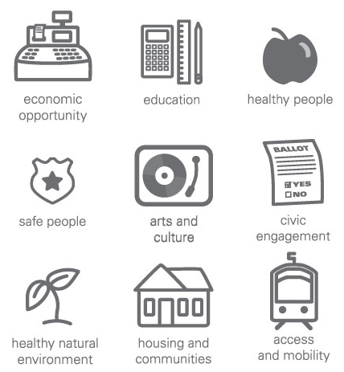
9 Outcome Categories
Equity?
111 variables for 64 indicators

Slide 5
Funding Model and Support
Subscriptions (spread the responsibility widely)
Base support (half projected budget raised)
  3-year start-up funding
    Metro
    Institute for Sustainable Solutions (Portland State)
  Yearly subscriptions
    City of Portland
    City of Vancouver, WA
    Multnomah County
    Washington State University, Vancouver, WA
    Other smaller donations

Slide 6
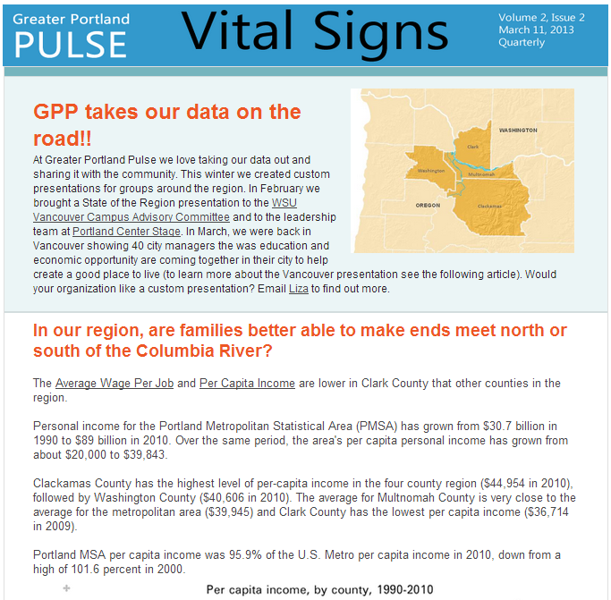
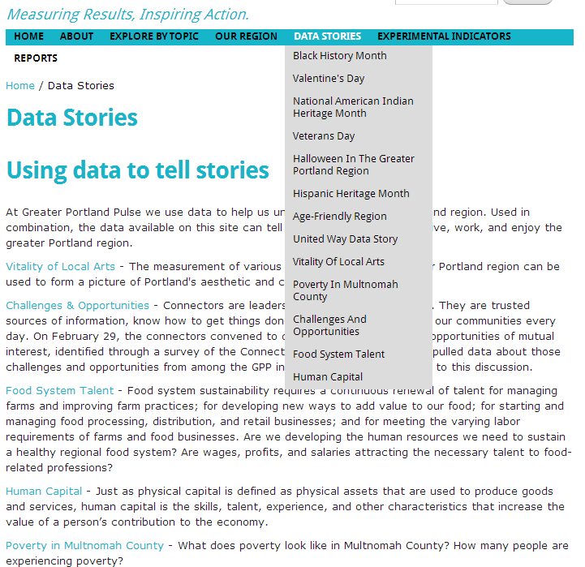
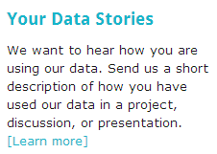
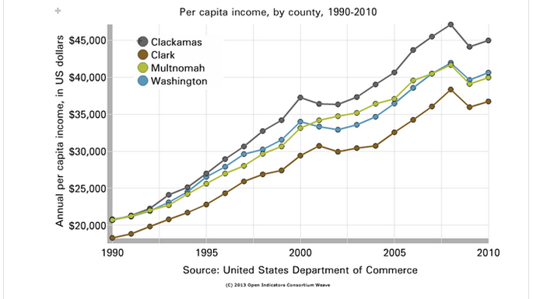
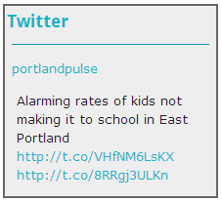
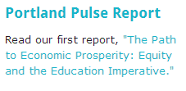

Greater Portland Pulse
Indicators, website, outreach (technical trainings on Weave)
Notes:
OUTREACH Quarterly newsletter reaches 2,000 people; Monthly data stories including stories on: Poverty in Multnomah County; United Way Data Story; Age-Friendly Region

Slide 7
Potential Funder Feedback
Couldn’t see themselves in the data
  Consensus-driven outcomes. Outcomes were overly broad and not targeted enough to user initiatives.
  Limited number of indicators. The indicators don’t speak directly enough to user interests.
  Geographic scale. Most of the indicators are only available at the regional or county levels.
  Website design and organization. Too dependent on the process.

Slide 8
Potential Funder Feedback
Confusion between data points and indicators.
Greater Portland Pulse data are secondary datasets that are free and accessible elsewhere.

Slide 9
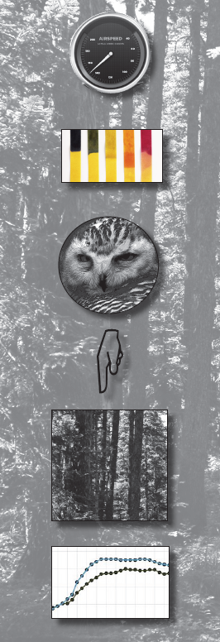
Indicators vs. Data
An indicator is “a pointer or gauge;” “a substance (as litmus) used to show visually the change of a condition;” “an organism or ecological community so strictly associated with particular environmental conditions that its presence is indicative of the existence of these conditions”
      - Merriam-Webster Dictionary
Social indicators are “statistics, statistical series, and all other forms of evidence that enable us to access where we stand and are going with respect to our values and goals…” - Academy of Arts and Sciences

Slide 10


Indicators vs. Data
“It is as if what we most want to measure is something that we cannot see if we look directly at it; we can see it only out of the corner of the eye.”
- Cobb and Rixford, 1998:14
“They point to and give a sense of but cannot by themselves paint the bigger picture: they are ‘only a piece of a larger puzzle’” or the tip of an iceberg. - Cobb and Rixford, 1998:25
            “Their purpose is to expand awareness and focus attention.” - Cobb and Rixford, 1998:2

Slide 11
Purpose of Indicators
Descriptive vs. Prescriptive indicators
  GPP indicators are descriptive
  To create and assess policy, prescriptive indicators may be more useful
Consensus-driven Outcomes and Indicators
Regional project: 2 states; 4 counties; 40 cities
  An exercise in “civic governance” (Martin and Morehead, 2013)
Politically neutral – the position of equity in the project for example
Produced very general outcomes and
ambiguous measures

Slide 12
Geographic scale of the indicators
  Mismatch between potential funders’ interests and the geographic scale of the data (MSA, counties)
  The choice of temporal resolution over spatial resolution
Website framework and design
  Emphasized and reflected the process at the expense of use
  Use of Weave and misfocus of trainings

Slide 13
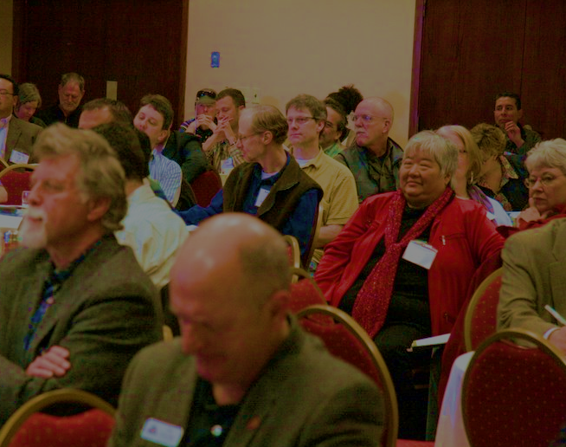
Moving Forward

Slide 14

Simplified Pulse (needing minimum support)
  Stick to county and MSA statistics
  Website redesign
Custom Portals (Neighborhood Pulse)-a move to Neighborhood Pulse
  Targeted outcomes and indicators
    City of Portland
    Metro
Trainings and User Guide
  Focus on the meaning and purpose of indicators
  Case study examples of hypothetical GPP indicator uses
Issue forums
  IMS: Bi-state forums
  City Club of Portland topic area series

Slide 15
portlandpulse.org
Meg Merrick, Ph.D.
Institute of Portland Metropolitan Studies,
Portland State University
merrickm@pdx.edu

