Slide 1
Exploring Measures of Social Capital
Eleanor Tutt
NNIP IDEA SHOWCASE
May 22, 2014

Slide 2
SOCIAL CAPITAL WORKGROUP MEETINGS
Rise plus three St. Louis CDCs with a particular interest in social capital and community engagement
Interested in measures that will assist in:
  identifying residents who connect multiple social, demographic, or geographic groups
  conducting more inclusive community engagement
  justifying funding for community engagement positions within neighborhood non-profits by demonstrating the importance of social capital

Slide 3
APPROACH #1: MAKE SURVEYING FUN?
Surveying initially seems like the best way to obtain the information we want – but residents are dealing with survey fatigue
Real-time results visualizations
Incorporating surveys into community-focused art
Keep surveys brief with tangible value

Slide 4

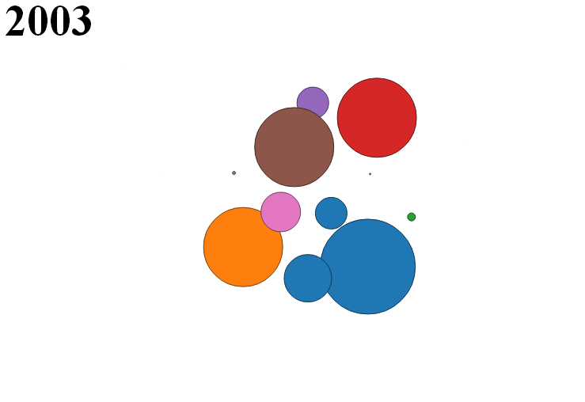
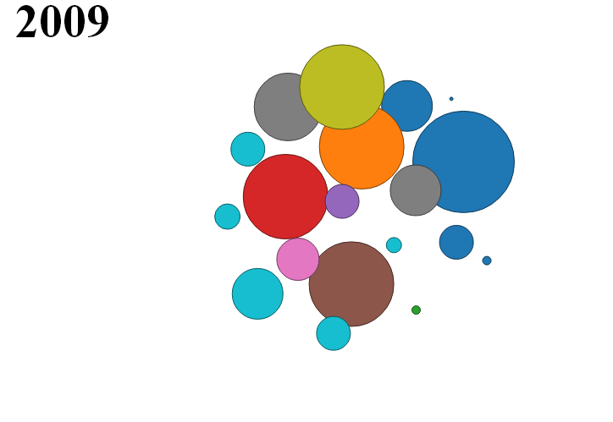
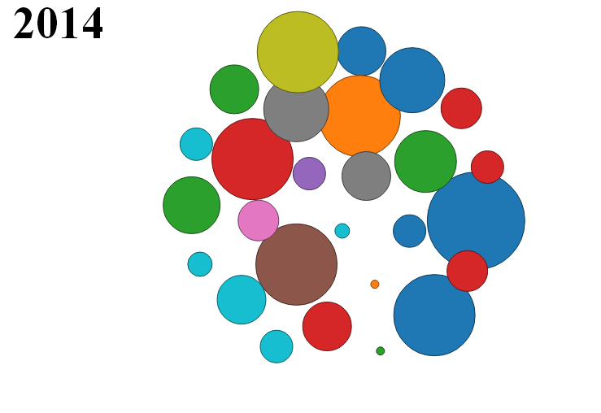
EXPERIMENT: SURVEY + REAL-TIME VIZ

Slide 5
EXPERIMENT: RESIDENT COUNCIL NETWORKS
Rise is providing leadership training to the Wellston Housing Authority Resident Council as a complement to Choice Neighborhoods planning
Who do you go to for advice or information?
Who comes to you for advice or information?

Slide 6
APPROACH #2: EXISTING ADMINISTRATIVE (OR SIMILAR) DATA?
Citizens Service Bureau calls (similar to 311)
Voter registration/participation
Neighborhood newspaper content analysis

Slide 7
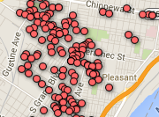
EXPERIMENTS: CORRELATIONS BETWEEN
CSB CALLS & BLOCK TEAMS?

Slide 8
NNIP NETWORK TO THE RESCUE!
April Hirsch (Cleveland) and I connected at the St. Louis NNIP Meeting.
April Hirsh, Taryn Gress, and Mark Chupp working in the social capital/community engagement space.
Are low-income residents building connections with higher-income residents in mixed-income neighborhoods?
Are there better ways to measure strong ties between low-income residents and/or demonstrate benefits of those social networks?

Slide 9
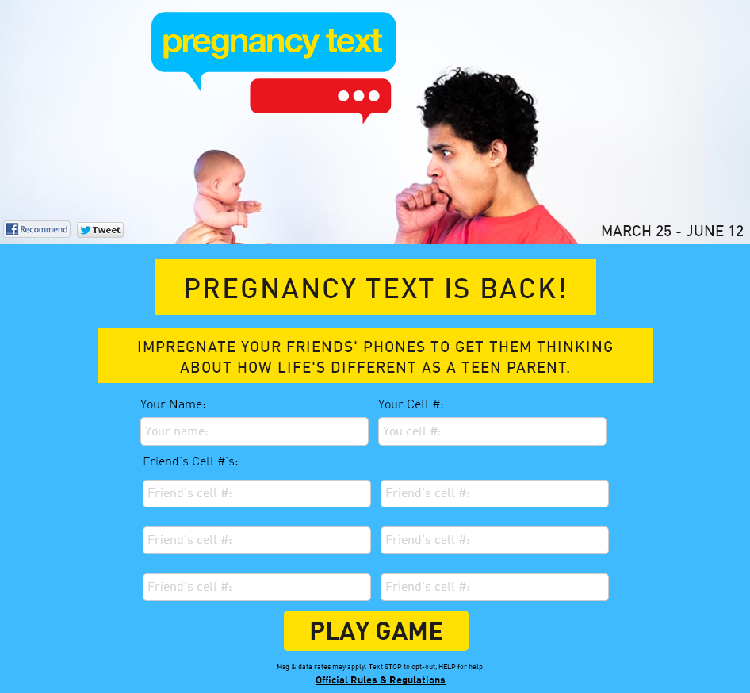
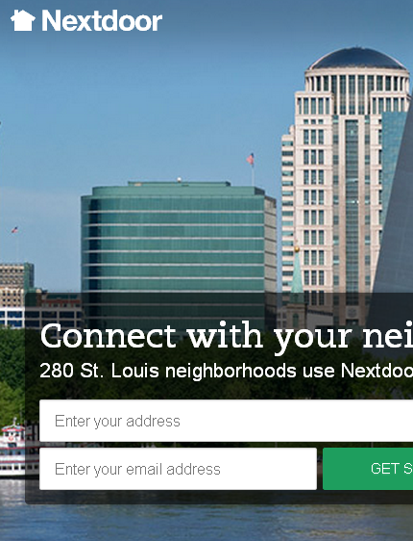
IDEAS TO EXPLORE

Slide 10
LOOKING FOR IDEAS & COLLABORATORS
St. Louis, Cleveland, & ____[your city here]____
How do you measure social capital in your cities? What works? What doesn’t? Let me know!
eleanor@risestl.org
twitter: @eleanortutt

