Slide 1

Engaging Hospitals as Partners in Community Change
Meetings of the National Neighborhood Indicators Partnership
Pittsburgh, May 2015

Slide 2

To provide a Community Health Assessment that would meet the needs of the local hospital systems in reporting the state of the County’s community health at the federal level, while providing a unified voice across the systems
To illustrate a strong collaborative model for community health in San Antonio – first in the nation with non-competitive model.
To guide local policy and programming in public health areas that were not being adequately addressed by the community
Empower the community to take responsibility for their own health
Build collaboration around priority health issues.

Slide 3
THC has broad membership, not just hospitals
Appddiction Studio
Baptist Health System
Bexar County Department of Community Resources
The Children’s Hospital (CHRISTUS Santa Rosa)
Community First Health Plans
Community Members (Pilar Oates, Charles L. Kight)
Methodist Healthcare Ministries of South Texas Inc.
Methodist Healthcare System
Our Lady of the Lake University
San Antonio Metropolitan Health District
U of TX Health Science Ctr SA - Dept of Family & Community Med
University Health System
YMCA of Greater San Antonio

Slide 4
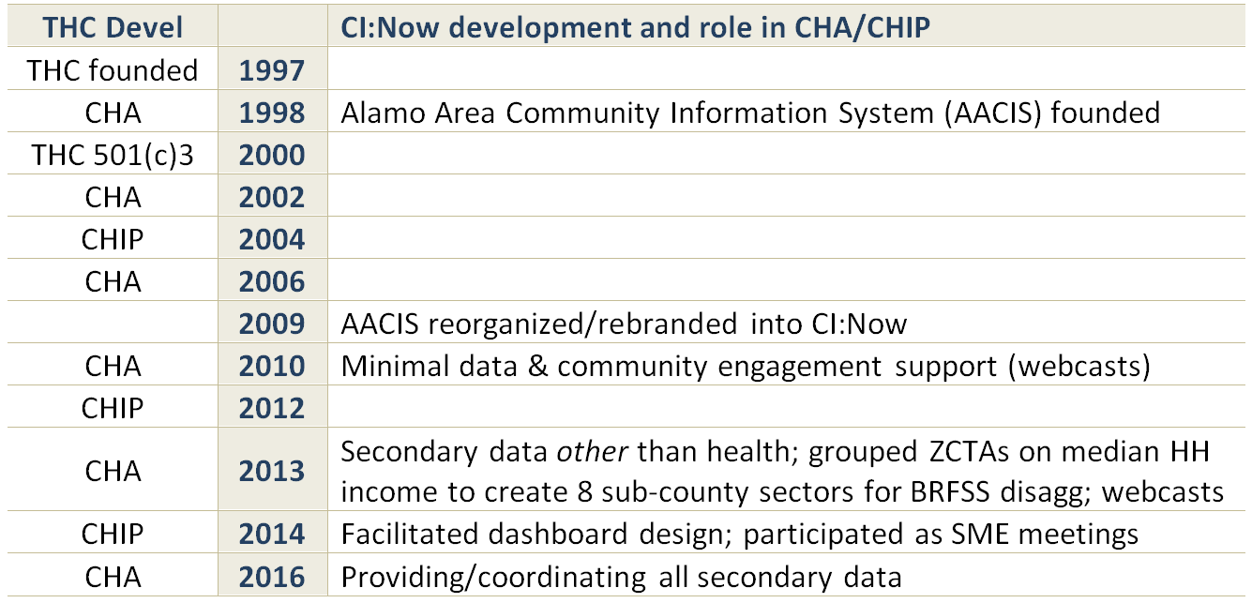
THC and CI:Now have grown together over time
Greater capacity, broader scope of work, wider collaborations

Slide 5

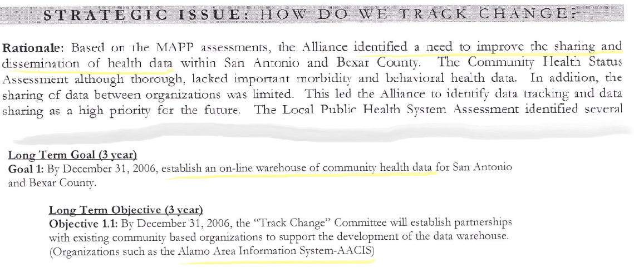
SA was NACCHO MAPP Demonstration Site 2000
http://www.maine.gov/dhhs/mecdc/public-health-systems/mapp/documents/mainemapp-toolkit.pdf

Slide 6
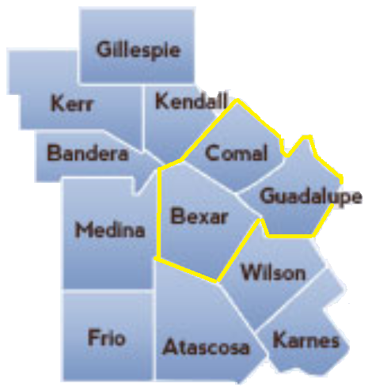
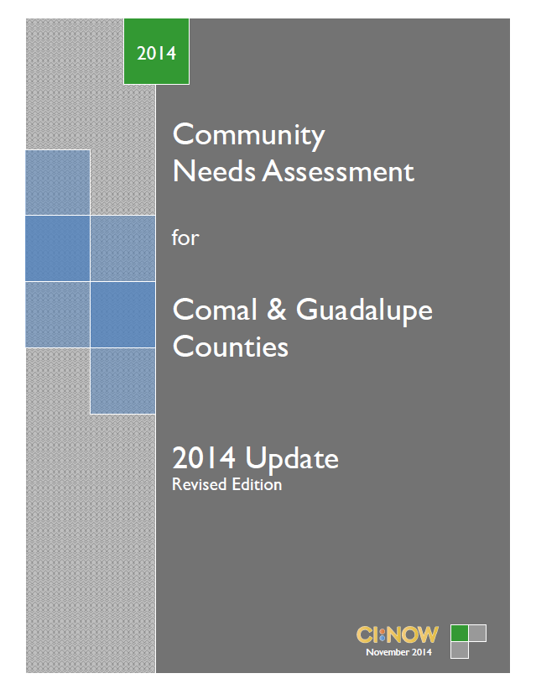
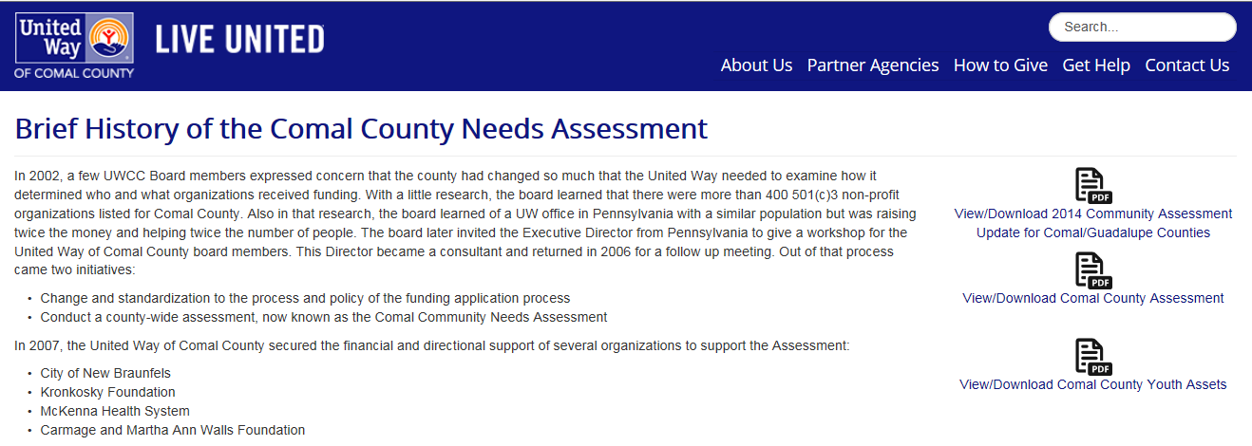
Hospitals in neighboring counties

Slide 7
For more information
Laura McKieran, DrPH
Laura.C.McKieran@uth.tmc.edu
210-276-9007
@iheartdata
CINow.info
HealthCollaborative.net

