Slide 1
Engaging Hospitals as Partners in Community Change
Vickie Boothe, MPH
Lead, Population Health Metrics Team
Division of Public Health Information Dissemination
CDC’s Center for Surveillance, Epidemiology and Library Services
National Neighborhood Indicators Project Meeting
May 7, 2015

Slide 2
Community Health Needs Assessment and Implementation Strategies – Drivers
IRS requirements for tax-exempt hospitals and community benefits every 3 years (n>3,000)
National voluntary public health department accreditation every 5 years (PHAB) (n~2,400)
Federally Qualified Health Centers (n>1,200)
Healthy People 2020/National Prevention Strategy
Other state requirements for needs assessment
Grant requirements or grant-related activities
Notes:
Different drivers have led health agencies and organizations to institutionalize community health assessment and community health improvement planning in recent years.

Slide 3
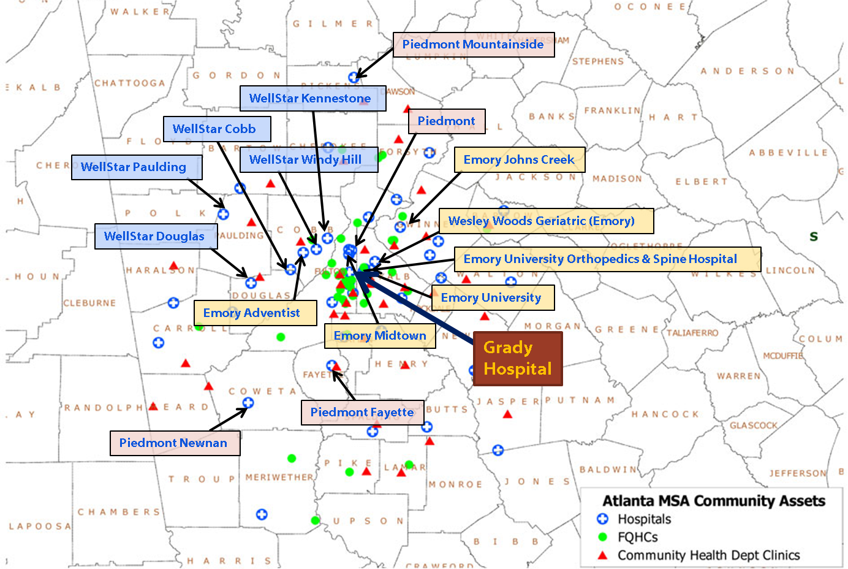
Not-for-Profit Hospitals, Atlanta, 2011
Source: Karen Minyard, GSU NNPHI
Notes:
Teresa
So, how does this information translate in the real world? This is a map of not all, but the larger health system non-profit hospitals in the metropolitan Atlanta area of which there are 23

Slide 4
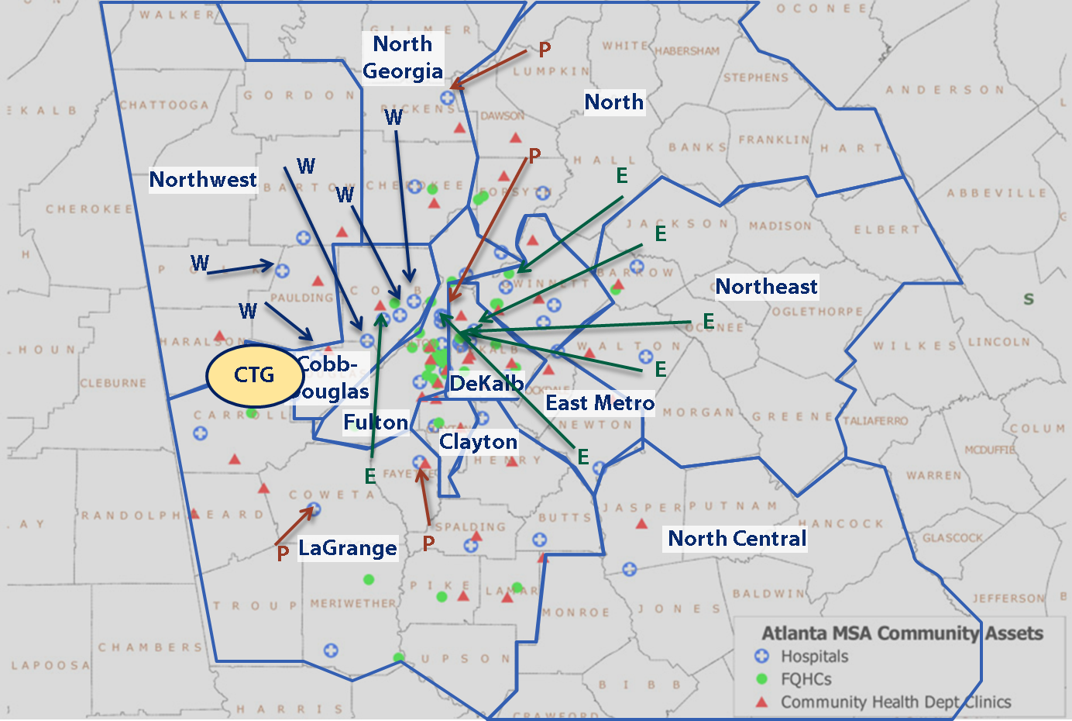
Local Health Jurisdictions, Atlanta, 2011
Source: Karen Minyard, GSU NNPHI
Notes:
Teresa
This is what it look like when you overlay that map with one of the 11 local health departments and Cobb County which is a CTG recipient. Now imagine the duplication of resources and confusion that would likely occur if each of these orgs independently analyzed different sets of data with different messages. Or worse, if all of these orgs tried to engage the same most vulnerable populations of Mechanicsville and Cabbage town around Fulton County Stadium. Or if all of these hospitals contacted the State health department to request a full time Epi for support. An alternative vision is one where these orgs pool their resources, perhaps hire staff from the state or local health departments to conduct one comprehensive assessment of the metropolitan area and then each bring their unique expertise and resources to address the resulting priorities.

Slide 5
Final Regulations for Tax-exempt Hospitals Key Provisions
Hospital organizations must conduct a community health needs assessment (CHNA) and adopt an implementation strategy for addressing “significant” community health needs at least once every three years.
Hospitals “may not define its community to exclude medically underserved, low-income, or minority populations who live in geographic areas from which the hospital draws its patients.”
In conducting a CHNA the hospital must solicit and take into account input from:
  “At least one . . . governmental public health department . . . with knowledge, information, or expertise relevant to the health needs of that community;
  Members of medically underserved, low-income, and minority populations in the community served . . . or individuals or organizations serving or representing [their] interests . . . ; and
  Written comments received on the [hospital’s] most recently conducted CHNA and most recently adopted implementation strategy.”
The hospital “must consider this input in identifying and prioritizing the community’s needs, as well as in identifying resources potentially available to meet those needs.”
Source: Crossley M. Health and Taxes: Hospitals, Community Health and the IRS. Legal Studies Research Paper Series Working Paper No. 2015 05. March 2015
Notes:
Medically underserved includes “populations experiencing health disparities or at risk of not receiving adequate medical care as a result of being uninsured or underinsured or
due to geographic, language, financial, or other barriers”

Slide 6
Final Regulations for Tax-exempt Hospitals Key Provisions (cont’d)
Health needs may include “financial and other barriers to accessing care, preventing illness, ensuring adequate nutrition, or social, behavior and environmental factors that influence health in the community.”
In prioritizing significant health needs a hospital “may use any criteria . . . including, but not limited to, the burden, scope, severity, or urgency of the health need; the estimated feasibility and effectiveness of possible interventions; the health disparities associated with the need; or the importance the community places on addressing the need.”
The CHNAs must be made “widely available” to the public (i.e., published on the hospital website).
CHNA’s for tax years beginning after 12/29/2015 must “include an impact evaluation of the actions taken by the hospital on significant health care needs it identified in its previous CHNA”.
Source: Crossley M. Health and Taxes: Hospitals, Community Health and the IRS. Legal Studies Research Paper Series Working Paper No. 2015 05. March 2015

Slide 7
Common Elements for the Community
Health Improvement Process
Prepare and organize
Engage the community
Develop a goal or vision
Conduct community health assessment(s)
Prioritize health issues
Develop community health improvement plan
Implement community health improvement plan
Evaluate and monitor outcomes
Notes:
While there are different process models of community health improvement, most of them include these common elements.

Slide 8
Community Health Improvement (CHI) Process
Monitoring
Organize
Assess
Prioritize and Plan
Implement
Improved Health Status
Data and Analytic Tools
Evaluate
Shared Ownership among Stakeholders
Ongoing Involvement of Community Members
Notes:
Vickie
This is a diagram of the common steps for community assessment and improvement process. It begins with organization, assessment is the 2nd step which yields 4 products that feed into the prioritization and planning step. Implementation kicks off a continuous monitoring step of the process, outputs and short and intermediate outcomes (which can facilitate mid-course corrections) because you do not want to get 3 or 5 years into the process only to discover that something went wrong in month 3 and that prevented the positive impact on community health. All of this info is fed back into step 1 to facilitate shared learning and continuous improvement. AND the entire process is built on shared stakeholder ownership and meaningful community engagement.

Slide 9
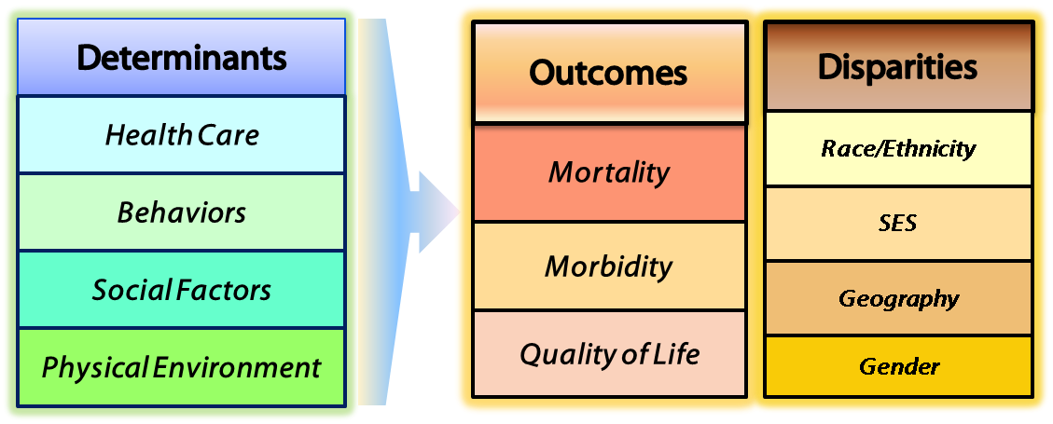
Population Health Framework
Scientific Tools and Resources
Holistic model of population health where health outcomes and disparities are the result of complex interactions between health determinants and individual biology and genetics.
Adapted from: Kindig DA, Asada, Y, Booske B. (2008). A Population Health Framework for Setting National and State Health Goals. JAMA, 299(17), 2081-2083
Notes:
Before I talk about specific products, I want to introduce the population health framework we use for all of our work. The model illustrates how the modifiable determinants combine with genetics and individual biology to create population health outcomes. It also illustrates that when the modifiable determinants are unevenly or inequitably distributed by race/ethnicity, SES, geography or gender, you get population level health disparities.

Slide 10
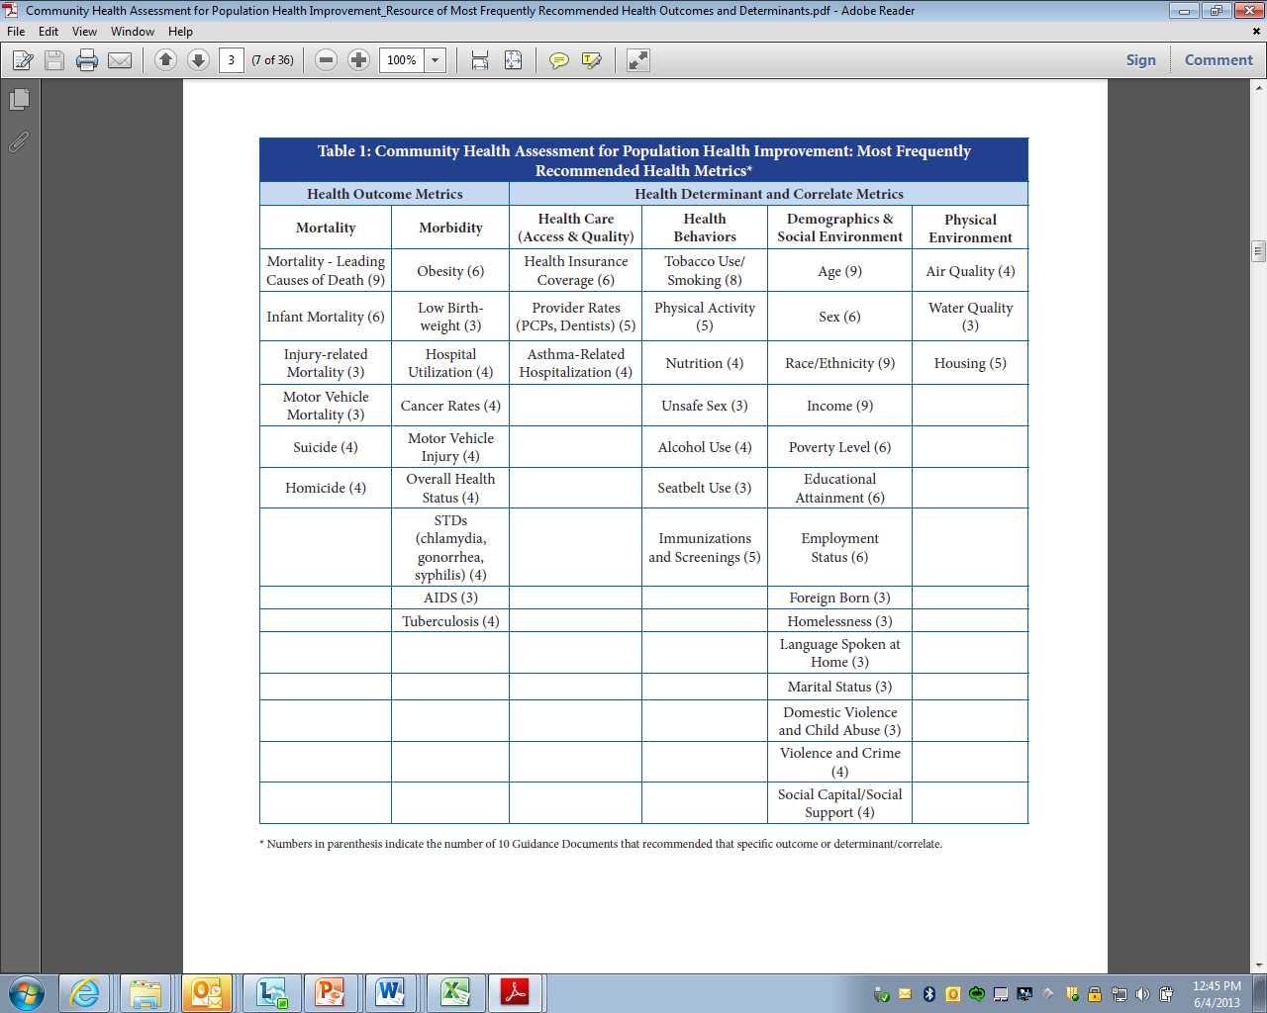
Notes:
Here is a table of the 42, the numbers behind each represent how many of the 10 sources recommended that outcome or determinant.

Slide 11
Redesigning the Community Health Status Indicators (CHSI)
Web-application
wwwn.cdc.gov/CommunityHealth

Slide 12
CHSI 2015 Redesigned Web Application
New and Updated Features
  Updated & refined set of peer counties
  Reorganized in a population health framework
  New and updated indicators
  Indicators by subpopulations & census tract maps to identify disparities
  Peer county comparisons for outcomes & determinants
  Summary comparison page
  Improved user interface
  Improved indicator visualization
Annual Release Strategy
  Biannual updated data release
  Biannual improved functionality release

Slide 13
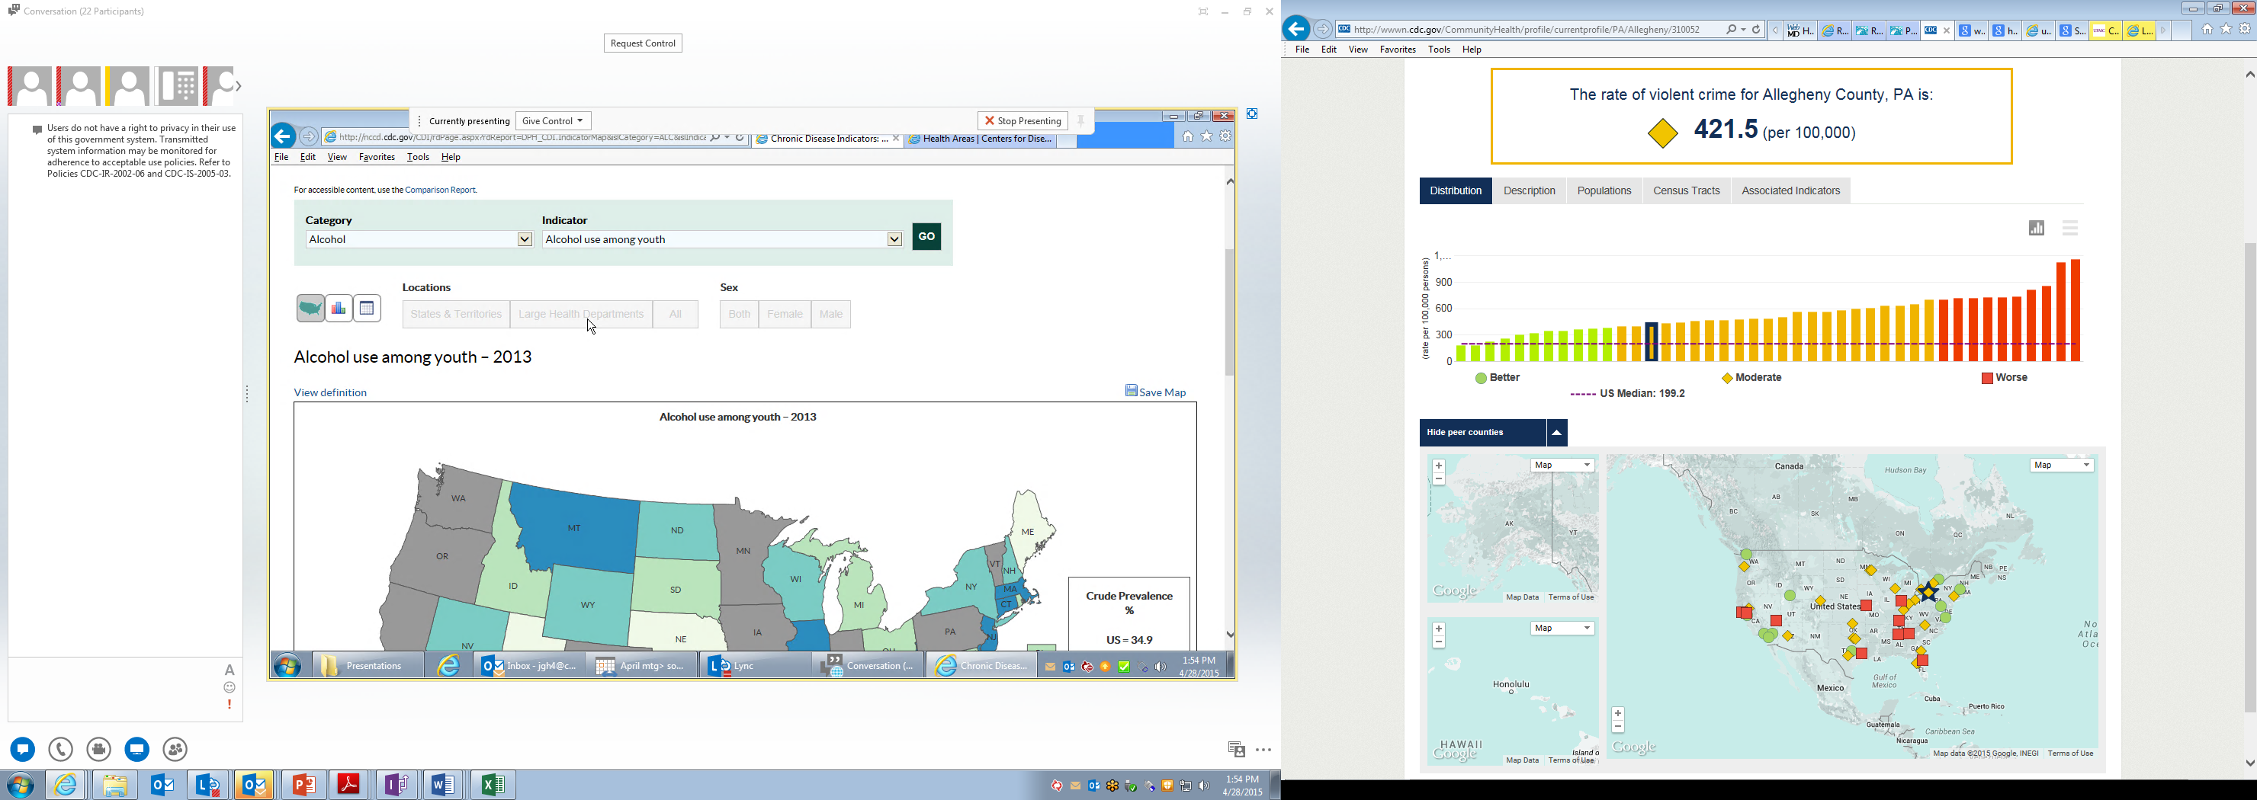
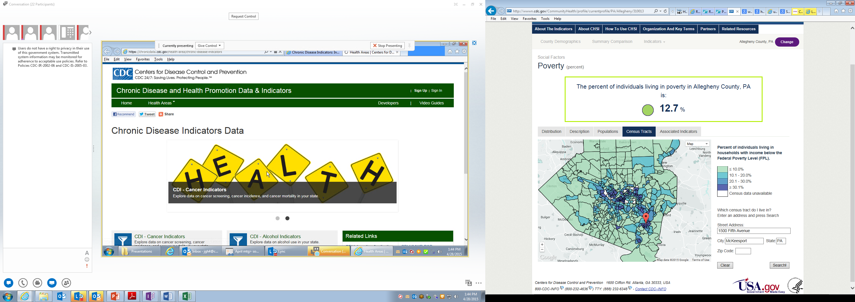
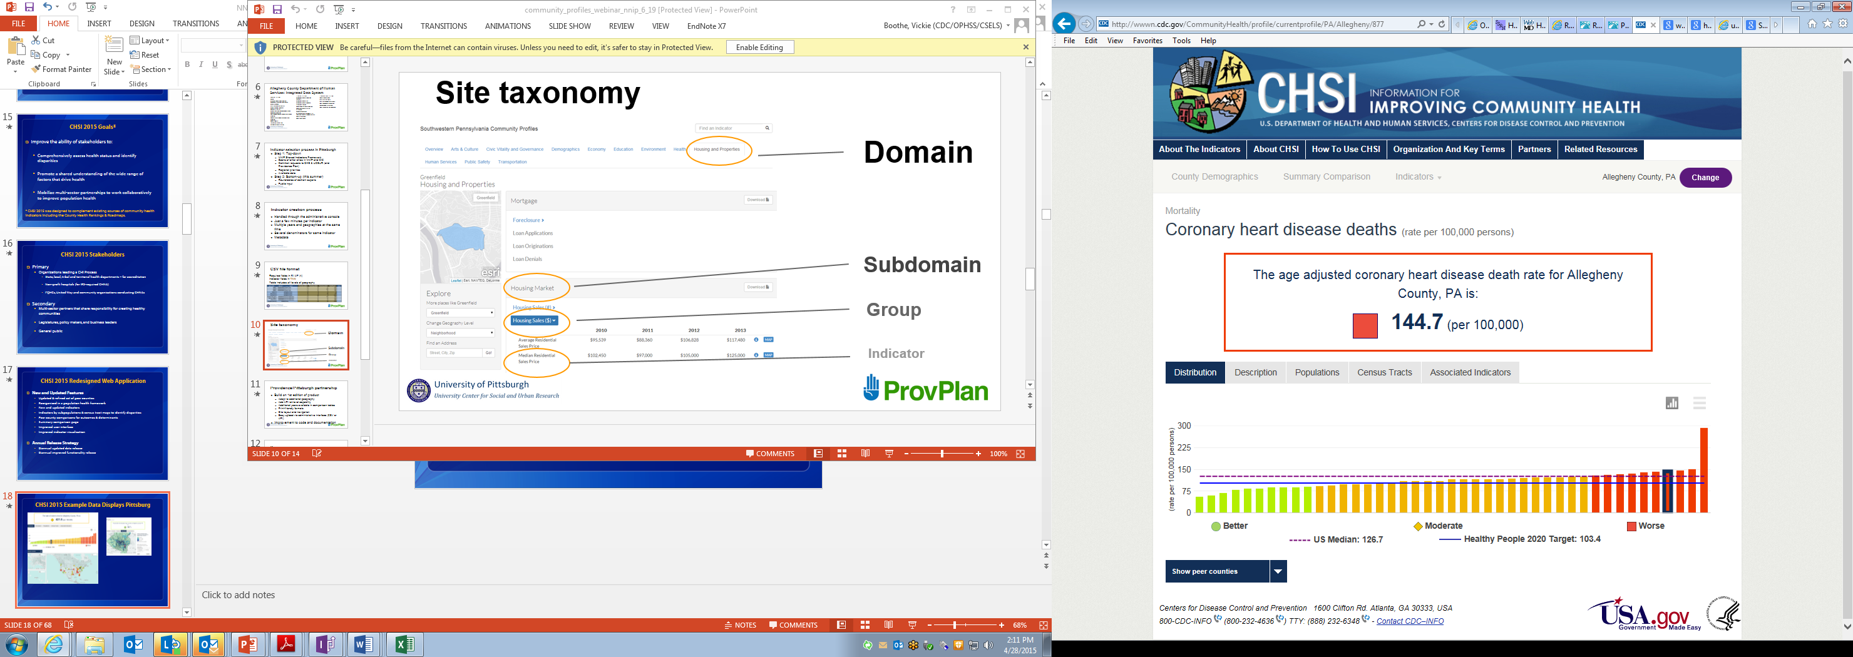
CHSI 2015 Example Data Displays Pittsburgh
Notes:
Map pin identifies the location of UPMC McKeesport, which is located in a high poverty area (>30% below FPL). The 2013 McKeesport CHNA identified Preventative Screenings, Immunizations & Vaccinations, Diabetes, Post-discharge coordination and follow-up as prioritized focus areas

Slide 14
New Scientific resources for identifying and addressing health disparities
Notes:
Our first product relates to the very first questions we received, which was, with all of the various indicator sets and available data, where do you even get started?

Slide 15

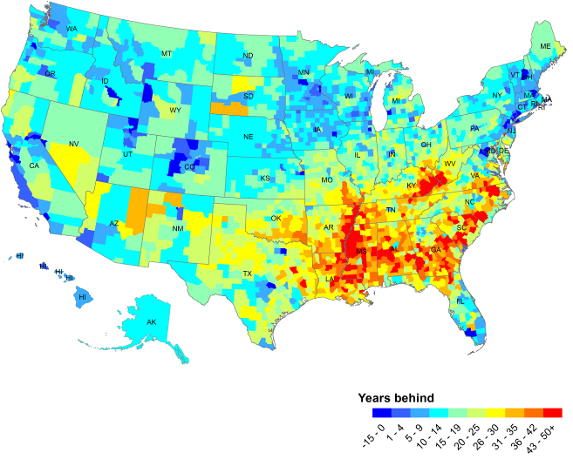
Life expectancy, by county, compared to the world’s 10 best countries
Source: David Fleming, MD, Director and Health Officer. Public Health-Seattle & King County ww.kingcounty.gov/.../health/.../HealthofKingCounty2012.ashx
Notes:
15

Slide 16
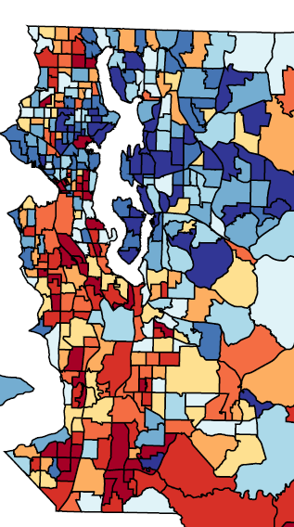
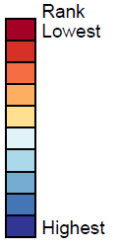
Life Expectancy in King County by Census Tract
Difference of 30 years! (Low of 66; High of 96)
King County Average: 81.6
Tracts with the lowest life expectancy are more than 40 years behind the longest lived countries

Slide 17
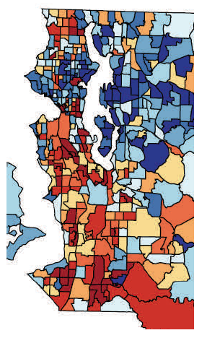
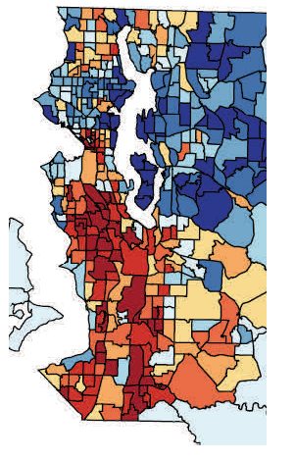
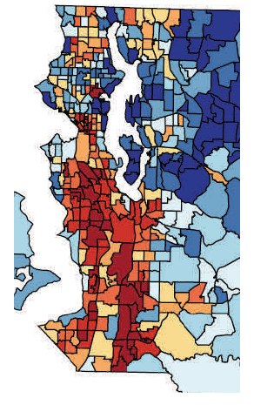
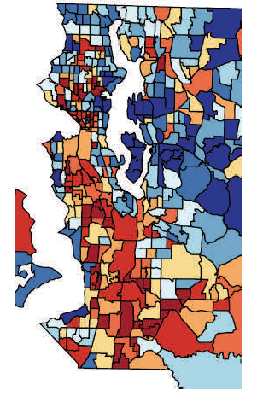
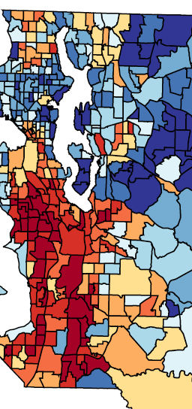
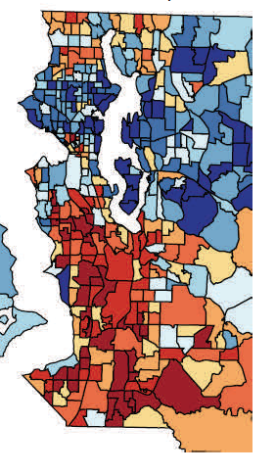
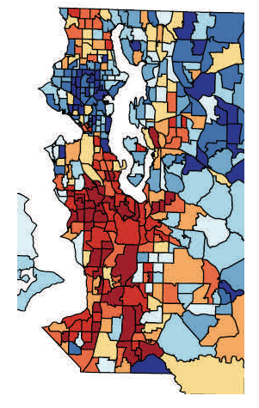
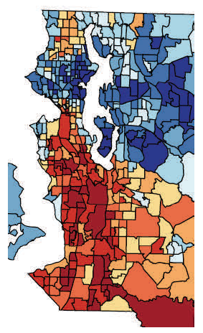
Life Expectancy
Tobacco Use
Frequent Mental Distress
Adverse Childhood Experiences
Lack of Physical Activity
Obesity
Diabetes
Preventable Hospitalization
Source: David Fleming, MD, Director and Health Officer. Public Health-Seattle & King County ww.kingcounty.gov/.../health/.../HealthofKingCounty2012.ashx

Slide 18
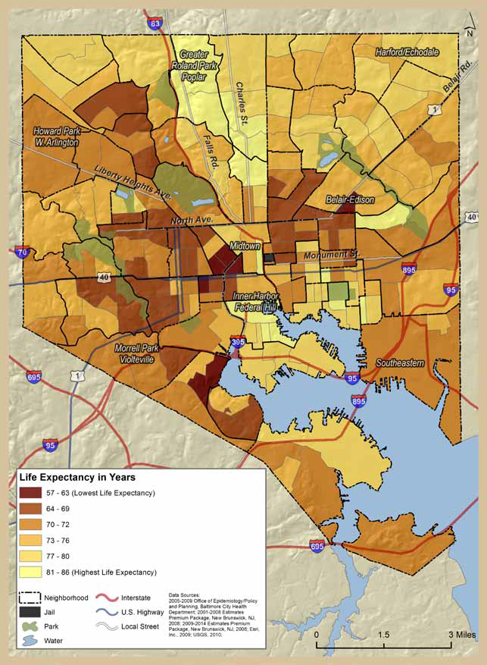
Baltimore Life Expectancy by Census Tract
Baltimore, MD
(Average life expectancy varies from a low range of 57- 63 years up to a range of 81- 86 years.
Joint Center for Political and Economic Studies. Place Matters for Health in Baltimore: Ensuring Opportunities for Good Health for All. Sept. 2012

Slide 19
2015 Collaborative LE Project
Two Year Project
  CDC, Council for State and Tribal Epidemiologists, 8 Health Departments
  Draft Guide & Software for Pilots - June, 2015
Goal
  Develop, pilot, and disseminate a stakeholder driven, easy to use Guide for Calculating and Visualizing Life Expectancy Estimates at the Census Tract Level
Public Health Practice and Research Applications
  Identify and monitor community hot spots of health disparities
  Investigate the potentially contributing behavioral, social and environmental factors
  Examine the degree to which LE and associated contributing factors vary across populations and geographies.
  Raise public awareness on the importance of multi-sector place based factors (i.e., education, transportation, community development, and business) in creating health and health disparities.
Notes:
We are on tract to have a draft guide and software available by June 2015 and we will be looking for health department volunteers to pilot the guide. If you or your PH partners are interested, please contact me.

Slide 20
Vickie Boothe
Email: veb6@cdc.gov
Phone: (404) 498-2826
Center for Surveillance, Epidemiology, and Laboratory Services
Division of Public Health Information Dissemination

Slide 21
EXTRA SLIDES
Notes:
Our first product relates to the very first questions we received, which was, with all of the various indicator sets and available data, where do you even get started?

Slide 22
Principles to Consider for the Implementation of a Community Health Needs Assessment Process
Maximum transparency to improve community engagement and accountability
Multisector collaborations that support shared ownership of all phases of community health improvement
Proactive, broad, and diverse community engagement
Definition of community (broad while addressing disparities)
Use of the highest quality data pooled from...diverse public and private sources
Use of evidence-based interventions and innovative practices with evaluation
Evaluation to inform a continuous improvement process
http://nnphi.org/CMSuploads/PrinciplesToConsiderForTheImplementationOfACHNAProcess_GWU_20130604.pdf
Notes:
Important principles to guide the process. . .

Slide 23
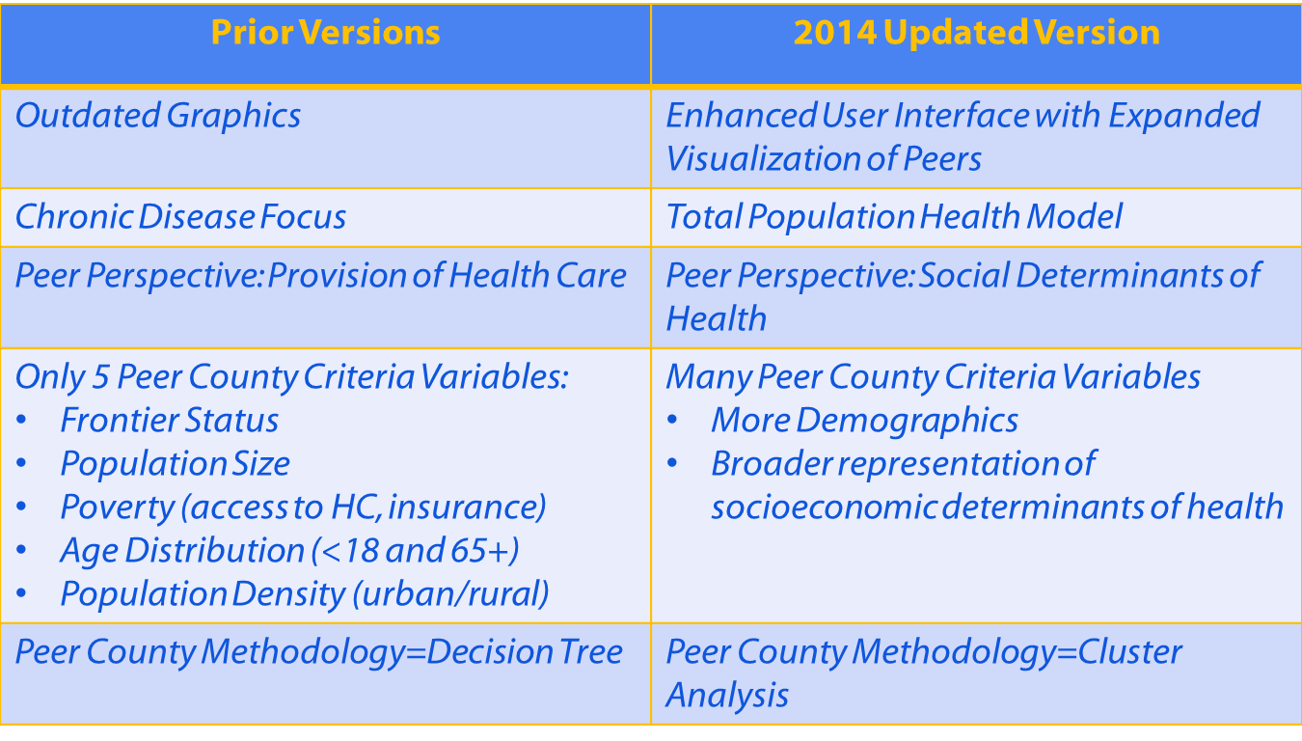
CHSI 2015 Updates

Slide 24

Peers via K-Means Clustering
19 Variables
Population (Size, growth, density, mobility)
Demographics (Children, Elderly, Gender Ratio, Foreign-born)
Education Level
Family Structure (Single Parent)
Housing (Home Value, Housing Stress, Tenure)
Income and Income Inequality
Poverty, Public Assistance, Employment
Urbanicity
89 Peer Groups
Average Size : 35 Counties
(Range= 9-78)

