Slide 1
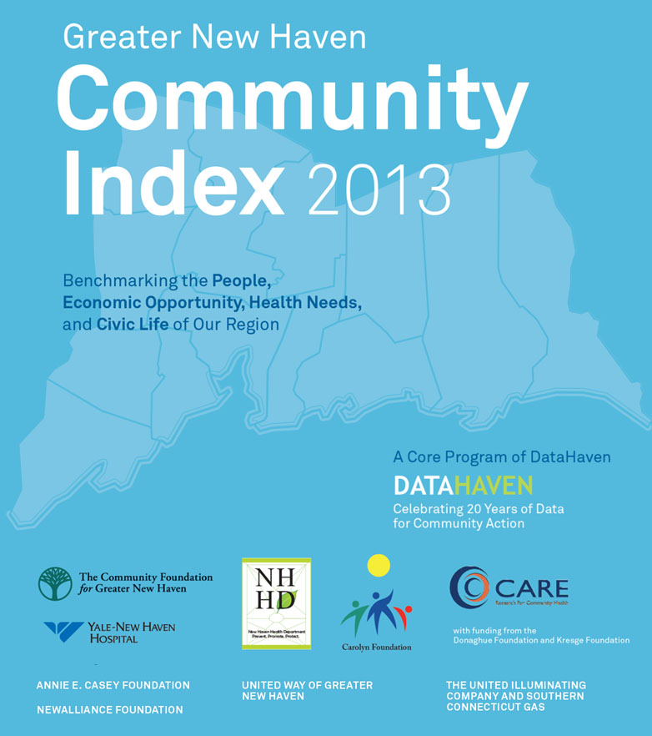
Lead Author
Mark Abraham
Co-Authors
Sarah Conderino
Nicholas Defiesta
Amanda Durante
Mario Garcia
Matthew Higbee
Jeannette Ickovics
Augusta Mueller
Jonathan Park
Download
www.ctdatahaven.org

Slide 2
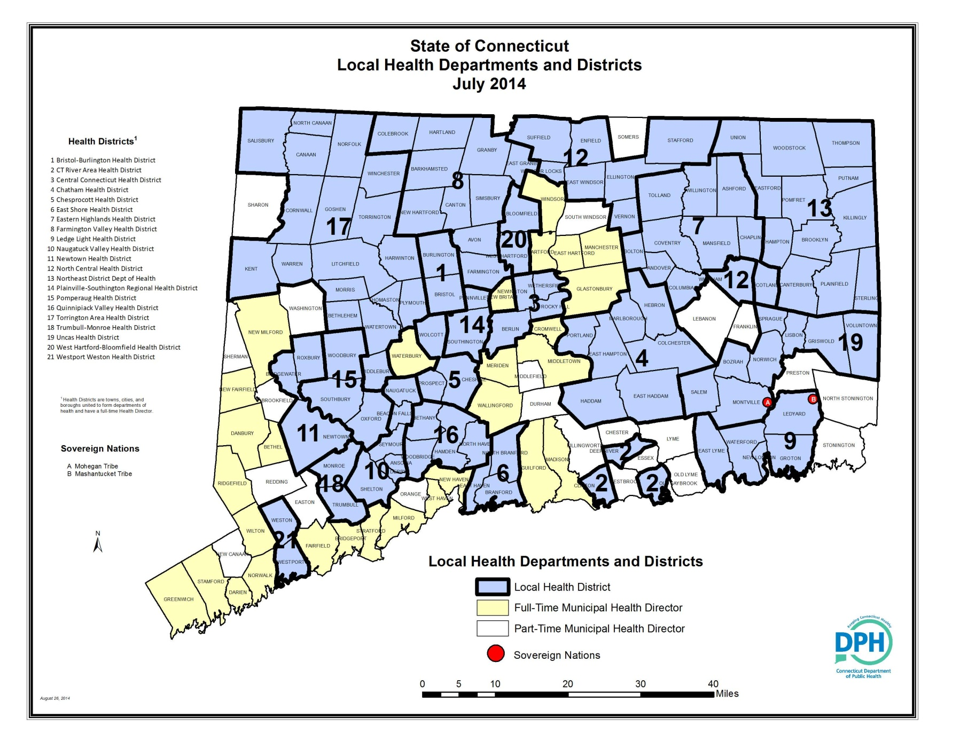
Community Wellbeing Survey – Rationale
169 Towns, Median
Population:
13,000
DATAHAVEN

Slide 3
Community Wellbeing Survey – Rationale
Individual Wellbeing and Quality of Life
Civic Satisfaction*
Community Optimism
Civic Engagement
Health Outcomes*
Health Behaviors
Healthcare Access
Employment*
Food & Housing Security*
Neighborhood Environment (Safety, Parks, Walkability, Social Cohesion)
Education Access Economic Mobility Transportation Housing Quality
Macroeconomic Trends Demographics
* = Key determinant of individual well-being (OECD, 2014)
DATAHAVEN

Slide 4
Community Wellbeing Survey – 2012 Funders
DATAHAVEN

Slide 5
Community Wellbeing Survey – 2015 Funders
DATAHAVEN

Slide 6
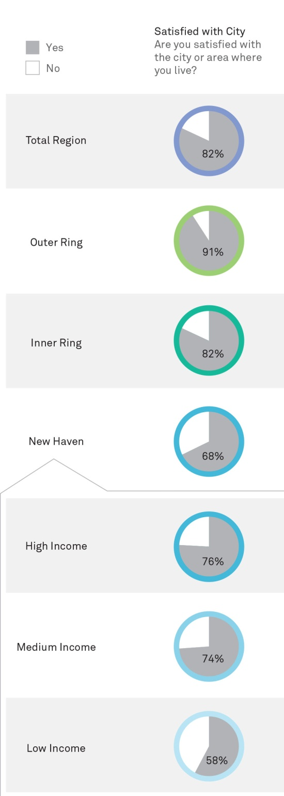
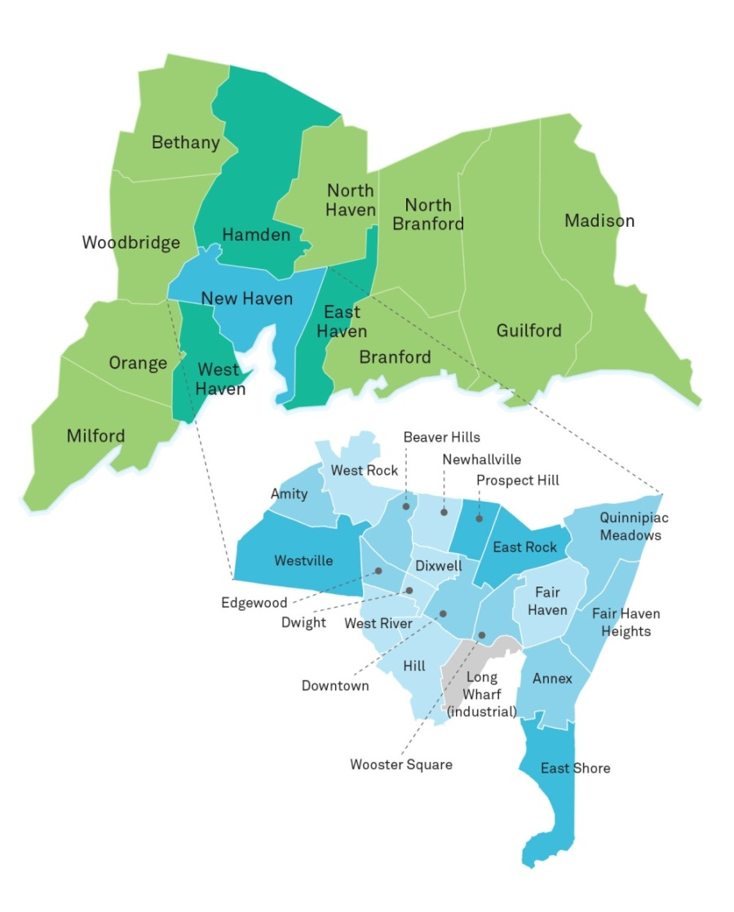
Community Index
DataHaven Greater New Haven Community Index 2013
DATAHAVEN

Slide 7
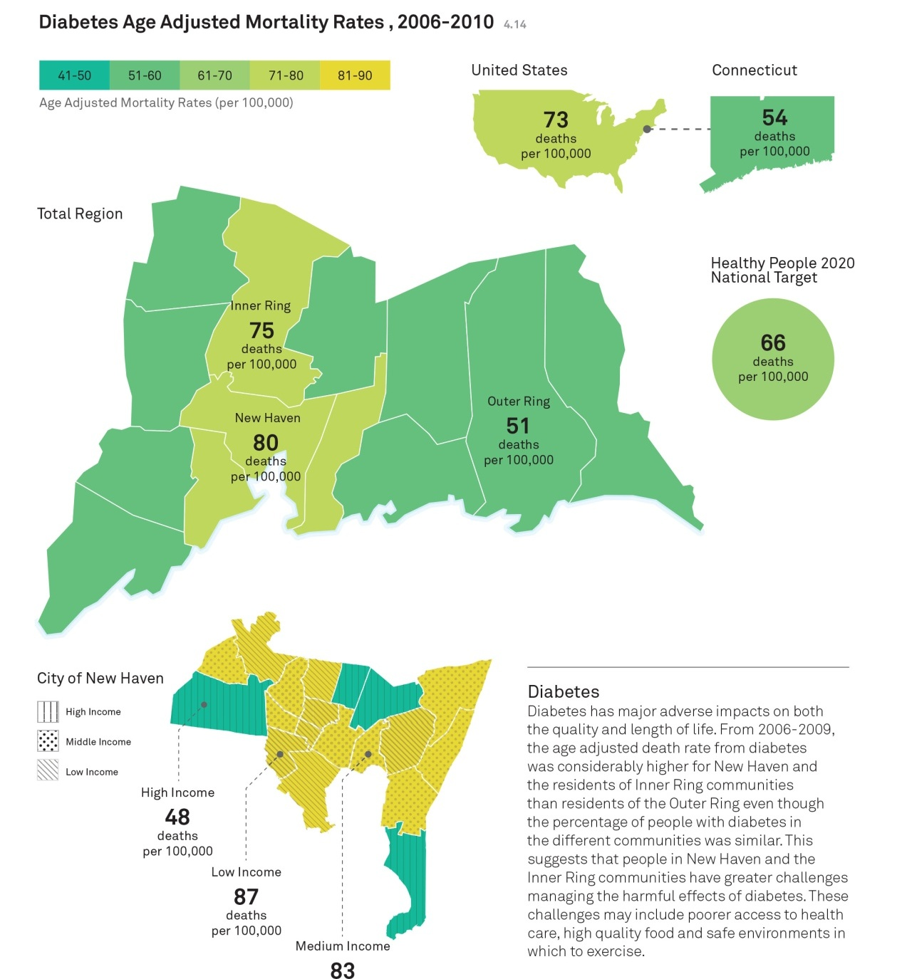
Community Index
Key Values
Neighborhood-level data
National context
Reliable, stable baselines
DATAHAVEN
DataHaven Greater New Haven Community Index 2013

Slide 8
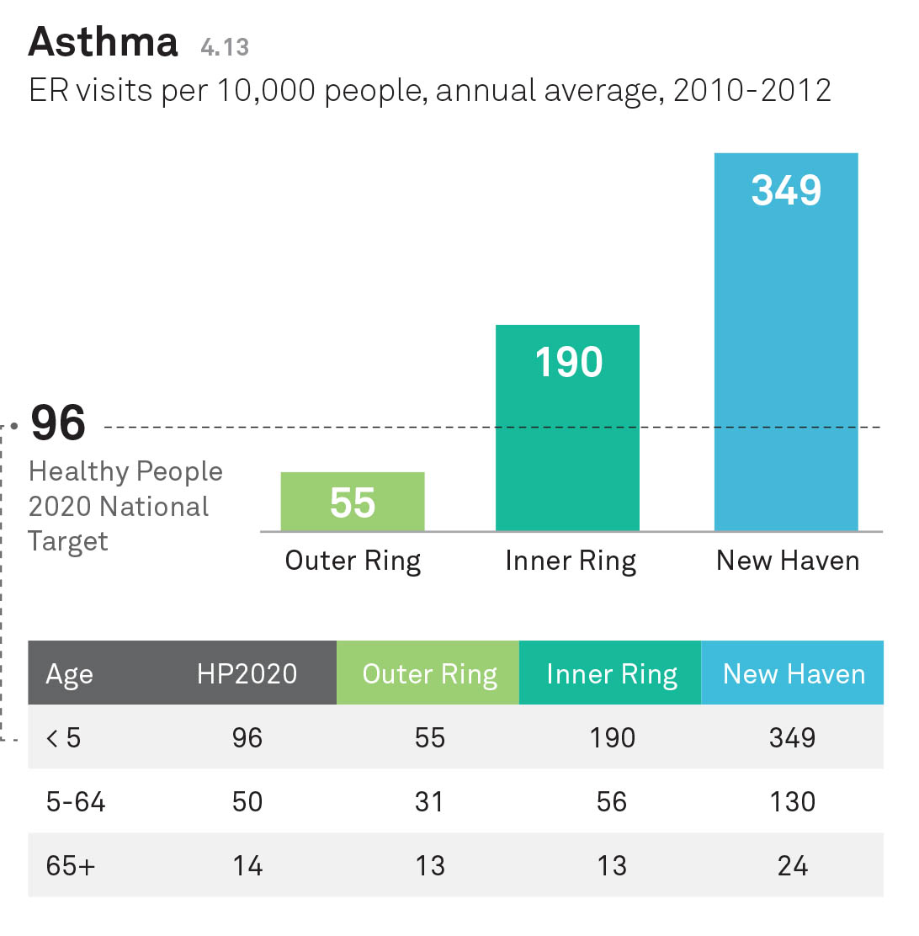
Community Index
DATAHAVEN
DataHaven Greater New Haven Community Index 2013

Slide 9
Community Wellbeing Survey: 2012 Example
DATAHAVEN

Slide 10
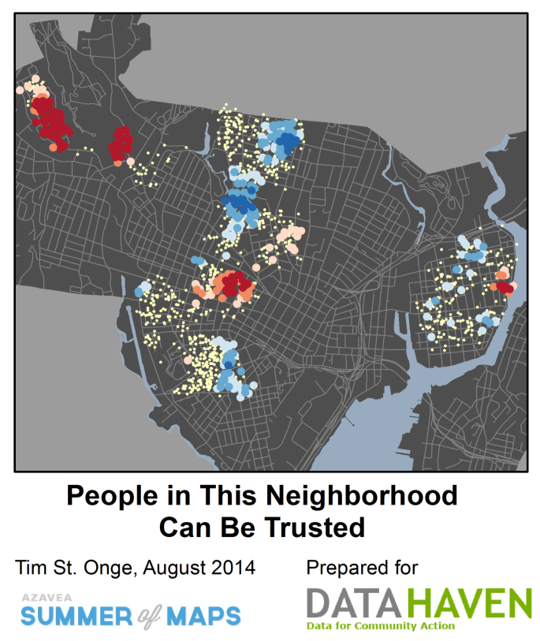
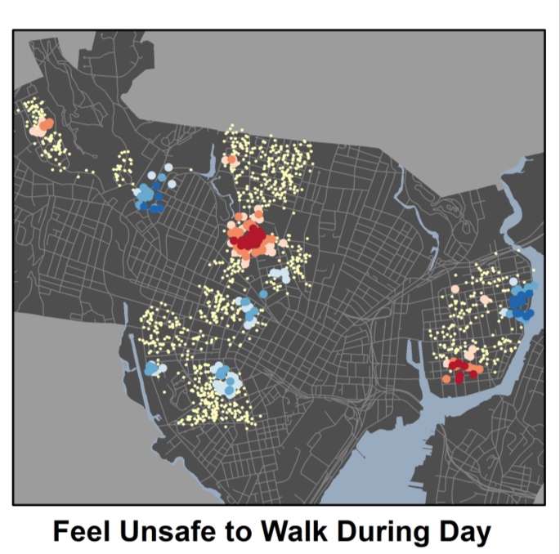
Community Wellbeing Survey: 2012 Example
DATAHAVEN

Slide 11
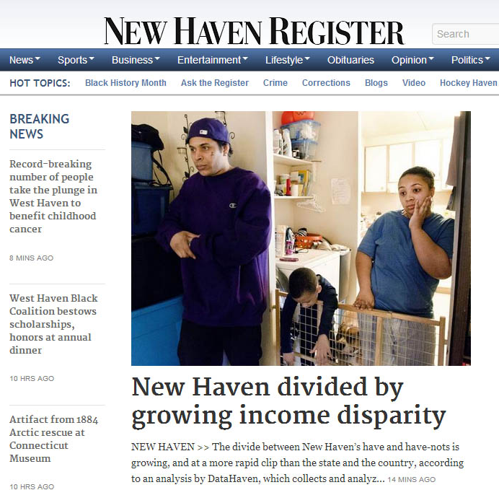
Community Index – Measuring Results
DATAHAVEN

Slide 12
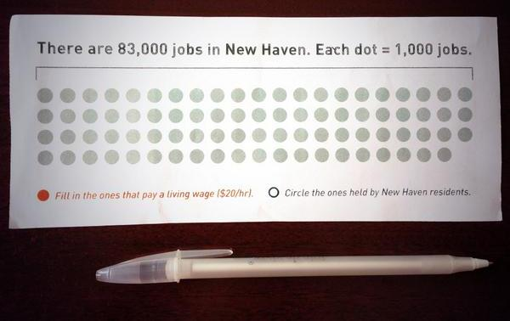
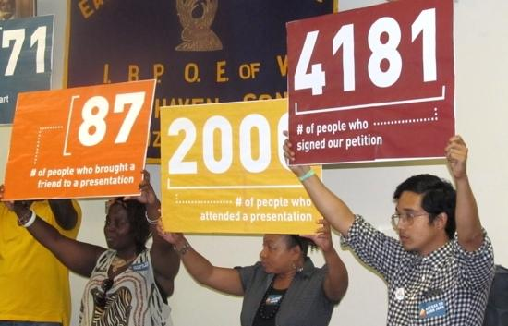
DATAHAVEN

Slide 13
Key Values for Health & Well-being Coalitions
Locally-driven agenda and process
Meaningful neighborhood data on health & well-being
Situation analysis & evaluation requires reliable, local-level information (often nonexistent)
Community engagement across multiple sectors
State & Local Government (Health/Other)
Health Care
Community and Philanthropic
Academic
Private Sector
Economies of scale – one product with multiple uses
DATAHAVEN

