Slide 1
The Rhode Island DataHUB
Bridging Data Silos to Inform Policy
Rhode Island Department of Education and The Providence Plan

Slide 2
Background
Initial scope part of US Department of Education Office of Safe and Drug Free Schools grant through RIDE
Five State agencies: RIDE, HEALTH, DCYF, BHDDH, Family Court
Grant required linkage, not a system
ProvPlan and RIDE saw opportunity to build IDS
ProvPlan

Slide 3
ProvPlan’s Role
Private non-profit (neutral ground)
Established data sharing agreements
HEALTH
RIDE, PPSD
DCYF
Etc.
Experience linking Health and Education records
Database programming, data analysis & presentation, web design, spatial analysis
ProvPlan

Slide 4
Data Sources
Data Sharing Agreements Executed:
RIDE, Providence Schools
HEALTH
Higher Education (RIOHE)
Dept. Children Youth, Families (DCYF)
Dept. of Corrections
Providence City Agencies (Police, Assessor, etc.)
Dorcas Place/Full Service Community Schools
Providence After School Alliance (PASA)
In the works:
DHS/EOHHS
Dept. of Labor and Training
Family Service RI
ProvPlan

Slide 5
Funding
RIDE (SDFS)
Casey (FSCS)
Higher Ed (CACG)
RIDE (LDS I)
Casey (DCYF)
RIDE (LDS II)
Higher Ed (CACG II)
DLT (Workforce Programs)
Up to summer 2012
Just starting
Early II2013
ProvPlan
Notes:
CACG= College Access and Completion Grant

Slide 6
Different Tools for Different Users
Data Stories (most basic): interactive slideshows that guide visitors through data on a specific policy or programmatic question
Reports (mid-level): single page data snapshots that allow users to explore data on a single topic
Do-it-yourself Weave (advanced) Visualization tools from Open Indicators Consortium (OIC)
Data Catalog (essential for advanced): search indicators, metadata, ilists
User Guides: FAQs, video tutorials, tip sheets
ProvPlan

Slide 7
DCYF Data Story: A Case Study of Convincement
Original participant in SDFS Grant
Shy about sharing data
Needed a convincing example
Use RIDE data on “DCYF Kids” to create Data Story
Data began to flow…
http://ridatahub.org/datastories/an-early-warning-story/1/
ProvPlan

Slide 8
Note: No linked data necessary! Just data all in one place.
ProvPlan

Slide 9
ProvPlan

Slide 10
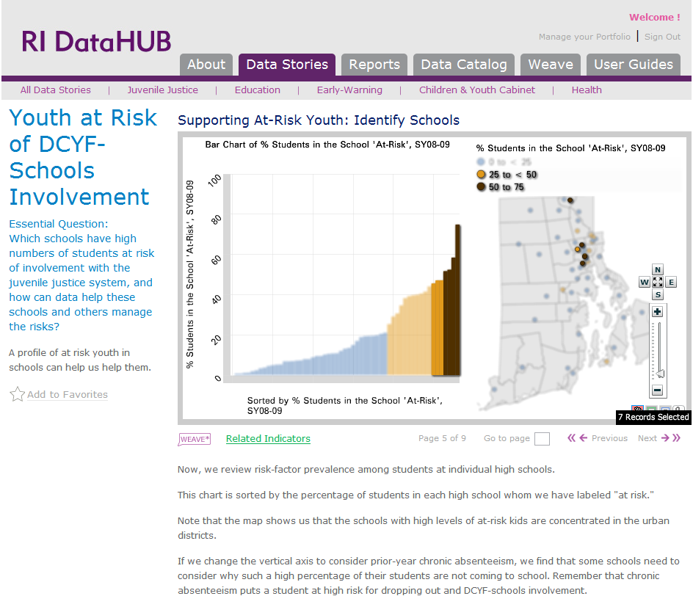
ProvPlan

Slide 11
Peg Votta, RIDE
The Agency Perspective

Slide 12
What is the value of the DataHUB to the RIDE?
Flexibility – Many ways to manipulate the data
Building partnerships (HEALTH, DCYF, DLT)
Neutrality – Data Switzerland
Large federated system
Broad appeal to multiple users
Changing a Data Culture

Slide 13
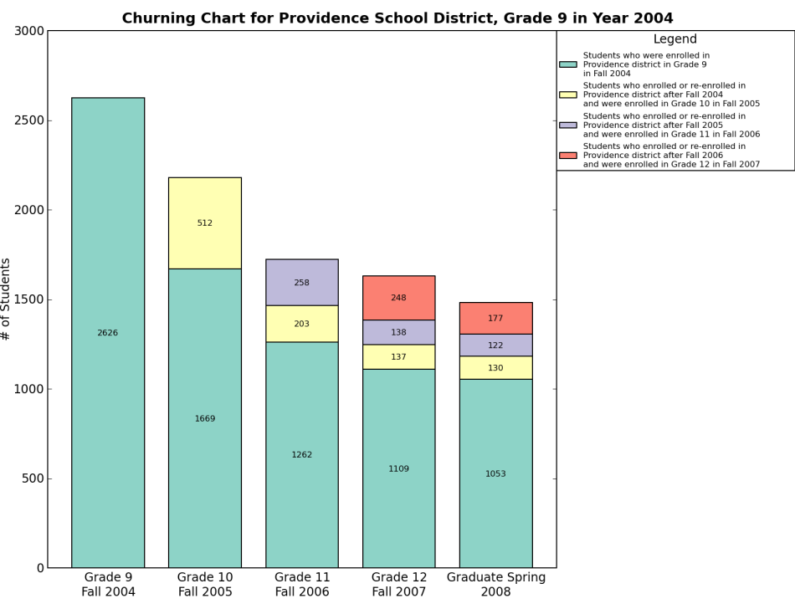
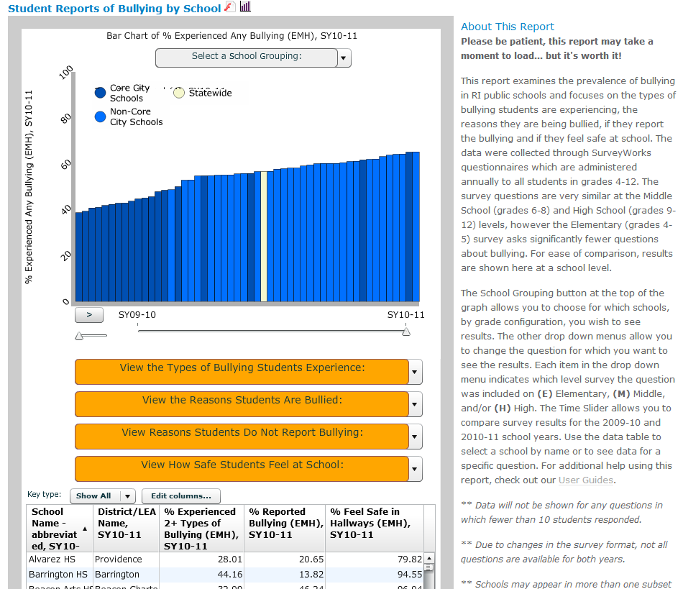
Benefits Beyond Linkage?
Better access to RIDE’s own data
Strong cross-agency relationships
Statewide capacity building

Slide 14
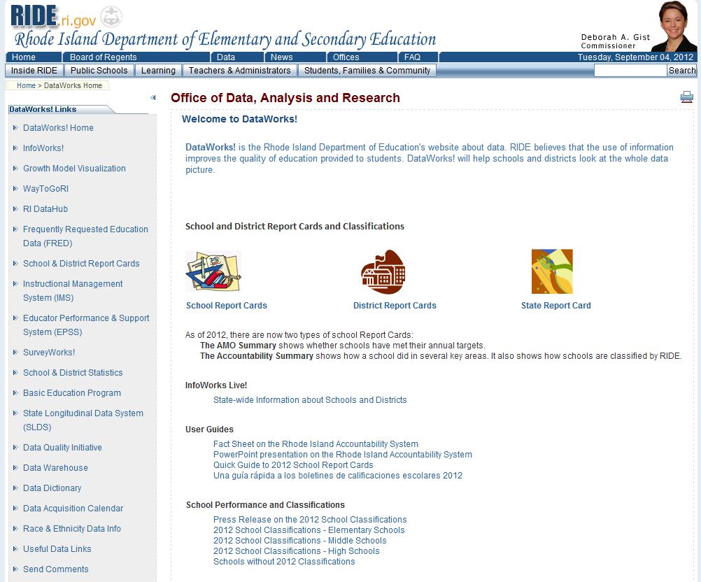
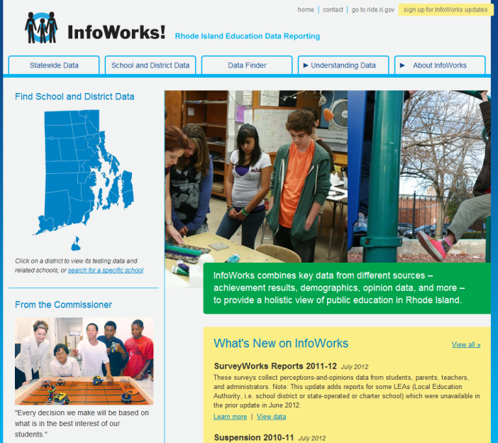
An Essential Piece

