Slide 1
Connecting People and Place: Improving Communities through Integrated Data Systems Chronic School Absenteeism in Pittsburgh PA
Sabina Deitrick, PhD
University Center for Social and Urban Research
University of Pittsburgh
NNIP, 7 May 2015
IDS Team: Feifei Ye, PhD, Caiyan Zhang, and Josh Childs

Slide 2
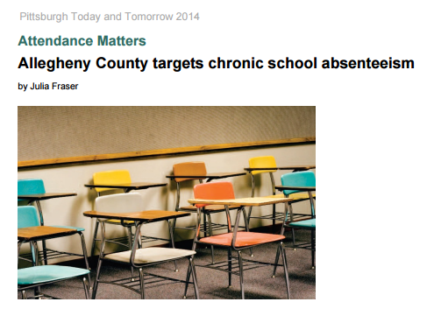
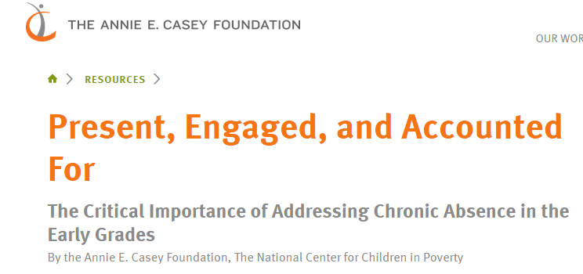
Local and national work on the importance of School Attendance

Slide 3
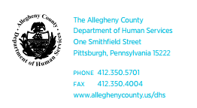
Local leader on data integration – Allegheny County Department of Human Services

Slide 4
Research Question Framework
.
Factor | Community | School | Property | Family | Student
Safety | Crime Ex-offenders | Incidents Bullying Building condition | Vacant property Property condition Code violations | Specific incidents Involvement with justice system | Involvement with justice system Walking paths
Instability |  | Teacher turnover Principal turnover | Tax delinquency Foreclosure Vacant property Affordability Home ownership status Financial distress | Relocation Homelessness Change in composition Parent in prison Finances | School change Mode of travel
Health | Pollution Teen births Food availability | Building condition | Age of housing Housing condition Public housing |  | Mode of travel
School | Poverty Race | Principal stability Suspension policies Teacher attendance Student perf. Special education |  | Participation in school activities | Poverty Race Special education
Employment | Labor force participation |  |  | Employed family members Transit access | Work patterns and industry

Slide 5
Connecting people and place in Pittsburgh
DHS-Children, Youth & Families
Housing authorities
School district student data
Allegheny County government
DHS=Drug & Alcohol
Municipal government
Public Welfare – SSI, TANF, FS
DHS-Child Welfare
US Census data
DHS-Early Intervention
DHS-Family Support Centers
Allegheny County Department of Human Services Data Warehouse
University of Pittsburgh Center for Social and Urban Research Regional Data Center
DHS Hunger & Homeless
DHS-JPO Children
Integrated data system of people, place and parcel for studying school chronic absenteeism in Pittsburgh
DHS-Mental Health
DHS-Mental Retardation & Developmental Disabilities

Slide 6
Data and analysis – Pittsburgh Public Schools
24,205 students included for 2013.
Chronic absence ≥ 10% excused + unexcused absences
6,129 students chronically absent in 2013, or 24.7%
First steps – CART analysis
Input advisory board
Neighborhood outreach and dissemination

Slide 7
Chronic Absence, Students Pittsburgh Public Schools, 2013

Slide 8
Factors and conditions affecting school attendance
INDIVIDUAL | NEIGHBORHOOD (tract) | HOME (parcel)
Demographic factors | Race | HH homeowner (estimate)
Reduced lunch status | Percent below poverty | Year built
DHS program involvement, by program | Violent crime | Property recent sale and sales price
Within year school move(s) | Median residential sales price
Old for grade | Tax delinquency
 | Median family income
 | Median recent sales price
 | No. residential structures built before 1914

Slide 9
Classification and tree analysis (CART) – Preliminary results of top predictors of chronic absence, Pittsburgh Public Schools, 2013
K – 5th grade students
6 – 12th grade students
Within-year school move(s) (PPS)
Median sales price of residential units (ACS)
Old for grade (PPS, DHS)
Percent poverty (ACS)
Violent crimes
Minority population (ACS)
Poverty (SSI,TANF, FS) (DHS)
Estimation of homeownership (UCSUR)
Within-year school move(s) (PPS)
Free lunch (PPS)
Poverty (SSI, TANF, FS) (DHS)
Median sales price of residential units (ACS)
Minority population (ACS)
Old for grade (PPS, DHS)
Percent poverty (ACS)
Estimation of homeownership (UCSUR)

Slide 10
Other top five predicators of chronic absenteeism, PPS by grade
DHS – Hunger and Homelessness (K, Grade 6)
DHS – Mental Health (Grades 3, 4, 5)
DHS – Children, Youth & Families (Grades 3, 8)
Public Housing (Grades 5, 12)
DHS –Juvenile Justice (Grade 7)

Slide 11
