Slide 1
Early adult outcomes for a Cleveland Metropolitan School District (CMSD) 9th grade cohort: How do youth with foster care and delinquency spells differ from their peers?
Claudia J. Coulton, Ph.D., Professor
David Crampton, Ph.D., Associate Professor
Seok-Joo Kim, Ph.D., Postdoctoral Scholar
Youngmin Cho, M.A., Graduate Assistant
Center on Urban Poverty & Community Development
May 7, 2015 | Pittsburgh, PA

Slide 2
Annie E. Casey Foundation (AECF) and National Neighborhood Indicator Partnership (NNIP) cross site project
Purposes
To combine data from local and state Integrated Data Systems (IDS) with neighborhood information
To address an important program and policy question regarding foster care and juvenile justice system
To enable community and neighborhood partners to take data driven action to improve outcomes for at risk youth

Slide 3
Why focus on system involved youth?
High level of community concern about youth aging out of foster care and youth involved in juvenile justice system
Problematic outcomes based on empirical studies
High school drop out rates
Failure to matriculate at post-secondary schools
High unemployment rates
Homelessness episodes
Involvement with criminal justice system

Slide 4
Why an Integrated Data System (IDS) approach?
Cuyahoga County and State of Ohio both have IDSs
Allows system involved youth to be compared with peers who are not system involved
Captures variability in the youths’ experiences
Foster care
Juvenile delinquency
Dually involvement
Differentiates of the at-risk youths from those who are likely to thrive
Helps providers and other decision-makers better target the appropriate services to the most vulnerable youth

Slide 5
Research questions
1
What is the incidence of involvement in the foster care and juvenile justice systems among youth in Cleveland Metropolitan School District (CMSD)?
System involvement
Foster care
only
Delinquency
only
Dually
involved
No involvement
2
How do system involved youth differ from their school and neighborhood peers on selected indicators of problems in transition to adulthood?
System involvement
Foster care
only
Delinquency
only
Dually
involved
Indicators
of transition to
adulthood
No involvement

Slide 6
Adult transitions for system involved youth : Longitudinal IDS model
Outcomes
Crime rates
Concentrated disadvantage
Residential instability
Immigrant concentration
Jail
TANF
SNAP
Medicaid
Nhood
School year
: 2005-06
2006-07
2007-08
Family
Home-
less
9th
10th
11th
12th
G
Individual
Education
Ohio Graduation
Test (OGT)
System
Involved
Attendance
Proficiency test
School mobility
Demographics
Disability
Language
Work
Delinquency
Abuse/Neglect
Out-of-home
placement
Employment
Earnings
Source:
Local
IDS
State
IDS
Census
Data

Slide 7
Data integration: Local and State IDS, and Neighborhood Indicators
CHILD system
Ohio Longitudinal
Data Archive
Educational Outcomes*
High school graduation
Attendance
Homelessness*
Jail involvement*
Individual characteristics
Demographic
Geographic identifiers
Disability
Mobility
School / Residential
Public assistance
TANF / SNAP/ Medicaid
Child welfare
Child maltreatment
Foster care
Permanent custody placement
Juvenile justice
Delinquency
EMIS
Educational Outcomes*
Individual characteristics
Migration
(State Student ID)
Workforce data
Employment records*
(SSN)
NEO CANDO
Neighborhood context
Concentrated disadvantage
Residential instability
Crime
(Census tract)
(ECIID)
Note. *Outcome variables; EMIS(Ohio Education Management Information System);
NEO CANDO(Northeast Ohio Community and Neighborhood Data for Organizing, http;//neocando.case.edu/)

Slide 8
Sampling
Sampling criteria
Youth who were first enrolled in 9th grade at CMSD from school year 2005/06 to 2007/08^{a)}
Youth were born after 01/01/1991^{b)}
Sample
Followed through the 12th grade and their first several years of early adulthood
12,489 students (based on the analysis of CMSD records)
Note. CMSD (Cleveland Metropolitan School District, OH), a) Unduplicated cases, b) Data availability
School year |  | 2005/06 | 2006/07 | 2007/08 | Total
N |  | 2,403 | 4,846 | 5,240 | 12,489

Slide 9
Foster care and delinquency of CMSD 9th grade cohorts : Between 9th grade and age 18
N(%)
9,553
(76.5%)
2,524
(20.2%)
205
(1.6%)
206
(1.7%)
9th
grade
Age 18
Foster care only
Delinquency only
Dually
involved
No involvement
(N=12,489)

Slide 10
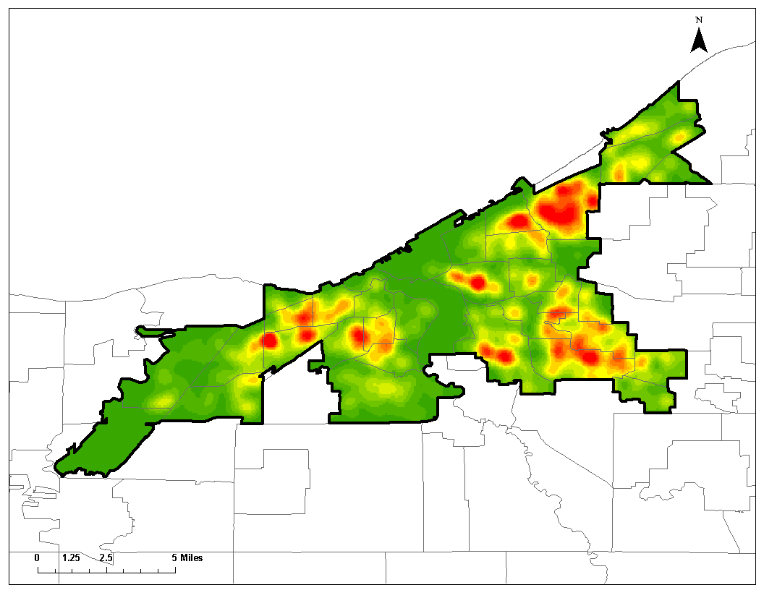
Density of system involvement (foster care and/or delinquency, n=2,935)
between 9th grade and age 18: Residential locations at 9th grade
Density (kernel) level
Cleveland Metropolitan School District
Low
Middle
High
Source: 1. Cleveland Metropolitan School District (CMSD)
2. Cuyahoga County Department of Children and Family Services
Note: System involved youth: n=2,935, 23.5 % of total sample
Total sample: 9th graders in years of 2005/6-2007/8 (N=12,489)

Slide 11
Academic trajectory of 2005 CMSD school entry cohort*: All youth vs. system involved youth
All
youth
2,403 (100%)
1,380 (57%)
1,118 (47%)
748 (31%)
Milestone
9th grade
enrollment
at CMSD
12th grade
enrollment
at CMSD
High school
graduation
at CMSD
College
matriculation
(Age 18-21)
System
involved
youth
491 (100%)
163 (33%)
101 (21%)
53 (11%)
Note. *Only the youth who were first enrolled in 9th grade at CMSD in school year of 2005/06 (N=2,403)

Slide 12
Homeless services use of CMSD 9th grade cohorts between age 18 to 21: By system involvement between 9th grade and age 18
No involvement
Dually
involved
Delinquency only
Foster care only
χ² (3)=233.04, p<0.001
(N=12,489)
No homeless service use =12,158 (97.4%)
Homeless services use=331(2.7%)
Mean of days=179.7 days

Slide 13
Homeless services use of CMSD 9th grade cohorts between age 18 to 21: By demographics, system involvement, and school attendance
Results of logistic regression analysis predicting homeless services use between age 18 and 21
Variables | Odds Ratio
Age at 9th grade (Mean=14.2, SD=0.58) | 1.232 | *
Gender (Female=1, 50.3%) | 1.717 | ***
Race (Reference=White or others, 16.0%)
African American (Yes=1, 72.6%) | 2.349 | ***
Hispanic (Yes=1, 10.2%) | 0.976
Foster care between 9th grade to age 18 (Yes=1, 3.3%) | 5.305 | ***
Delinquency between 9th grade to age 18 (Yes=1, 21.9%) | 1.961 | ***
Attendance rate at 9th grade above 89% (Yes=1, 47.6%) | 0.795 | ⁺
Model χ² (7)=200.606, p<0.001; N=12,489;
Homelessness services use between age 18 and 21 (Yes=1) =2.7%
Note. ⁺p<.10 *p<.05 **p<.01 ***p<.001

Slide 14
Jail involvement of CMSD 9th grade cohorts between age 18 to 21: By system involvement between 9th grade and age 18
No involvement
Dually
involved
Delinquency only
Foster care only
χ² (3)=1816.958, p<0.001
(N=12,489)
Not involved in jail =10,826 (86.7%)
Involved in jail=1,663 (13.3%)
Mean of days=87.7 days

Slide 15
Jail involvement of CMSD 9th grade cohorts between age 18 to 21: By demographics, system involvement, and school attendance
Results of logistic regression analysis predicting jail involvement between age 18 and 21
Variables | Odds Ratio
Age at 9th grade (Mean=14.2, SD=0.58) | 1.449 | ***
Gender (Female=1, 50.3%) | 0.202 | ***
Race (Reference=White or others, 16.0%)
African American (Yes=1, 72.6%) | 2.177 | ***
Hispanic (Yes=1, 10.2%) | 0.806
Foster care between 9th grade to age 18 (Yes=1, 3.3%) | 1.509 | **
Delinquency between 9th grade to age 18 (Yes=1, 21.9%) | 5.664 | ***
Attendance rate at 9th grade above 89% (Yes=1, 47.6%) | 0.561 | ***
Model χ²(7)=2375.211, p<0.001; N=12,489;
Jail involvement between age 18 and 21 (Yes=1)=13.3%
Note. ⁺p<.10 *p<.05 **p<.01 ***p<.001

Slide 16
Conclusions
Adult transition problems (between age 18 and 21)
Youth with foster care involvement are at markedly increased risk for homelessness than their peers with no system involvement.
Youth with juvenile justice system involvement are at markedly increased risk for jail involvement.
Dually involved youth are at highest risk of both of these problematic outcomes.
School outcomes
School instability is high for all youth
Graduation rate is generally low for system involved youth
Higher education—need more data

Slide 17
Thank you!
Q / A
Contact Information
Claudia J. Coulton, Ph.D. (claudia.coulton@case.edu)
Resources
Center on Urban Poverty & Community Development: http://povertycenter.case.edu/
NEO CANDO: http://neocando.case.edu/

