Slide 2
ProvPlan’s Role
A City-State partnership working to improve the social and economic well-being of Providence and Rhode Island
Private non-profit
Established data sharing agreements
HEALTH
RIDE, PPSD
DCYF
Etc.
Database programming, data analysis & presentation, web design, spatial analysis

Slide 3
DataSpark
Conversation. Collaboration. Change.
Connecting data and people to fuel evidence-driven policy for human and social impact.
Transform and link data from spreadsheets and databases into useful information
Visualize data via maps, charts, data stories, and tools
Empower policy makers and residents to advocate for community change

Slide 4
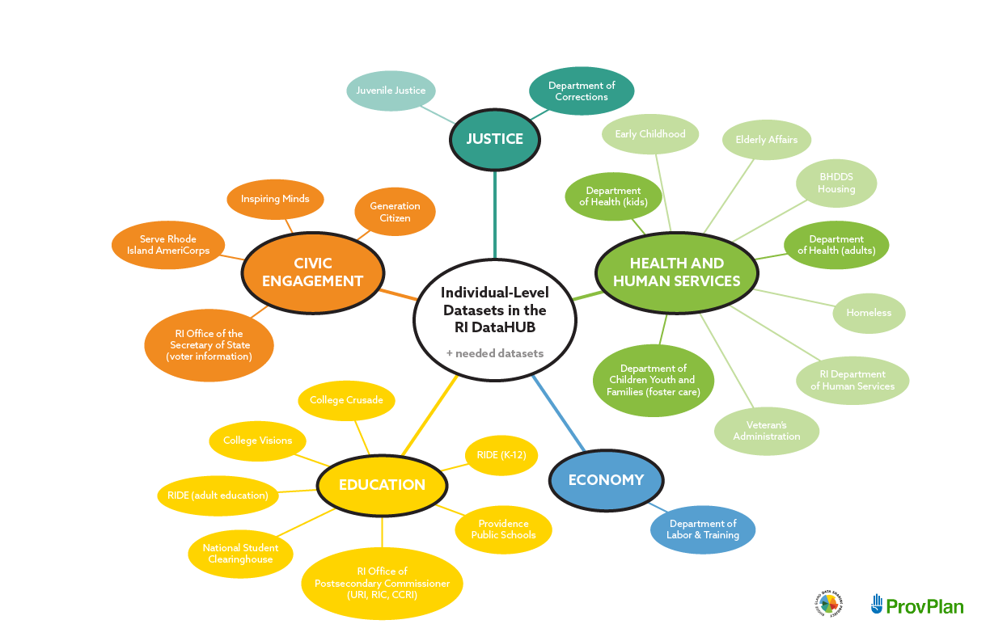
Data Sources

Slide 6
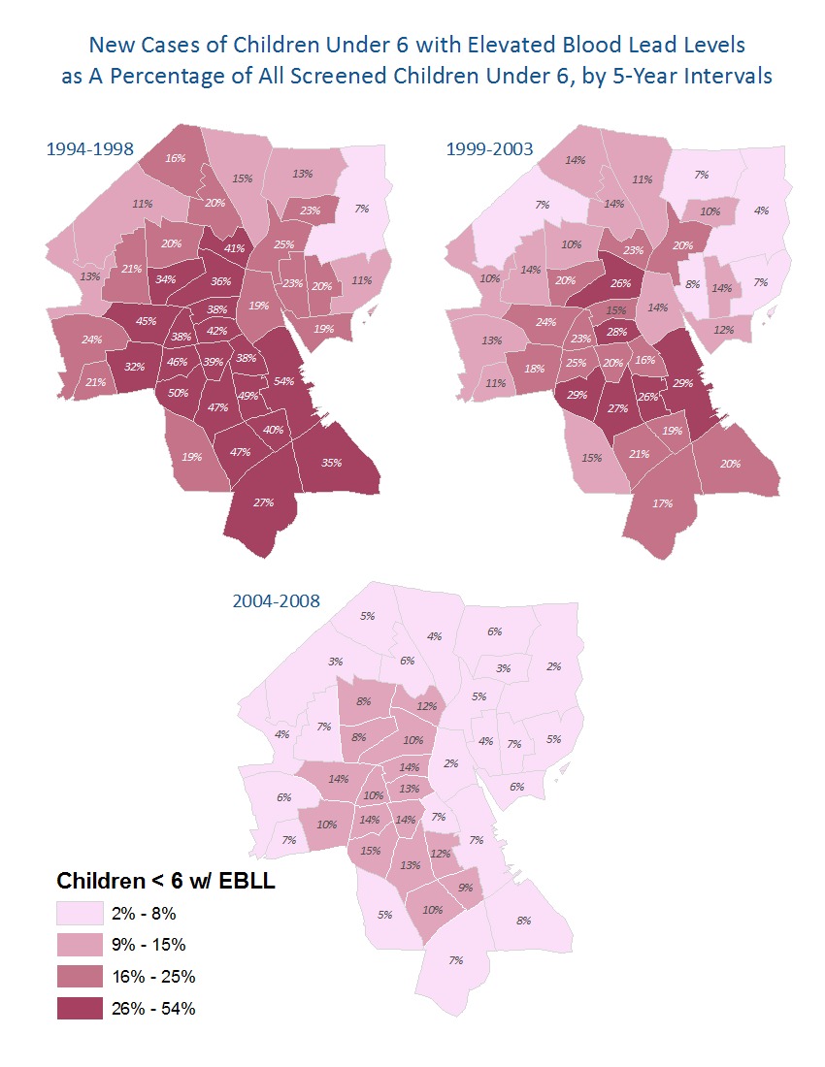
Elevated Blood Lead Levels, 1994-2008
Previous Benchmark
(“Level of concern”)
=
10 micrograms/deciliter

Slide 7
Elevated Blood Lead Levels in Children Who Will Enter Kindergarten in Fall 2014
Current Benchmark
(Reference Level)
=
5 micrograms/deciliter
Is this a landlord issue?
Is this an education issue?
Is this a cleanliness issue?
Is this a housing condition issue?
Is this a financial issue?

Slide 8
Data
Property-Level Data
Child-Level Data
Compliance certificates
Tax Assessor Data
Current as of…
Providence, 2009
Woonsocket, 2009
Pawtucket, 2010
Central Falls, 2011
Master Look-Up Tables
Verifies the property associated with each address
Blood Lead Levels (BLLs)
Confirmed blood lead test results
Children living at addresses in the core cities
Ages 0-72 months

Slide 9
Linking Method
1. Aggregate Lead Test Results to Properties
2. Standardize Address Data to Properties and Match
Lead-exposed children
Lead
Compliance
Property
descriptives
Notes:
Describe match rates

