Slide 1
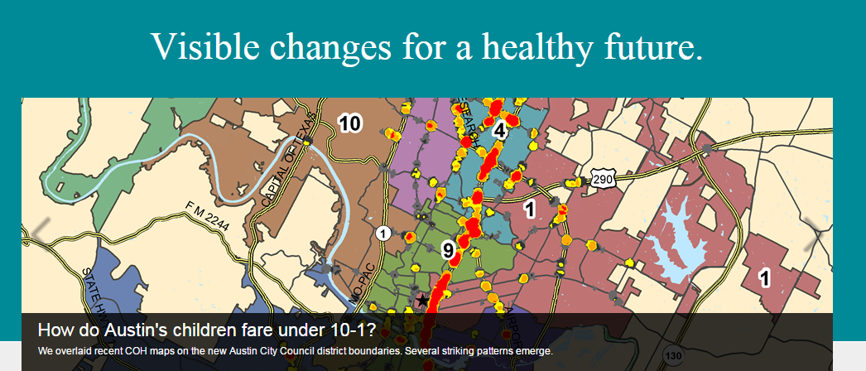
Connecting Health, Housing and Neighborhoods in Austin, Texas
Susan Millea, Ph.D.
Urban Institute/National Neighborhood Indicators Project
Dallas, Texas October 22, 2015

Slide 2
Characteristics of Austin’s Development
Long term, sustained rapid population growth
Uneven landscape with areas of growth/decline (suburbanization)
Profound racial and ethnic diversification
Growth of Hispanic/Latino population, rate of growth of Asian population
Suburbanization of African American population
Stubborn structural separations
Disproportionality by ethnicity in educational attainment/income
Stubborn spatial socio-economic separations
Source: Ryan Robinson, City of Austin Demographer

Slide 3
Austin: Inheriting Inequality

Slide 4
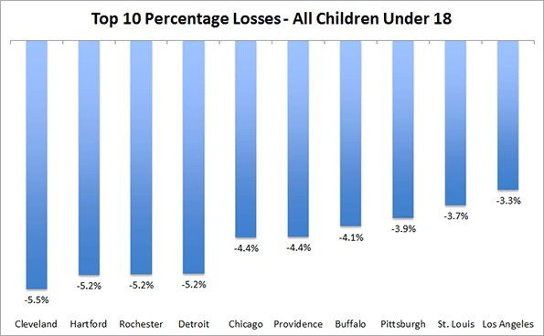
Census Bureau Estimate Data MSAs 2010-2014 % Gains and Losses of Children Under 18
Austin had highest rate of growth in child population (7.9%) from 2010-2014
http://www.newgeography.com/content/005054-recent-growth-and-decline-children-major-metropolitan-areas
Notes:
These disparities are even more pronounced today when we look at Austin’s children.
The Austin MSA had the nation’s highest rate of growth in the child population from 2010-2014 among large urban areas.

Slide 5
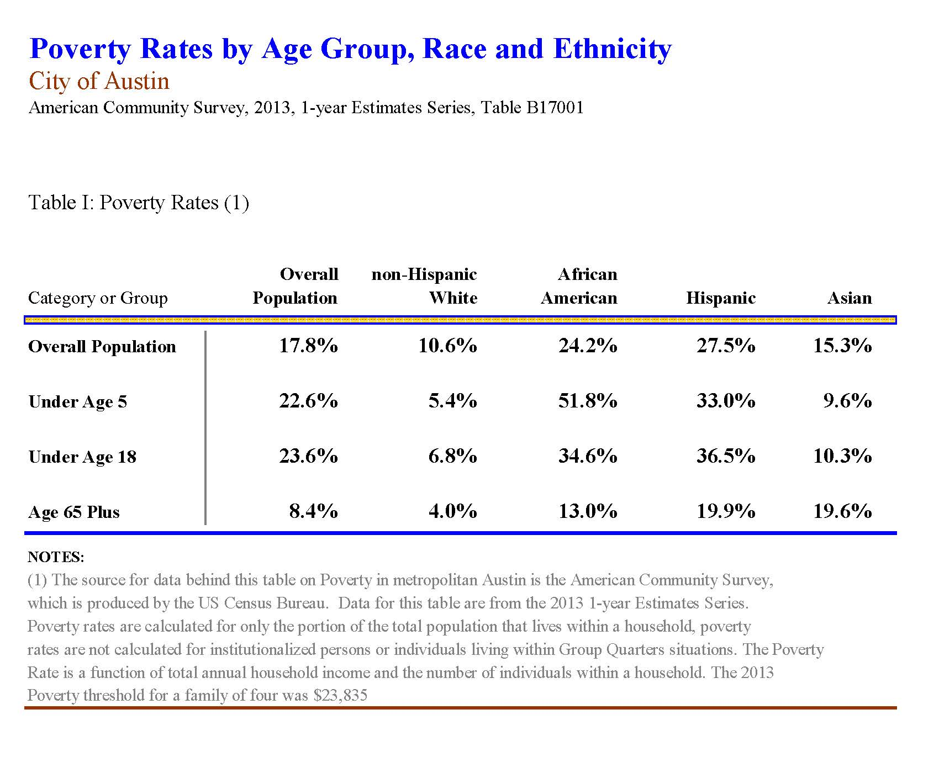
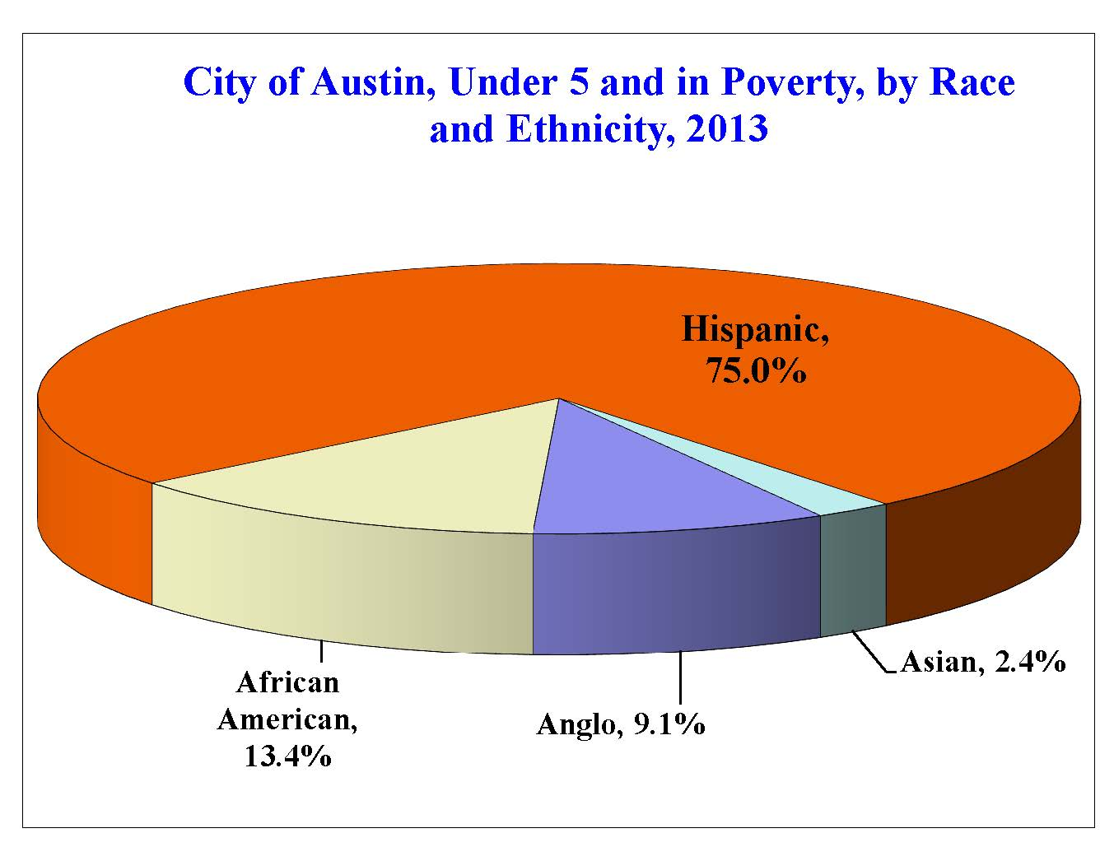
Austin Children: Disproportionality
Source: American Community Survey, 2013 1-year estimates, Table B17001.
Source: Ryan Robinson, City of Austin Demographer
Notes:
We see significant disproportionality in poverty rates among Austin’s children overall and particularly by ethnicity. Over 1/3 of Hispanic Children and over half of African American children under age 5 live in poverty.
When looking at the proportion of children under 5 living in poverty, 75% are Hispanic.

Slide 6
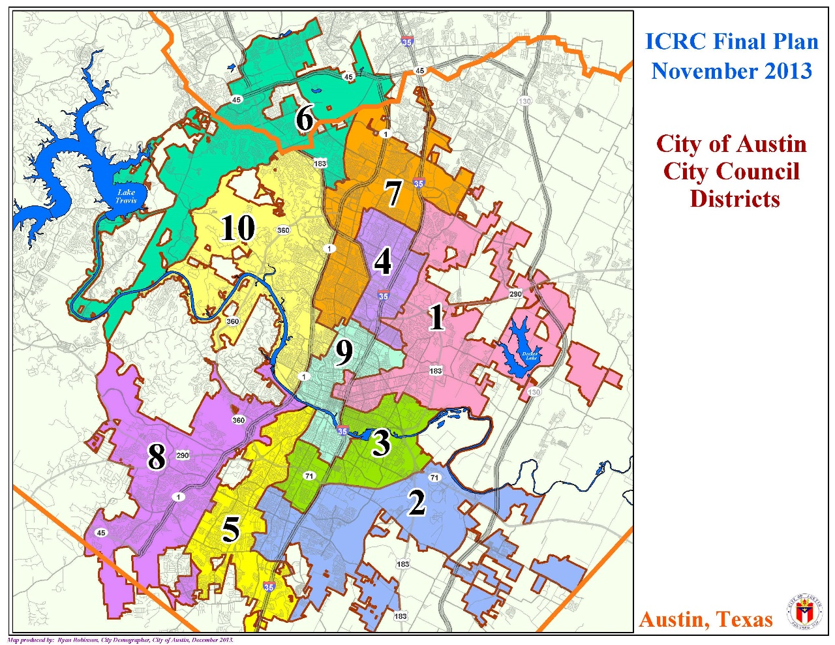
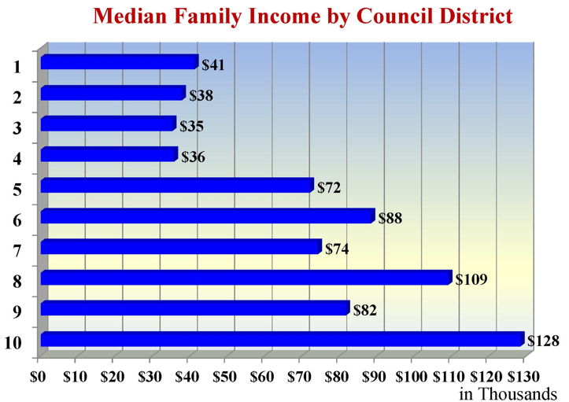
Notes:
So what can and are we doing about this?
1. Change in governance structure (City Council Districts); increased participation with better representation in local government
Each district approx. 78,000 people, economic diversity across districts
2. Austin has been the largest metro area without a medical school. It is currently under construction, and a new model of medical education is being implemented.
3. Multi-sector participation
COA has adopted the WHO framework of “health in all policies”
Multi-institutional engagement
City, County, Urban Planning
Long term challenges in gathering data
COH: not reinventing the wheel
Importance of story!
CAPCOG
Publicly Accessible Administrative Data
COH Cooperative Agreements, DSAs
Population Health focus, distinction in what that means in public health v. clinical practice/ACO

Slide 7
Partners in Health http://www.pih.org
Partners in Austin Transforming Health
Notes:
PATH is a multi-sectoral approach to improving health.
It is influenced by the model from Partners in Health, founded by Dr. Paul Farmer at Harvard
Austin’s PATH includes key institutional partners as well as neighborhood advocacy and community organizations

Slide 9
Children’s Optimal Health
Partners in Austin Transforming Health
Notes:
What is COH role in connecting geography and health?
Given national movement toward democratization of data, increased accessibility to admin data, COH continues to focus on more ‘closely held’ data sets pertinent to health, particularly that of children in Central Texas. That’s the value add (in addition to analytics) we bring to the conversation.

