Slide 1
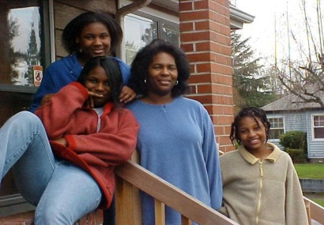
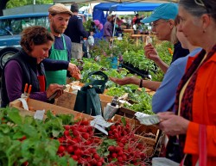
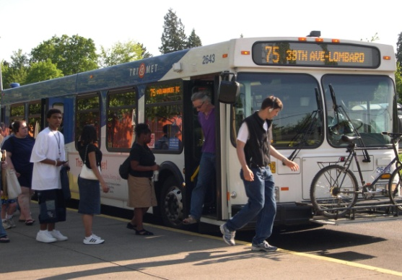
Health and Housing Social Determinants of Health and Access Examples from the Regional Equity Atlas and Multnomah County Health Department Meg Merrick, Ph.D. Institute of Portland Metropolitan Studies Portland State University

Slide 2
We measure what we understand to be important Looking at root causes - Making the invisible visible
TRAJECTORY OF HEALTH DISPARITIES/SOCIAL DETERMINANTS
DISPARITIES
IN
HEALTH
OUTCOMES
ROOT
FACTORS
ENVIRONMENTAL
& BEHAVIORAL
FACTORS
MEDICAL
SERVICES
POVERTY
DISCRIMINATION
OPPRESSION
- RACE
- GENDER
- ETHNICITY
COMMUNITY
ENVIRONMENT
- OPPORTUNITY
- PEOPLE
- PLACE
CULTURALLY-
COMPETENT
MEDICAL CARE
- ACCESS
- SCREENING
- DIAGNOSIS
- TREATMENT
PREVENTION INSTITUTE

Slide 3
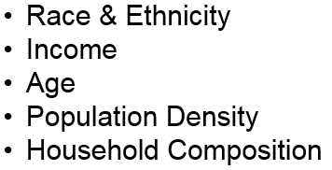
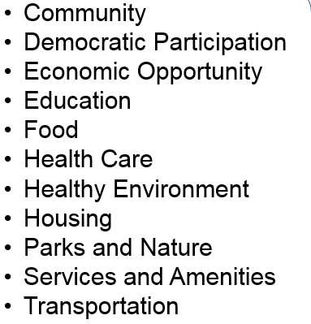
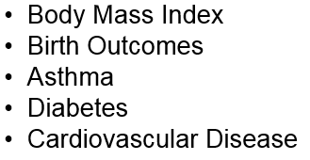
Indicator Identification Using the Social Determinants Lens
Health record data
Ground-truthing

Slide 4
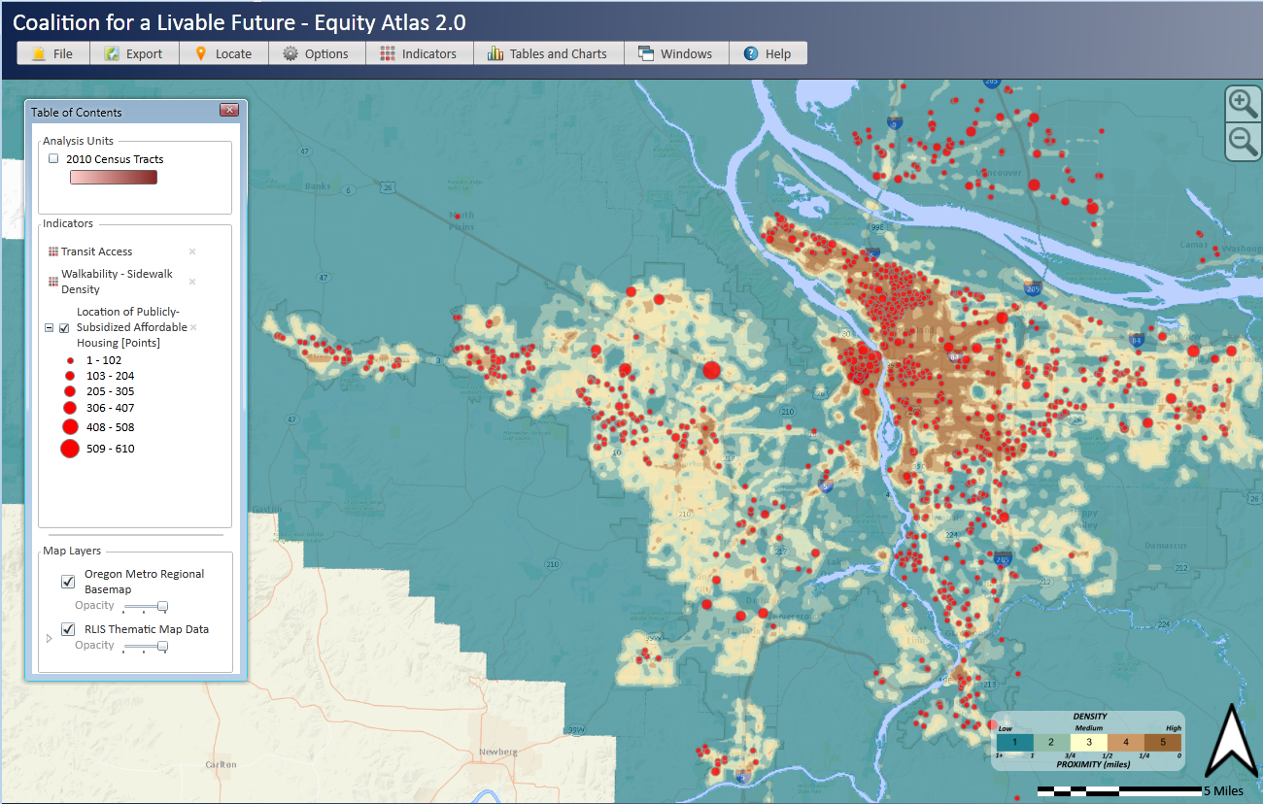
Locations of Publicly Subsidized Affordable Housing, Transit Access, and Sidewalk Density

Slide 5
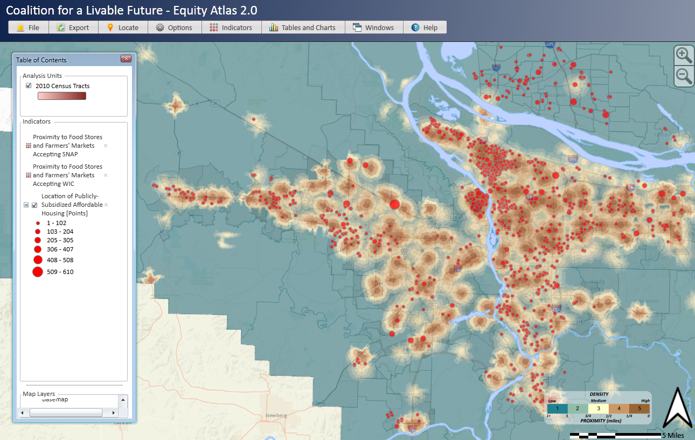
Locations of Publicly Subsidized Affordable Housing, Food Stores and Farmers’ Markets Accepting SNAP and WIC

Slide 6
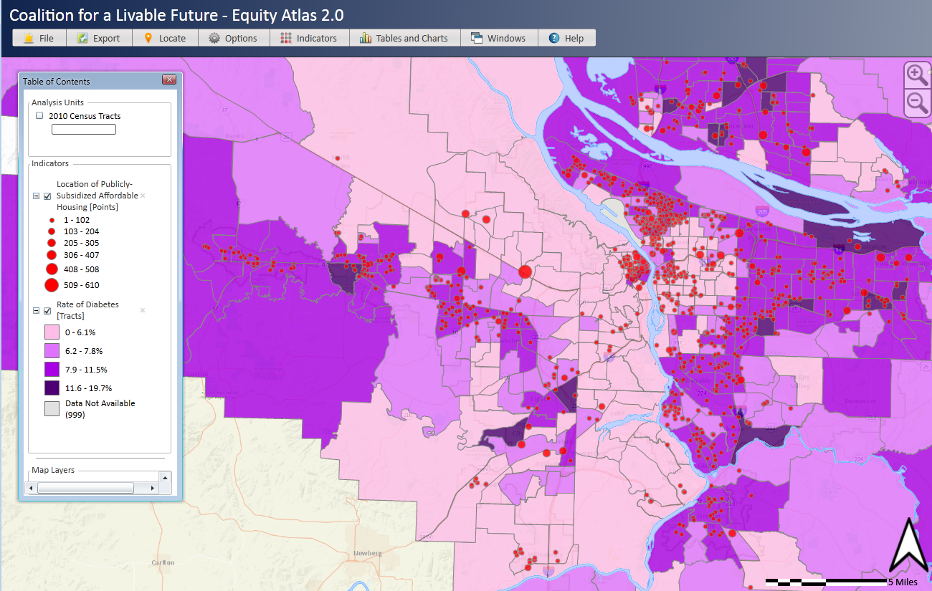
Locations of Publicly Subsidized Affordable Housing in Relationship to the Rate of Diabetes (Type 2) by Census Tracts

Slide 7
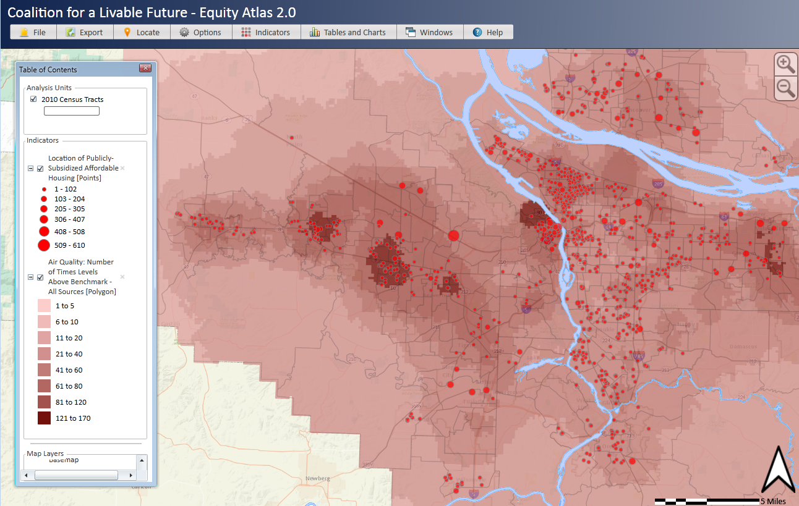
Locations of Publicly Subsidized Affordable Housing in Relationship to Air Quality

Slide 8
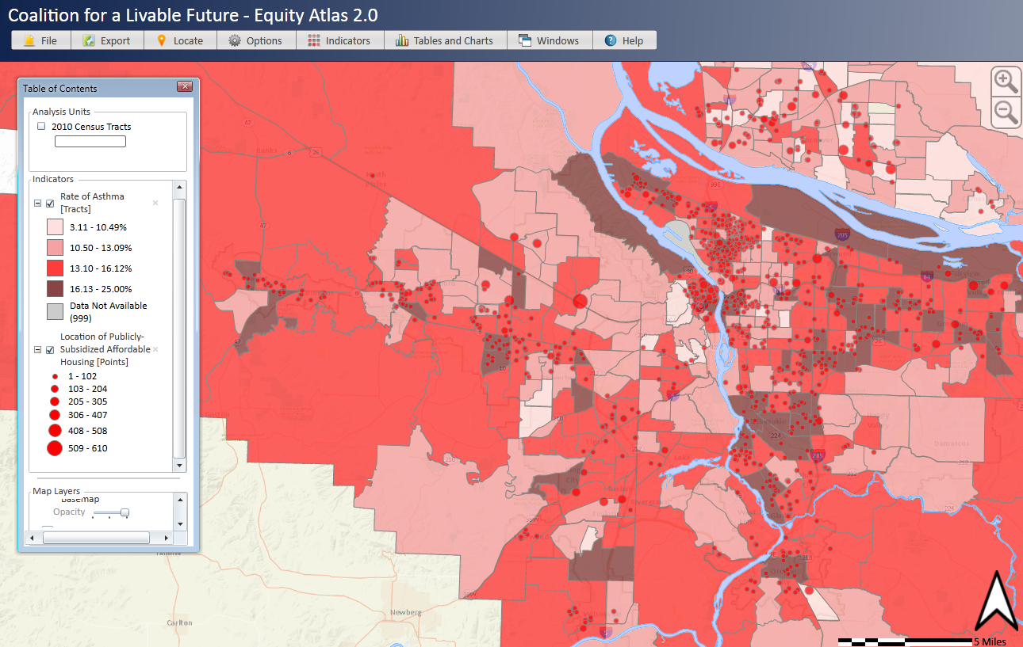
Locations of Publicly Subsidized Affordable Housing in Relationship to Rate of Athsma by Census Tract

Slide 9
Multnomah County Health Department Application
Indicators | Median (Min-Max) | Direction of health equity need
1. Communities of color* | --
2. Percent of youth (ages 0-17) | 19.9% (0.0%-32.6%) | Greater need
3. Percent of seniors (ages 65+) | 10.1% (0.0%-29.5%) | Greater need
4. Percent students eligible for free/reduced priced lunch | 65% (4.9%-94/5%) | Greater need
5. Body Mass Index (age-adjusted mean among adults) | 25.8% (23.6%-27.8%) | Greater need
6. Asthma | 14.0% (7.7%-19.2%) | Greater need
7. Cardiovascular events | 1.5% (0.6%-3.1%) | Greater need
8. Diabetes | 7.3% (1.9%-12.5%) | Greater need
9. Walkability – number of intersections per sq mile | 134 (0-367) | Greater need
10. Air quality | 1/2x-1x (<1/2x->10x) | Greater need
11. Median home value | 271k (0k-806k) | Greater need
12. Percent change in median income from 2000 to 2006-2010 | -1.7% (-34.0%-187.9%) | Greater need
* ≥15% of the Census tract population identified as Black/African American, Asian/Pacific Islander, or Latino-either alone or in combination with another race or ethnicity

Slide 10
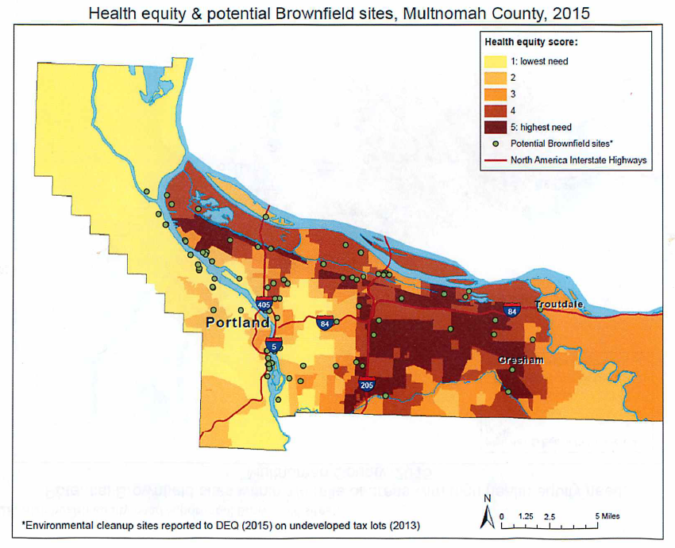
Multnomah County Health Department Health Equity Analysis
Uses Regional Equity Atlas data that were rasterized in Arcmap and reclassified on a 1-10 scale (0=missing data). The scale corresponds to health equity need, a raster cell “10” is an area with the highest need compared to a raster cell of “1” with the lowest need. For example, for the walkability indicator, areas with the least amount of walkability correspond with areas of the highest need or “10.”
The Composite measure was created using the Map algebra spatial analysis tool.

Slide 11
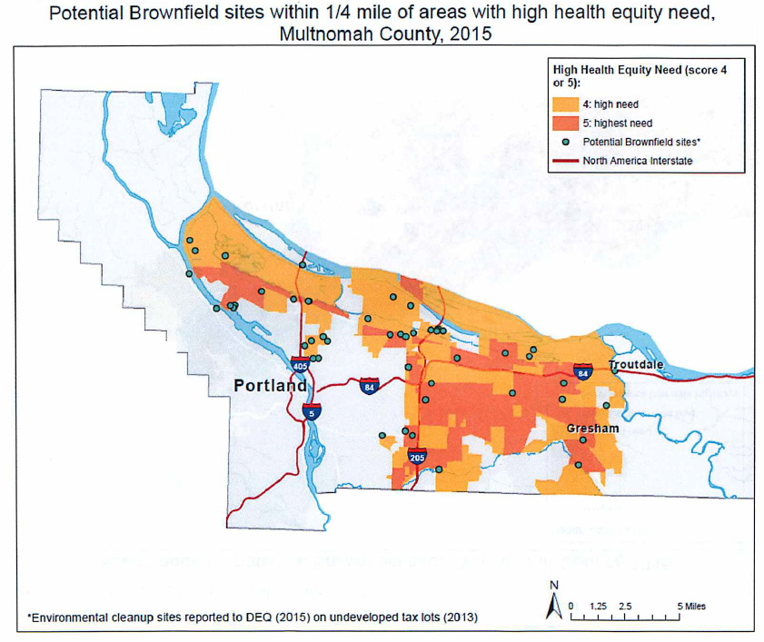
Multnomah County Health Department Health Equity Analysis
Uses Regional Equity Atlas data that were rasterized in Arcmap and reclassified on a 1-10 scale (0=missing data). The scale corresponds to health equity need, a raster cell “10” is an area with the highest need compared to a raster cell of “1” with the lowest need. For example, for the walkability indicator, areas with the least amount of walkability correspond with areas of the highest need or “10.”
The Composite measure was created using the Map algebra spatial analysis tool.

