Slide 1
Susan Millea
Children’s Optimal Health
Austin, Texas
National Neighborhood Indicators Partnership
October 23, 2014
Notes:
KEYE TV 8.3.2013 The U.S. Census finds that the number of people in poverty in Austin's suburbs more than doubled in the last decade -- up a whopping 142 percent (poor population has increased from 42,578 in 2000 to 103,248 in 2011). [increased to 162% by 2012, according to Kneebone] Meanwhile, Williamson County started off with 11,735 people living in poverty in 2000 and ended up with 34,069 by 2010.

Slide 2
Austin Suburban Poverty
Increased 162% from
2000-2012
Notes:
KEYE TV 8.3.2013 The U.S. Census finds that the number of people in poverty in Austin's suburbs more than doubled in the last decade -- up a whopping 142 percent (poor population has increased from 42,578 in 2000 to 103,248 in 2011). Meanwhile, Williamson County started off with 11,735 people living in poverty in 2000 and ended up with 34,069 by 2010 (190%).

Slide 3
Children’s Optimal Health
How did you get involved in addressing issues of suburbanization of poverty?
How do you see work on suburban poverty fitting with your mission?

Slide 4
Austin’s Demographic Change

Slide 5
Source: Ryan Robinson, City of Austin Demographer
Notes:
Williamson Co. poverty rate rose 190% from 2000 to 2010 (from 11,735 to 34,069)

Slide 6
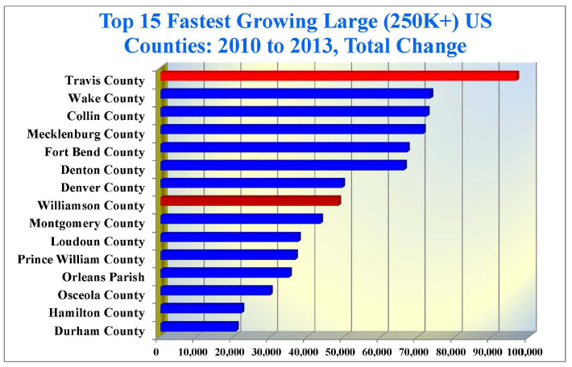
Suburban Poverty Growth Occurring in Context of Rapid Overall Growth
Source: Ryan Robinson, City of Austin Demographer

Slide 7
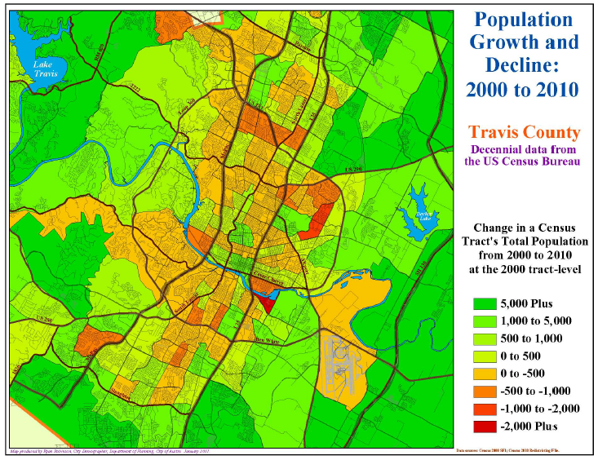
Population Shift within Austin MSA, 2000-2010
Source: Ryan Robinson, City of Austin Demographer
Notes:
Housing affordability driving change

Slide 8
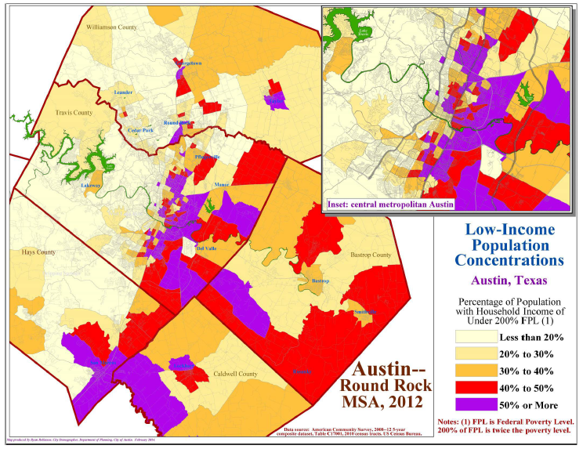
Low Income Population Concentrations 2011, 2012 (Percent of Census Tract with Income < 200% FPL)
Source: Ryan Robinson, City of Austin Demographer
Notes:
150,000 live in poverty; 300,000 struggling

Slide 9
Child/Youth Poverty is a Special Concern (Travis Co.)
Source: Travis County HHS/VS, Research and Planning Division

Slide 10
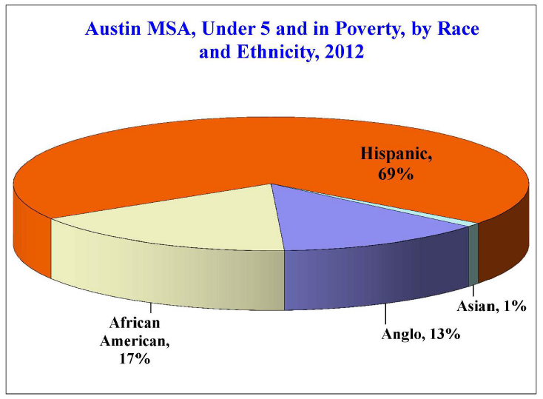
Child Poverty Disparities by Ethnicity (Austin MSA)
Source: Ryan Robinson, City of Austin Demographer

Slide 11
Children’s Optimal Health
What are the big challenges?
How are you overcoming them?

Slide 12
School District Enrollment Growth 2000-2011

Slide 13
Challenges:
‘Lost in Austin’
Technical issues
Notes:
Technical challenges represented in this map
Challenge: Lost in Austin

Slide 14
Manor
Incorporated
Population 2010
5,037
Eastern Travis Co.
School District
7,685
ISD partially within Austin
Del Valle
Unincorporated
Population Estimate 2010
17,500
Eastern Travis Co.
School District
11,120
ISD partially within Austin

Slide 15
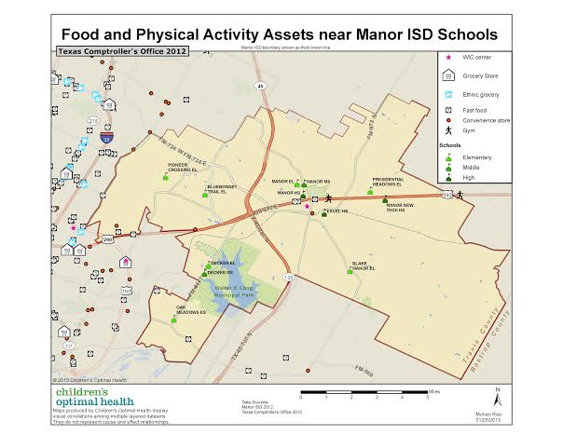
Avoiding that “Lost in Austin Feeling”: Manor

Slide 16
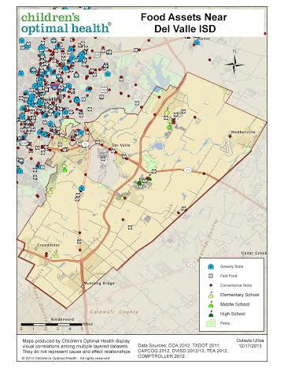
Avoiding that “Lost in Austin Feeling”: Del Valle

Slide 17
Children’s Optimal Health
What are your concerns about being able to do this work well?
How do we move this work forward?
Notes:
Technical
Differing data systems in different School Districts
Jurisdictional challenges
Police, Sherriff, Municipal Courts, Truancy Courts, Juvenile Courts
Staff Capacity
COH
School District
Building Needed Relationships
Jurisdictional challenges

Slide 18
Partnership, Coordination and Collaboration

Slide 19
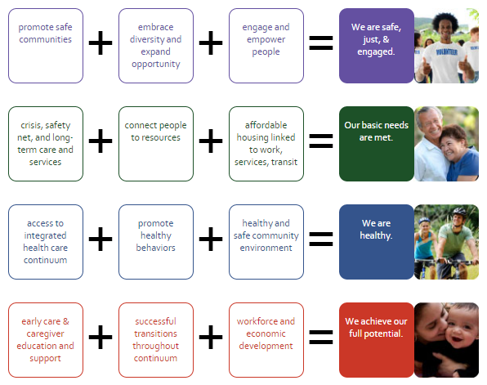
Strategic Framework for Action
Notes:
Community Achievement Network

Slide 20
Indicators and Shared Metrics

Slide 21
Play Well Together!!!

