Slide 1
Supporting Data Driven Decision-making in 1st Tier Suburbs: Portland Region
Meg Merrick, Ph.D.
Institute of Portland Metropolitan Studies
Portland State University

Slide 2
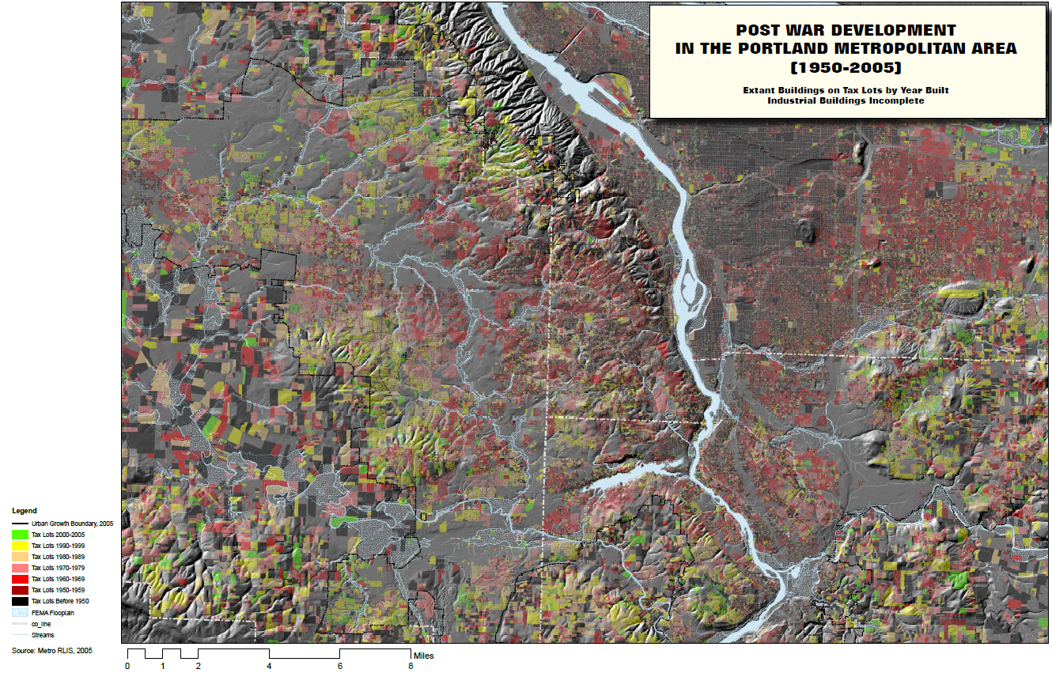
Derived from Tax Lot Attribute Data: Regional GIS Database, Metro Regional Government

Slide 3
Influence of Urban Morphology, Suburban Culture, and Politics

Slide 4
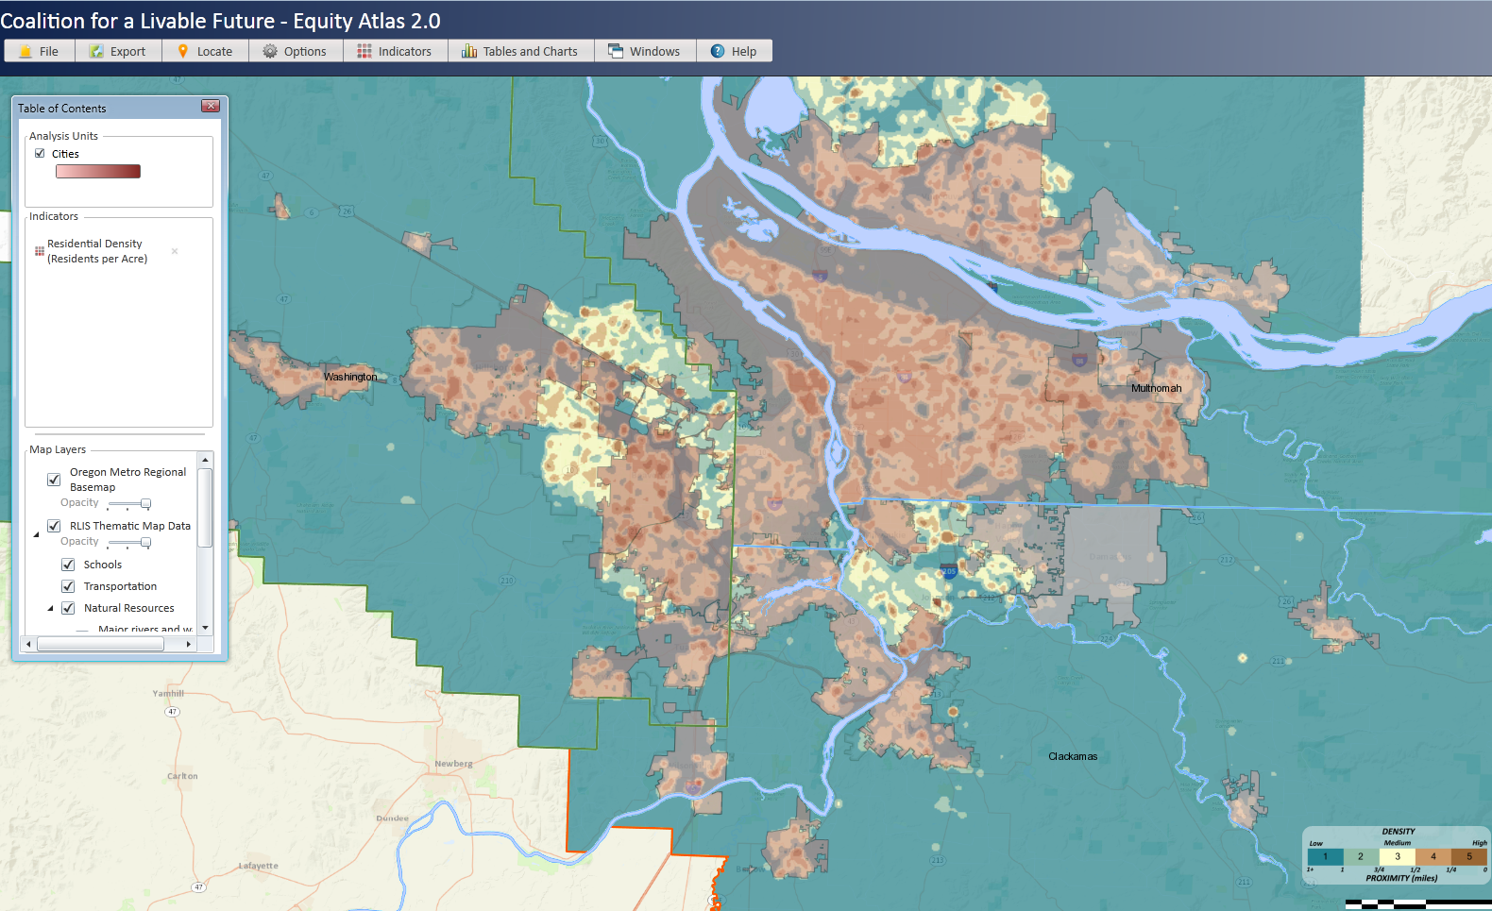
Significance of Unincorporated Areas
Population density calculated from Census block data, 2010
Notes:
This map represents the population density in 2010 in the Portland-Vancouver region. Over time, suburban cities have incorporated more territory. However, there are still large unincorporated areas with significant and growing populations that aren’t accounted for in municipal data sets.

Slide 5
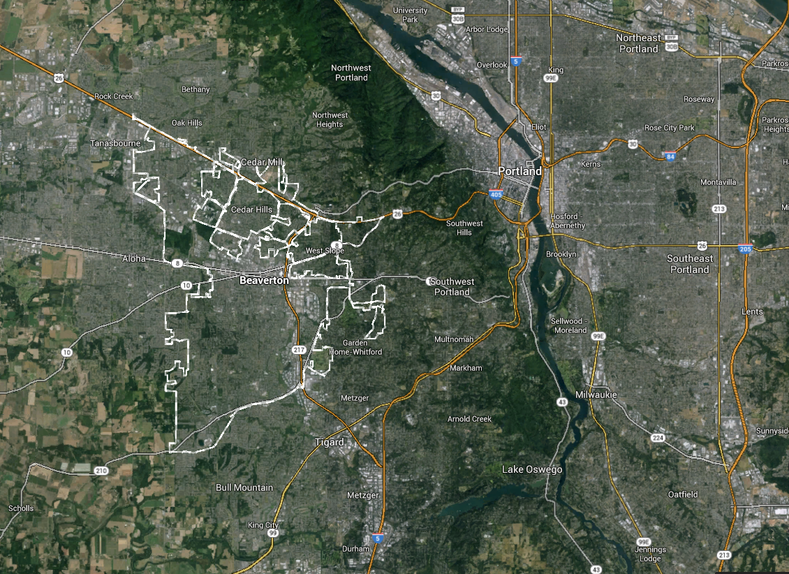
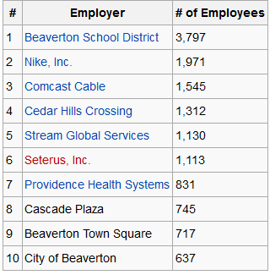
Beaverton, OR
Political Complexities of Suburban Boundaries
Nike Headquarters
(in unincorporated Washington County, surrounded by the City of Beaverton)
Largest Employers in 2013
Notes:
Although many suburban municipalities have successfully incorporated surrounding areas, the geography of cities boundaries are often highly complex representations of the push/pull of politics. The Nike headquarters campus is located in an unincorporated area surrounded by the City of Beaverton.

Slide 6
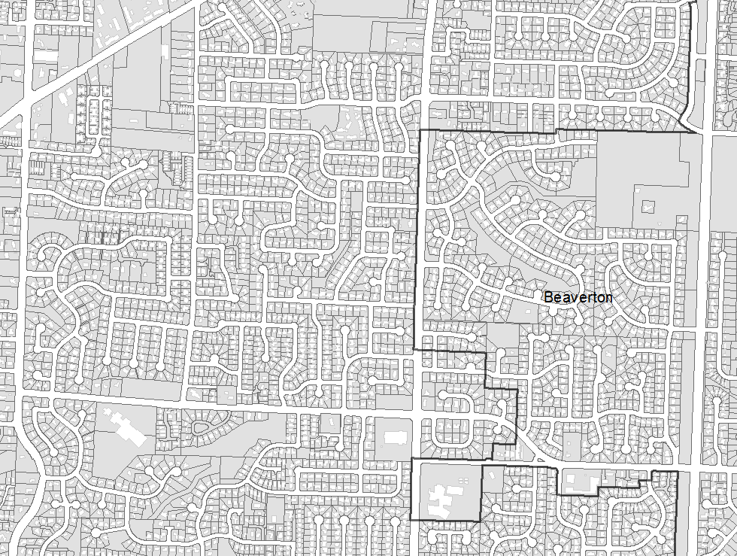
Unincorporated
Notes:
Inside and outside of the City of Beaverton. Development patterns and densities are identical.

Slide 7
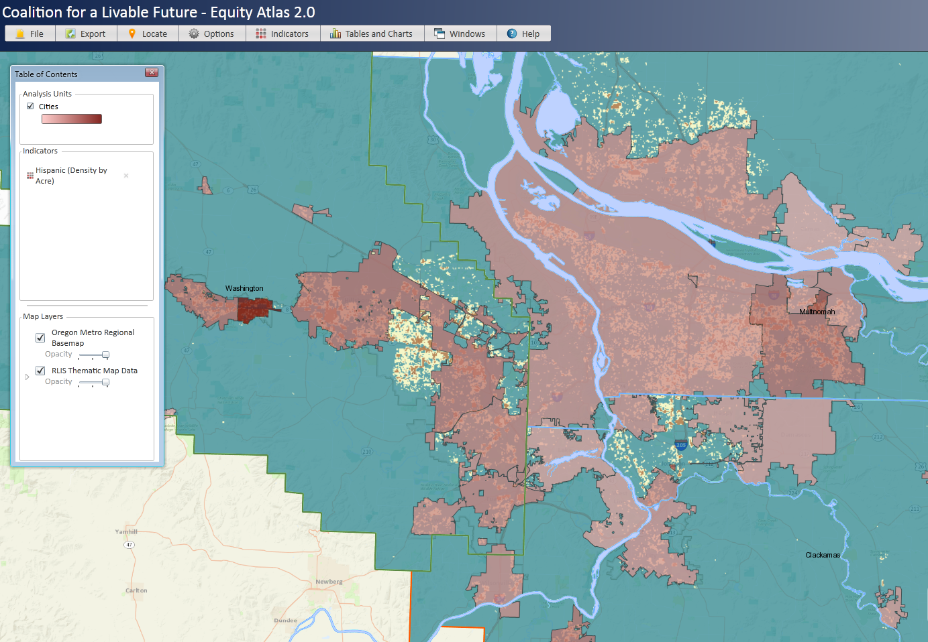
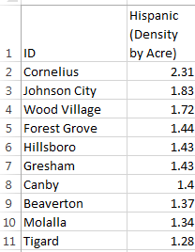

Hispanic population density calculated from Census block data, 2010
Top 10 Cities
Notes:
The influence of political geography, scale, and the demography of place: an example. The 2010 Hispanic population in the Portland-Vancouver region ranked by cities.

Slide 8
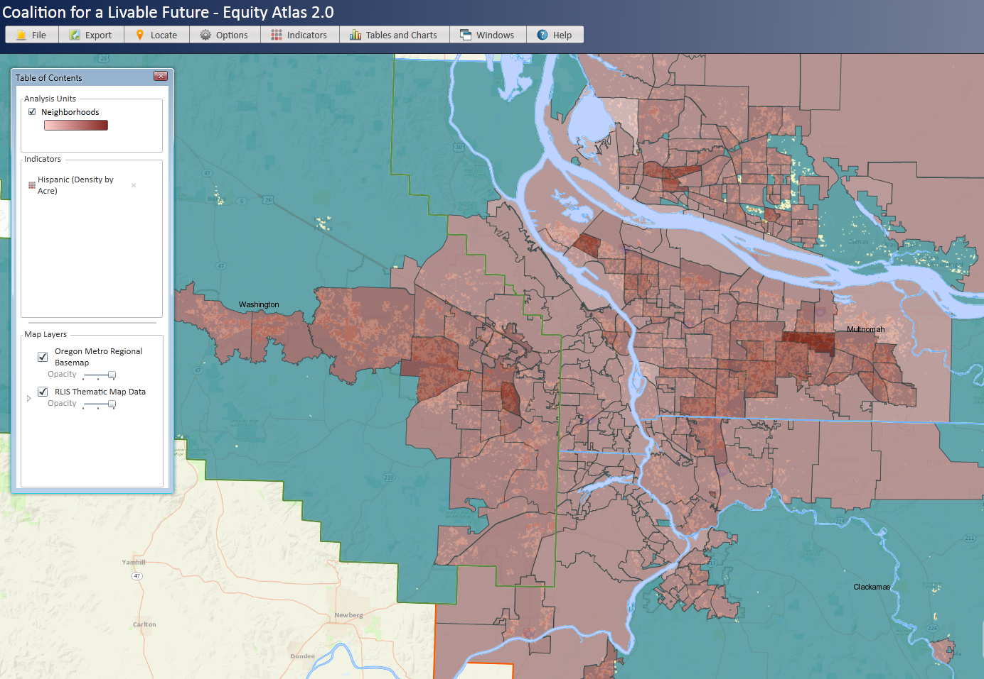
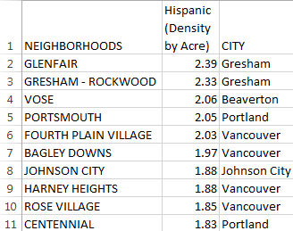
Hispanic population density calculated from Census block data, 2010
Top 10 Neighborhoods
Notes:
Our regional government, with jurisdiction over 3 counties on the Oregon side of the Columbia River, has created a neighborhoods shapefile that encompasses all of the populated areas (incorporated and unincorporated) in those counties. Clark County’s neighborhood geographies omit some unincorporated areas. These shapefiles, however, contain no attribute data. The ranking of the Hispanic population by neighborhood gives a very different picture than the city ranking.

Slide 9
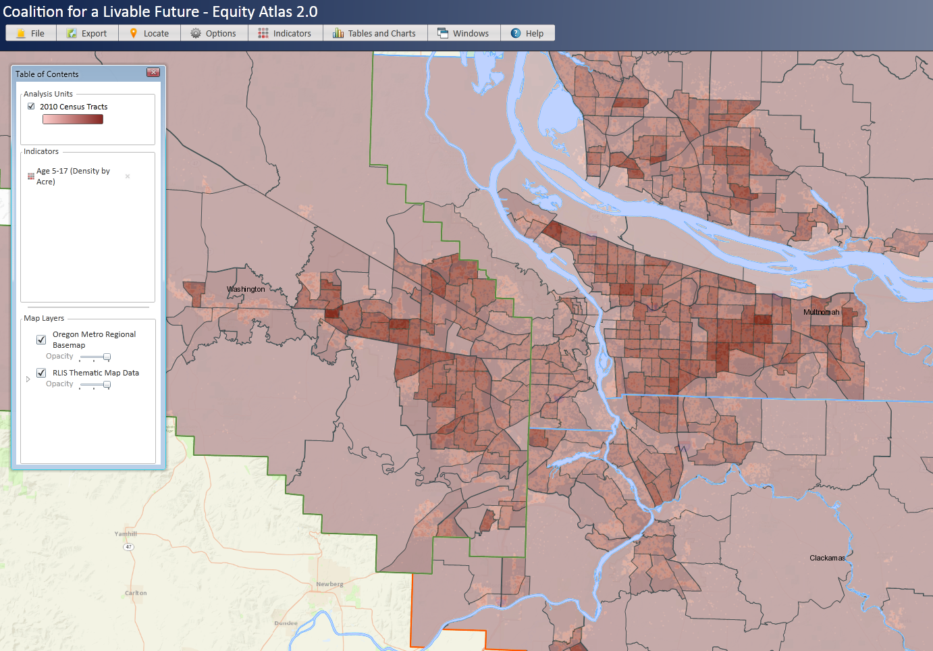
Children 5-17 density calculated from Census block data, 2010
Notes:
And, of course, Census tracts cover the entire area. The red circles represent unincorporated areas.

Slide 10
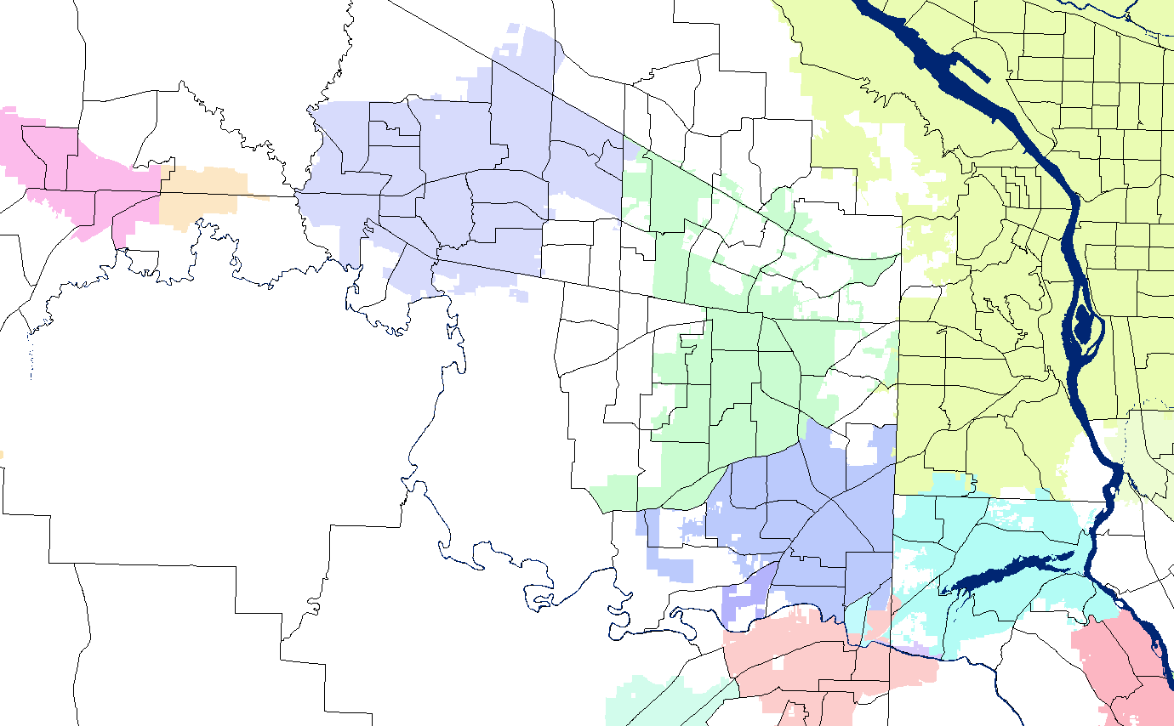
City boundaries and Census tracts don’t nest
Notes:
Data at the tract level don’t nest nicely into municipal boundaries.

Slide 11
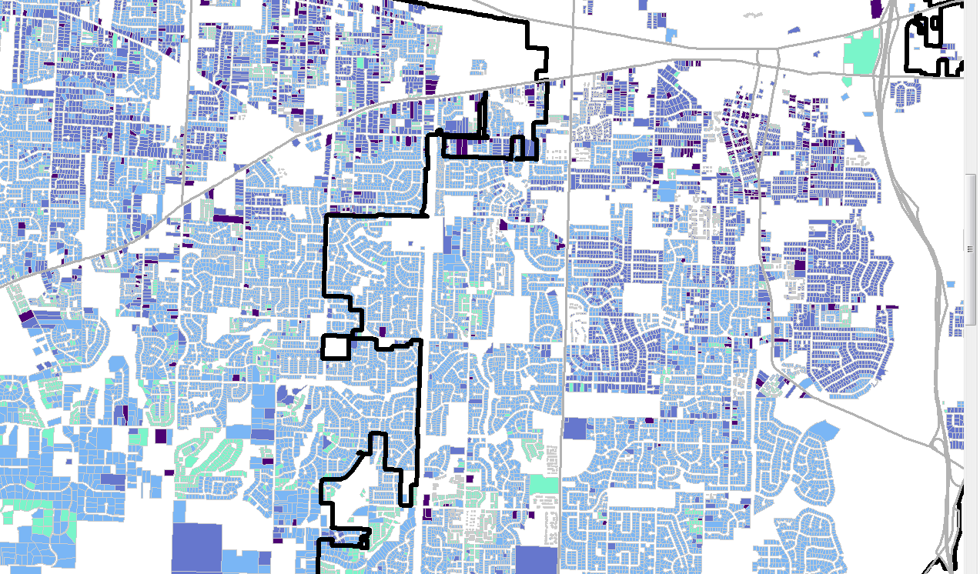

Workarounds:
Tax lot level data
Unincorporated
Incorporated

Slide 12
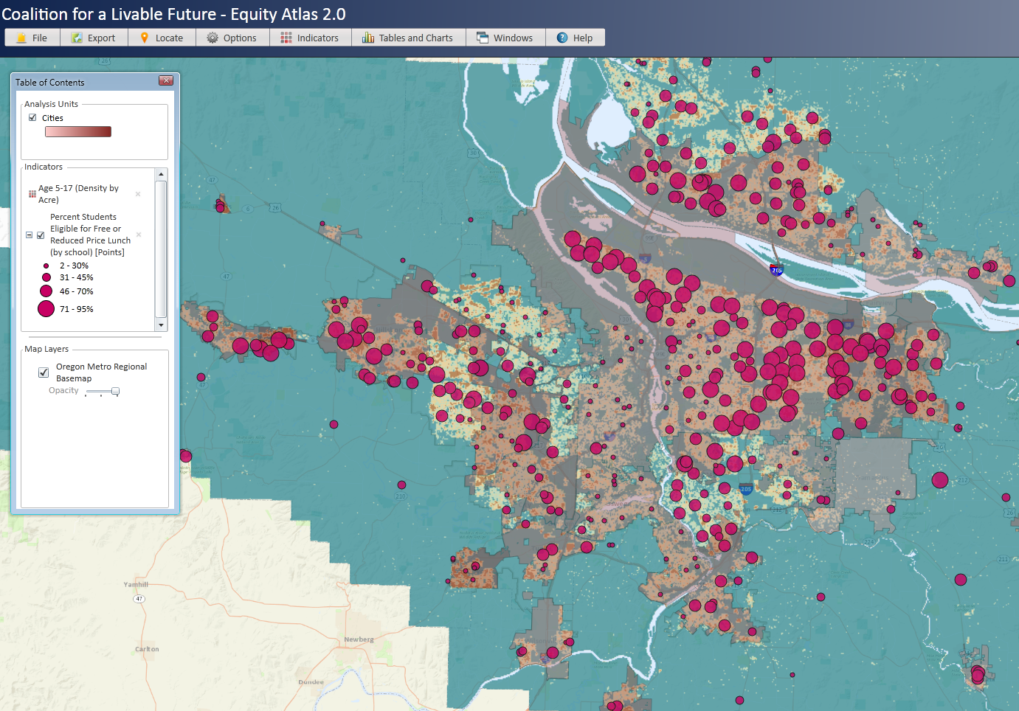
Workarounds: Geocoded
Schools Data
% Students Eligible for Free/Reduced Priced Lunch

Slide 13
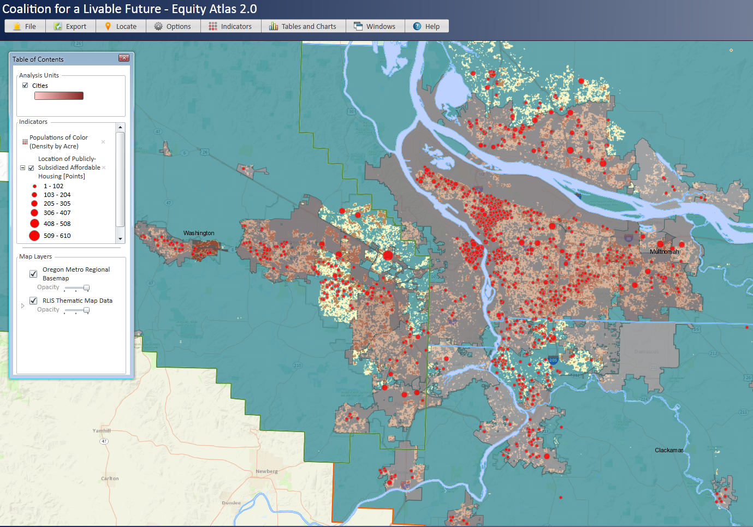
Workarounds: Geocoded
Housing Authorities/ Counties, Regional Government, Publicly Subsidized Affordable Housing

Slide 14
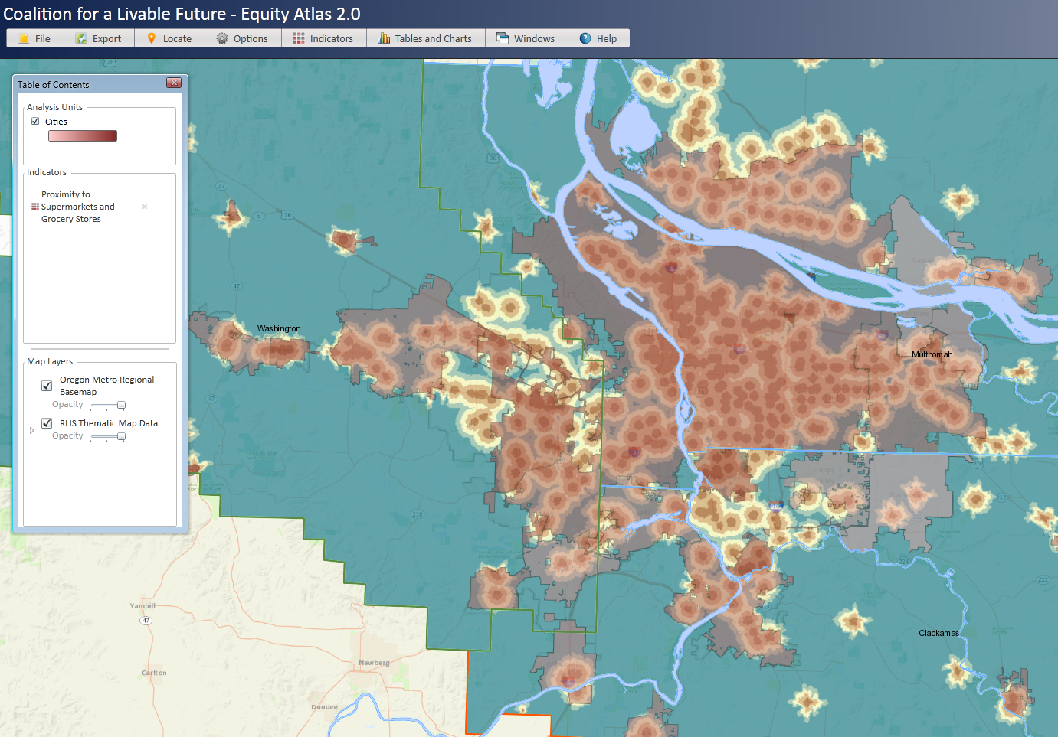
Workarounds: Geocoded Data,
ESRI Business Analyst Data Proximity to Grocery Stores

Slide 15
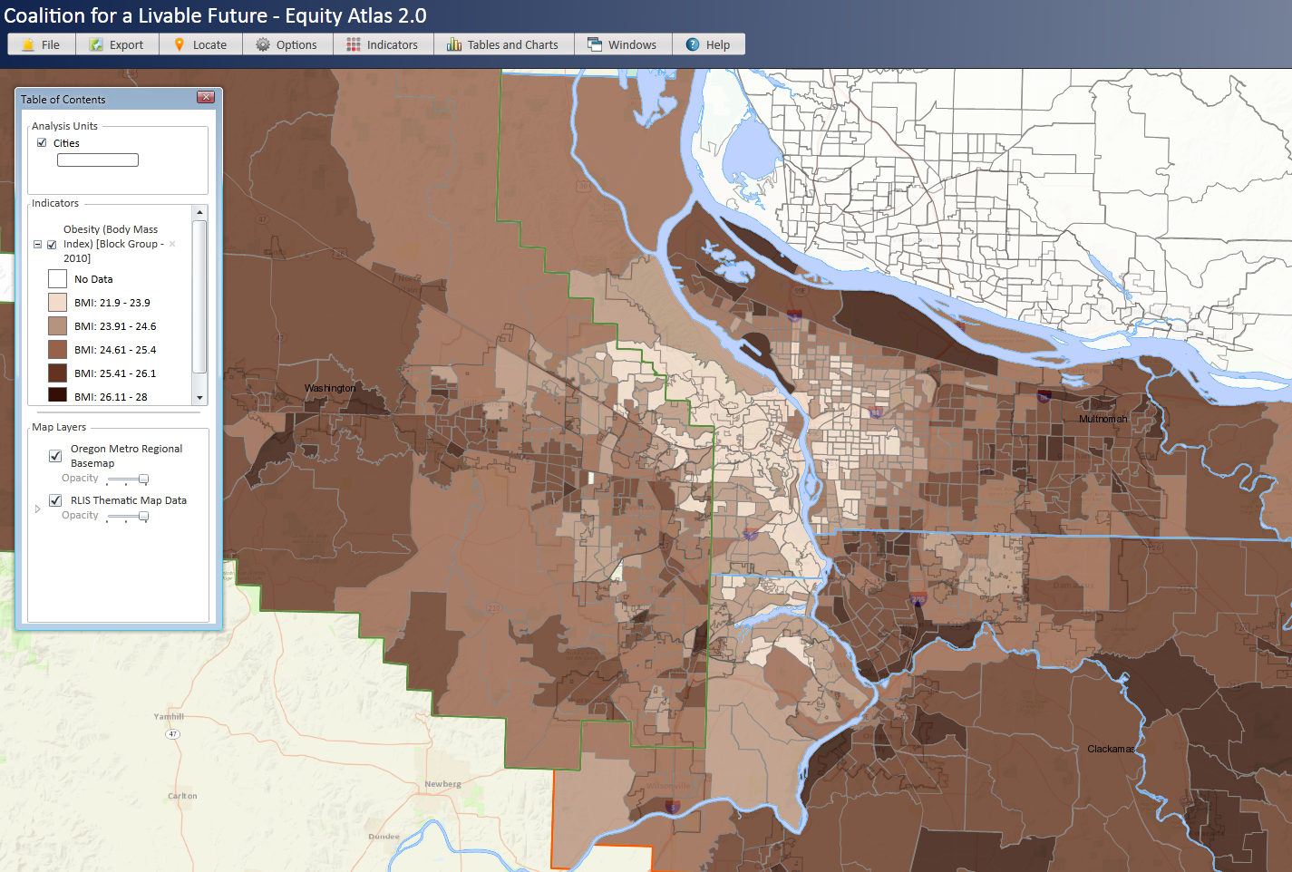
Workarounds:
DMV point level data aggregated to Census block groups by the state health department, BMI
Notes:
Red circles represent unincorporated areas.

Slide 16
A Word About The Nature of Suburban Places and Challenges to Public Participation and Primary Data Collection
Creekside District Master Planning Project
Funded in part by a HUD Sustainable Communities Challenge Grant

Slide 17
Creekside District Master Plan & IMS’ Role
The Master Plan: Create a new vision and master plan for the Creekside District focused on promoting green infrastructure and an inclusive transit oriented development; create a new “heart of the city”
IMS’ role:
  Produce baseline statistics/indicators
  Assist in primary data collection (quantitative and qualitative) focused on identifying the concerns and aspirations of existing business owners and residents with an emphasis on minority involvement

Slide 18
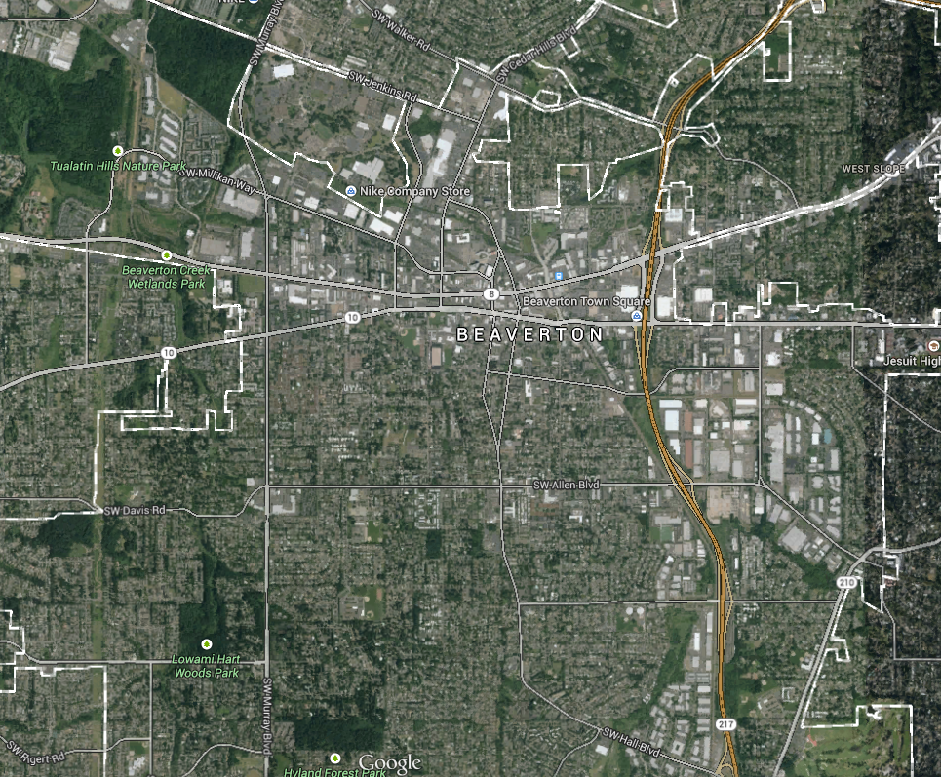
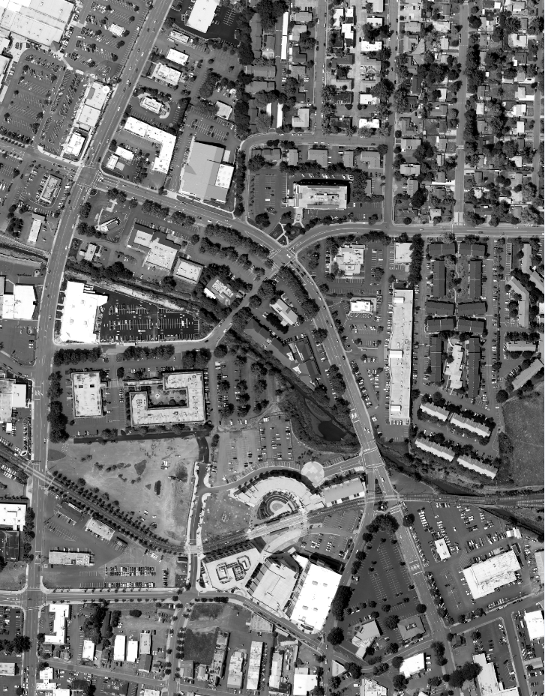
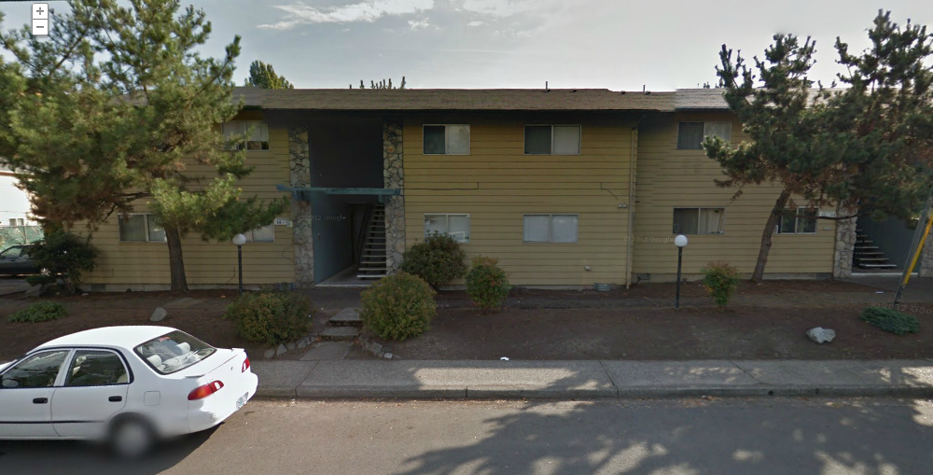
Beaverton’s “Downtown” Area
Beaverton’s
Creekside District
The place is unkept/falling apart, mngmt doesn't fix anything. There r crack heads/drug dealers that live hear. Each one of the 5 adults that live in these 2bd apts has 5 cars, so there is no parking. Glad my lease is up! - google review of Beaverton Apartments
Notes:
Poor quality rental units.

Slide 19
We have had to go beyond the Open House
- Beaverton planner
Growth and demographic change have caused the City to make fundamental changes in the ways that it does outreach.
  Diversity Advisory Board has developed a draft Diversity, Equity, and Inclusion Plan that states:
    Members of all racial ethnic and other cultural backgrounds feel welcome in City Hall. Strategies for outreach and mitigating language, cultural, economic and transportation barriers to participation are in place and result in increased civic participation.
    Translation of communications
    Go to the community (location and events)
      Door to door if necessary
    Reach out and build on existing and new relationships within communities
    Experiment with a variety of tools (Photovoice, focus groups, celebratory events)
  Labor intensive activities require resources

Slide 20
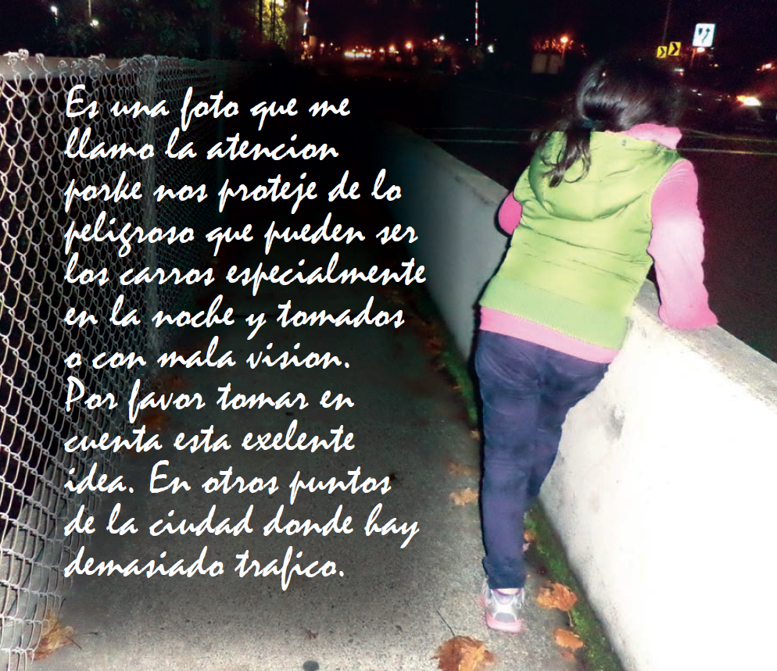
Pedestrian safety
This photo attracted my attention because it protects us from how dangerous cars can be. Especially, at night and drunk or with bad vision. Please take note of this excellent idea in other areas where there is too much traffic.
- Creekside District Photovoice participant
Notes:
Post WW II suburbs were not built with pedestrians in mind but many new, low income residents don’t have access to a car. The fact that a Jersey barrier would be seen as an “excellent idea” for pedestrian safety speaks volumes about the conditions that this community member faces on a day to day basis.

Slide 21
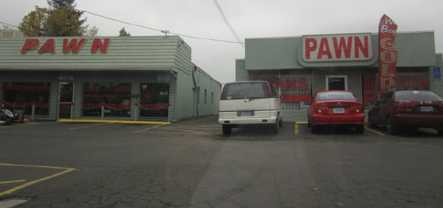
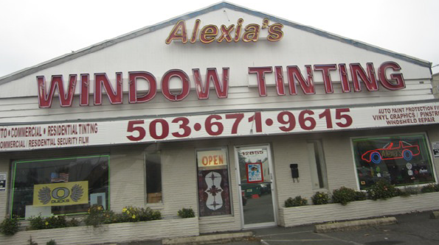
Aging commercial strips and structures and the quality of businesses.
There are many retail stores that are not attractive to walk around in the Creekside area. I hope there will be more pleasant stores that attract more people who have family and kids, such as an ice cream store, bookstore, coffee shop, bicycle store, clothing shop, diner, etc.
- Creekside District Photovoice participant
Notes:
The movement of many larger businesses to large shopping malls has left many 1950s/1960s strip malls behind. The result in Beaverton is a dominance of sometimes marginal commercial and light industrial businesses that find the low rents and large surface parking lots attractive. Many of these structures are poorly maintained and/or vacant.

Slide 22
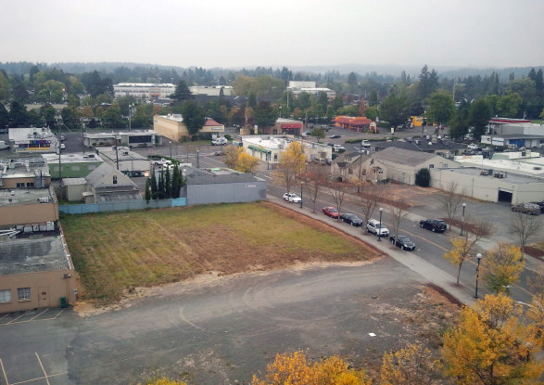
Underutilized land
This photo shows the poor use of land. You could use this for a number of things, shops, local businesses, a park. This is a lot of empty space and makes people think Beaverton isn’t well put together (which is partially true).
- Creekside District Photovoice participant
Notes:
Although some large cities have an abundance of underutilized “central city” commercial land, this is especially an issue for many 1st tier cities that have no identifiable city center.

Slide 23
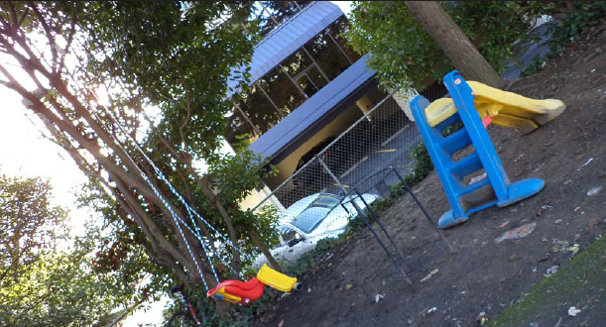
Poverty and racism
I see a lot of poverty in this picture. It is something very sad and humiliating because we live in a country where the advancement is supposed to make our life excellent or at least a lot better than other countries with a bad economy.
I can see even when we live in the country of wonders, poverty or simply the neglect of our city and the people that work don’t pay any attention to our children or our community.
There are a lot of places that would be perfect to build a pretty park for our children, for our neighbors and to reflect the warmth of a community interested since it represents our potential to success and it collaborates with the growth of a city as natural as Oregon.
Please look at this photo in depth and understand that we’re not weirdos, we are human beings that are part of our community.
We need a survey of our neighborhood to get our good ideas about what type of park and were we can build it. This would be excellent.
- Creekside District Photovoice participant
Veo mucha pobreza en esta foto. es algo muy triste y muy humillante; pues vivimos en un pais donde se supone q’ el adelantamiento de nuestra viva deberia ser exelente o de menos mucho mejor q’ otros paises de muy mala economia. Puedo ver a’ a pesar de q’ vivimos en el pais de las maravillas la pobreza o simpleza del descuido de nuestra ciudad y de las personas q’ trabajan no ponen nada d’ atencion a nuestros niños o nuestros comunidad. Hay muchos lugares q’ serian perfectos para poder construir un bonito parke para nuestros hijos, para nuestros vecinos y para reejar el calor de una comunidad interesante pues representa nuestro potencial de exito y colabora con el crecimiento de una ciudad tan natural como Oregon. Por favor de mirar esta foto con profundidad y comprender q’ no somos unos bichos raros, somos humanos parte de uno solo. Nuestra comunidad. Un censo a la Vecindad para recuperar buenas ideas de ke tipo de parke y donde podemos hacerlo seria exelente.
Notes:
The effects of poverty and racism are very real in 1st tier suburbs. Participatory data collections methods had never been used by Beaverton city staff before. And, although planners stated that they suspected that these problems existed, these data raised a flag that couldn’t be ignored and helped to target and prioritize particular issues and places.

