Slide 1
Hands-On Workshop on User-Centered Design
Indianapolis
NNIP Fall 2017 Partner Meeting

Slide 2
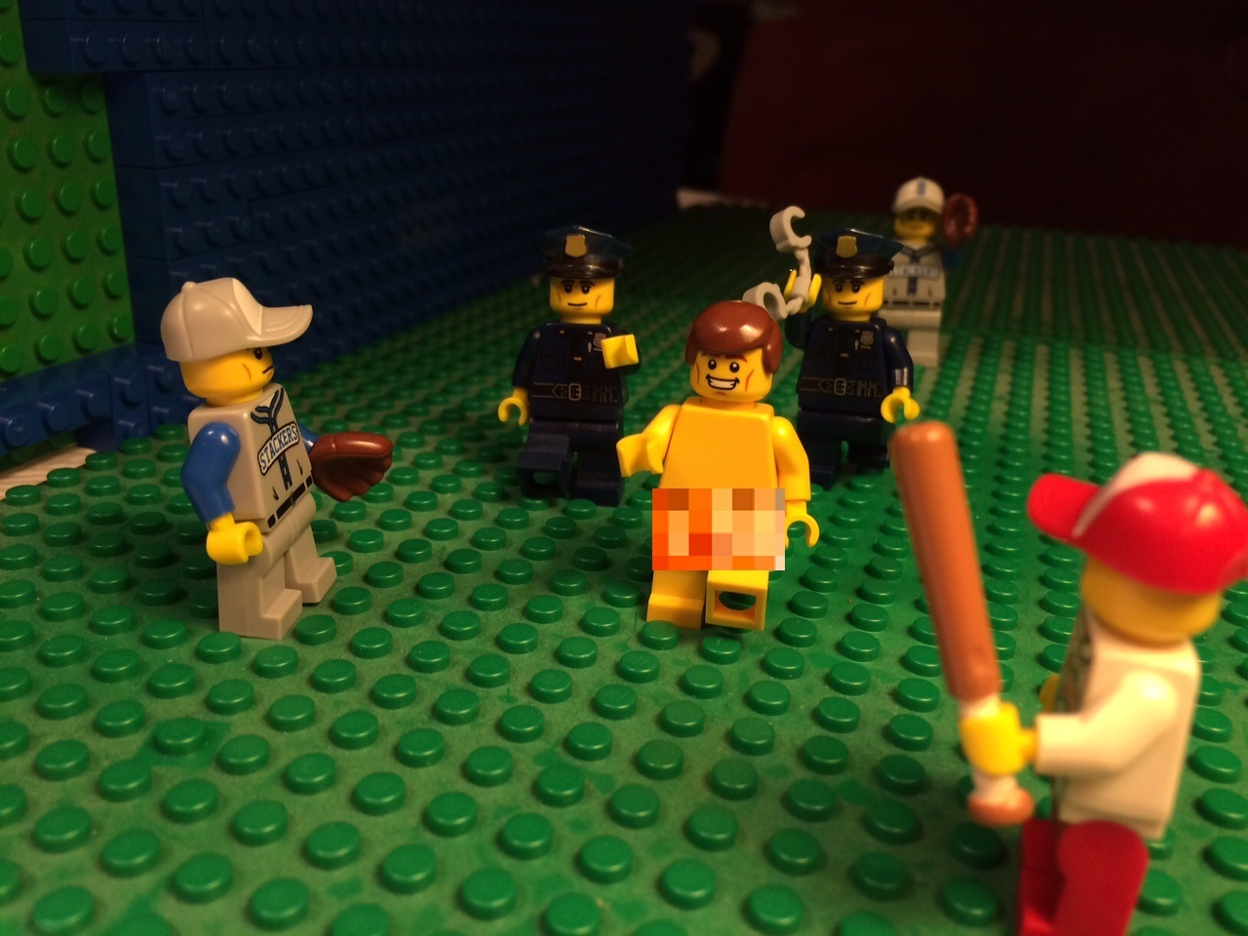
We want to expose you to user-centered design

Slide 3

We also want to keep you awake after lunch
https://www.youtube.com/watch?v=bIlVYLygYOI

Slide 4
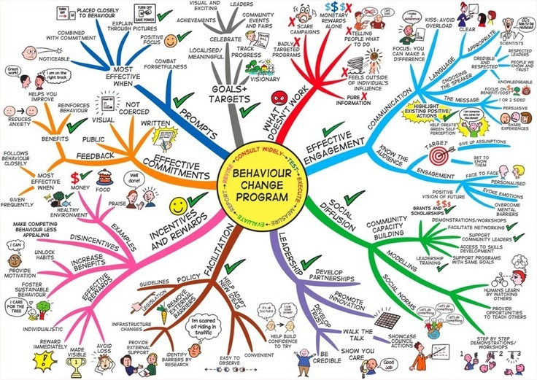
User-centered design builds for user needs as opposed to asking users change their behavior
This chart really makes changing behavior seem complicated
https://i.pinimg.com/736x/f0/a9/50/f0a950731ba06af33a7116cde9ee8090--behaviour-change-mindmaps.jpg

Slide 5
User-centered design incorporates user needs in every stage of the development process
Learn about users
Identify product requirements
Create design solutions
Evaluate designs

Slide 6

User-centered design enables efficient product development
https://thenounproject.com/term/stopwatch/839

Slide 7
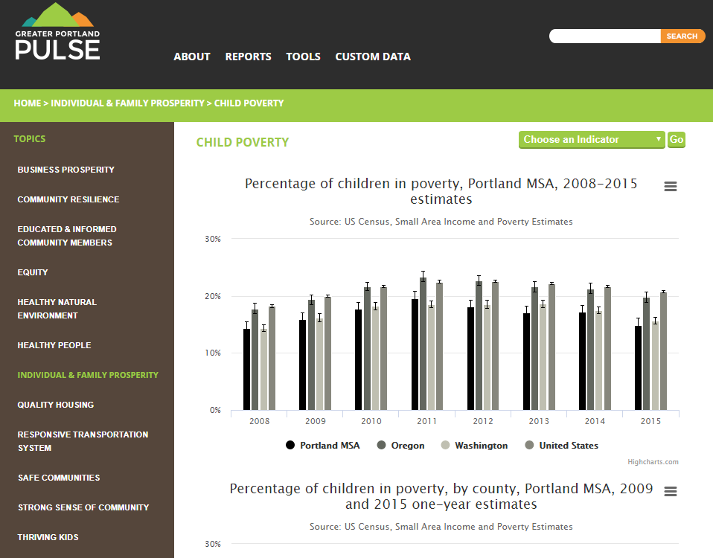
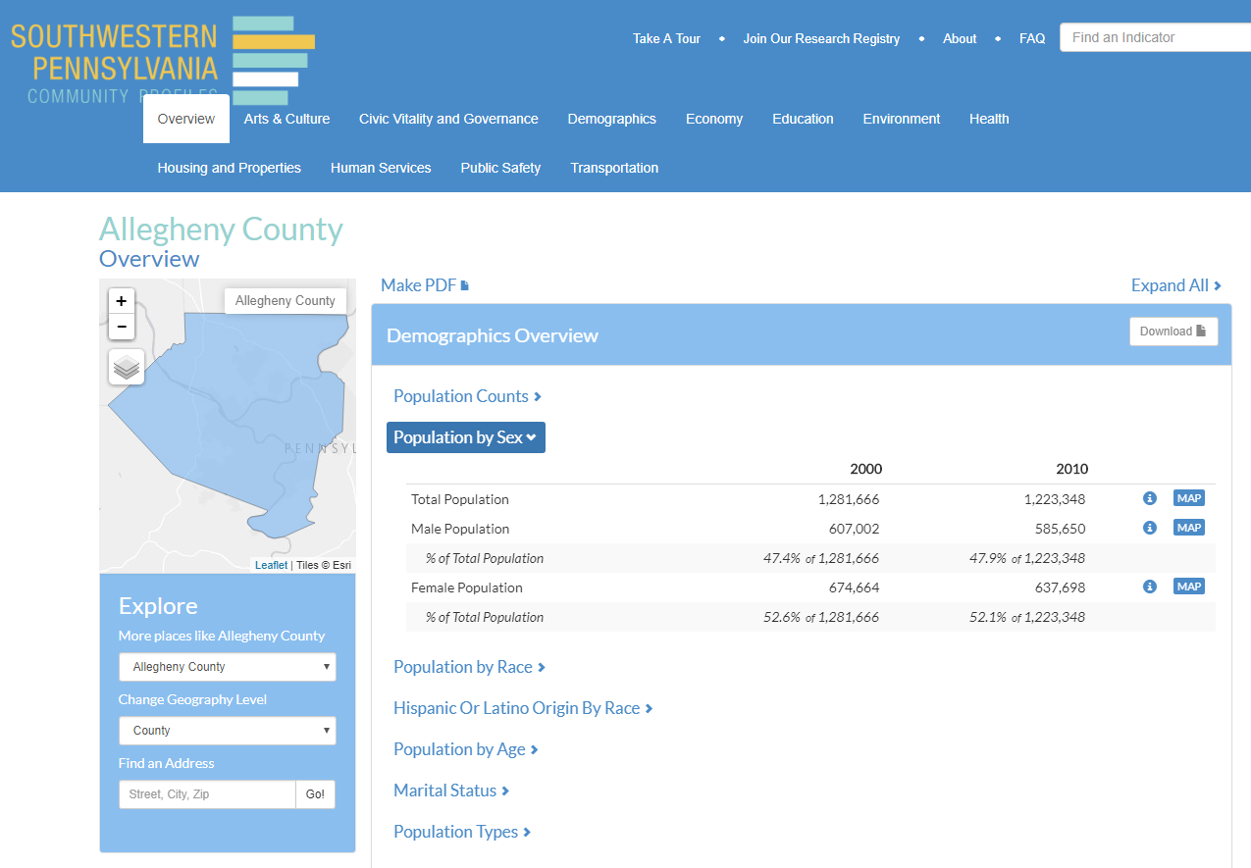
Four activities, one scenario
Let’s design a community indicators website using user-centered design techniques!

Slide 8
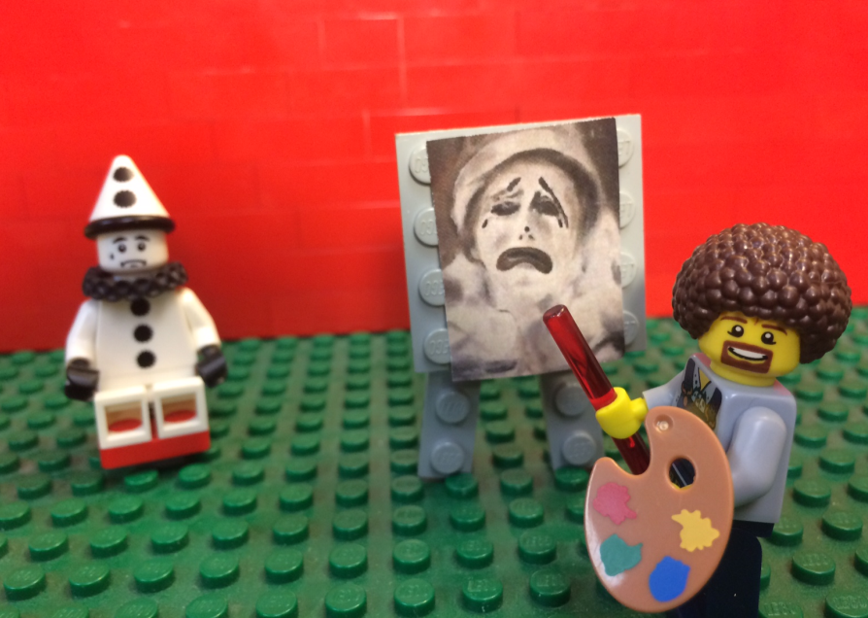
Activity 1: Developing Personas
Facilitator:
Noah Urban

Slide 9
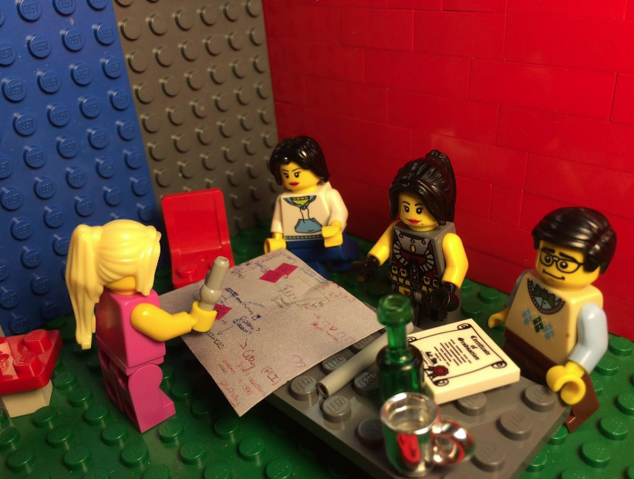
Activity 2: Creating User Scenarios
Facilitators:
Bob Gradeck
Liz Monk
Eleanor Tutt

Slide 10
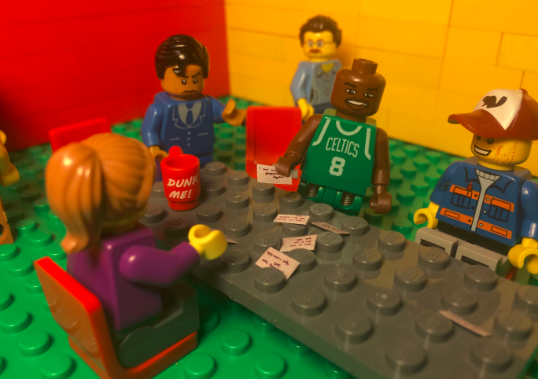
Activity 3: Card Sorting
Facilitator:
Louise Carter

Slide 11
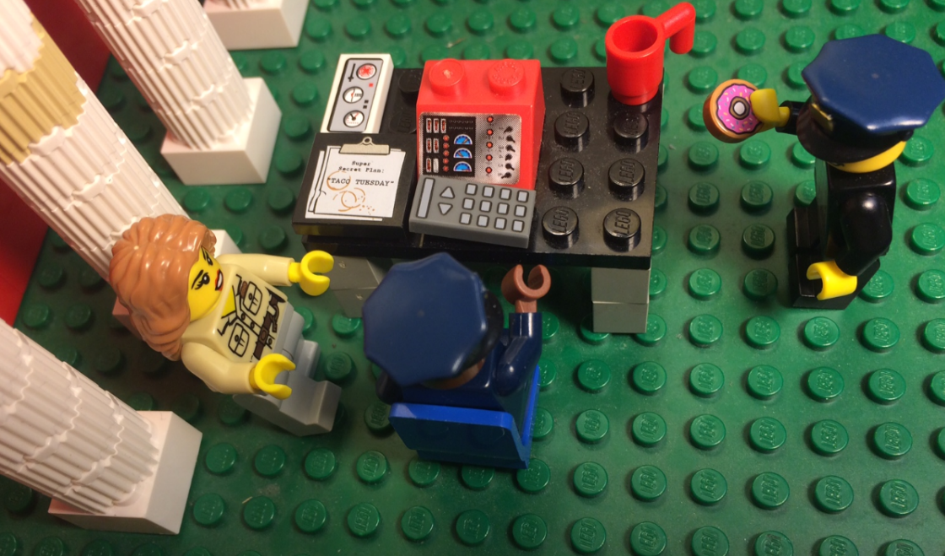
Activity 4: User Testing
Facilitators:
Sonja Marziano
Denise Linn Riedl

Slide 12
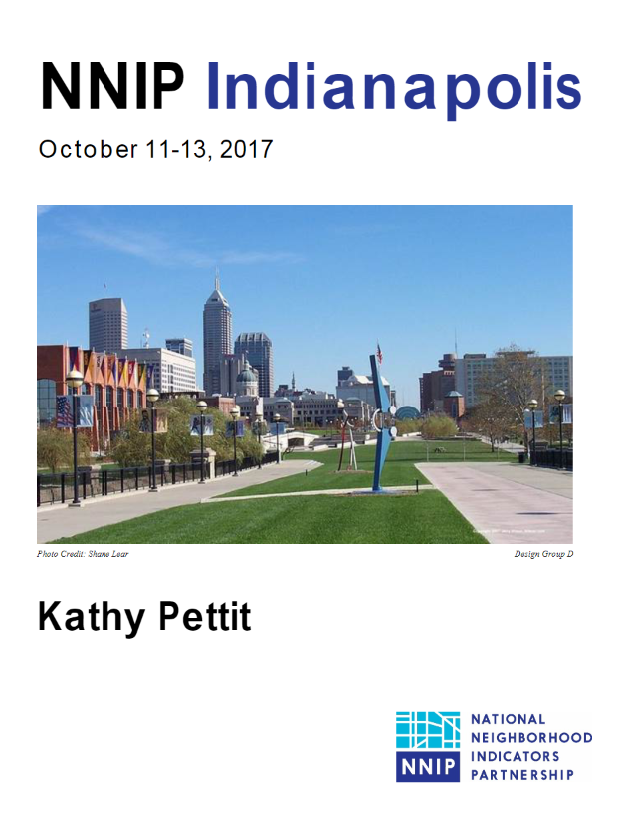
How this will work
Look on the cover of your packet
for your group assignment

Slide 13
How this will work
Move now to your group’s assigned location. Facilitators will rotate.
Alexander Ballroom West
Group A
Alexander Ballroom East
Group B
Fletcher Place
Group C
Renaissance Place
Group D

Slide 14
Discussion Questions
Have you ever tried user-centered design techniques?
Which activities were most-interesting?
How can you use these techniques?
What implementation challenges will you face?
How can NNIP help you once you get home?

Slide 15
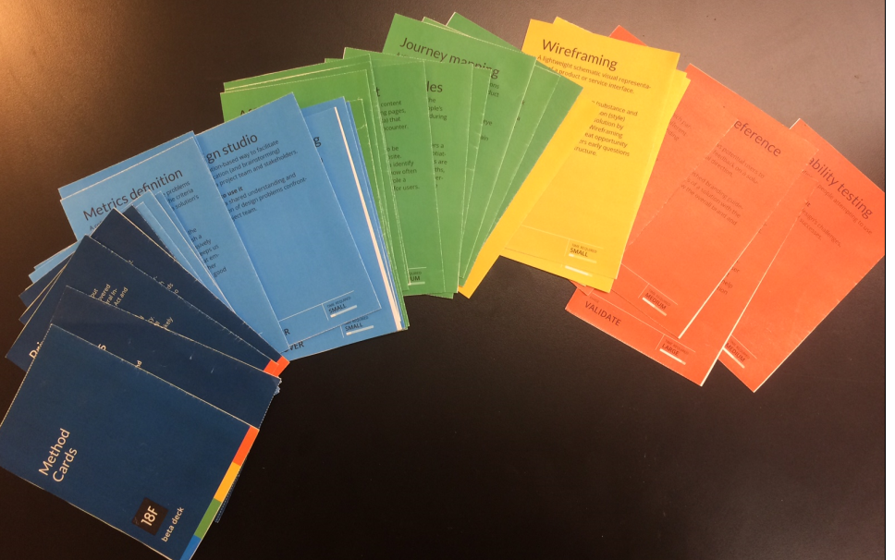
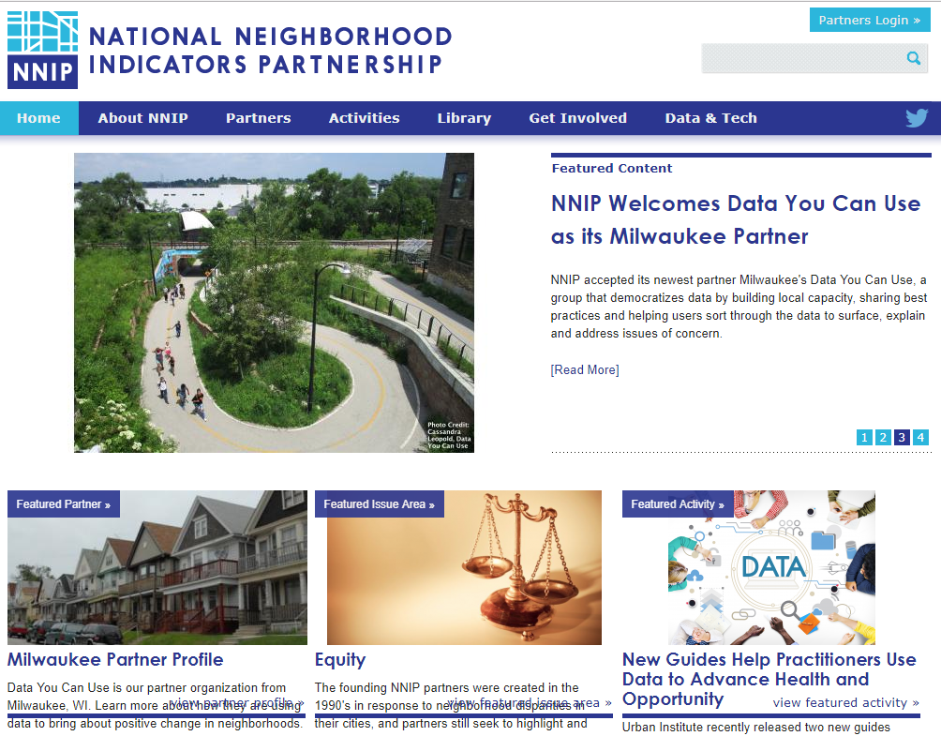
Additional resources are on the NNIP website

