Slide 1
CommunityViewer Integrated Data System May 2015

Slide 2
Why? …all the things to all the people
Need | Examples
Identify people or households needing specific interventions | Identify schoolchildren who have just missed 3rd school day in a row Public housing households generating multiple emergency room visits and school absences for respiratory problems
Track individual, family/HH, or population progress | Change in EPN student math grade after four weeks of tutoring Change in child’s behavioral issues after non-custodial father secures and retains employment Change in percent of EPN students missing 10% of more of school instruction days
Conduct evaluation and research | Outcome measurement: Four-year graduation rate for kids who attended Pre-K vs. those who did not Quantify the intensity of grades K-2 out-of-school time learning needed to preserve the protective effects of Pre-K thru 3rd grade

Slide 3
What SA chose NOT to do, and why
Import to warehouse
Force use of single database by every partner
Import lots of raw data to single database
CommunityViewer IDS intended to
Integrate person-data with place-data
Be used long-term across region
Maximize power, minimize risk and effort
Be scalable at low(ish) cost once core is built
Make aggregate data freely available, keep PII highly secure and private

Slide 4
What it integrates
Person-to-person
Links and de-duplicates people, families, and households across datasets using record-matching algorithms and defined attributes
Early-warning dashboard and longitudinal tracking
Person-to-place
Geocodes person-level records
Enables use of place-based data (neighborhood and environmental influences)
Place-to-place
Aggregate up across datasets (census tract to ZCTA)

Slide 5
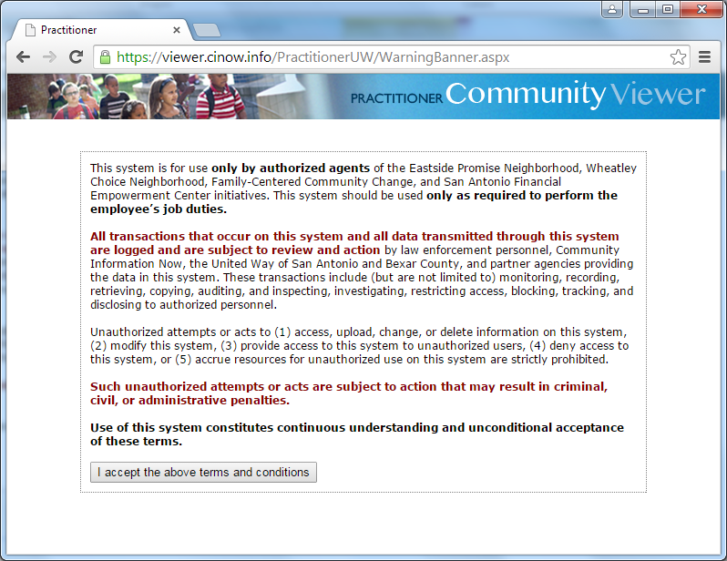
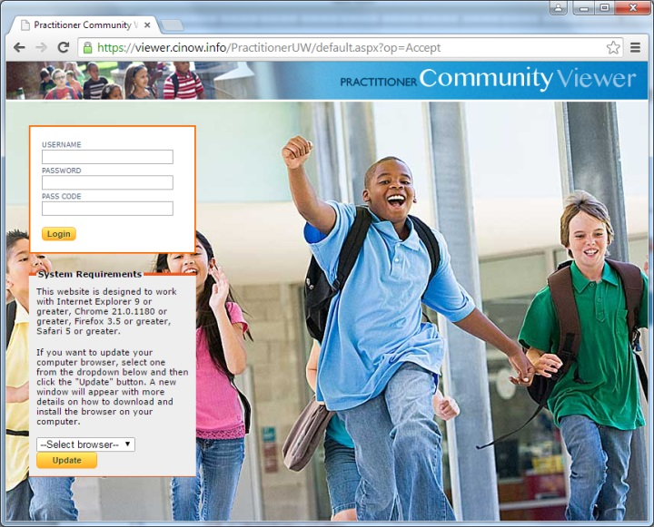
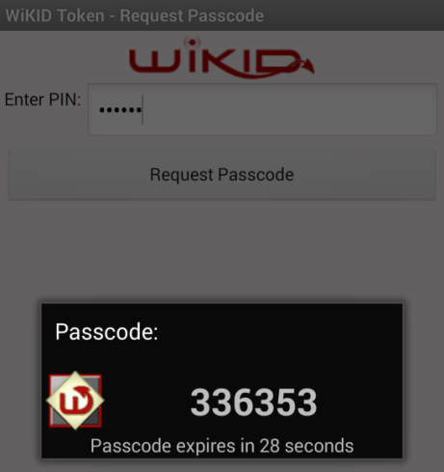
Governance and management
Currently, control shared by United Way, CI:Now
CI:Now handles user support; secure managed hosting and development (incl. data connections) contracted
Data access and use controlled by (1) Agency MOU, (2) person consent, (3) User Agreement, (4) user rights,
(5) supporting functionality
What that all looks like…
Secure log-on to front end
User mini-agreement Two-part authentication

Slide 6
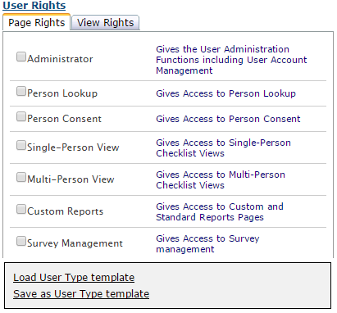
Person/parent consent
Point of service
Granular (issue, agency, PII view, PII move)
Dynamic
Locking code for signature
Role-based permissions
Data by issue area
PII vs. aggregate
Established by agency
and by client consent
Requires central approval

Slide 7
Virtual workstation: extremely restricted data access for on-demand and complex queries
Custom Reports: nested crosstabs with PII drill-down for programmed indicators (expensive!)
Notes:
And connect absent kids to the right intervention. Here’s an aggregate report showing that the group of kids who are MOST likely to be chronically absent (~29% vs ~22%) is Hispanic girls who are NOT LEP, and they’re TWICE as likely to be chronically absent as non-Hispanic boys.

Slide 8
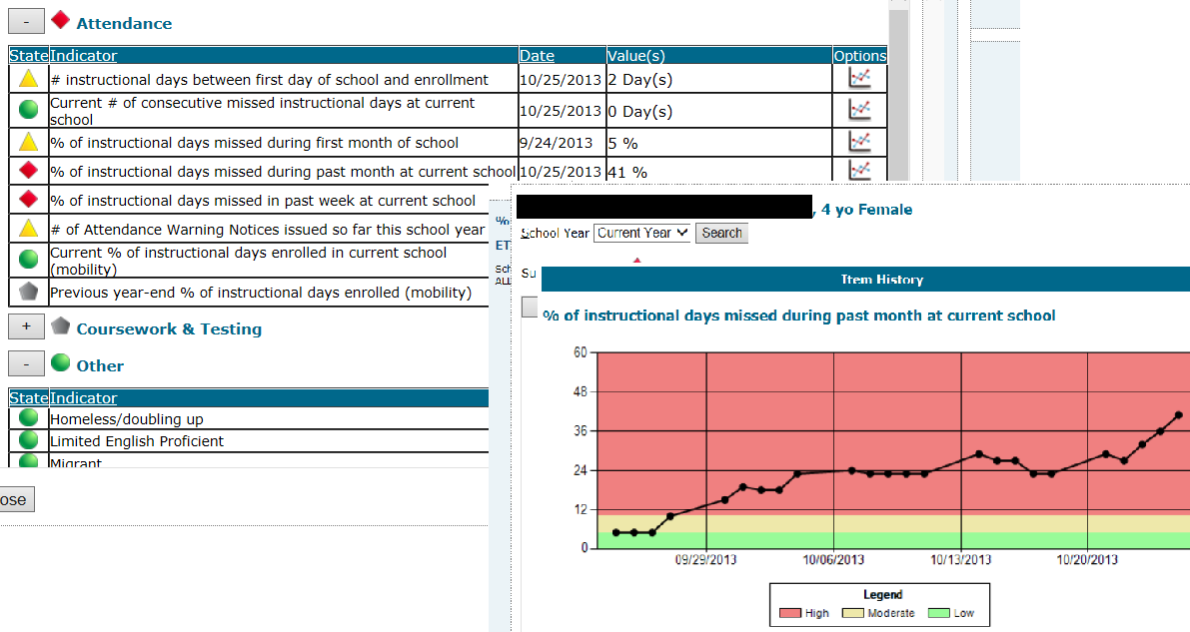
Person Viewer: PII dashboard w/ most recent value and trend for programmed indicators (more expensive!)
Notes:
With permissions I can drill down from that report to the record of one of those chronically absent Hispanic girls. She’s only had one attendance warning notice recorded, but with this early warning system we see that her absenteeism is getting worse – now she’s missed 41% of school days in the last month.
Once we connect the datasets and with consent, we can also tell from this same screen whether she has a serious health problem that might cause absence. We can already see that she isn’t mobile or homeless, but she did enroll in school two days late.

Slide 9
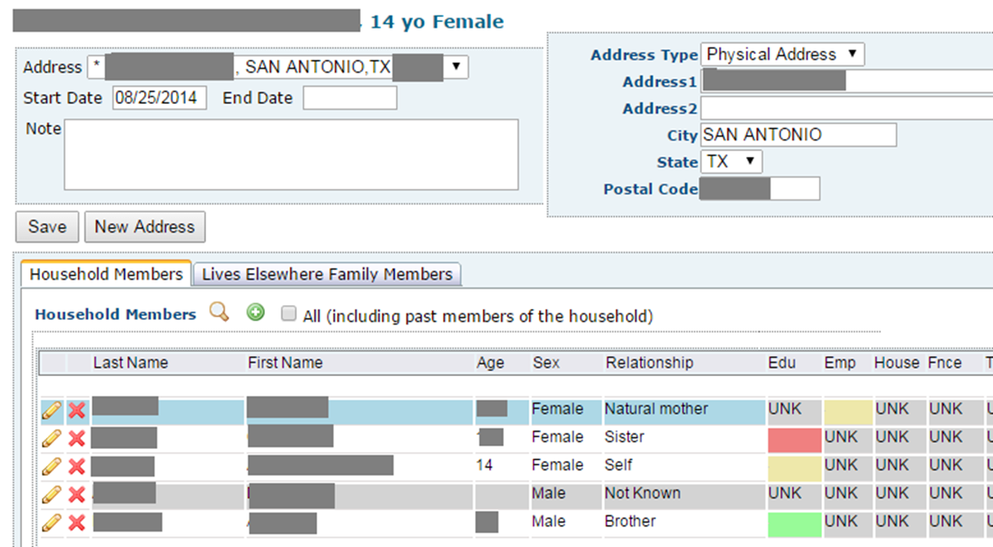
Household/Family Viewer:
“Household” is physical address + time period
“Lives elsewhere” like non-custodial parent, FFN caregiver
Any person can temporarily or permanently be related to any other person (must be keyed in if not extant)
Notes:
And with consent we can start to build a family-level dataset that captures things like parent employment and transportation and after school child-care. This is the dashboard we need to support family-centered approaches

Slide 10
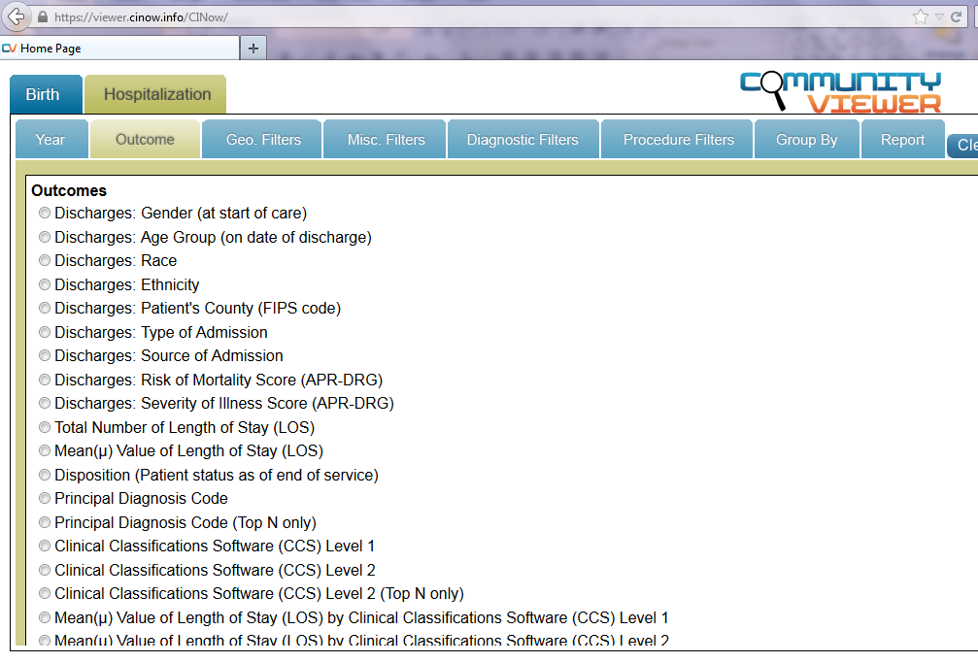
Public reports: will be connected to PII db over time

Slide 11
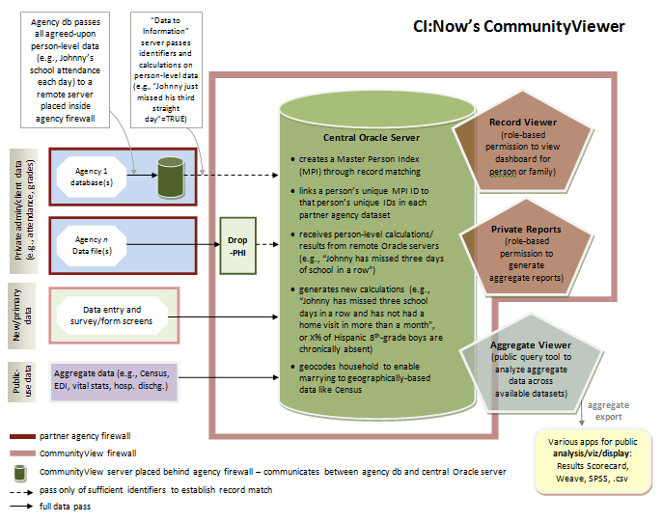
Notes:
Why we built something from scratch:
San Antonio needed a “data commons” that would make integrated data (in aggregate form) accessible to the general public, not just a small group of project staff or researchers. So a case management-type application wouldn’t work.
Initiatives like Eastside Promise and Casey FCCC, though, needed integrated data for individual children and families, with identifiers intact and visible. So a data warehouse wouldn’t work.
We didn’t want to ask partner agencies to key client data into a shared database, because that means duplicate data entry and a lot of extra data entry errors, or else switching databases even if the agency is happy with what they’ve been using and doesn’t want to switch.
So we built a solution that would pull together and link data from whatever data system the partner agency is using. They might be using Excel, or they might have six different relational databases. Regardless, they keep entering their data into the system they like (ETO would be an example), and we pull it together and integrate it at the person level with other agencies’ data, as well as other datasets like Census and neighborhood conditions.
We went a step further and created a solution that would MOVE less raw data than is usually required to integrate data using a product like nFocus or ETO. [see next slide]

Slide 12
Notes:
Why we built something from scratch:
San Antonio needed a “data commons” that would make integrated data (in aggregate form) accessible to the general public, not just a small group of project staff or researchers. So a case management-type application wouldn’t work.
Initiatives like Eastside Promise and Casey FCCC, though, needed integrated data for individual children and families, with identifiers intact and visible. So a data warehouse wouldn’t work.
We didn’t want to ask partner agencies to key client data into a shared database, because that means duplicate data entry and a lot of extra data entry errors, or else switching databases even if the agency is happy with what they’ve been using and doesn’t want to switch.
So we built a solution that would pull together and link data from whatever data system the partner agency is using. They might be using Excel, or they might have six different relational databases. Regardless, they keep entering their data into the system they like (ETO would be an example), and we pull it together and integrate it at the person level with other agencies’ data, as well as other datasets like Census and neighborhood conditions.
We went a step further and created a solution that would MOVE less raw data than is usually required to integrate data using a product like nFocus or ETO. [see next slide]

Slide 13
Some lessons learned the hard way
Manage everyone’s expectations, actively and often
What’s possible, how fast, at what cost
Systematically identify recurring costs triggered by one-time costs
Full automation of integration is not Holy Grail; integrate manually after QA to start
Critical that non-tech leadership has someone trusted who can advise on tech issues like time, cost, capabilities

Slide 14
More lessons learned the hard way
Find some way to get user requirements spec’d out before product is completely finished
Form doesn’t always get to follow function because function isn’t always well-defined and -understood
Things change fast; possible that it won’t matter what specs ever were
Revisit specs often and be willing to leave something unfinished

Slide 15
There weren’t any lessons learned the easy way, actually
Expect reporting/ ad-hoc query needs to crop up quickly, be significant, continue for duration
Be prepared for possibility of very low data quality
Plan for increasing partner data capacity
Always develop backup plan - Plans A through F will not work
Laugh, have faith, and try to fail forward

Slide 16
More information
Overview
http://nowdata.cinow.info/CommunityViewer
Public Reports
https://viewer.cinow.info/CINow
Courtney Denton, MPH
Courtney.Denton@uth.tmc.edu

