Slide 1
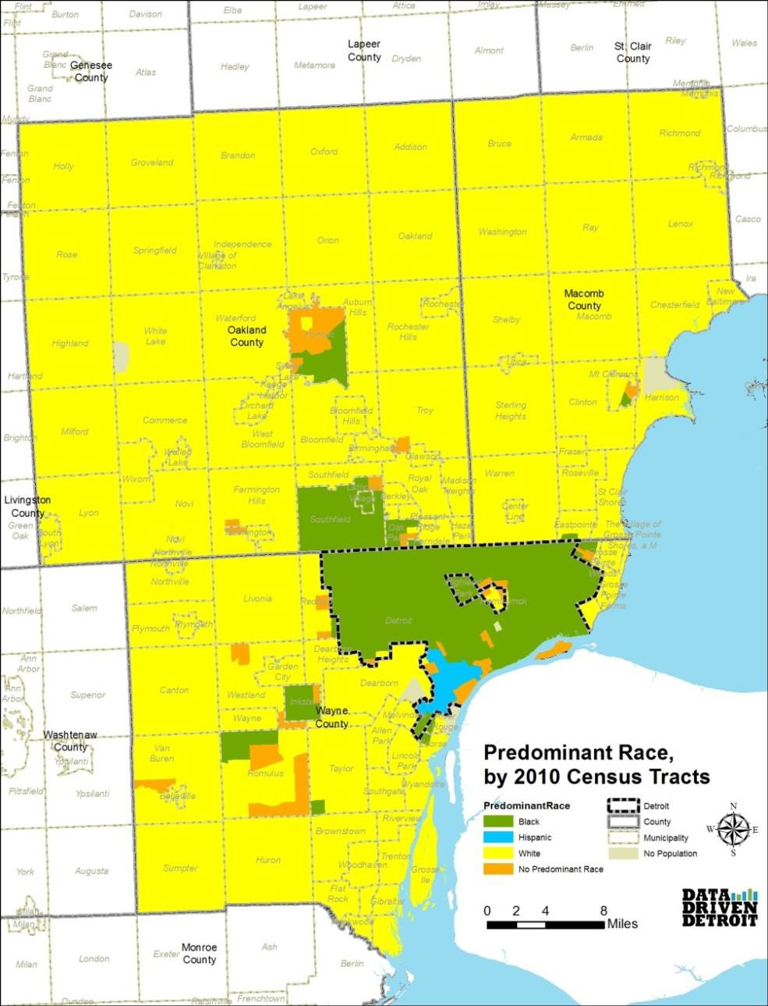
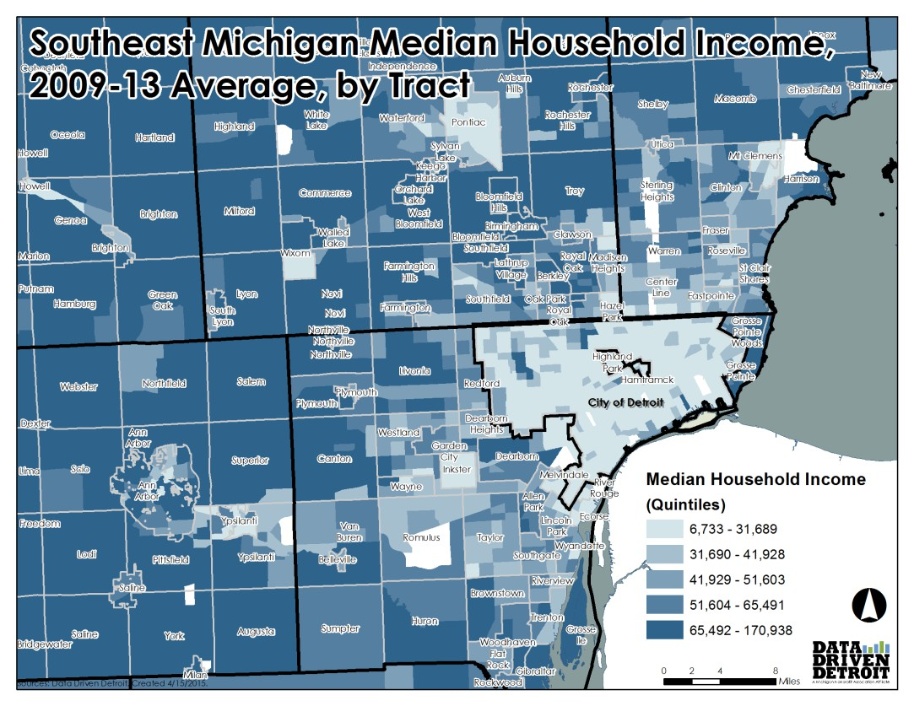
Affiliated with the Michigan Nonprofit Association

Slide 2
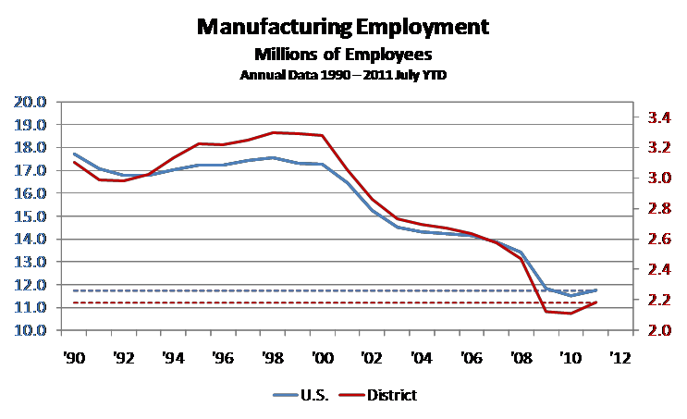

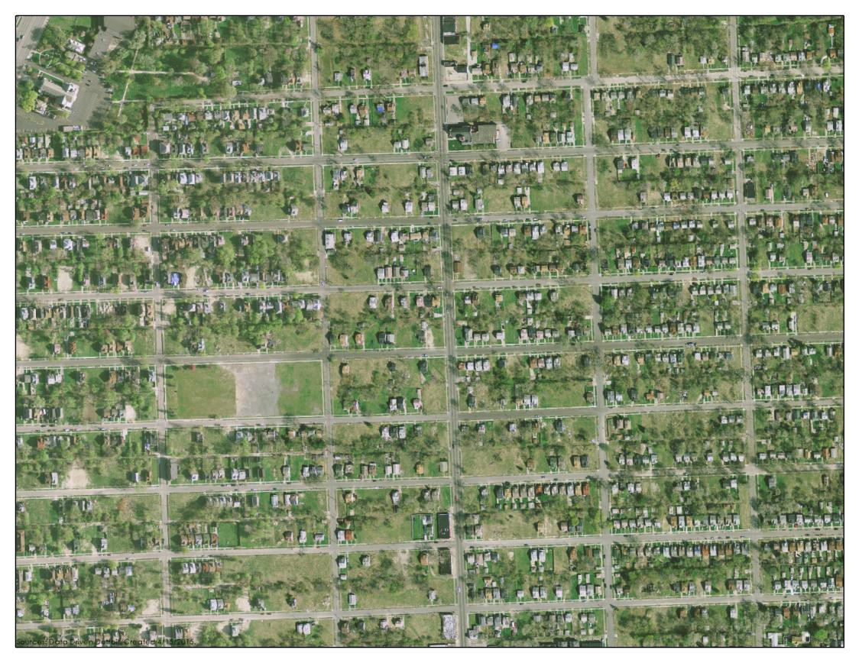

Affiliated with the Michigan Nonprofit Association

Slide 3

Data Driven Detroit provides accessible high- quality information and analysis to drive informed decision-making.
Affiliated with the Michigan Nonprofit Association

Slide 4


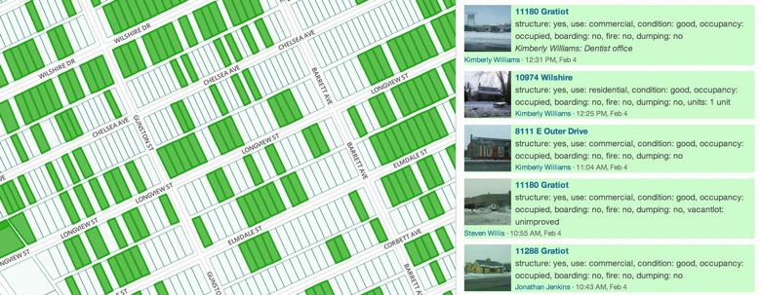

Affiliated with the Michigan Nonprofit Association

Slide 5


































Open Data
Tech Trainings
Maker Culture & STEAM Education
Start-Up Culture & Coworking
Human-Centered Design
Meet-Up Culture
Coordinated & Creative Partnerships
A Michigan Nonprofit Association Affiliate
Affiliated with the Michigan Nonprofit Association

Slide 6
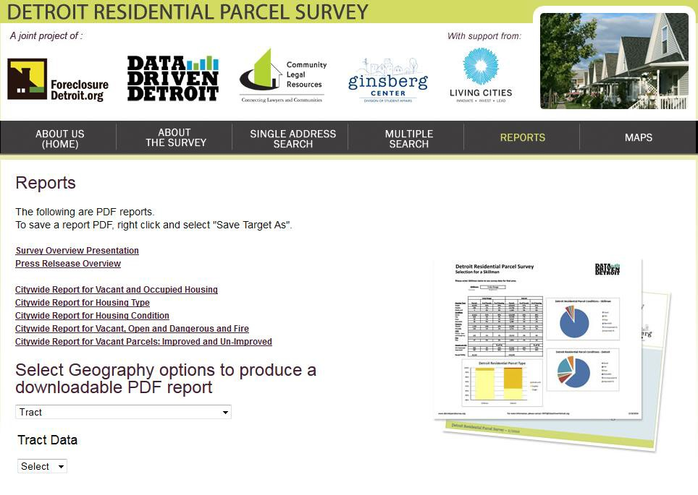
Affiliated with the Michigan Nonprofit Association

Slide 7
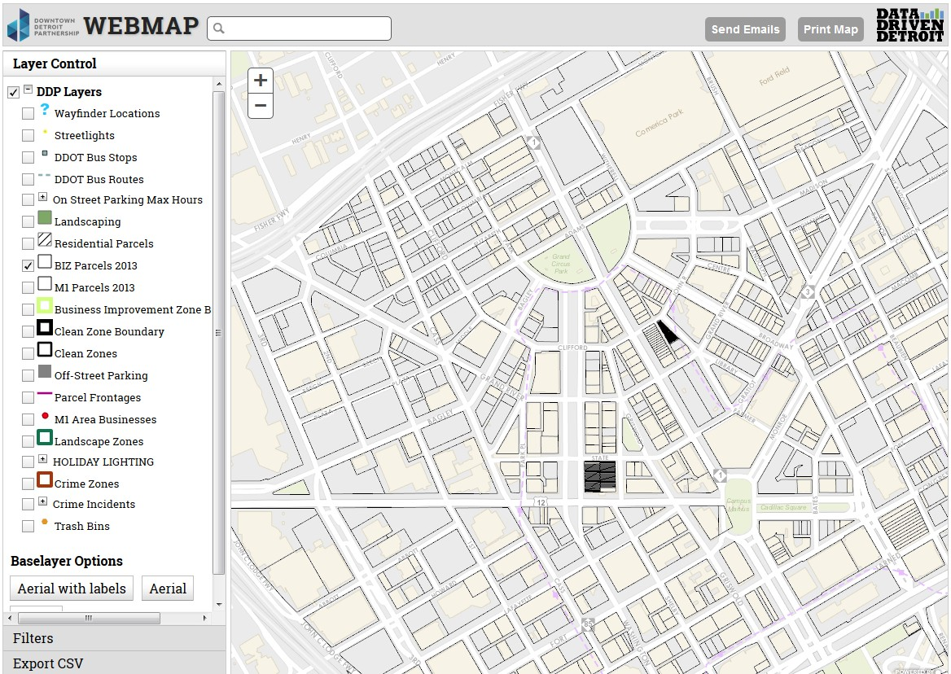
Affiliated with the Michigan Nonprofit Association

Slide 8

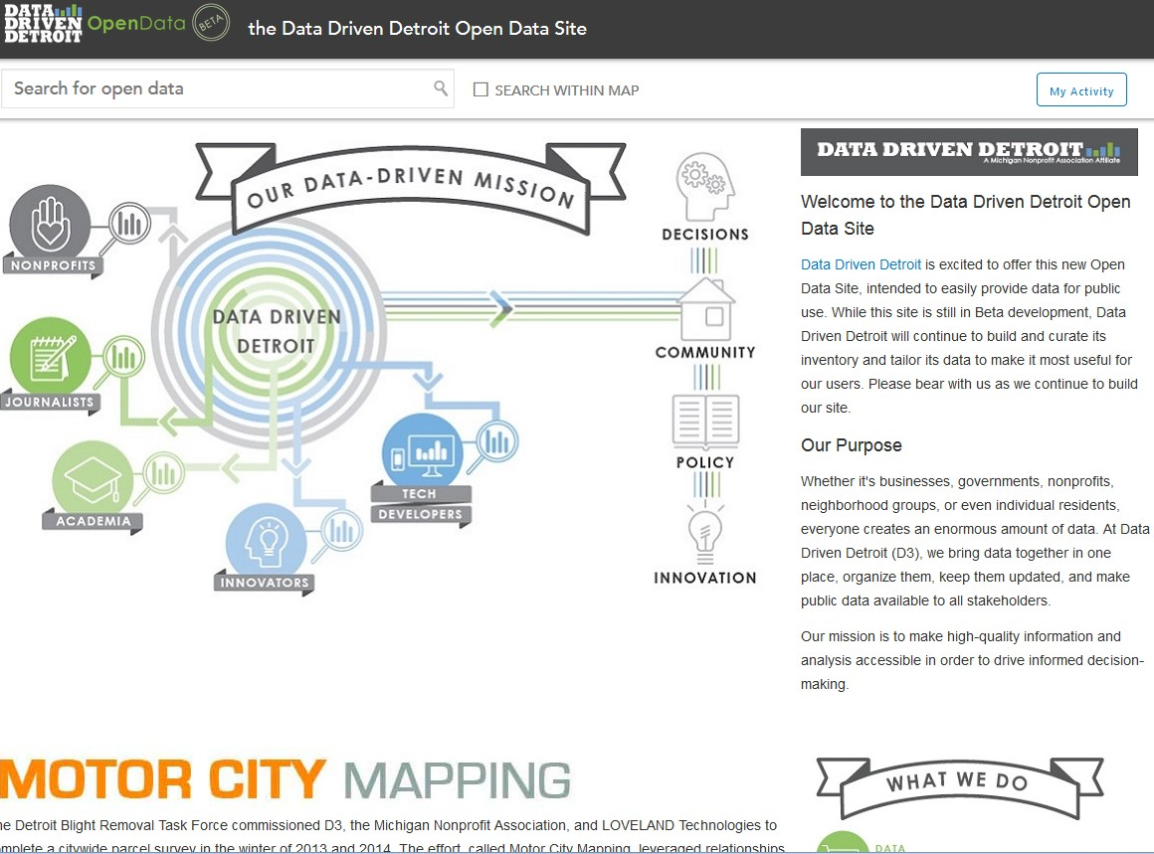

A Michigan Nonprofit Association Affiliate
Affiliated with the Michigan Nonprofit Association

Slide 9
A Michigan Nonprofit Association Affiliate
Affiliated with the Michigan Nonprofit Association

Slide 10
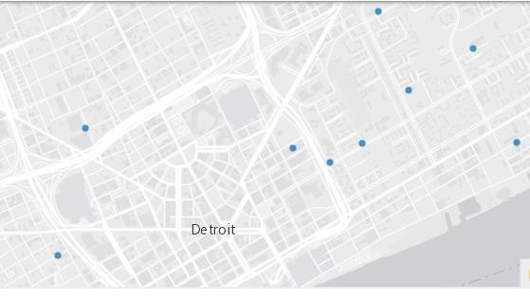
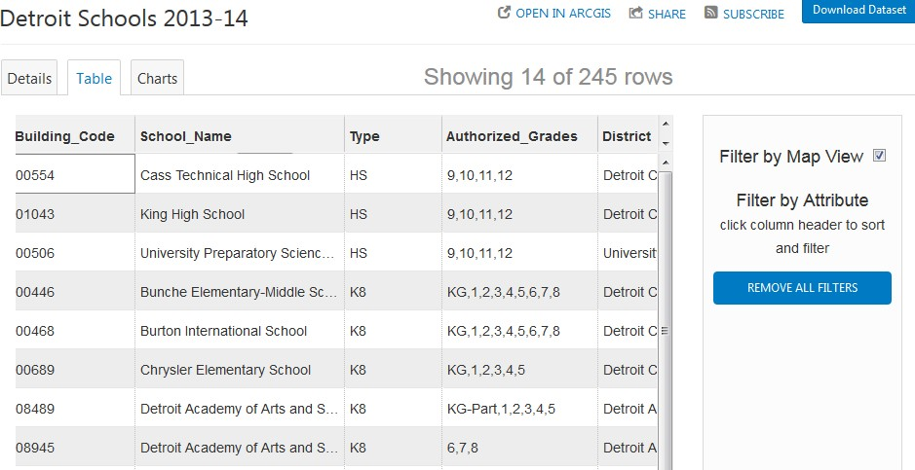
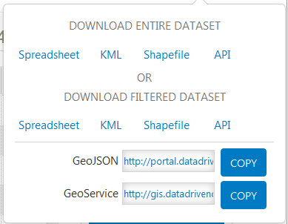
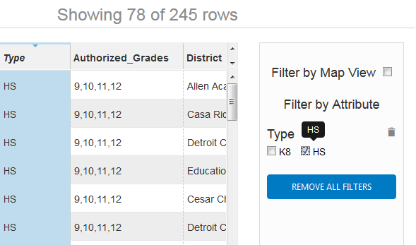
Affiliated with the Michigan Nonprofit Association

Slide 11
Affiliated with the Michigan Nonprofit Association

Slide 12
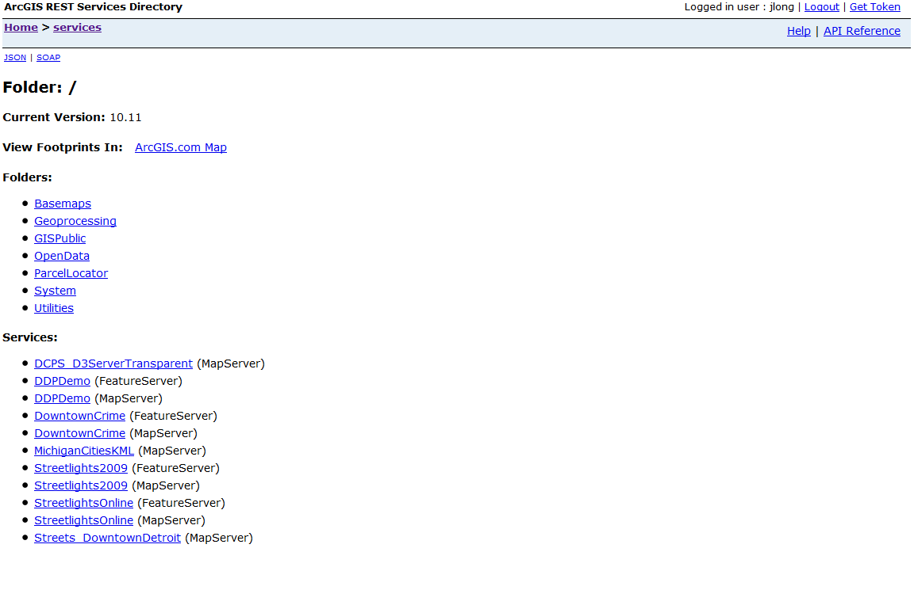
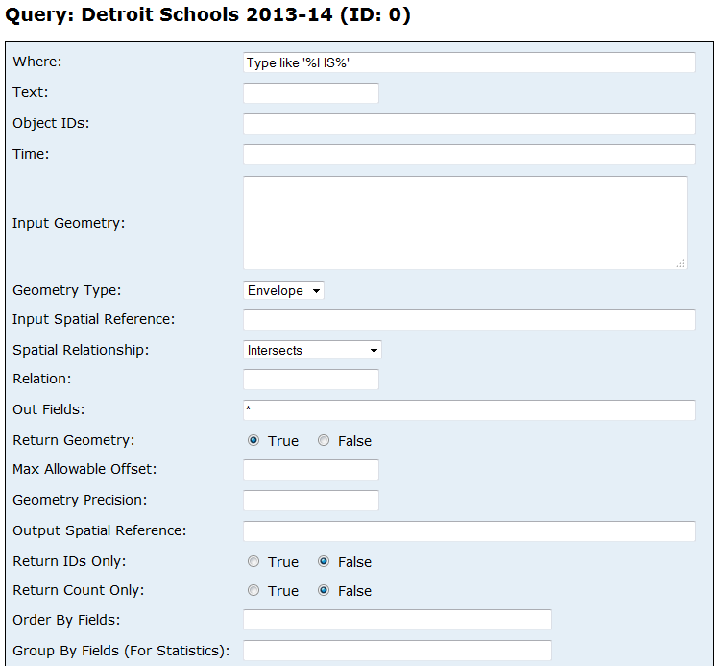
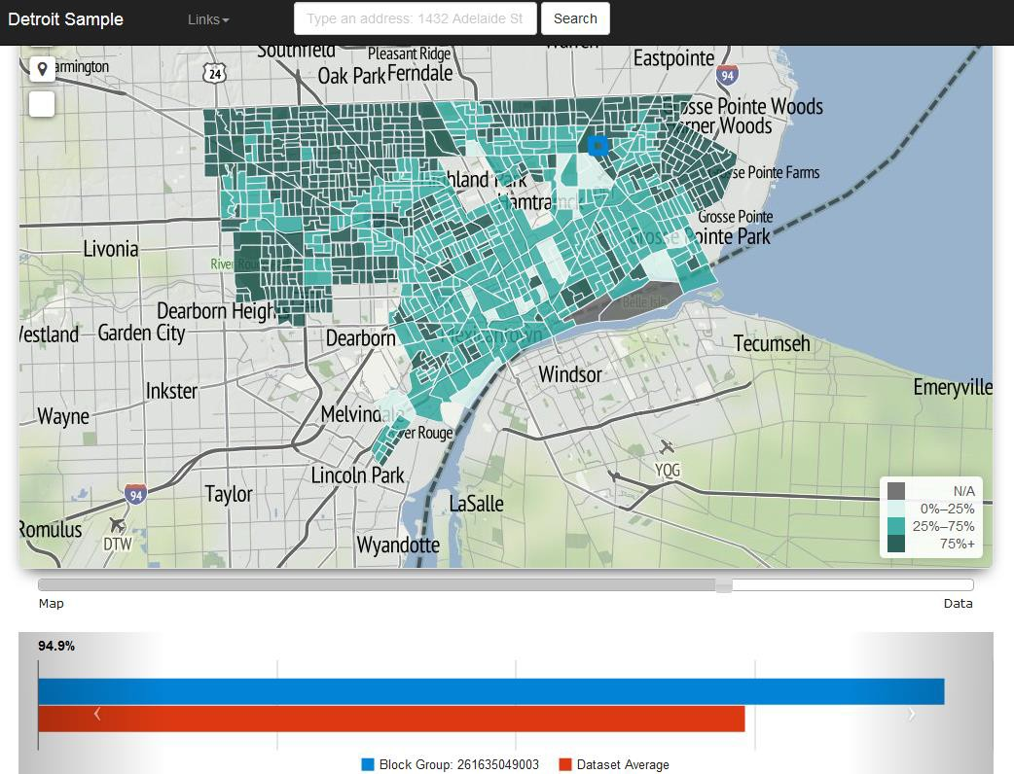
Affiliated with the Michigan Nonprofit Association

Slide 13
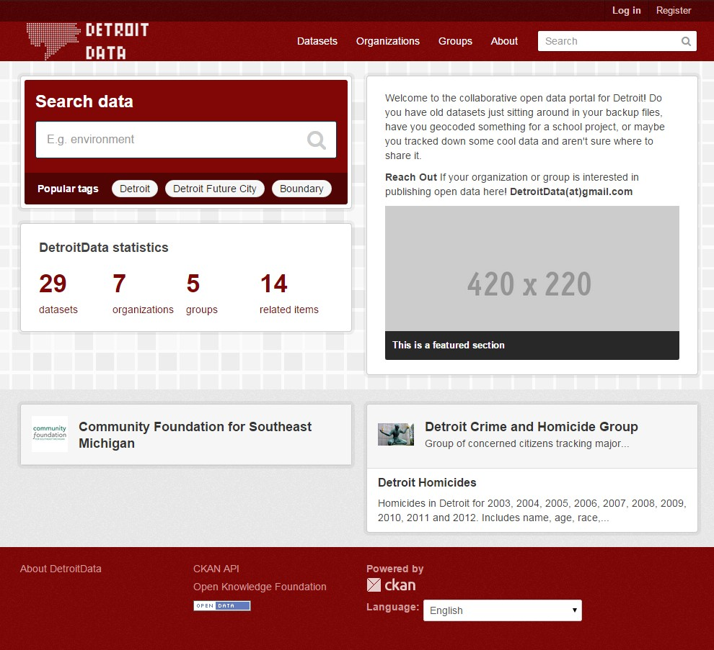
DetroitData.org
Affiliated with the Michigan Nonprofit Association

Slide 14
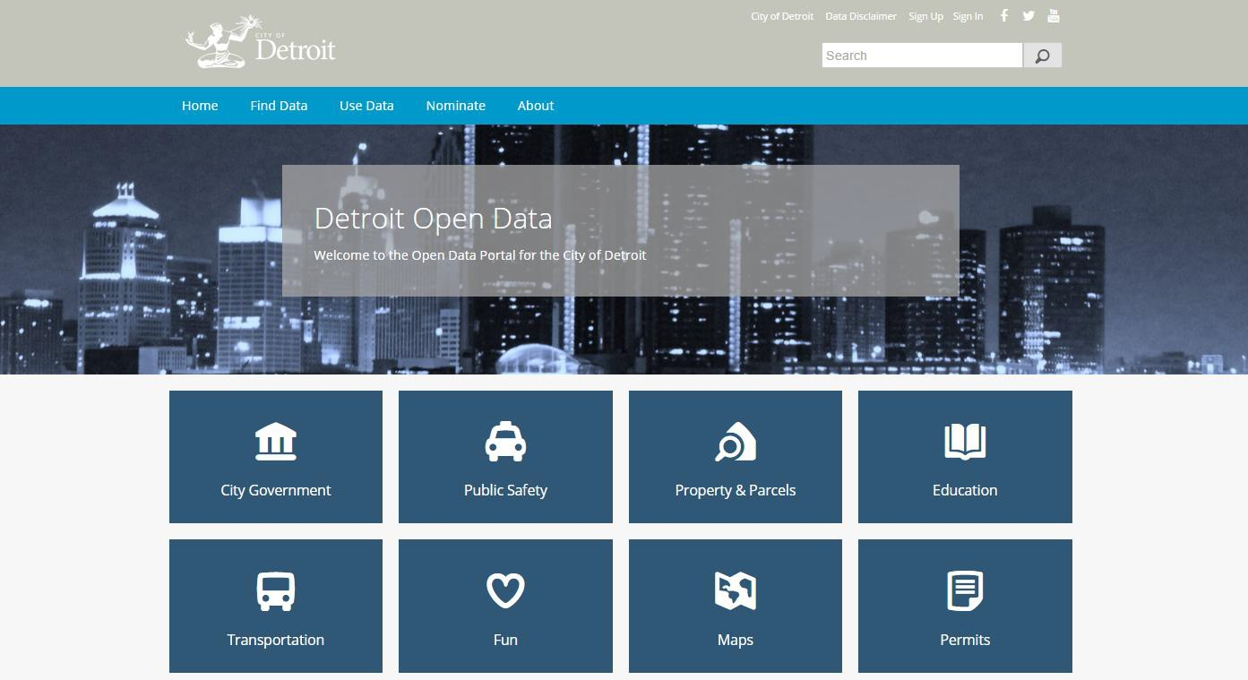
Data.DetroitMI.gov
Affiliated with the Michigan Nonprofit Association

Slide 15
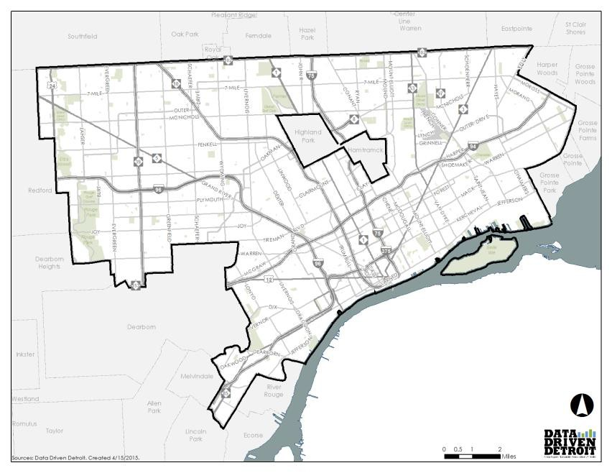
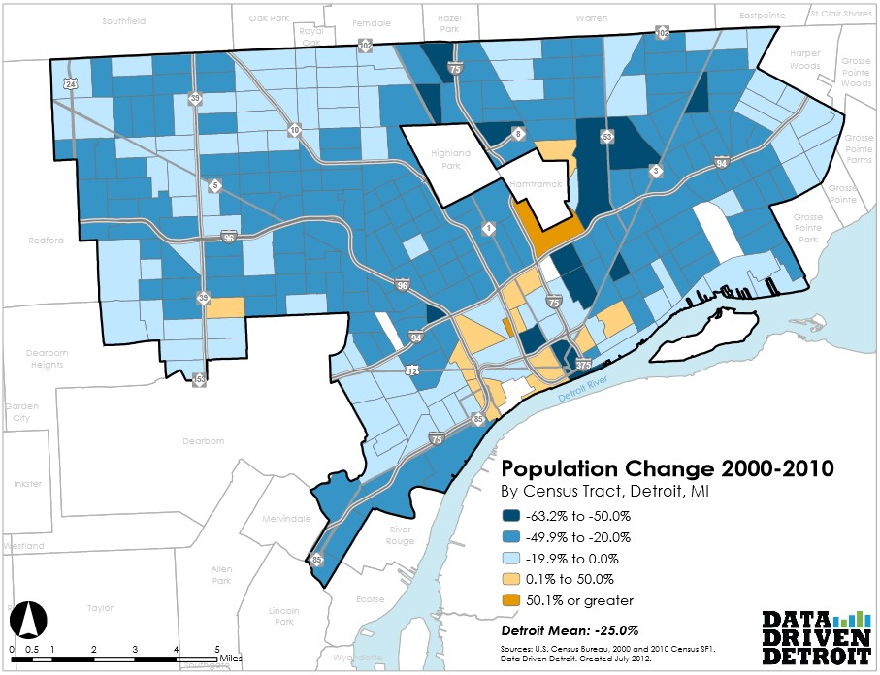
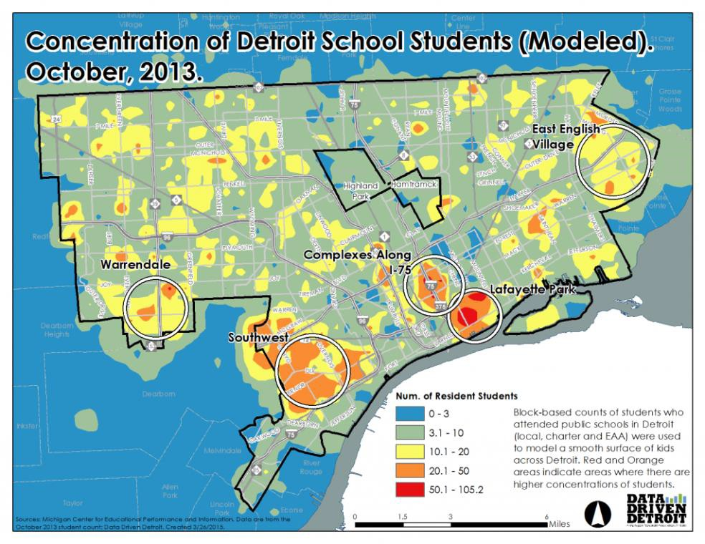
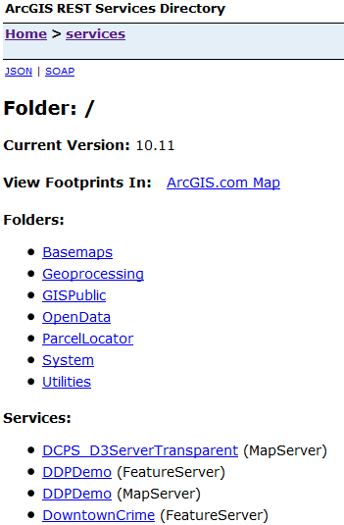
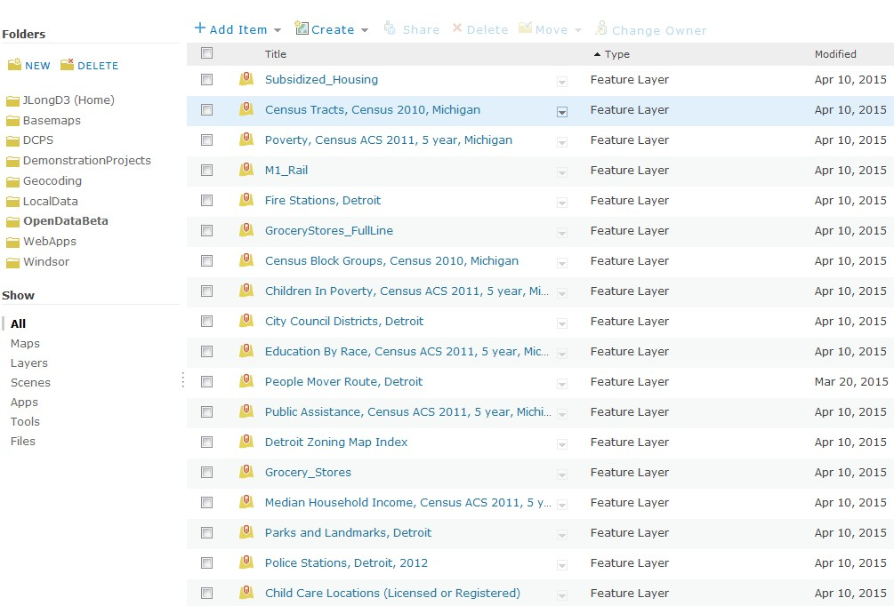
Affiliated with the Michigan Nonprofit Association

Slide 16
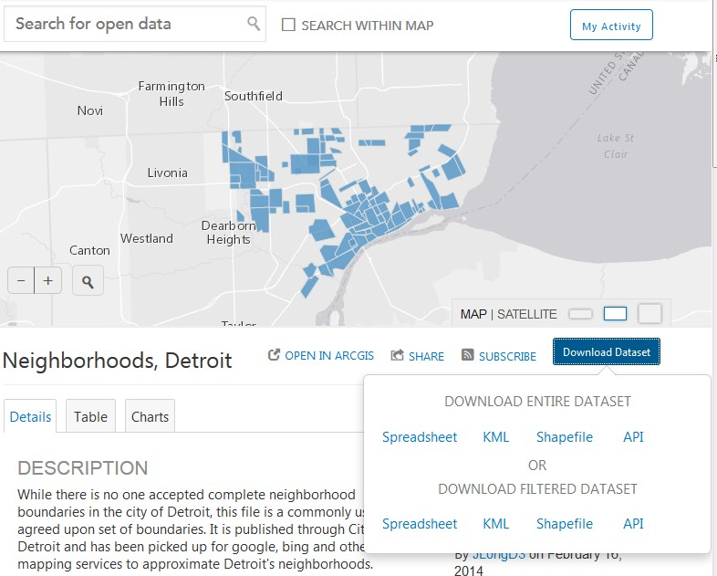
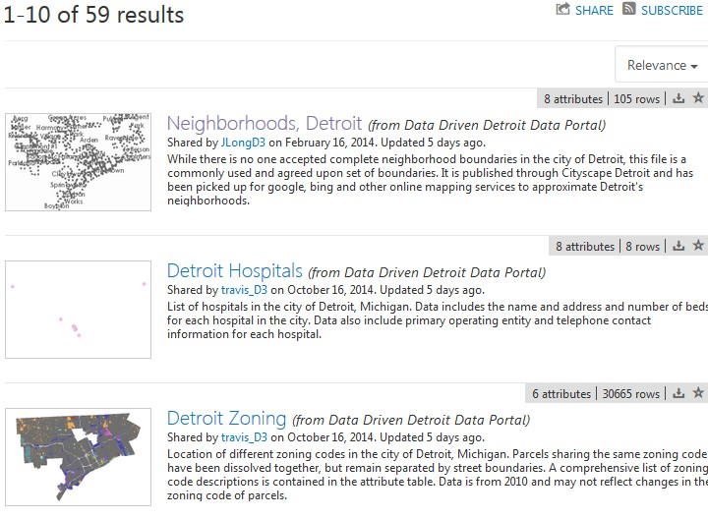
If yes, then you should consider turning on ArcGIS Open Data
Affiliated with the Michigan Nonprofit Association

Slide 17
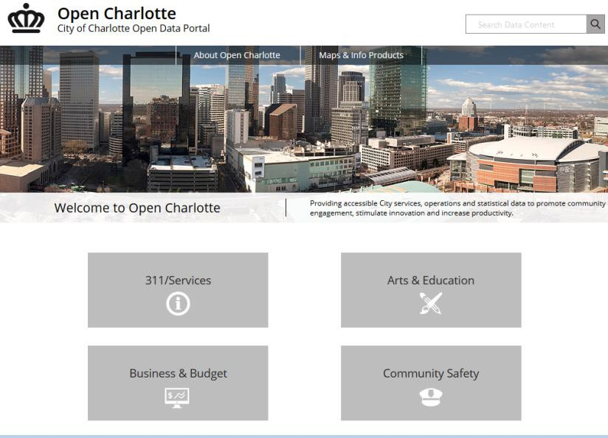
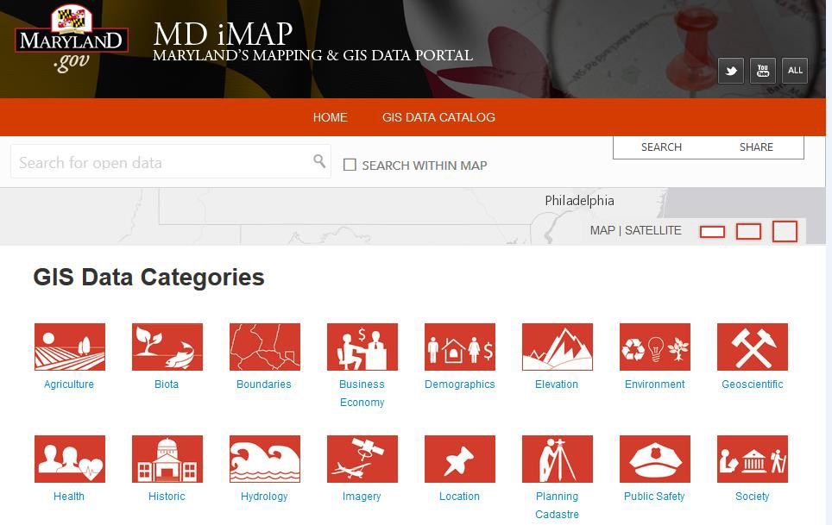
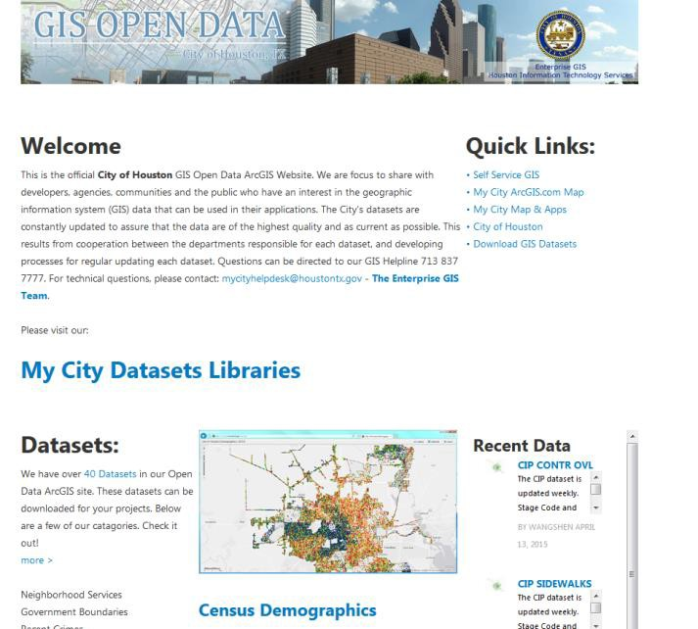
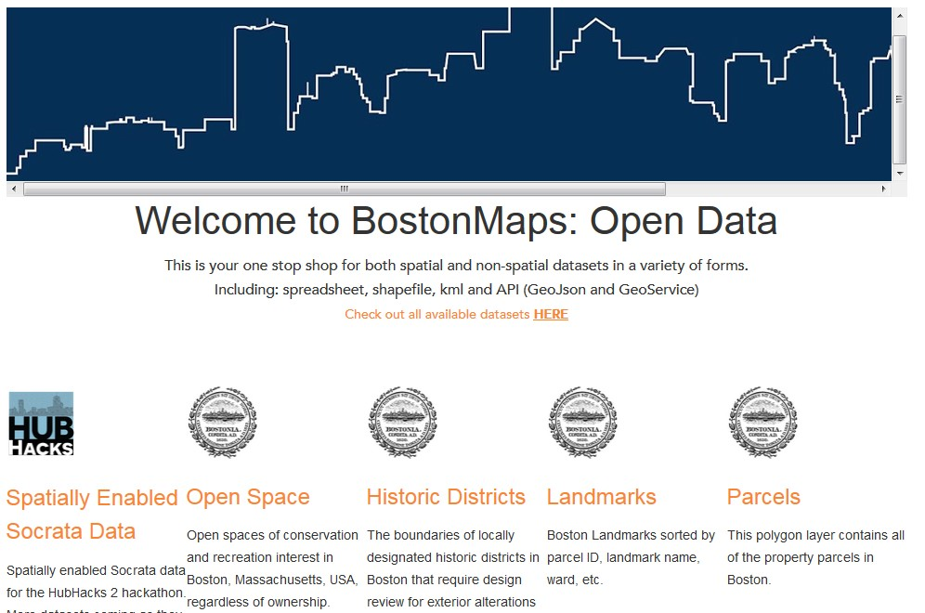
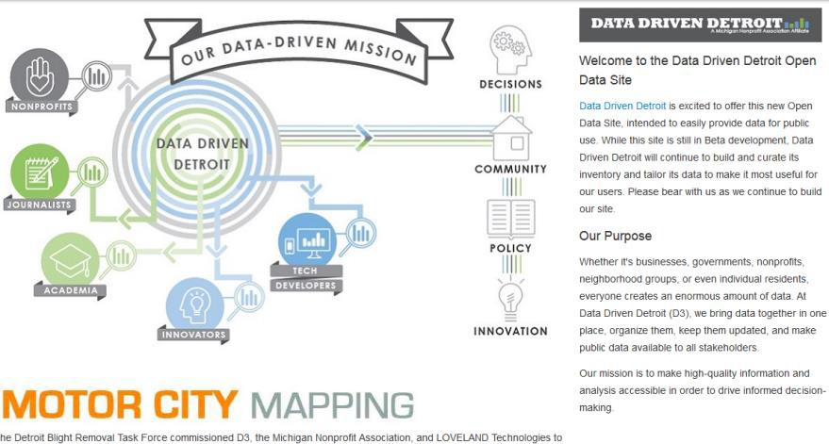
“Hardest” part is designing the front page
Affiliated with the Michigan Nonprofit Association

Slide 18
“Hardest” part is designing the front page
Affiliated with the Michigan Nonprofit Association

Slide 19
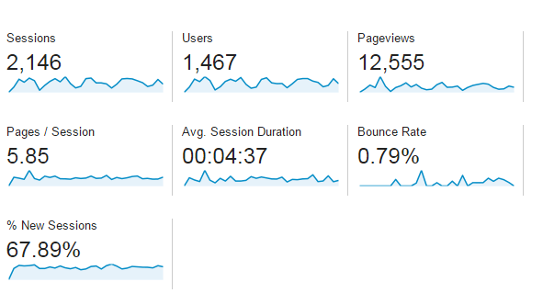

Impact
Average between 70-100 sessions per day.
Affiliated with the Michigan Nonprofit Association

Slide 20
Impact
Average between 70-100 sessions per day.
Affiliated with the Michigan Nonprofit Association

