Slide 1
Evolving Data Management in Longitudinal Indicator Tracking
Making sense out of data in an Age of High Expectations
Nancy Jones, Data Manager
Baltimore Neighborhood Indicators Alliance
NNIP snip = 9

Slide 2
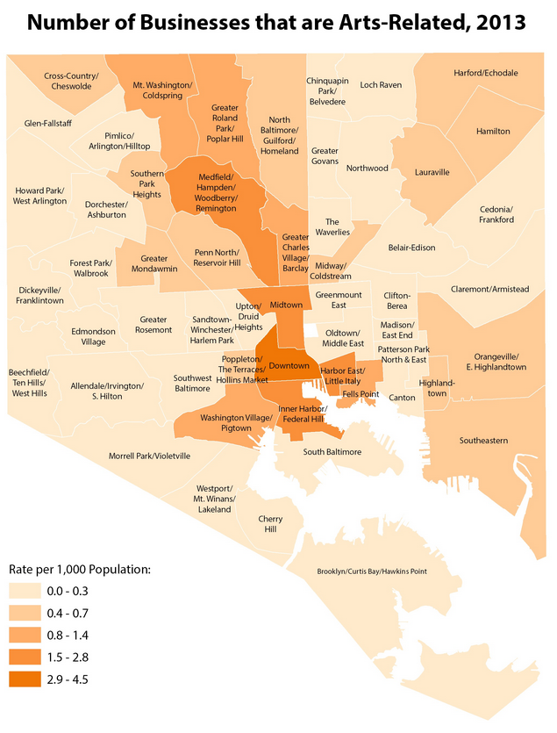
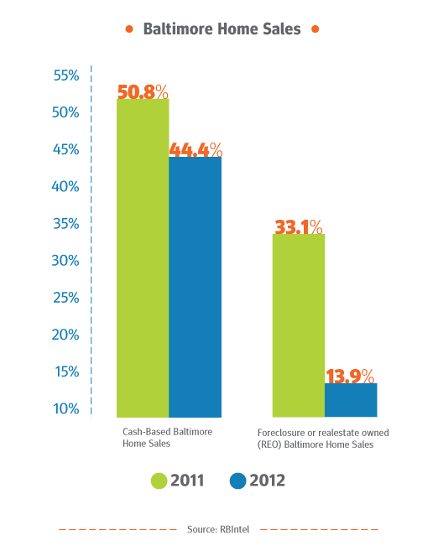
The Output

Slide 3
The Input
Sneakernet
CD-Rom
Flash Drive
Email
Online download
SFTP
Direct data entry
Future - web scraping
Photo © Yianni Mathioudakis

Slide 4
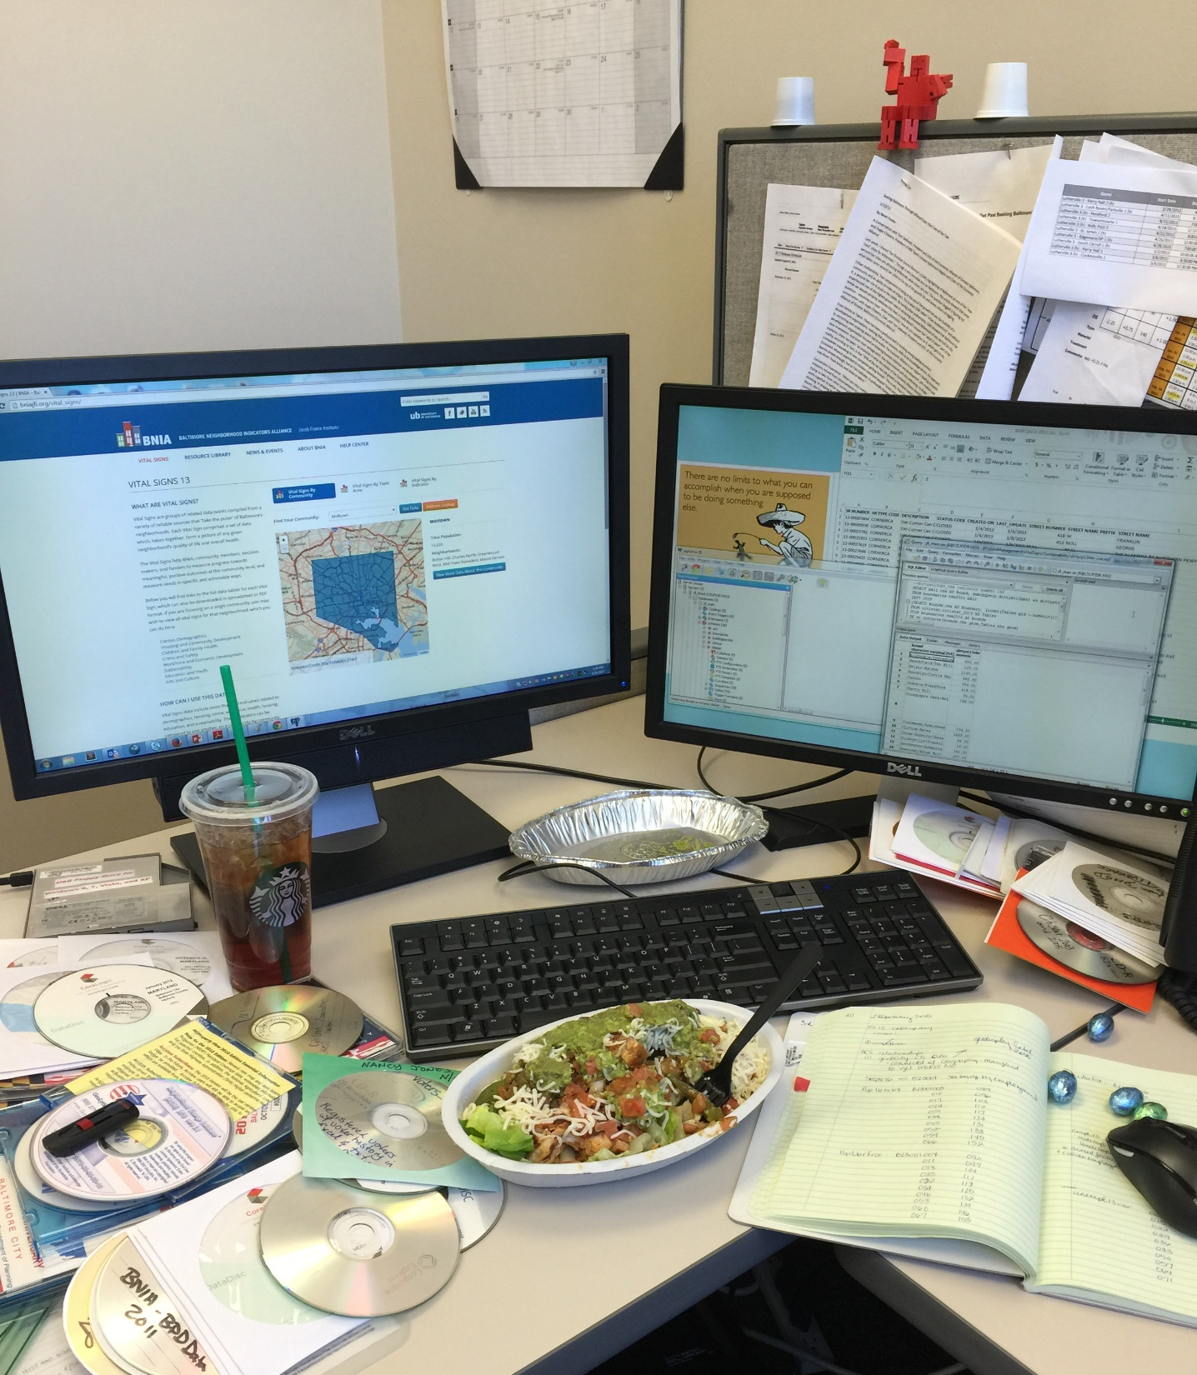
The Process

Slide 5
External Data
Administrative data
Multiple raw formats provided (csv, xlsx, spss, shp, sas, and #$@%^!!!.pdf)
No standards from providers. Varies year to year even among a single source.
Staff changes hinder access

Slide 6
Data Sanitation Engineering
Address cleaning
Field name standardization
Field type standardization

Slide 7
BNIA Data Warehouse
The Secure
Server hosted and maintained by University of Baltimore
Limited user access
The Evolving Reality
14 years of longitudinal records reside in many, many files
54 data providers
118-ish separate files
Downtime = locating original file, when possible, and cleaning
Raw to Processed to Geoprocessed (sounds simple, right?...)

Slide 8
BNIA Database
postGIS / postgreSQL
Geodatabase
Demographics
Health
Sustainability
Workforce
Crime
Housing
Education
Arts

Slide 9
Indicator Output
Vital Signs Report
200 possible indicators
Vital Signs 13 published 139 indicators for the City of Baltimore
Visualization
Maps
Tables
Infographics

Slide 10
Enjoy our website bniajfi.org

