Slide 1
SAVI Advanced and SAVI Indices
New SAVI tools published this year
Jay Colbert
Indianapolis

Slide 2
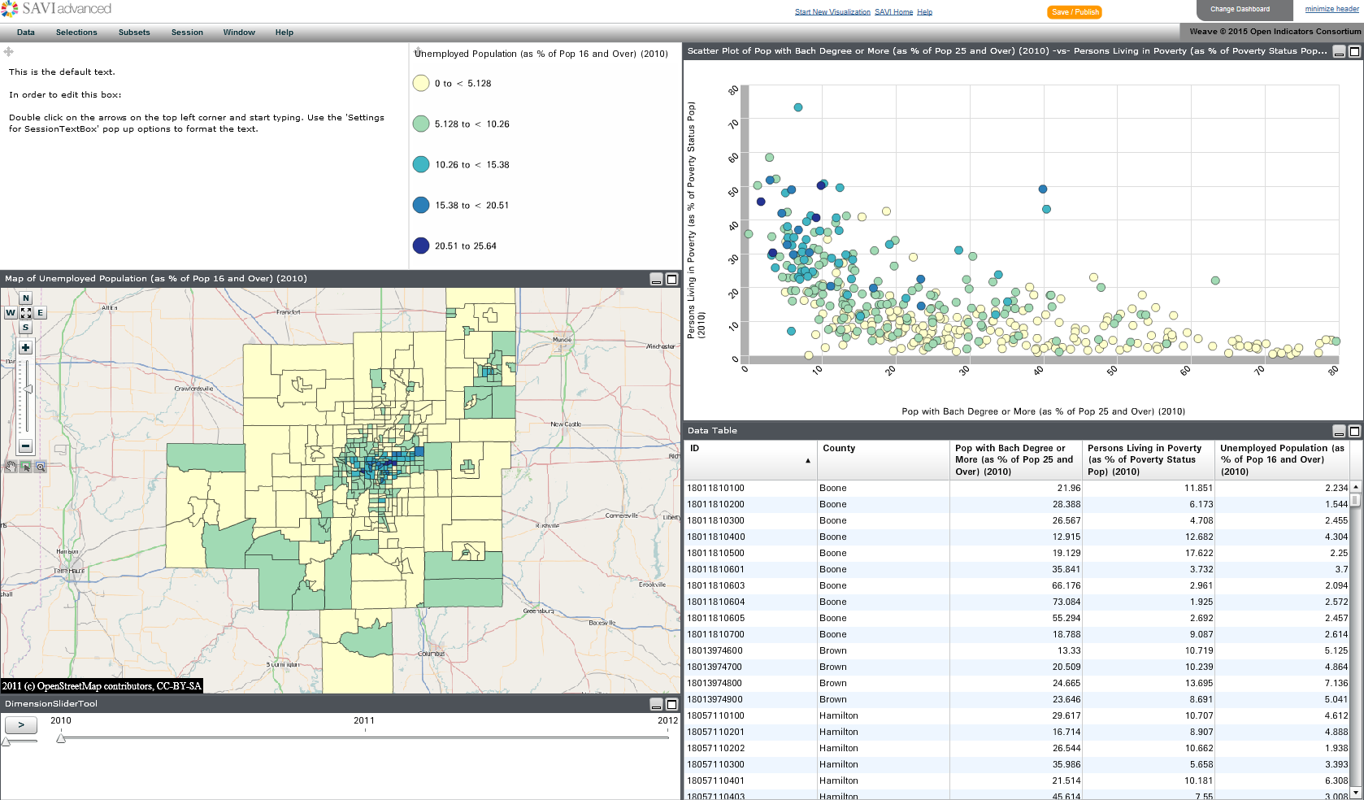
SAVI Advanced
SAVI Advanced is an implementation of WEAVE (WEb-based Analysis and Visualization Environment) developed for use in SAVI. The home screen opens with default data already loaded.
Legend
Scatterplot
Map
Specific to SAVI Advanced
Time Slider
Table

Slide 3
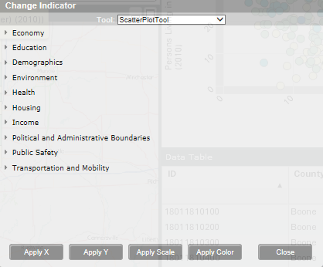
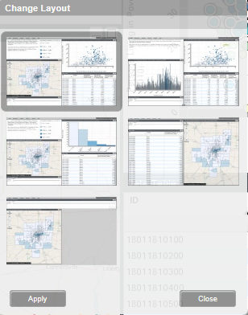
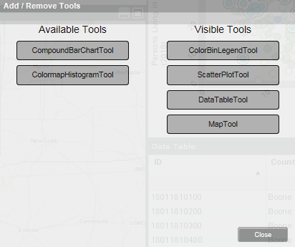
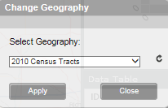
Changing Geography, Indicator, Layout, and Tools
SAVI Advanced allows users to customize their visualizations by selecting a particular geography, indicator, layout, and tools.

Slide 4
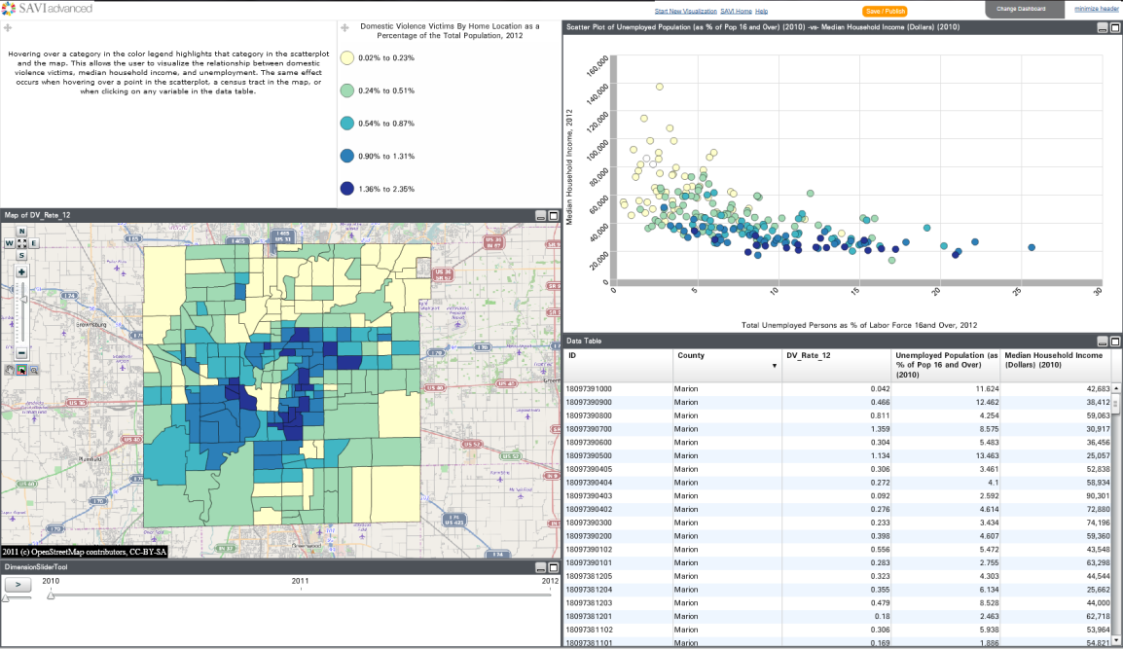
Uploading Data
Visualizations can be created using the data already loaded in SAVI Advanced or users can upload their own data

Slide 5
Uploading Images
Images can be uploaded using SAVI Advanced along with text describing the significance of the image.
Once saved, images can then be incorporated into a data story, adding interest and emphasis to a narrative.
Add your own custom text to any visualization

Slide 6
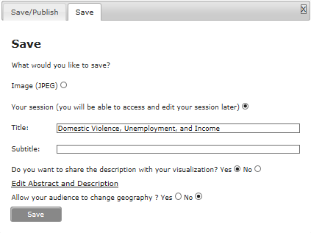
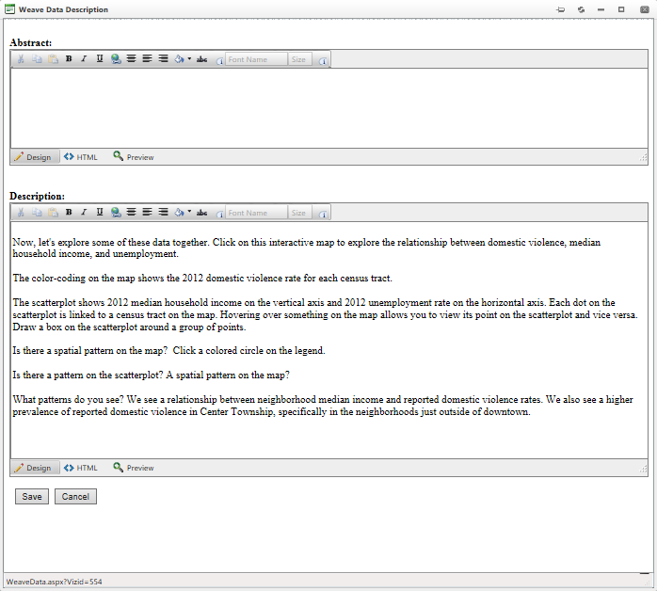
Saving a Visualization
Visualizations or images can be saved by clicking the button at the top of the SAVI Advanced screen, then clicking Save under the Save/Publish tab
Select whether you’d like to save the visualization as an Image (JPEG) or a session (which may be accessed and edited later)
Click whether or not to share a description with the visualization and whether to allow the audience to change the geography in the visualization
Enter a title and then enter an Abstract and Description if desired
Click Save twice once the Abstract or Description have been entered to save the visualization

Slide 7
Creating a Data Story
This feature allows you to combine your visualizations to tell a compelling story about your data. You can use any combination of the following to create your story:
A Saved Session
A Saved Image (static JPEG of the session)
An Uploaded Image

Slide 8
Creating a Data Story
Once several visualizations or images have been created/uploaded and saved, they can be linked together creating a data story which provides a detailed picture of the described population.
Visualizations
Story

Slide 9
Publishing a Data Story
A saved data story can then be published to the SAVI website or published and embedded in the website of another organization.
Create a link to your story.
Embed your story in your website

Slide 10
Accessing Data Stories
Published data stories are accessible to the public and can be accessed via the Data Stories tab
Both published and unpublished data stories created under a user login can be accessed via the User Dropdown Menu which appears when hovering over the user name

Slide 11
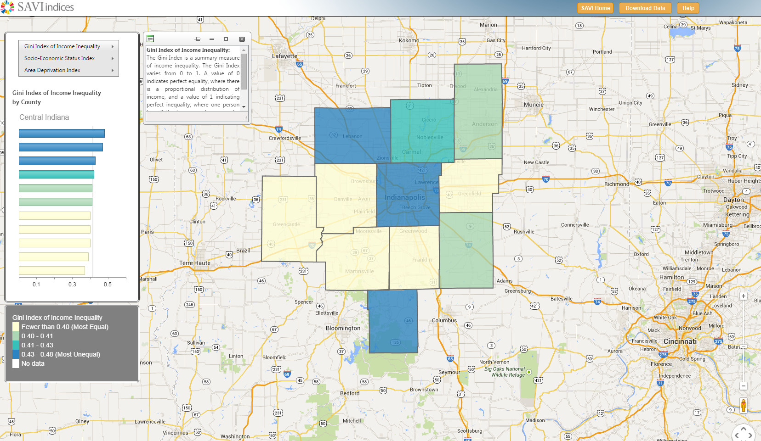
SAVI Indices
The SAVI Indices tool can be used to reveal socio-economic conditions and disparities across the region
Index Selection
Index Details
Chart
Map
Legend

Slide 12
SAVI Indices
To view a different index or a different geography, hover over the index name and select a geography type
Available Indices

Slide 13
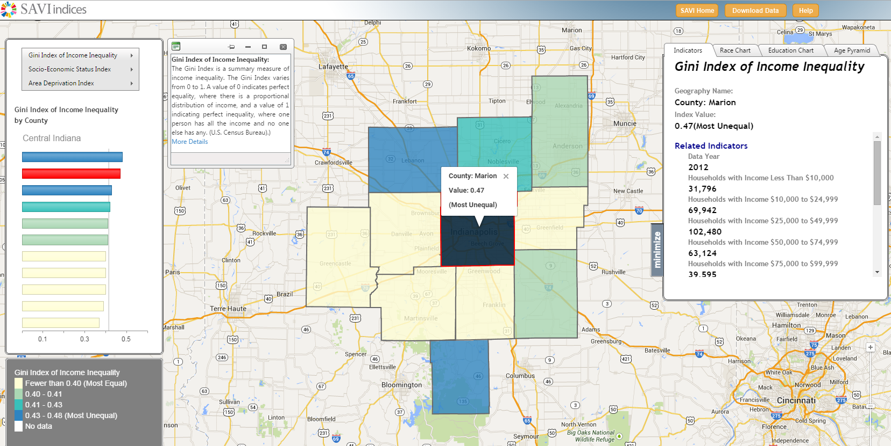
SAVI Indices
Click on a geography to get more details
Clicking in the map/chart highlight the geography in the other visualization…
…and opens up the indicator window

Slide 14
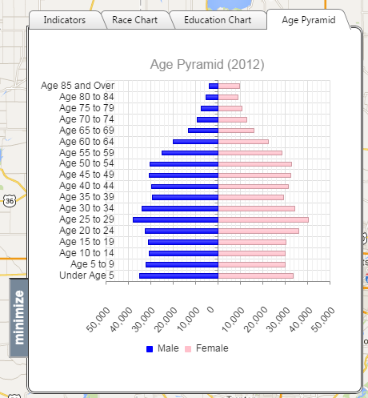
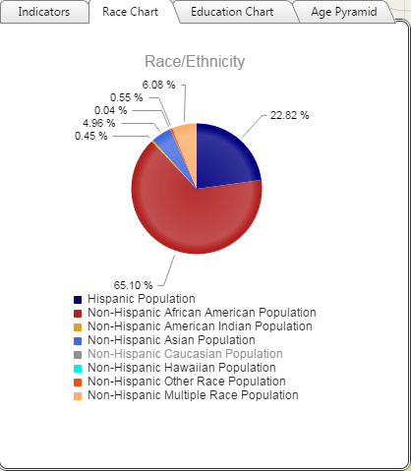
SAVI Indices
Easily view a Race Chart, Education Chart, and Age Pyramid by clicking on the tabs
Elements of the chart can be turned off by clicking in the legend
Viewing Minority Population Only
Non-Hispanic Caucasian Population Turned Off

Slide 15
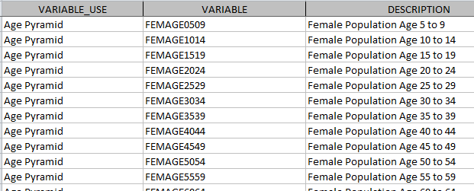
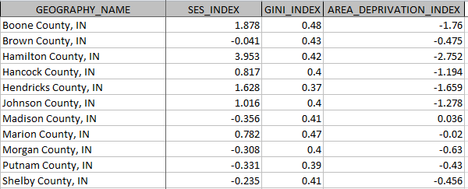
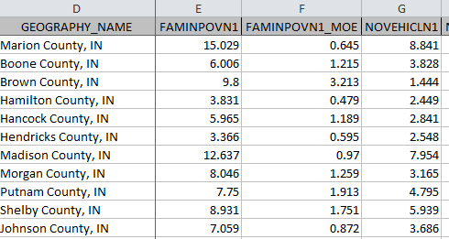
SAVI Indices
Data can be downloaded from SAVI Indices by clicking the
button in the top right corner of the web page.
The selected data can be opened or saved as an .xlsx file.
List of Variables
Index Values
Index Input Data

