Slide 1
Workshop #1: Innovative Uses of Public Data Examples from NeighborhoodInfo DC
Peter A. Tatian, The Urban Institute
Strategic Data Use to Stabilize Neighborhoods Conference
December 7, 2011 ▪ Baltimore, Maryland
Notes:
Introduce myself & Urban Institute:
Today’s presentation: A little about NNIP, and then 3 examples of our DC partner has used local public data to help neighborhoods.

Slide 2
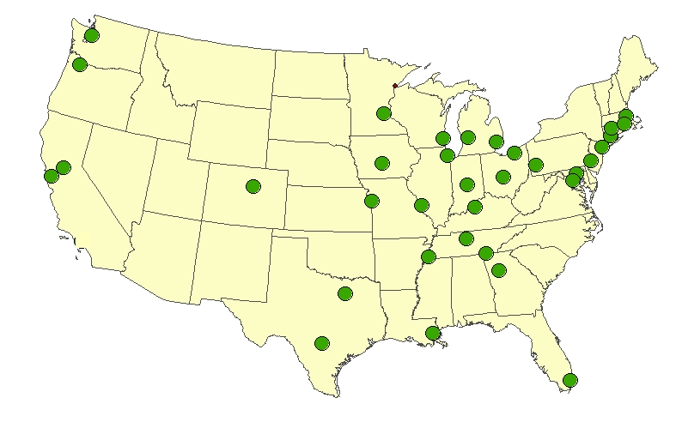
NNIP Mission: Information for Change
Democratizing Information
Facilitate the direct use of data by stakeholders
Work for many clients
Helping Boys and Girls Club choose a new site
Working in a cross-sector collaboration to reduce infant deaths
A central focus on strengthening, empowering low-income neighborhoods
Information as a bridge for collaboration among public agencies, nonprofits, businesses
Notes:
Lots of data sites, but the NNIP mission sets us apart. Partners are different in many ways, but we share a set of key principles
1. Agreed to take on the role of facilitating and promoting the direct practical use of data by community and city leaders in community building and local policy making. Reaction to too much research done about ngh without any value coming back.
2. All partners have a wide variety of partners and audiences since systems on the shelf don’t sustain support. A colorful map will not be enough unless it leads to greater understanding or new conversations. (These are short-term & long-term examples).
3. Giving emphasis to building the capacities of institutions and residents in distressed neighborhoods. Level the playing field by making sure everyone has access to the information
4. Importance of interacting with stakeholders around the data and building ongoing relationships. In New Orleans, our partner hosted a meeting with the various state, city, and nonprofit agencies that own 14,000 vacant properties in the city. Having some initial analysis from our partner offered an opportunity for them to connect and begin to coordinate strategies.
UI coordinates the partnership and works nationally to build the field.

Slide 3
Lessons from NNIP
Design indicators for action—not just to passively monitor trends.
Develop indicators at the neighborhood level as well as the city or county as a whole.
Use available indicators but recognize their inadequacies – don’t discount local wisdom.
Place the numbers in the context of images and stories about the issues you care about.
Notes:
1. need to motivate the data collection and analysis to keep the effort going
2. Overall city trends in teen pregnancy won’t help identify where you need to target your efforts. Also, people relate to where they live, gets them engaged right away
3. I love data, but some of it is not so good… Be a critical user of data. For example, code enforcement in many cities is complaint-driven, so sometimes you see more violations in well-off areas that are more likely to demand city action. Doesn’t mean there are fewer problems with dangerous buildings or poorly maintained properties in lower-income parts of the city. Be sure to vet findings with people on the ground.
4. You all could probably teach us something about the last piece of advice. Most effective work combines the numbers analysis with stories of real people and real neighborhoods.

Slide 4
Examples:
Quality schools and healthy neighborhoods
Foreclosure prevention and mitigation
Preserving affordable rental housing

Slide 5
Quality Schools & Health Neighborhoods
Provides roadmap for coordinated planning, policy, and funding for public education, housing, and neighborhood development.
Looks at ALL public schools – traditional and charter – as one system.
Links neighborhood characteristics to student and school information.

Slide 6
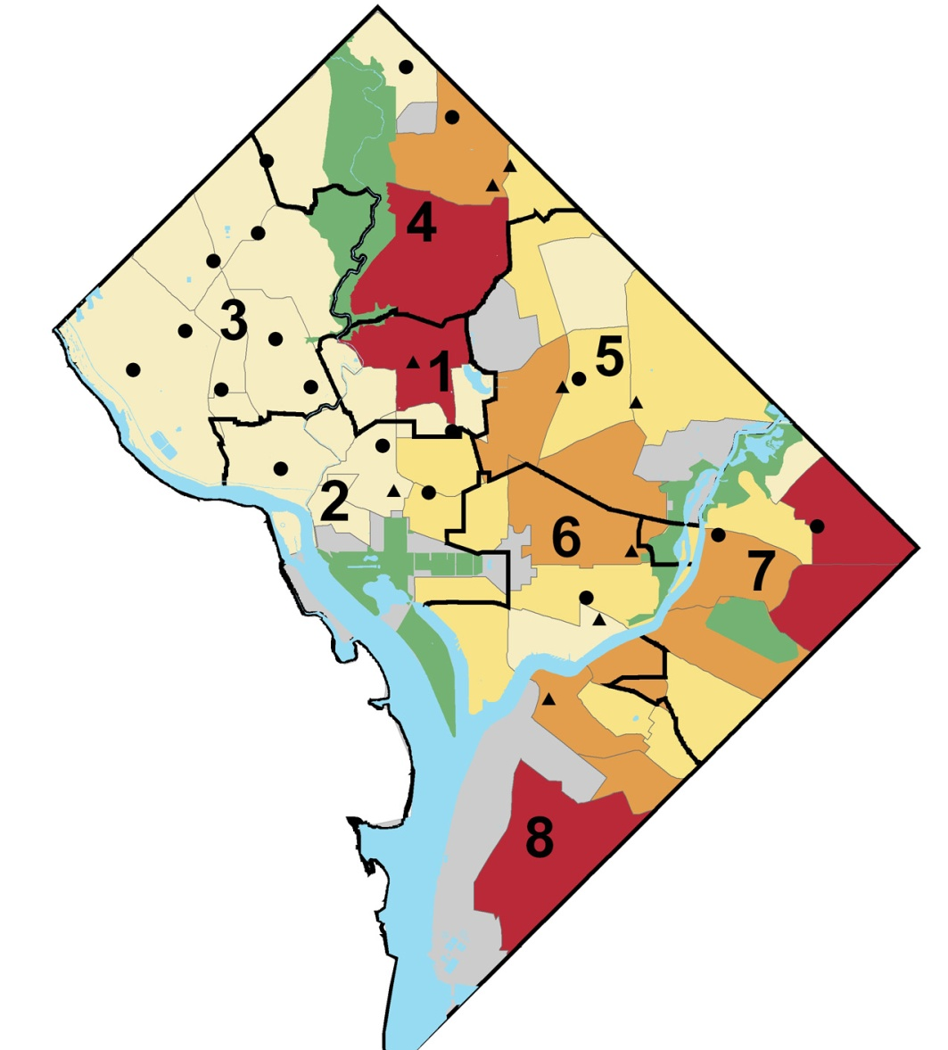
Schools in greatest demand are NOT where most students live
Number of public school students living in neighborhood cluster:
More than 3,000 students
2,000–2,999 students
1,000–1,999 students
Fewer than 1,000 students
High-Demand Elementary Schools
DCPS Charter
Notes:
MARGE
Schools with high results are generally in high demand.
But as the map shows – few of the high-demand schools are located where most of the city’s public school kids live.
Of the city’s 135 elementary schools, only 26 are in “high-demand” and only three are located East of the Anacostia River.

Slide 7
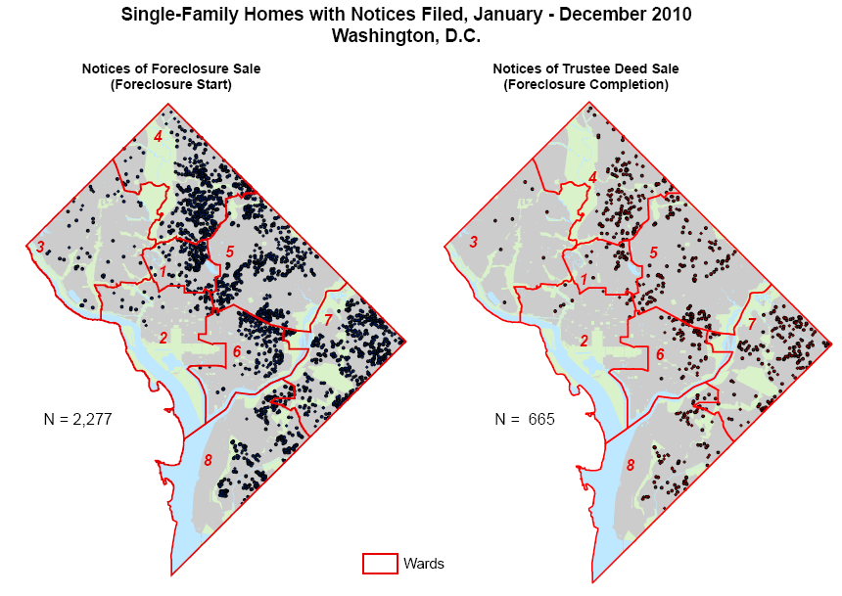
Foreclosure Prevention & Mitigation

Slide 8
Weekly lists of new foreclosure notices used for outreach
Public notice data are enhanced by adding additional information, such as property type and address.
Filing date | Document number | Property type | Square/suffix/lot | Property address
11/03/2010 | 2010094401 | Residential: Single-family home | 5084 0042 | 0342 50TH ST NE
11/03/2010 | 2010094502 | Residential: Single-family home | 5090 0023 | 1938 SHANNON PL SE
11/03/2010 | 2010094603 | Residential: Rental apartment building | 0073 0065 | 8304 13TH ST NW
11/03/2010 | 2010094704 | Residential: Single-family home | 4088 0004 | 4010 25TH ST NE
11/03/2010 | 2010094806 | Residential: Single-family home | 2022 0856 | 3920 14TH ST NW
11/03/2010 | 2010094907 | Residential: Single-family home | 3044 0029 | 2540 7TH ST NE
11/03/2010 | 2010095033 | Residential: Single-family home | 0057 0079 | 1762 10TH ST NW
11/05/2010 | 2010095126 | Residential: Condominium unit | 0040 2220 | 0934 G ST SW Unit: 129
11/05/2010 | 2010095228 | Residential: Condominium unit | 5072 2278 | 1030 FORT DAVIS ST 00202
11/05/2010 | 2010095329 | Residential: Condominium unit | 2044 2034 | 3001 20TH ST NW Unit: 501

Slide 9
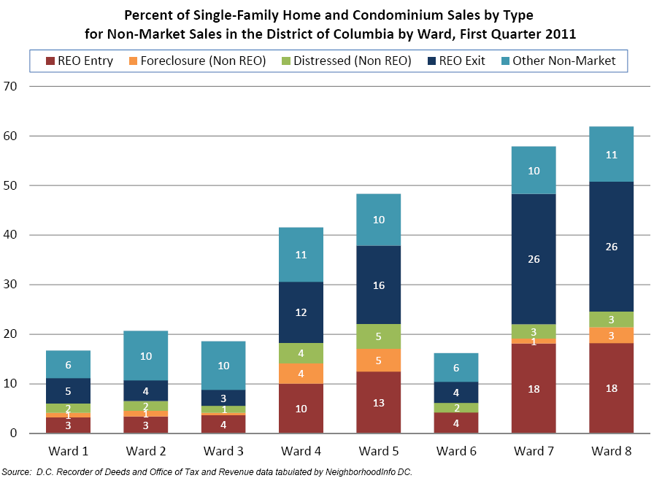

Slide 10
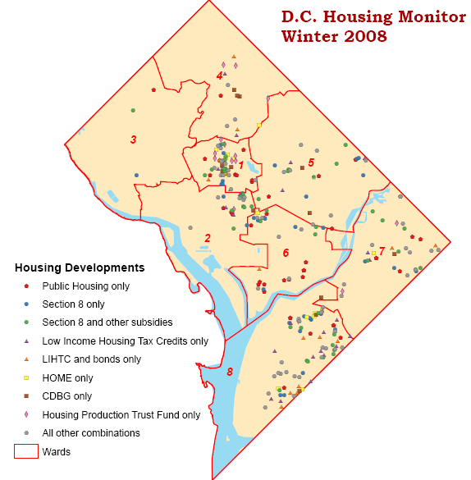
Preserving Affordable Rental Housing
Housing Strategy Task Force (2006):
Preserve at least 30,000 existing affordable units; preserve all federally subsidized units.
Notes:
Housing Strategy Task Force (2006)
Composed of city officials, advocates, and non-profit housing and for-profit producers.
Report recommended:
2.1 Preserve at least 30,000 existing affordable units
2.1a Preserve all project-based Section 8 and other federally-supported units
Outcome measure:
Number of project-based Section 8 units preserved/lost

Slide 11
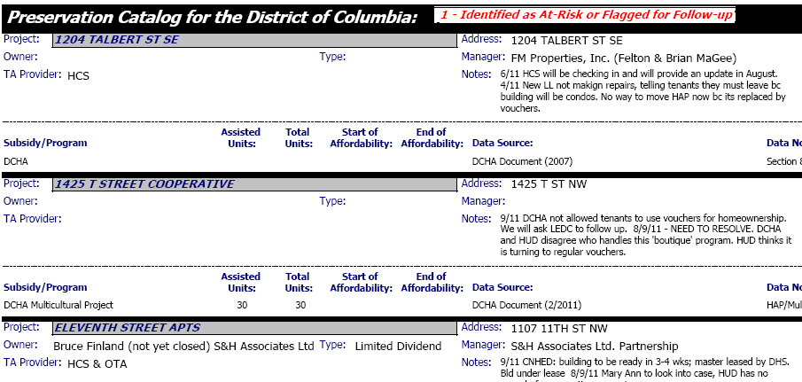
DC Preservation Network
Notes:
Collaboration between NeighborhoodInfo DC and Coalition for Nonprofit Housing and Economic Development.
NIDC maintains DC Preservation Catalog, a database of rental properties with units affordable to low-income households (at or below 80% area median income) through one or more federal or local housing subsidy programs.
Properties flagged as At Risk or Flagged for Follow-up; Expiring Subsidy; Recent Failing REAC Score; More Info Needed; Other Subsidized Property.
NIDC updates list of federally or locally subsidized rental housing from various sources
PN meets monthly with HUD, city staff, housing nonprofits, and some private developers to review the list.
Each group takes on responsibility to follow-up with individual properties, tenants, and owners.
INDIVIDUAL SUCCESS/EXAMPLE?
Congress Heights I – failed REAC. We found out through the Network. LEDC organized a tenant association and did an assessment. Through the Network we were able to get the tenant association pro bono legal representation (Washington Legal Clinic for the Homeless) and get a meeting with HUD and the association and a meeting with all these partners and the management / owner to make a plan between all to get the conditions resolved before the next inspection. REAC score went from a 29 to 92.
We would not have known about the failed REAC so quickly if we had not had the Preservation Network meeting which HUD was at. Since the scores are not posted regularly on-line, it’s very helpful to get a heads up from HUD.

Slide 12
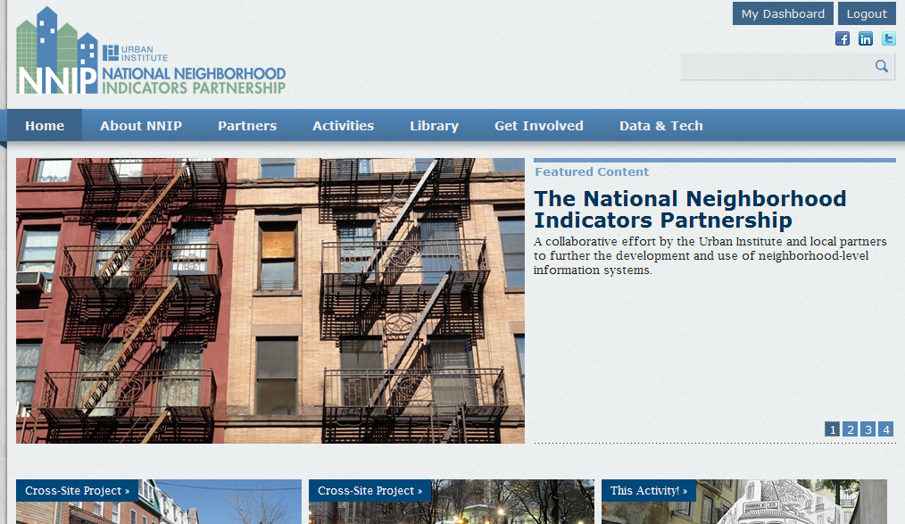
Visit NNIP website for more ideas...

Slide 13
For more information
Schools & neighborhoods:
www.urban.org/publications/411769.html
Foreclosures:
www.neighborhoodinfodc.org/foreclosure/
Affordable housing preservation:
www.neighborhoodinfodc.org/dcpreservationcatalog/
NNIP:
www.neighborhoodindicators.org
Peter Tatian email: ptatian@urban.org

