Slide 1
Structural Economic Change & Racial/Ethnic Disparities in Boston
The Boston Indicators Project
February 10, 2012
Notes:
Good morning.

Slide 2
The profile of poverty in Boston has changed little since 1990, despite great effort. Why?
In Poverty
All Boston Residents
Families with Children
All Children
Latino
African American
Asian
White
1990
102,092 | 19%
13,980 | 24%
30,372 | 28%
8,375 | 45%
14,664 | 34%
2,142 | 33%
8,213 | 18%
2005-2009*
112,667 | 19%
12,805 | 23%
30,957 | 28%
11,227 | 40%
13,842 | 35%
2,502 | 31%
2,962 | 9.5%
* American Community Survey 5-year Average Estimates
Notes:
Since 1990, Boston’s poverty rates overall changed little,. About 1 in 5 of Bostonians and almost 1 in 3 of Boston’s children lives in or below “official” poverty—with great racial /ethnic disparities
despite the hard work of many on this room today
So what happened?
While we were all focused on our work, the bottom was dropping out…

Slide 3
WHY?
Because recent
structural economic trends eliminated jobs and widened disparities.
Notes:
Because recent
structural economic trends have eliminated jobs and widened disparities.

Slide 4
1980 – 2010: Divorce of productivity and wages due to automation and the off-shoring of US jobs
1947 – 1979: Shared prosperity and increasing income equality.
1980 – 2009:
Divorce of rising productivity from wage gains, with widening income inequality.
Notes:
In contrast to the three decades right after WW II, over the past 30- years, automation and outsourcing divorced worker productivity from wages, with great gains for those at the top, losses for those at the bottom
This is what black scholar William Julius Wilson called the end of work…

Slide 5
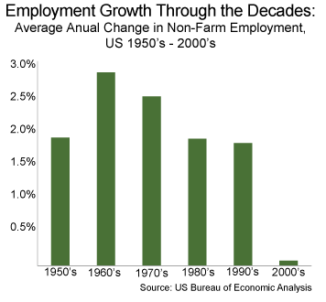
2000s = new territory: lower corporate taxes, higher profits, fewer jobs
Notes:
In the 2000s we entered new territory: declining corporate taxes, rising corporate profits but barely any increase in jobs

Slide 6
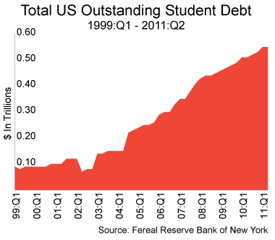
We did the right things: “Buy a home; go to college.” Mortgage debt 1977-2011; Student debt 1999-2011
Notes:
With near-stagnant average incomes, Americans tried to get ahead – buy a home, go to college -- and instead, incurred record debt, making them highly vulnerable to the impact of the Great Recession
And sharply rising health care costs more than absorbed any small average wage gains over the decade

Slide 7
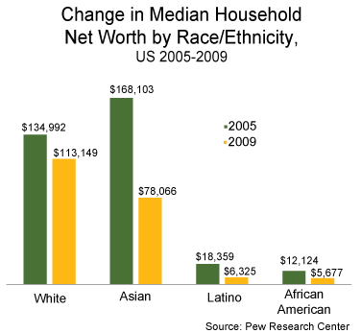
Disproportionate impacts of the Great Recession on net worth (housing values) by race-ethnicity
Notes:
This is the most heart-breaking slide. Between 2005 and 2009, blacks Asians lost half of their net worth and Latinos lost 2/3s because their wealth was more tied to their home values than whites, who on average held more wealth in stocks.

Slide 8
Today, in comparison with our peers, Americans are: the most personally indebted, the most incarcerated, the most income unequal, the most overweight and obese, pay the most for health care, consume the most energy per capita (after Canada) and have the least intergenerational mobility (after the UK).
Notes:
The consequences of these trends, hard as it may be to grasp, is that today, in comparison with our wealthy industrialized peers, Americans are the most personally indebted, the most incarcerated, the most income unequal, the most overweight and obese, pay the most for health care, consume the most energy per capita (next to Canada) and have the least intergenerational mobility (next to Britain).

Slide 9
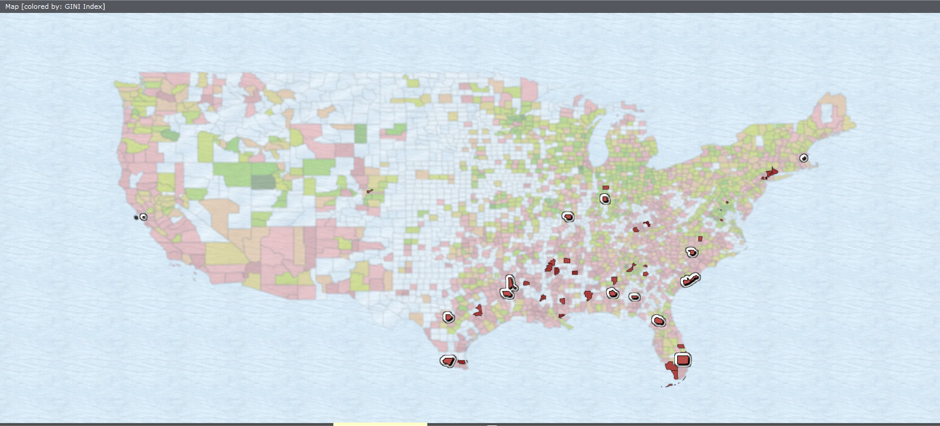
Suffolk County is among the top 50 most unequal of 3200 US counties (2007-2009), with most in the South. Boston is 8th among the 50 largest US cities.
Notes:
9
So, where do we fit nationally?
Suffolk County –driven by Boston --ranks among the top 50 most unequal of 3200 US counties.

Slide 10
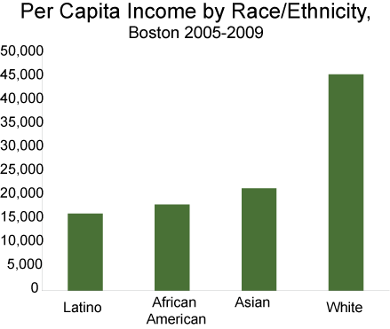
In Boston, increasing income disparity by race/ethnicity and widening income inequality
Notes:
This high level of inequality is reflected in Boston by income disparities by race/ethnicity and by widening income inequality.
25%/2.2%

Slide 11
Example - Disparities in health-related jobs by annual wage: whites/Asians vs. blacks/Latinos
Notes:
Example - Disparities in health-related jobs by annual wage: whites/Asians vs. blacks/Latinos

Slide 12
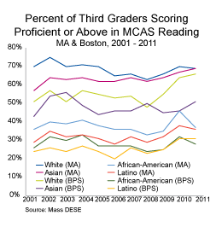
With persistent racial/ethnic disparities in education: 3rd grade reading; adults with a BA or higher
Notes:
Which is in turn driven by deep and persistent racial/ethnic disparities in education: for example 3rd grade reading; adults with a BA or higher
These disparities, in turn, are linked to geography in Boston

Slide 13
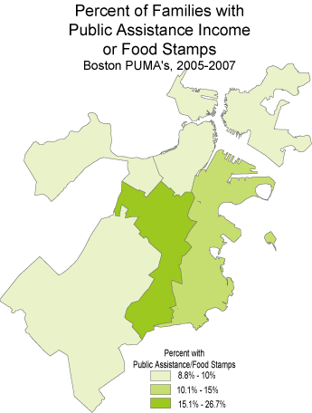
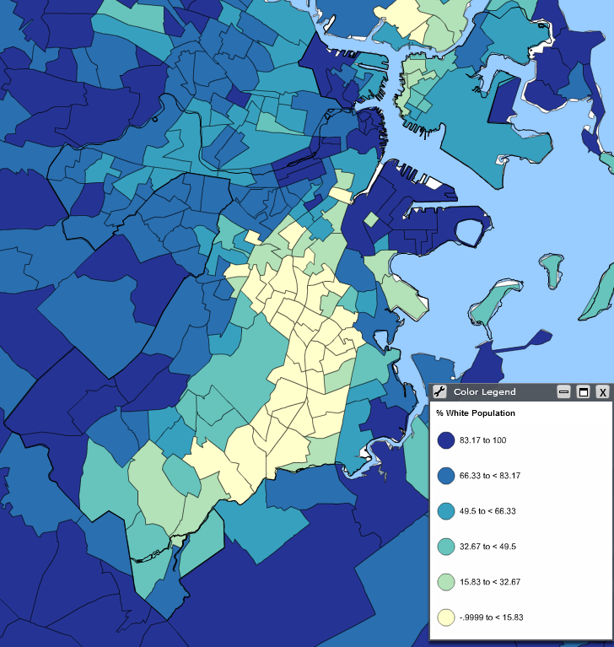
RACE, GEOGRAPHY: GREATER BOSTON CENSUS TRACTS % WHITE/ BOSTON FAMILIES: PUBLIC ASSISTANCE OR FOOD STAMPS (2005-2009)
Percent of the Total Population that is White by Census Tract 2005—2009
Notes:
And particularly to the part of Greater boston with the lowest percentage of white residents – the boston neighborhoods of Dorchester, Roxbury and Mattapan

Slide 14
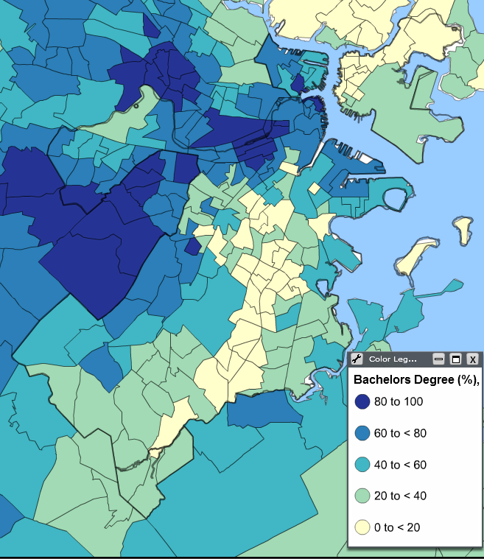
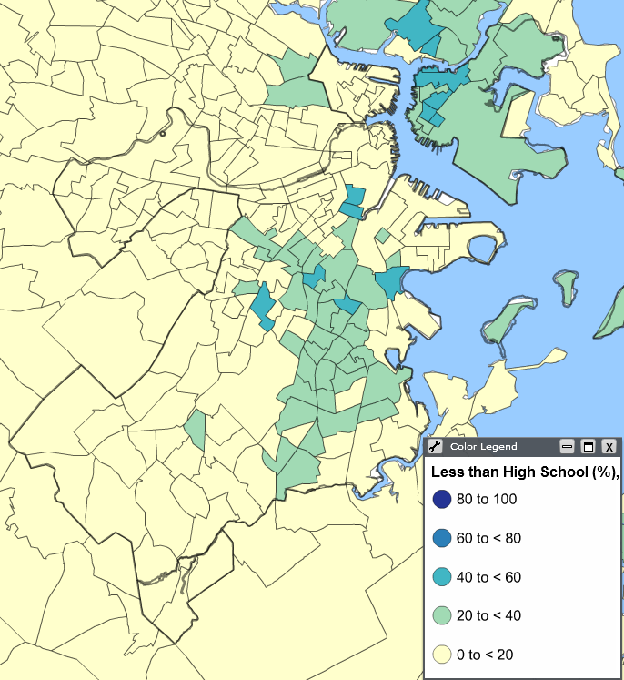
NEXUS – EDUCATIONAL ATTAINMENT, GEOGRAPHY GREATER BOSTON: PERCENT WITH A BACHLOR’S DEGREE OR HIGHER/PERCENT WITHOUT HIGH SCHOOL (2005-2009)
Percent of Adults with a Bachelor’s Degree or Higher, 2005—2009
Percent of Adults without a
High School Diploma, 2005—2009
Notes:
While Boston is one of the nation’s most highly-educated cities, fewer than 20% of adults in this area have a Bachelors degree (the map on the left), in the map on the right, the highest concentration of those without a high school diploma

Slide 15
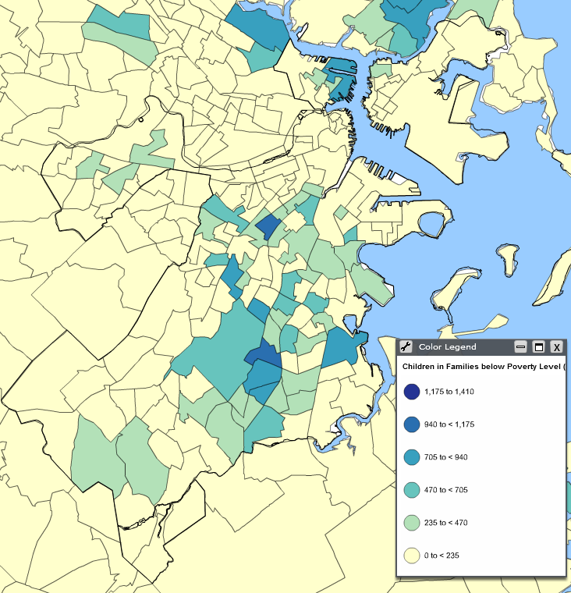
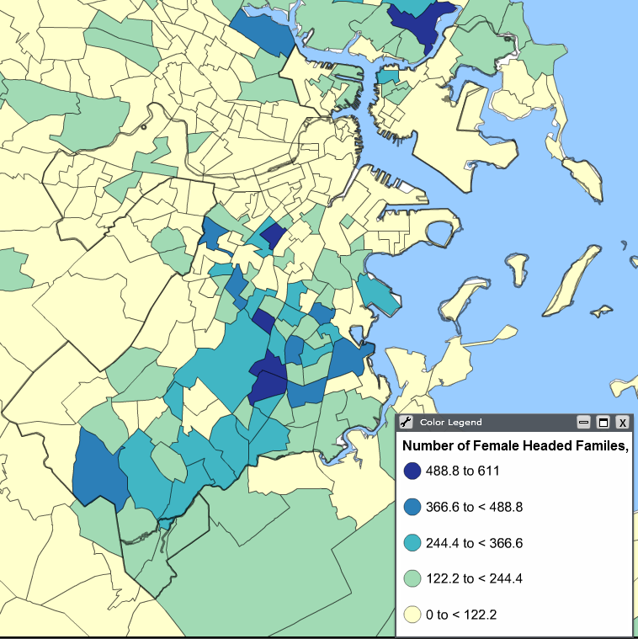
NEXUS - POVERTY, FAMILY STRUCTURE GREATER BOSTON CENSUS TRACTS: CHILDREN IN FAMILIES IN POVERTY/ SINGLE-MOTHER-HEADED FAMILIES (2005-2009)
Children in Families Below Poverty Level 2005—2009
Single Mother-Headed Families
2005—2009
Notes:
At 42%, this part of Boston contains the largest concentration of children in poverty, in the Commonwealth at 42% , and among the highest percentages of single-parent households

Slide 16
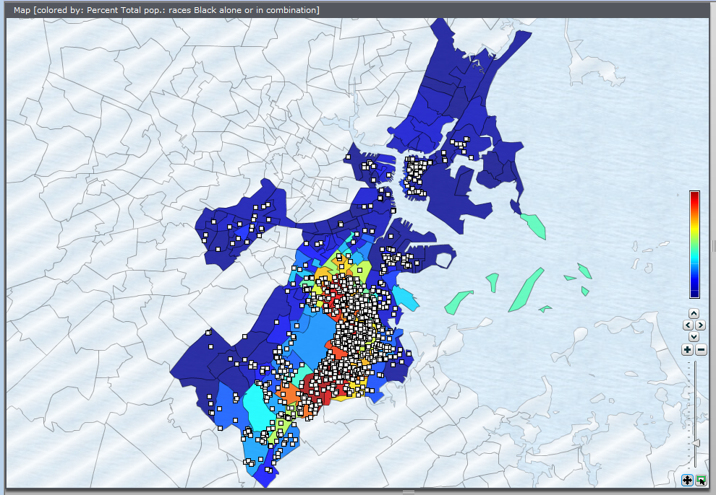
NEXUS: Foreclosures by Boston Census Tract
Countries with Gini Ratio above .51
This Map Shows that a Gini Ratio of .51 and above is quite high even among Developing Countries for which there is reliable data.
Notes:
It also reflects the highest concentration of housing forecluosres, reflecting aggressive and often predatory lending before the Recession

Slide 17
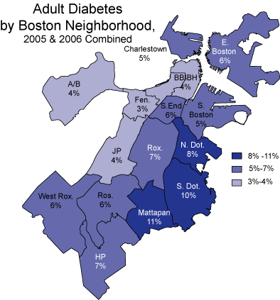
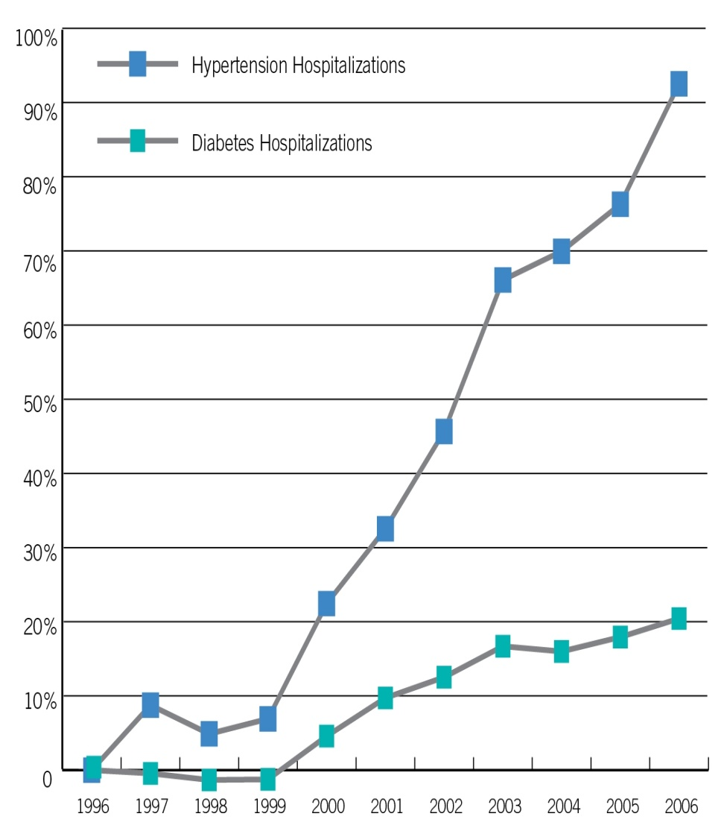
The same neighborhoods are disproportionately affected by obesity and rising risks of chronic preventable disease
Notes:
High rates of obesity and risng risk factors for preventable chronic disease

Slide 18
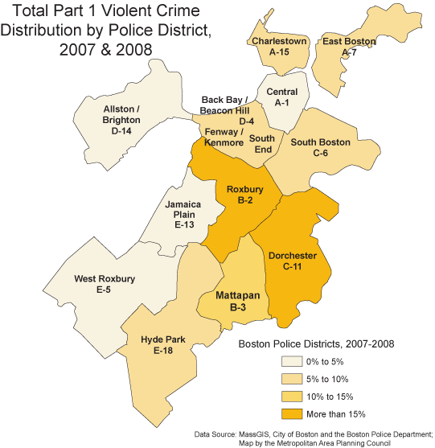
… and disproportionate rates of violent crime and youth violence
w w w. b o s t o n i n d i c a t o r s. o r g
Notes:
As well as high rates of violent crime and youth violence
Data Tables:

Slide 19
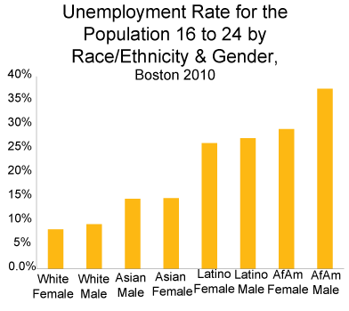
African American young men 16 – 24 have the highest rates of unemployment among their peers
Notes:
African American young men 16 – 24 have the highest rates of unemployment among their peers

Slide 20
Deep state budget cuts, even in programs with proven return on investment (ROI)
Head Start | Every $1 spent on Head Start has been found to save in $7-$9 in future public costs and to increase lifetime earnings, including a 62% reduction in special education at $11,000 per student annually; a 12% reduction in incarceration at $29,000 per inmate nationally; and a 19%-25% reduction in adult obesity, with attendant health risks and costs.
Food Stamps (SNAP) | Every $1 spent generates nearly $2 in economic activity: the $1.2 billion in SNAP benefits issued annually in Massachusetts results in $2.4 billion of economic activity.
Employment Services | Every $1 spent on Employment Services has been found to yield $1.52—$3.50 in economic activity.
Early Intervention | Spending on Early Intervention saved Massachusetts’ cities and towns an estimated $29 million in Special Education Services in the 2009-2010 school year.
Notes:
Despite these compelling statistics about the impact on low-income households of color over the past 3 decades, deep cuts have been made in programs proven to be effective, such as Head start, with every dollar invested shown to save between $ 7 and $9 in future public costs such incarceration and obesity , creating a viscous cycle

Slide 21
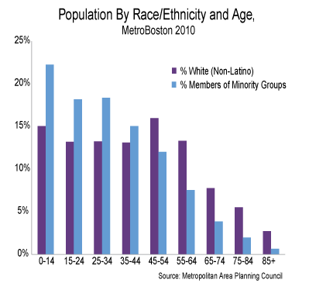
Bottom Line: Boston and the region’s – and US -- young residents of color are most at risk in this fragile economy. And we ALL have a stake in their success.
Notes:
The bottom line is that The region’s youngest residents, increasingly of color, are the most at risk in this fragile economy – in Boston, the Greater Boston and the US.
We ALL have a stake in their success as disproportionately white, educated Baby Boomers make way for a younger and more diverse workforce.

Slide 22
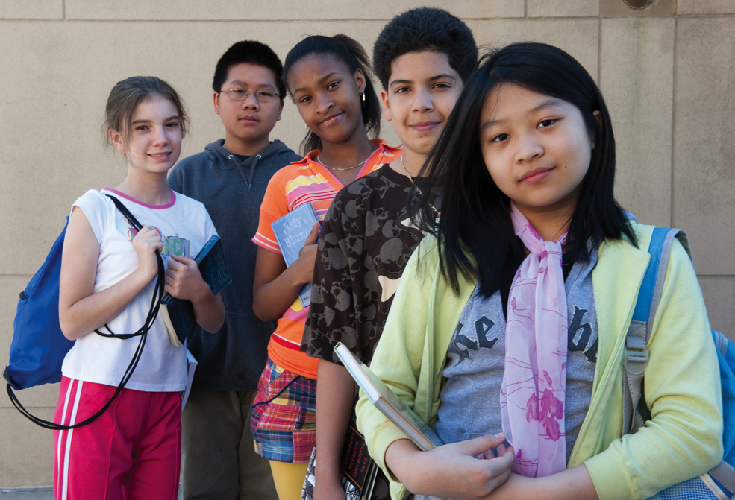
Thank you.
Notes:
And with that, on behalf of our future leaders, thank you.

Slide 23
THE BIG SHIFT:
A New Measurement Paradigm
Disaggregate data by community and demographic groups, highlight key long-term trends and track the social/environmental /economic costs and benefits of policies and initiatives.
A New Civic Engagement Paradigm
Engage Boston’s range of workers across industries and trades, committed residents, and newcomer immigrants in better decision-making.
A New Hyper-Global Growth Paradigm
By developing solutions, products and services needed locally and by emerging global markets, Greater Boston can leapfrog into a new paradigm of innovation in the public, private and academic sectors through competitions

Slide 24
THE BIG SHIFT:
A New Consumer Spending Paradigm
Hyper-Local Exchange, Capital & Technical Assistance for Small Businesses and Start-Ups, Triple Bottom-Line Purchasing, Financial Literacy & Transparency, Education, Health Care, Housing, Banking & Finance
A New Municipal & Institutional Spending Paradigm
Focused effort s to purchase goods and services produced in the region,
A New Jobs Paradigm
As computers and robots perform an increasing share of human labor, new forms of human organization and exchange that reward talent, skills, hard work and achievement will be needed.

