Slide 1
Community+Data+Power
OSF San Diego, Feb 2016
Steve (Spike) Spiker
Director of Research + Technology
Urban Strategies Council
@spjika

Slide 2
Equity Framework
Agree on definition
Measure outcome disparities
Agree on outcomes/accountability
Engage your community
Focus on eliminating disparities
Targeted Universalism
Continuous assessment
Notes:
Data driven because the core of public decisions and understanding impact is data- data that can be turned into actionable knowledge and with action, advocacy, becomes power- the power that equalizes money and levels the playing field.
One of our cores has been the democratization of data- to support planning, advocacy, decision making.

Slide 3
Data Driven Cities: an ecosystem
Accessible data
Data analysis in a local context
Clear communication of data & results
Build community capacity to use data
Engage stakeholders using data as a driver of discussion
Tools to measure impact
Notes:
20 plus years of this work has highlighted the need for more than just data in a vacuum. We’ve developed a framework that needs to be supported if we are to create a future where data driven decisions are the norm in our cities and communities. Data driven mind you, not data obsessed.

Slide 4
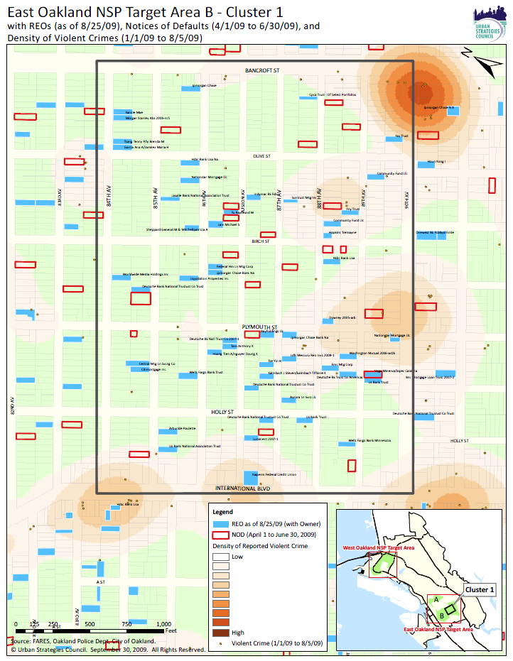
Foreclosures
Data- legal
Entity- house (loan)
Reality- home
Story- families

Slide 5
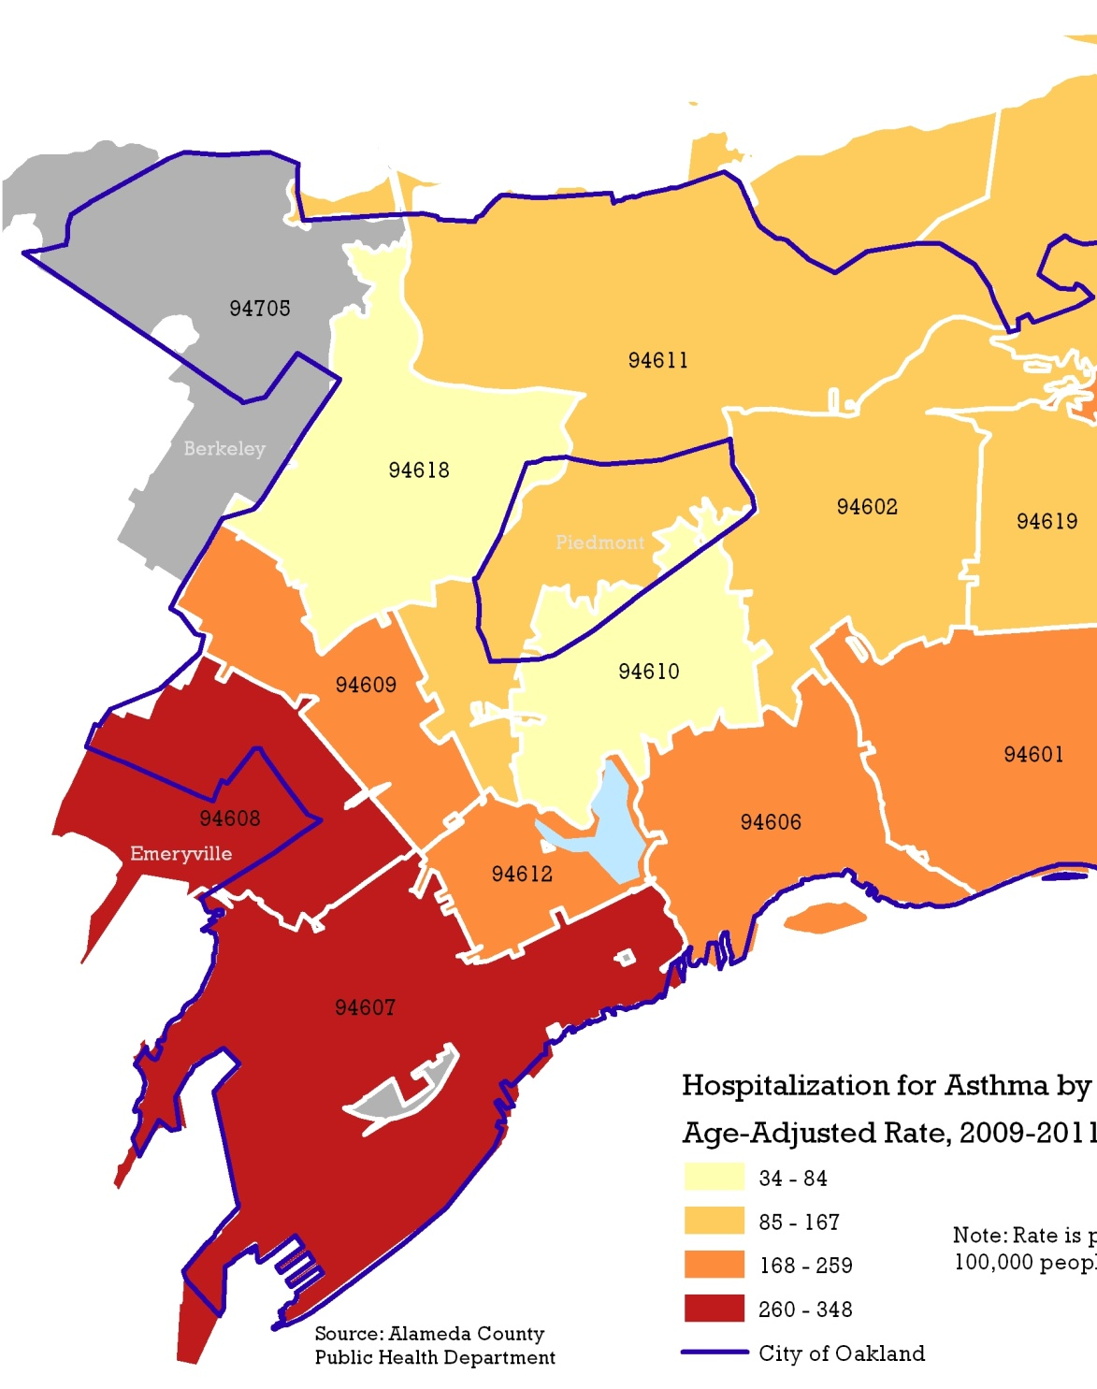
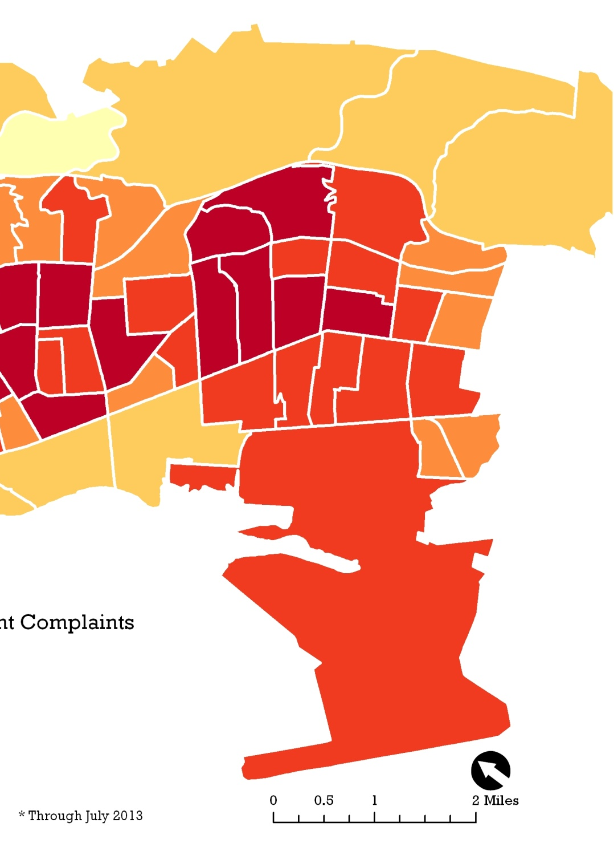
Data in Action

Slide 7
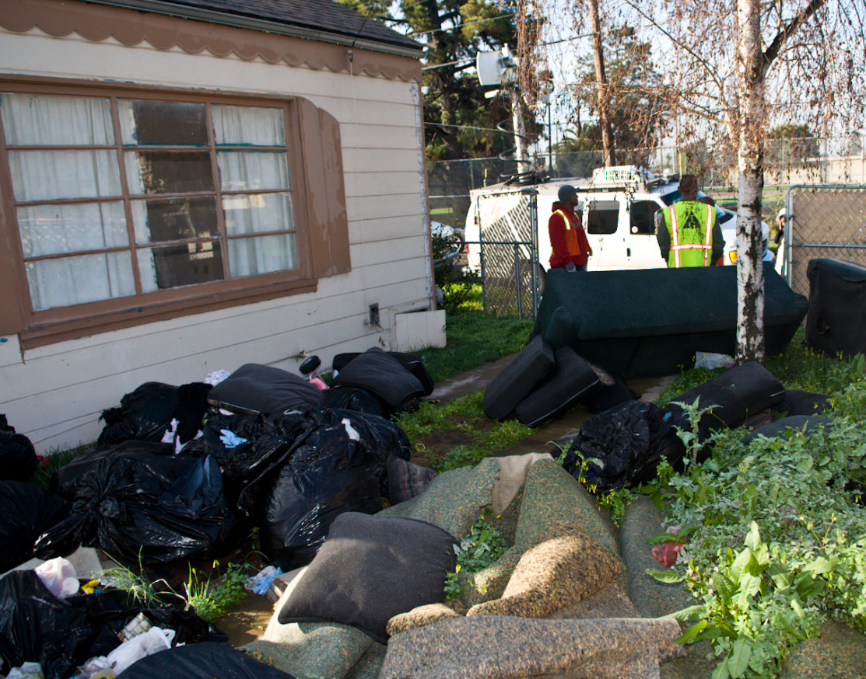
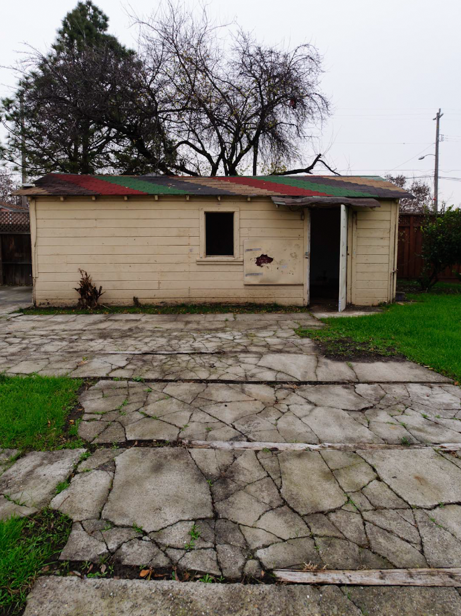

Slide 8
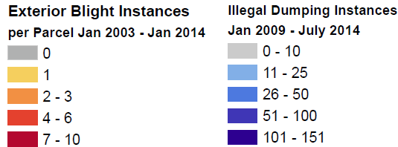
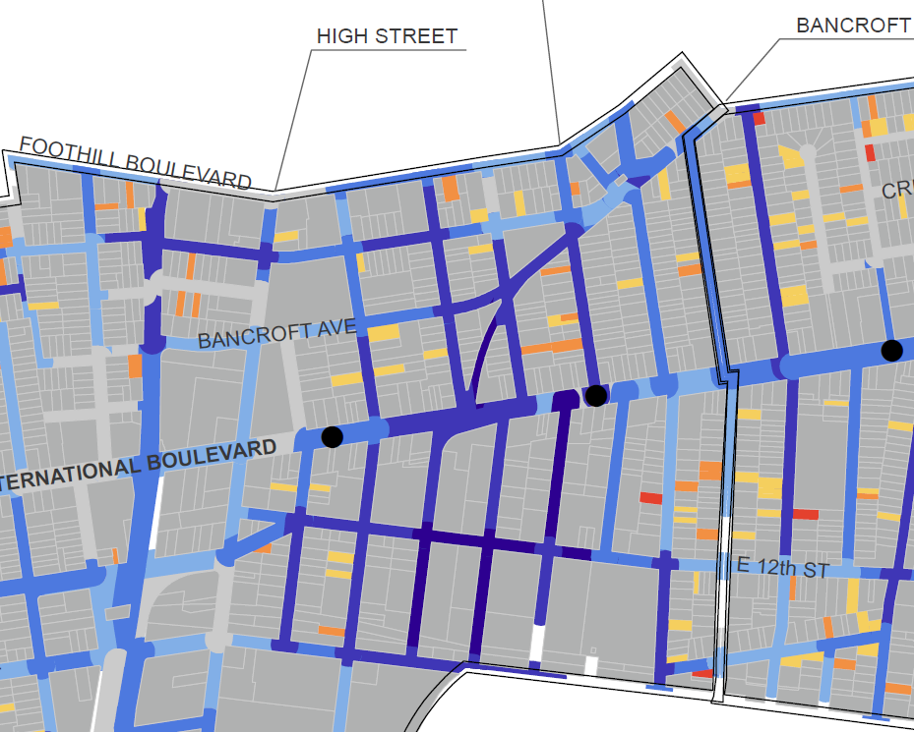
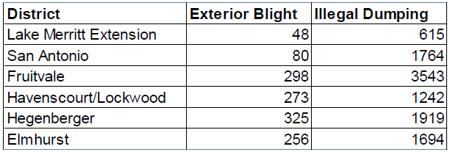

Slide 9
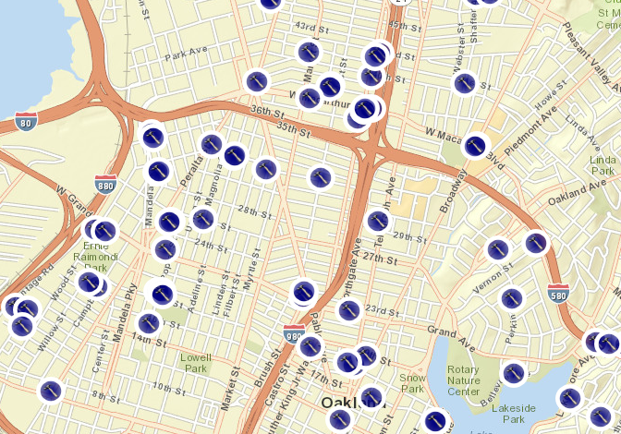
The Missing Data

Slide 10
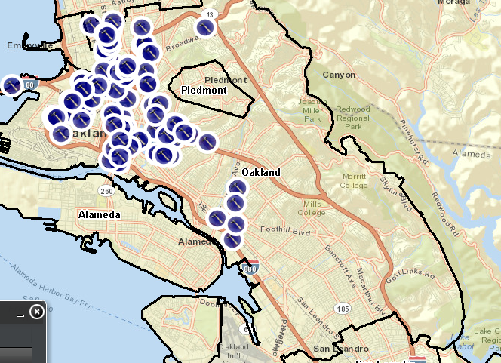
The Missing Data

Slide 11
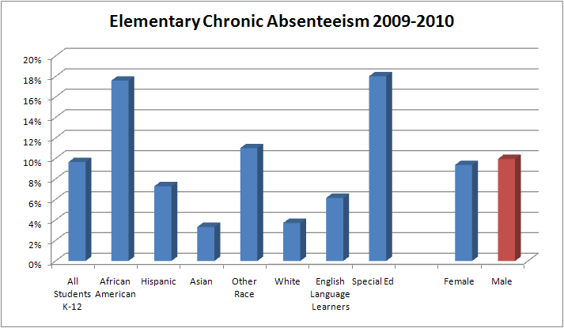
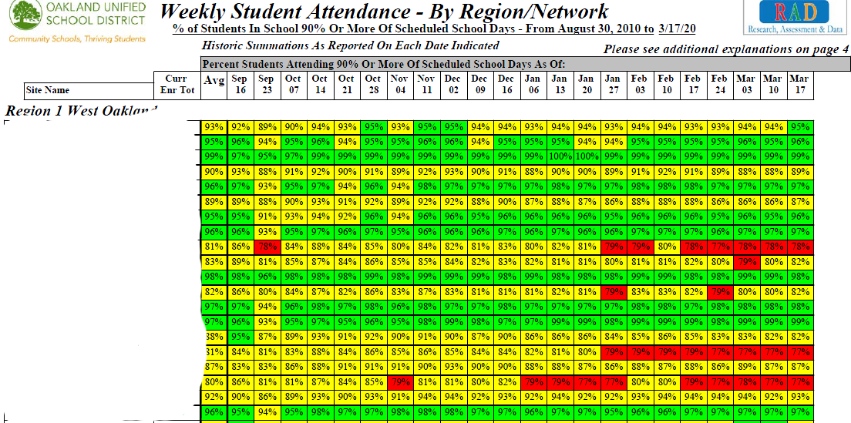
Education Data
Research partnership with OUSD
Student level data- protected
Identify more than just schools-neighborhoods w issues

Slide 12
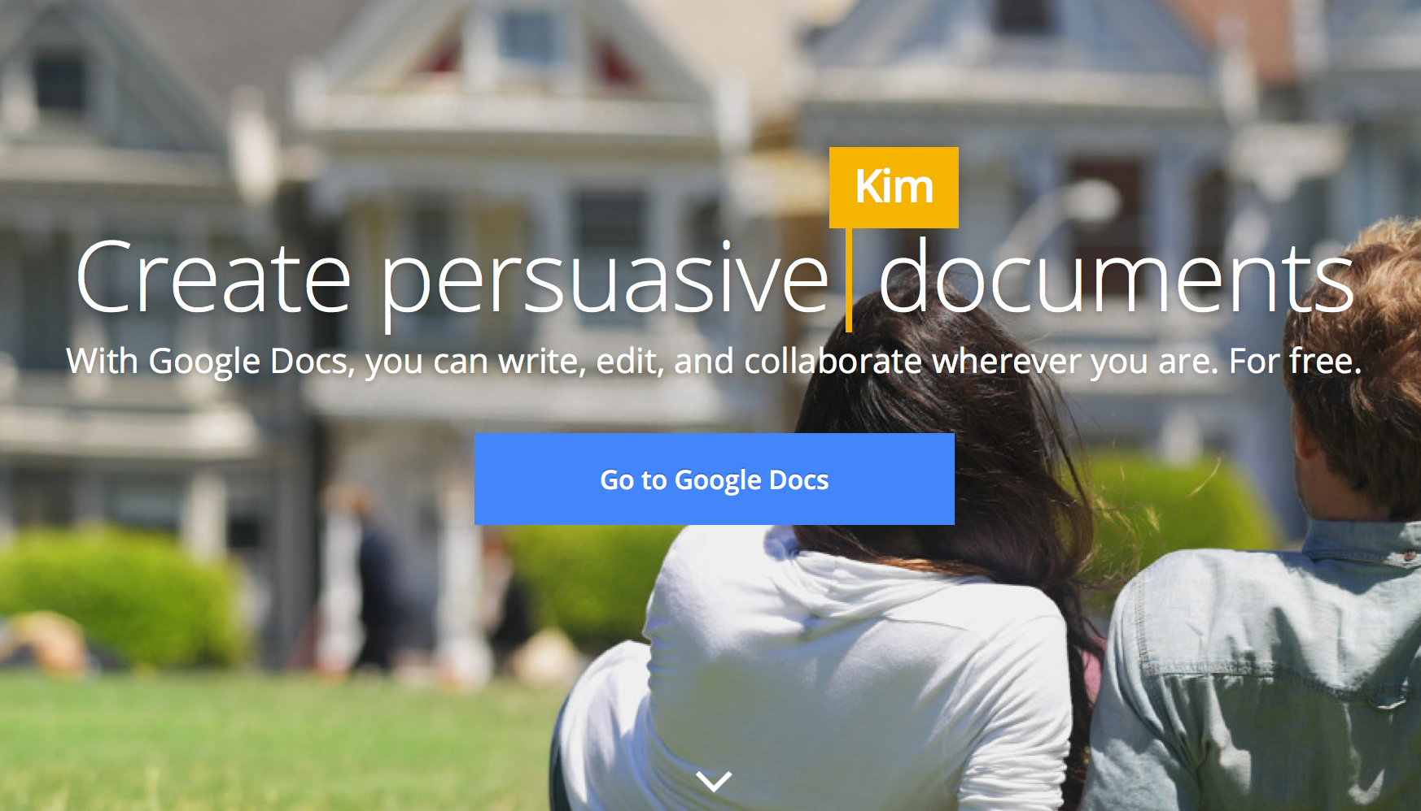

Slide 13
Simple agenda: https://docs.google.com/document/d/16BSkSbdHZprIXea4ZoGkhxsl51zcjiVE-07Z09-_5qY/edit

Slide 14
Open Data Process
Analyze
Publish
Open Data
Get Data

Slide 15
Open Data? What? Why?
Outcomes, baselines, plans!

Slide 16
Want to talk more?
SteveS@urbanstrategies.org
@spjika

Slide 17
Site scenarios
San Diego: What are strategies for advocating for more government transparency, including open data?
Puerto Rico: How do we communicate complex information to larger numbers of Puerto Ricans in ways that are understandable and actionable?
Buffalo: How do we access and use data in our campaign to ensure communities benefit from economic development?

