Slide 1
The Evolution of Open Data Meeting of the National Neighborhood Indicators Project St. Louis, MO
April 2014
Notes:
IMAGE:
We officially started on the Chicago School of data project on March 25, 2014

Slide 2
Smart Chicago is a civic organization devoted to improving lives in Chicago through technology.
Notes:
The John D. and Catherine T. MacArthur Foundation
A center for ideation and conception
2007 report, “The City that NETWorks”
The primary source of funding
Chicago Community Trust
Provides housing for the organization and is fiscal agent
At the center of funding and knowledge for the region
Critical financial, human resources, and other support
The City of Chicago
The most important policy lever in the region
Departmental relationships
Getting things done

Slide 3
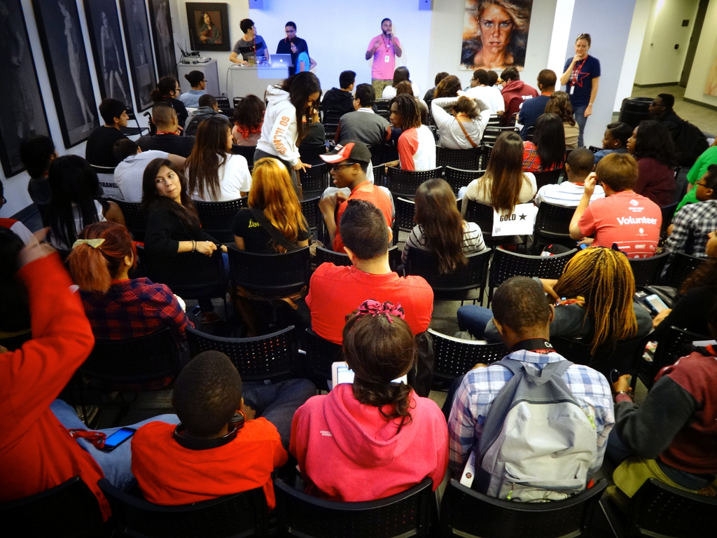
Our Principles
Technology
Open
Everyone
Chicago
Notes:
We are about technology
Everything we do relates to technology. We are of and about the Internet
We believe in the transformative power of the Internet to change lives and build the economy for all
We are open
We are a small organization looking to make the biggest impact possible. We can’t do that by being tight or closed
We work in the open, using & publishing open source technology
We have methods for others allowed “in”, whether as contributors, observers, users, whatever
We seek to be of use to everyone
We believe in the power of the network
The network needs everyone in it to be powerful
We work on solutions that cover the entire city
We focus on Chicago
Our middle name
We do seek to scale our solutions, but not without serving Chicago

Slide 4
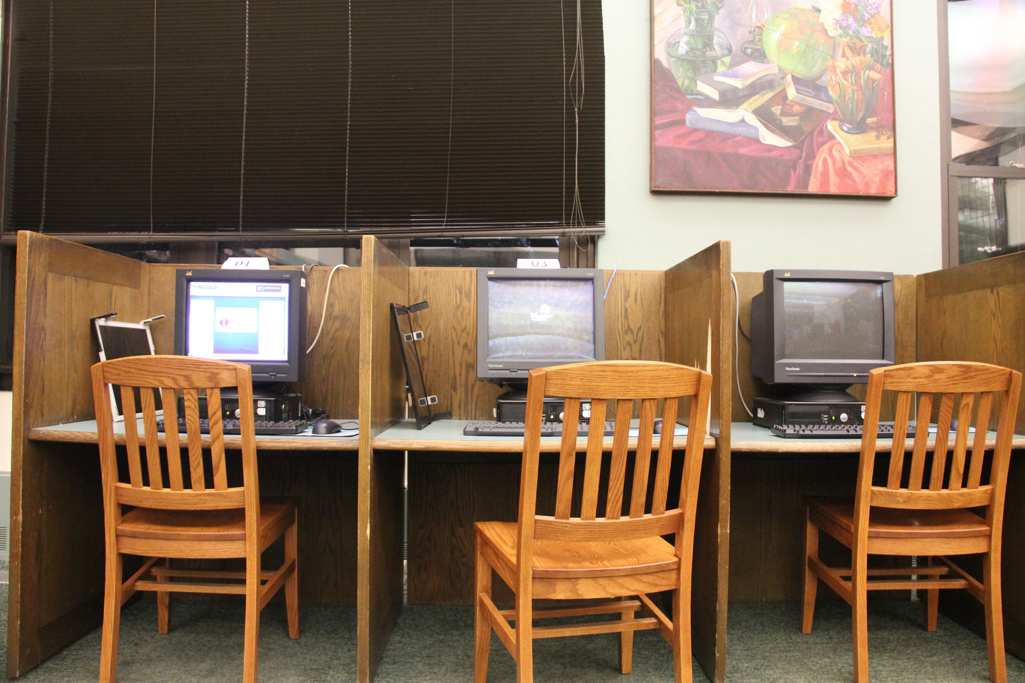
The Strategy
Notes:
Kelly Library, Englewood

Slide 5
Access, Skills, and Data
Access to the Internet for all
Broadband at home
Public computer centers and Community technology centers
Next generation stuff
Skills once you’re on the Internet
All on ramps
Data so that there’s something worth looking at once you’re on and know how to work it
Apps
Infrastructure

Slide 6
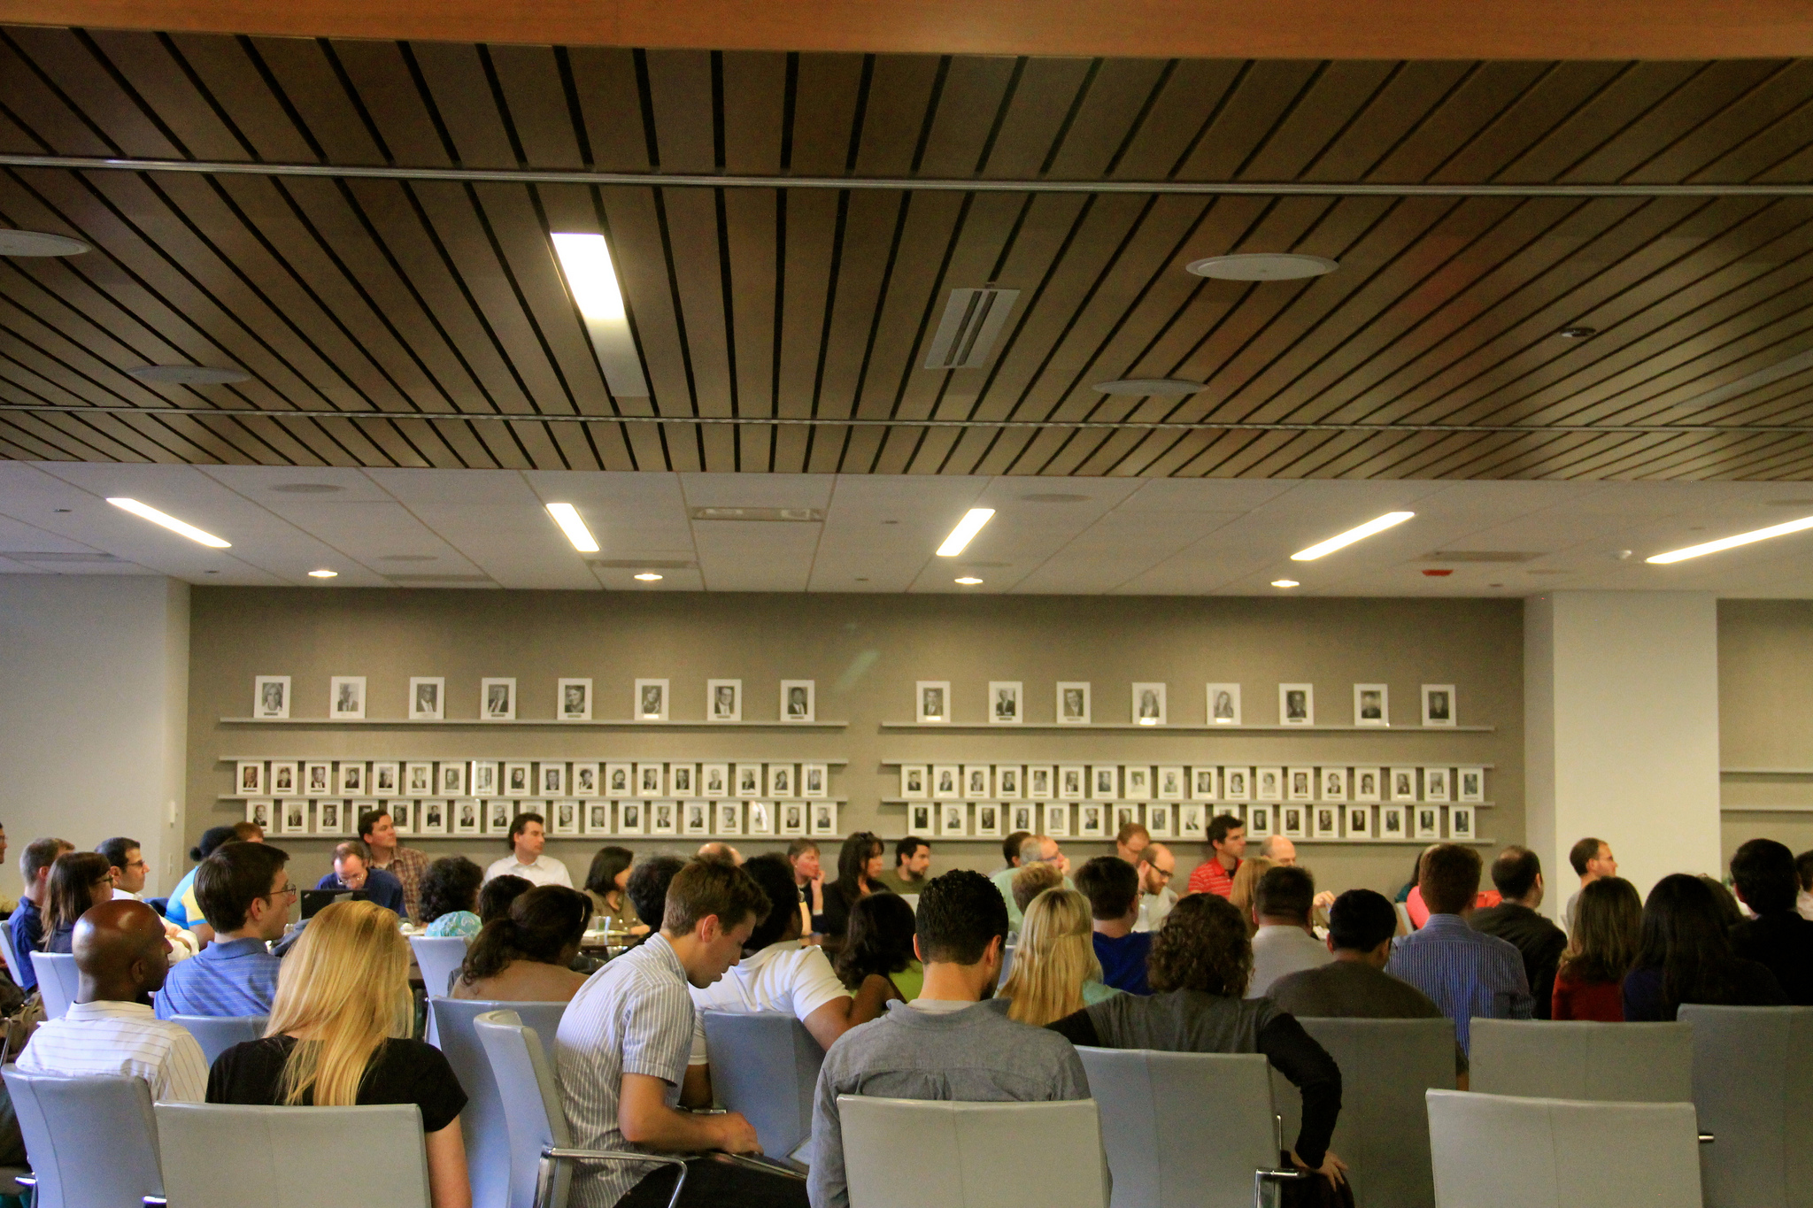
The Work
Notes:
Kelly Library, Englewood

Slide 7
Connect Chicago
Connect Chicago is a loose network of more than 250 places in the city where internet and computer access, digital skills training, and online learning resources are available—for free.
Recent metrics project
Two teams of 7 people employed for the summer with Federal money
1,110 photos
200+ records updated
197 in-depth interviews with front-line people working in public computer centers and community technology centers

Slide 8
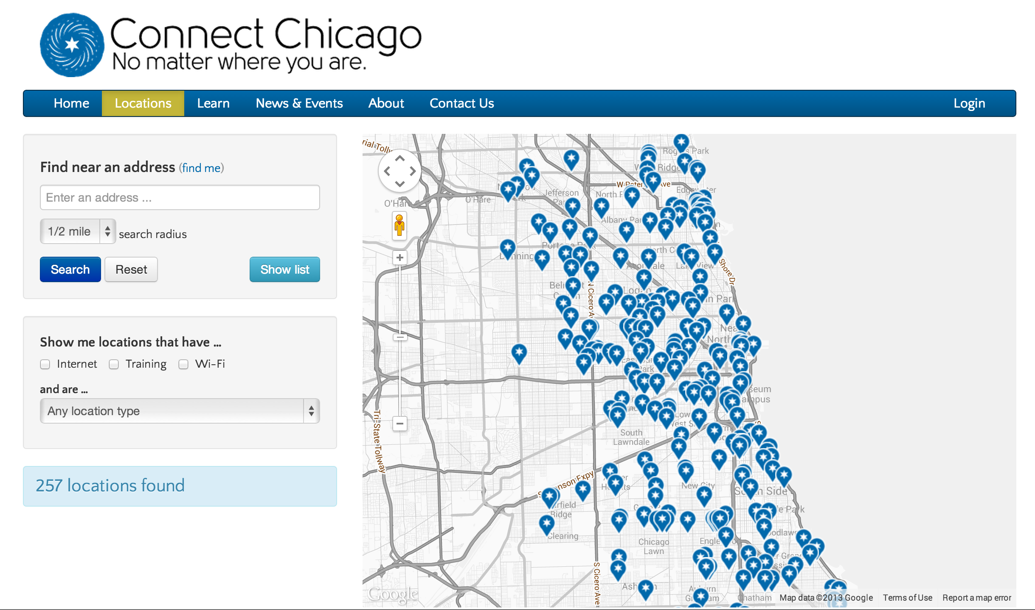
The Work
Notes:
Kelly Library, Englewood

Slide 9
Civic User Testing Group
512 signups in 49 wards. +119 since June 3
Completed test #3
Published results of FreedomPop test
Patterns– our last month of Gansen
We are planning a huge push on this, with a project page listing our advisors and philosophy
Two partners (Hoy Newspaper and Open Maps) want to do tests with us
Notes:
393 to 512

Slide 10
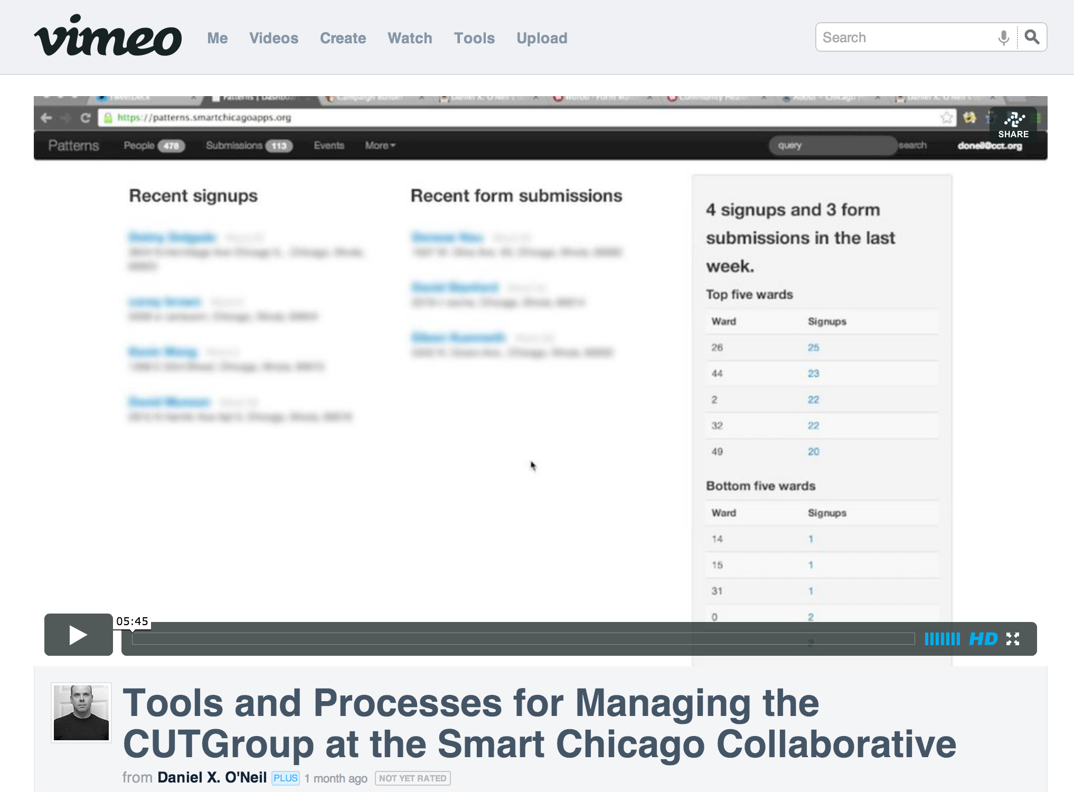
City Update

Slide 11
Chicago Works For You
A city services dashboard that helps people see the entire corpus of the city at once
Not their little slice, but all of us
We’re in this together, but we will have a hard time seeing things that way unless we have tools that frame it that way

Slide 12
#CivicSummer
6 week program
Learned a lot about teaching youth (150+)
Learned a lot about the organizations (FSM and Mikva)
Learned a lot about how summer works in Chicago
Badge!

Slide 13
Moar
There’s always more
@danxoneil
(773) 960-6045
doneil@cct.org

