Slide 1
Open Data Policies: Challenges & Opportunities
Emily Shaw
National Policy Manager
@emilydshaw

Slide 2
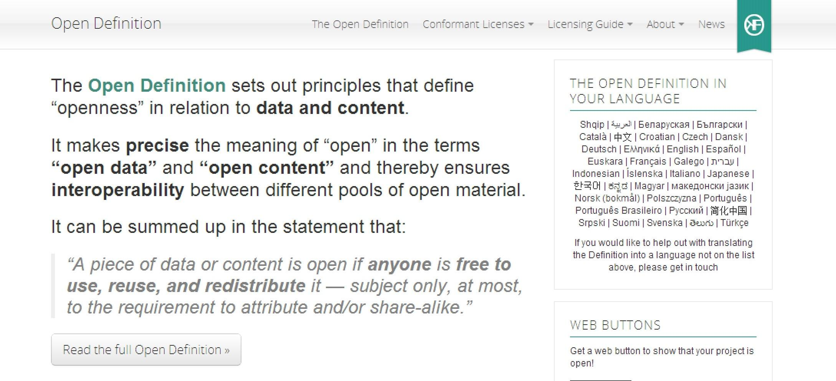
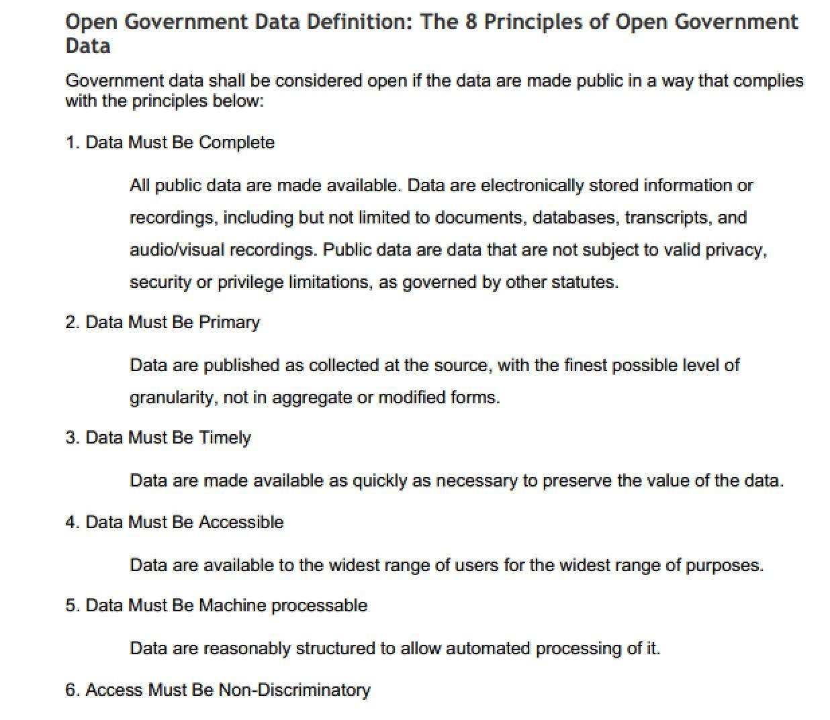
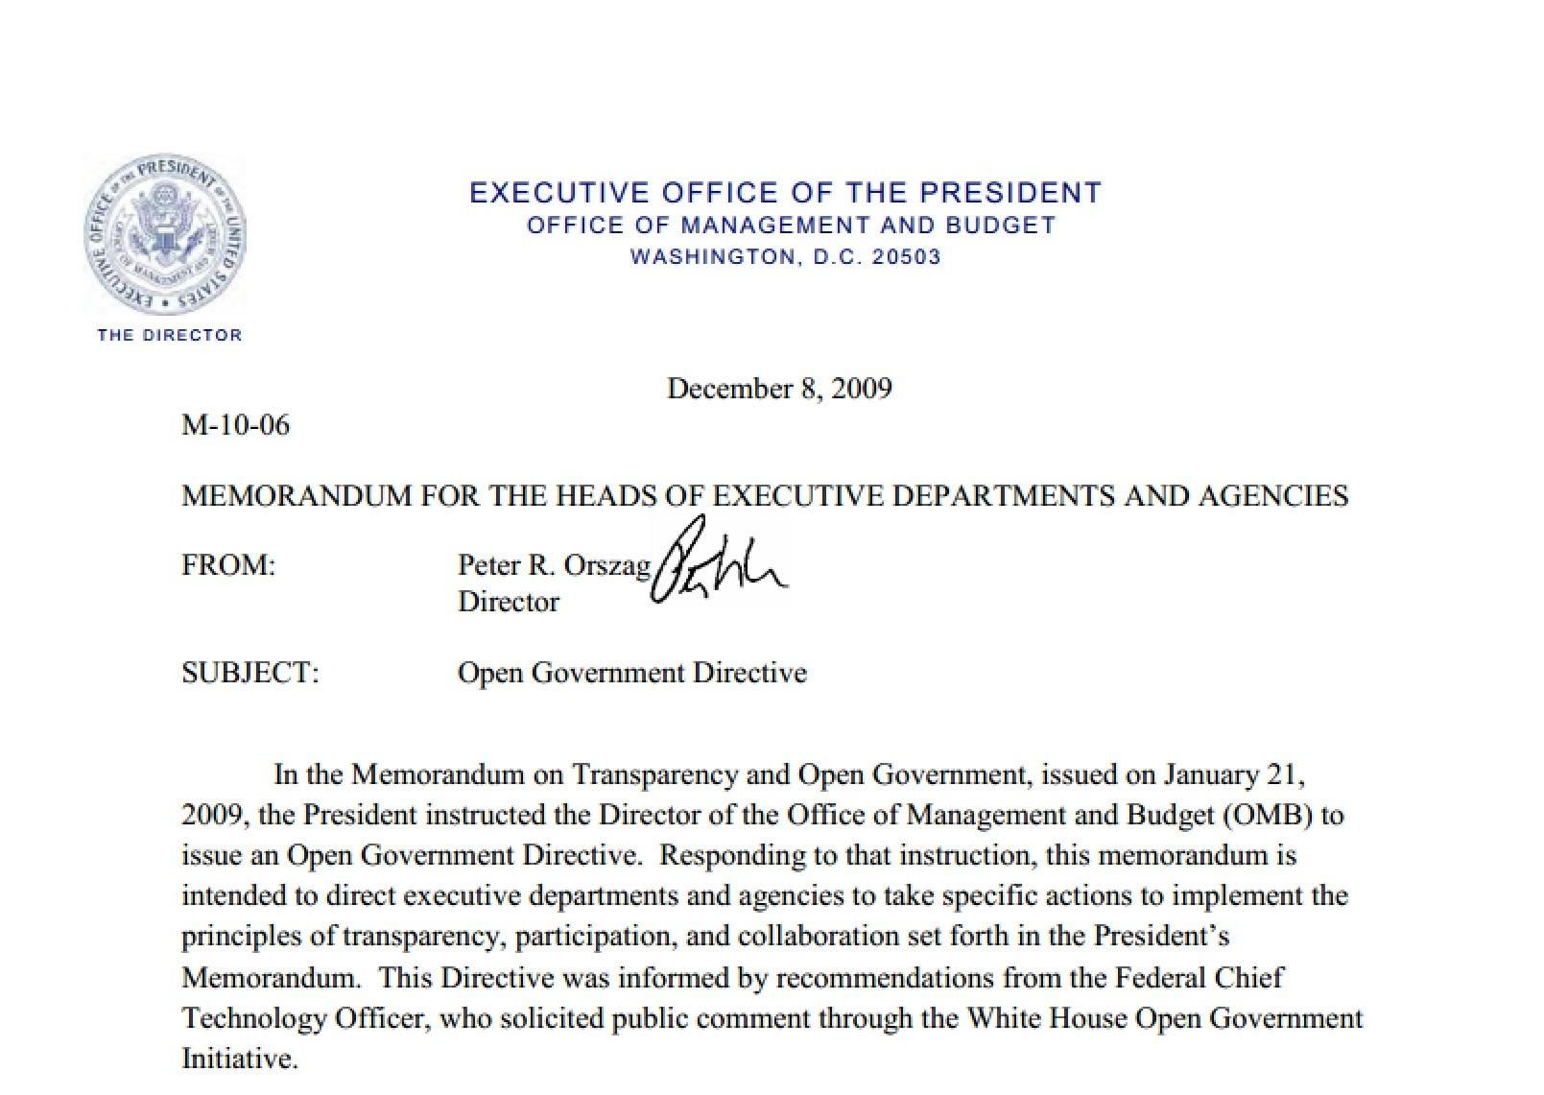
.

Slide 3
OPEN DATA
= the right to information online
ADMINISTRATIVE | TECHNICAL
Public = Online | Non-proprietary
Proactive Disclosure | Structured
http://sunlightfoundation.com/policy/documents/ten-open-data-principles/

Slide 4
Values of Open Data
Create transparency
Empower accountability
Enhance efficiency
Improve service quality
Attract commerce
Increase public participation
http://sunlightfoundation.com/blog/tag/why-open-data/

Slide 5
Data sourced from all 50 state legislatures (along with DC and Puerto Rico)
Search state bills, find your state legislator, explore recent votes
Access and reuse the data with an open API
http://openstates.org

Slide 6
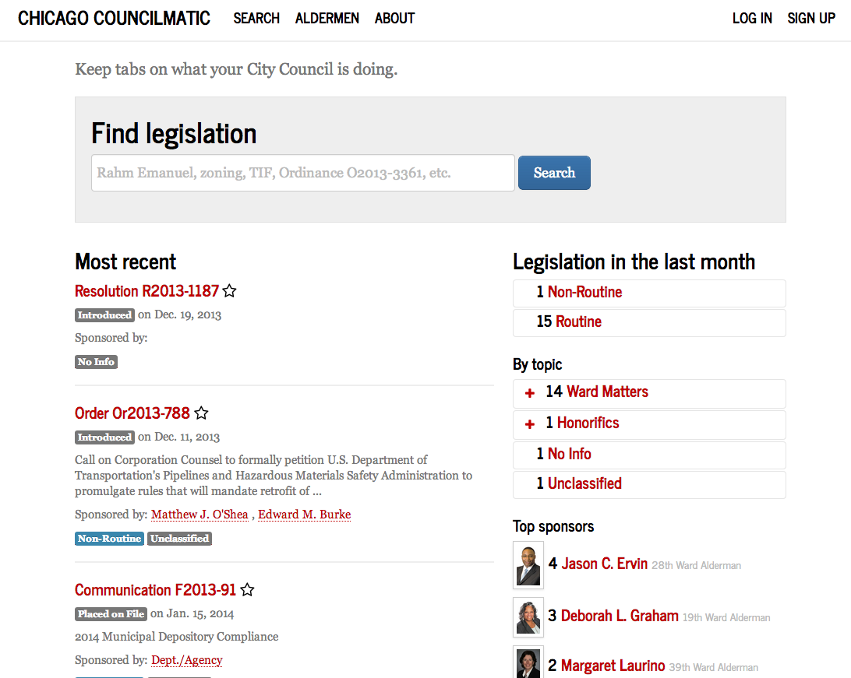
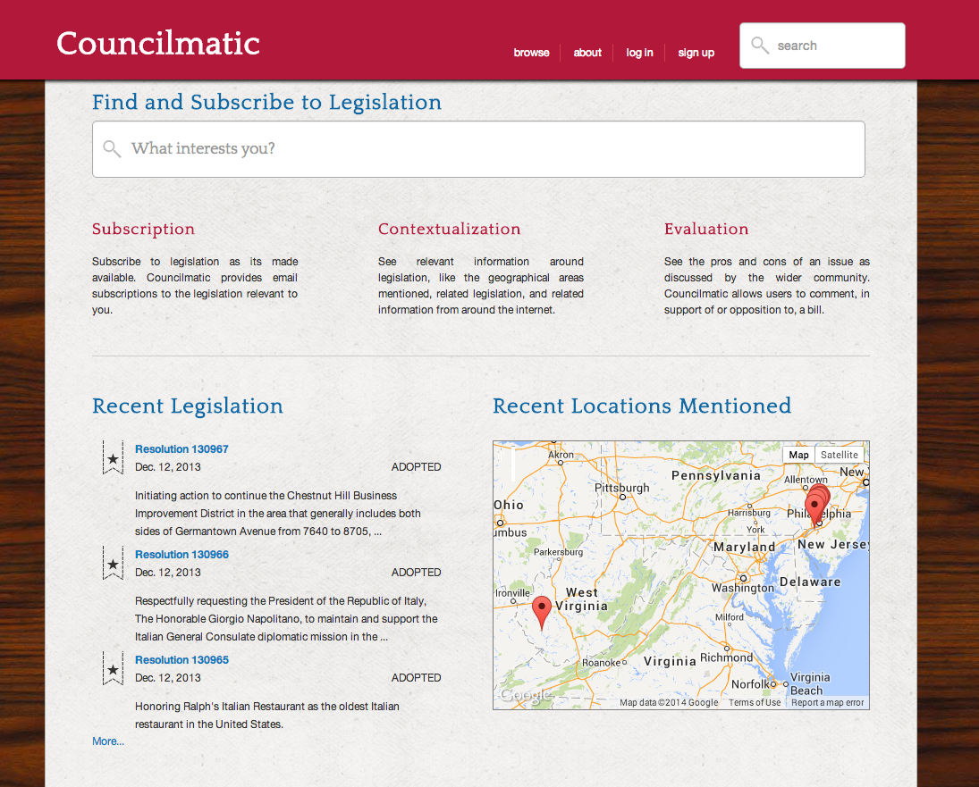
Councilmatic in Chicago and Philadelphia

Slide 7
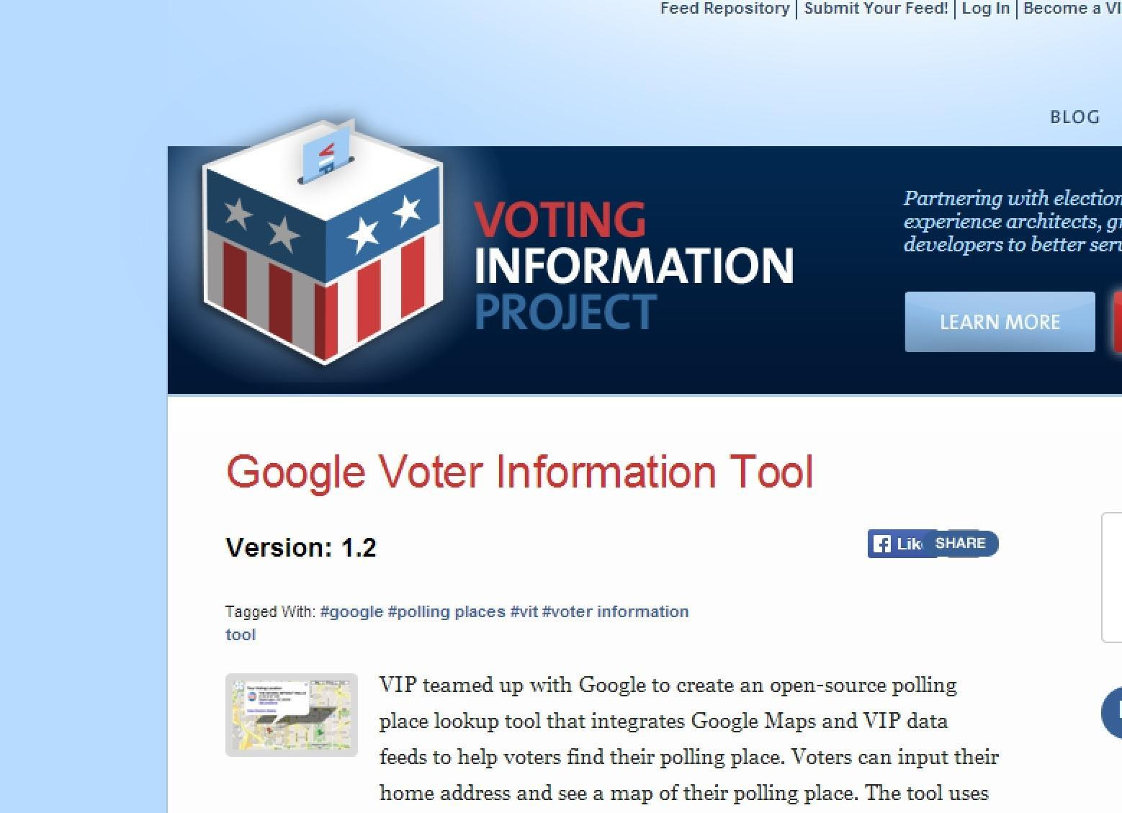
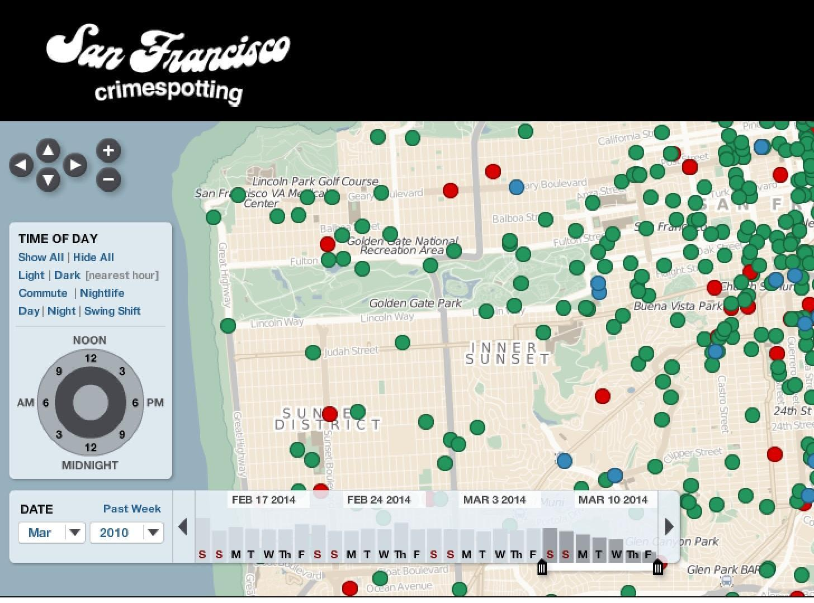
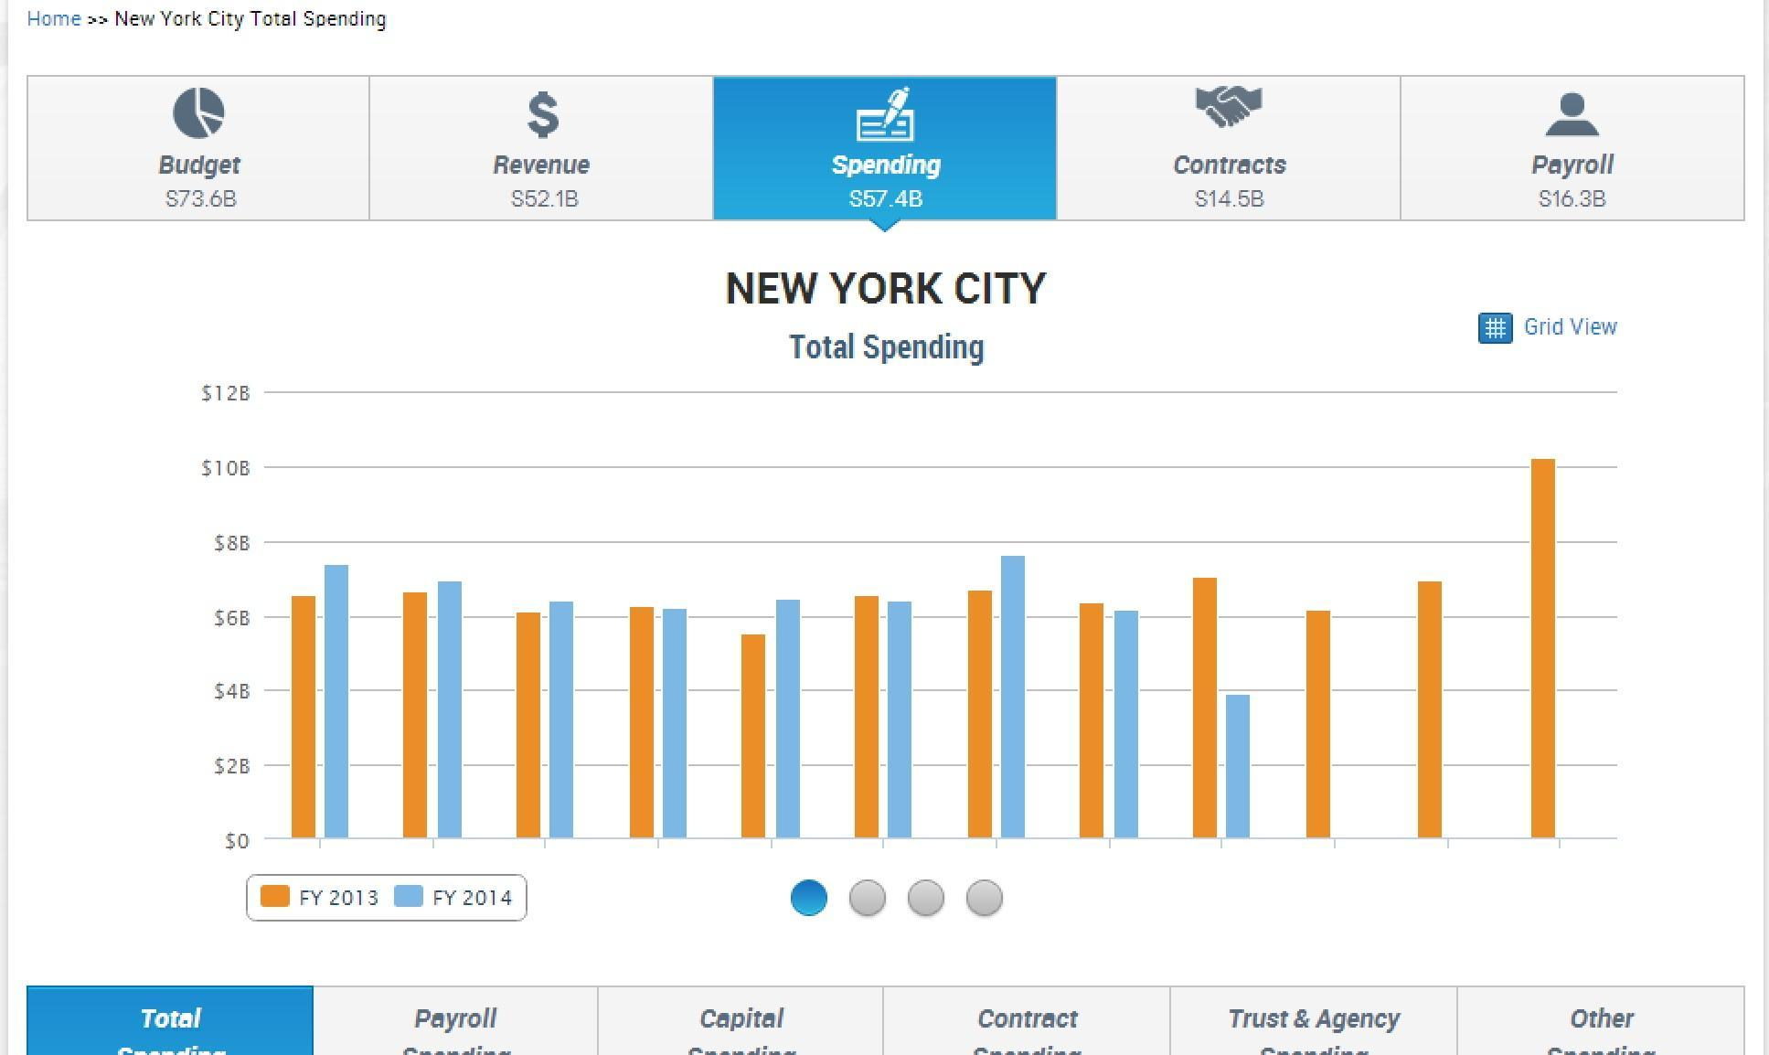
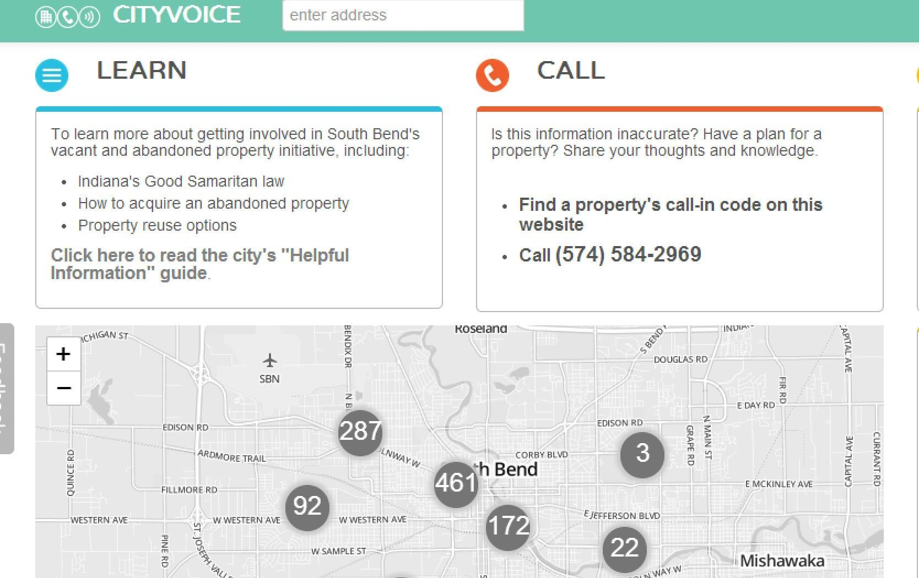
Open Data Ecosystem
Open data = available to build on

Slide 8
V1: 2012
V2: 2013
V3: 2014
http://sunlightfoundation.com/opendataguidelines

Slide 9
Open Data Policy Guidelines
1. What Data Should be Public
Proactively put information online
Build on existing public access and goals
Inventory everything
Prioritize thoughtfully
Include contractors and quasi-governmentals
Balance-test exemptions
http://sunlightfoundation.com/opendataguidelines

Slide 10
Open Data Policy Guidelines
2. How to Make Data Public
Set technical standards
Use open formats
Allow for bulk download
Publish guidance
Create a data portal
Remove barriers to access
Sketch new frontiers
Digitize archival material
2. How to Make Data Public
Set technical standards
Open formats
Use-appropriate formats
Bulk download
Create APIs
Enhance use
Central data location
Remove licenses and fees
Digitize archives
http://sunlightfoundation.com/opendataguidelines

Slide 11
Open Data Policy Guidelines
3. How to Implement Policy
Establish guidance and oversight
Create data inventories
Set timelines
Mandate future review
Include public perspectives
3. How to Implement Policy
Establish guidance and oversight
Set timelines
Create partnerships
Include public perspectives
Mandate future review
http://sunlightfoundation.com/opendataguidelines

Slide 12
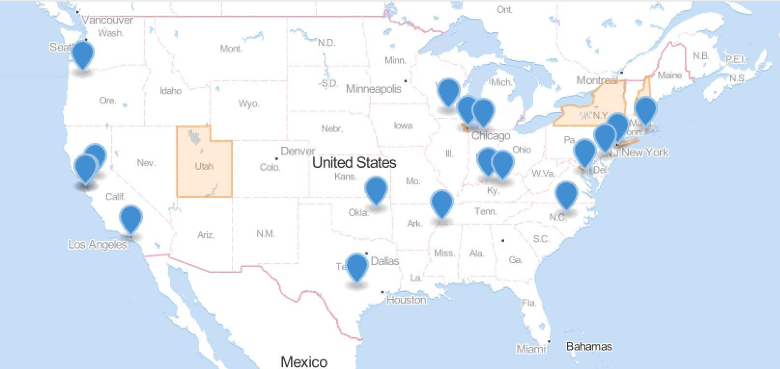
Open Data Policies in the U.S.
29 policies on the state and local level since 2006
http://sunlightfoundation.com/policy/opendatamap/

Slide 13
Guidelines + Specialization
Locally embedding policies
More input = better policy
Create actionable guidance

Slide 14
Challenges for Cities
Fears around novelty:
Risk aversion
Power and process
Unknown liabilities
“New” disclosure risks:
Inadvertent release
Mosaic effect

Slide 15
Opportunities for Collaboration
Open Data Production
Analysis of Open Data
Connecting Networks
NGO to government
NGO to NGO
Path: building on successful models

