Slide 1

The Voice of the Community: Neighborhood Corner
A New Tool for Telling Your Story

Slide 2
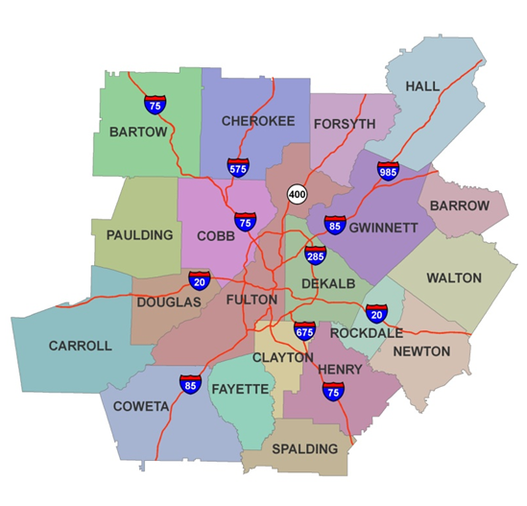
Neighborhood Nexus
Provide data, tools and expertise about the 20-county metro Atlanta region
Focus on Demographics, Health, Wealth and Wisdom
2

Slide 3

Goals
Support a regional network of information-led leaders and residents
Provide information, tools and expertise
3

Slide 4

Two Sides of the Story
Neighborhood Nexus
  Data-heavy site
Neighborhood Corner
  Put a name and face with the data
4

Slide 5
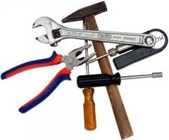
Need for New Tools
Neighborhoods need information about themselves
User friendly process to identify and address challenges and assets

Slide 6

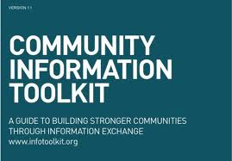
Knight Foundation Support
Community Information Challenge Grant
Community Information Toolkit

Slide 7
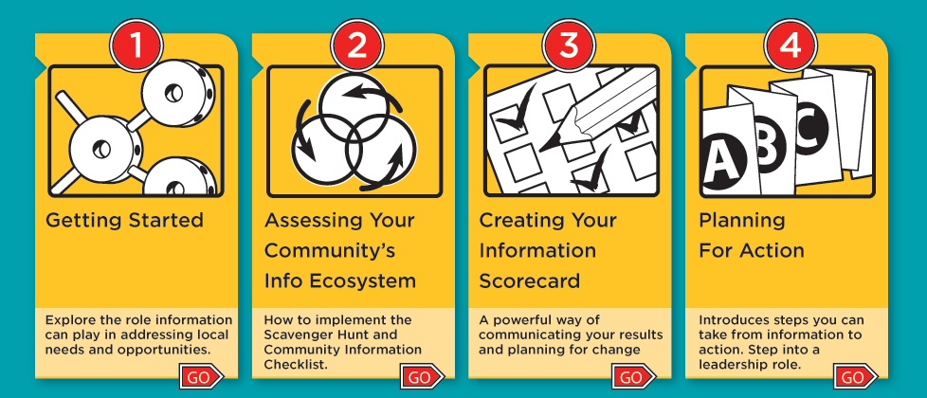
Community Information Toolkit
7

Slide 8
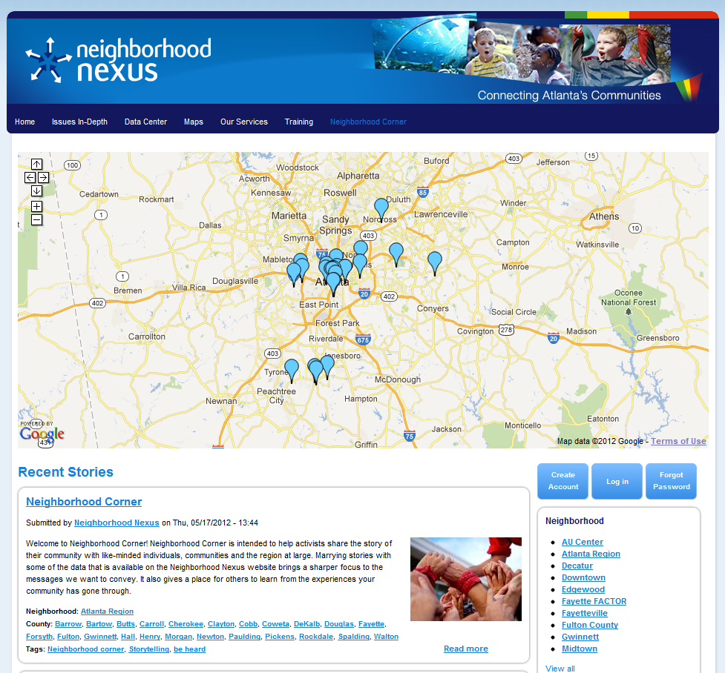
Neighborhood Corner
Stories
Blogs
Pictures
Videos
Resources
8

Slide 9



Technology
Geo-tagging
Spatially capture stories
Open Source

Slide 10
Five Pilot Communities

Slide 11

Three Step Process
Community Information Toolkit
Neighborhood Nexus
Neighborhood Corner

Slide 12

Incentives for the Communities
Up to $2,500
Community Information Toolkit outputs
Training and community coaching
Invitation to the 2012 Neighborhood Summit
Exposure

Slide 13


Outcome and Success Measures

Slide 14


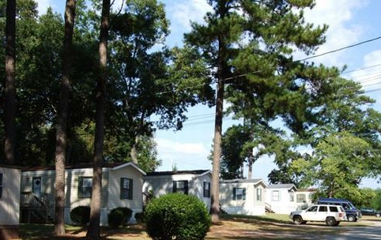

Sample Stories

Slide 15
Sample Stories

