Slide 1



An Integrated Database of the Development Review Process
http://realestate.bniajfi.org/
Seema D. Iyer, PhD
Associate Director
Research Assistant Professor
Jacob France Institute
University of Baltimore
siyer@ubalt.edu
1

Slide 2
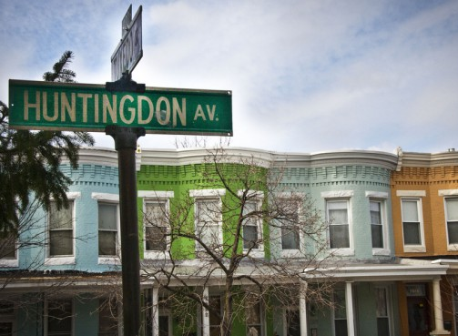

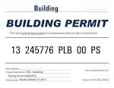
X
Investment
Stability
Growth
Decline

Slide 3
Development Review Process
Zoning Appeals
Historic Preservation Review
Design and Architectural Review
Planning Commission

Slide 4
Keeping Track
BMZA
  Every other Tuesday
  Docket released 2 weeks in advance
UDARP
  Every other Thursday
  Open meeting, but not a public hearing
CHAP
  2nd Tuesday of the month
  A public hearing; agenda released ahead, but staff reports after
Planning Commission
  Every other Thursday, opposite UDARP
  A public hearing; agenda released ahead, but staff reports after

Slide 5
The Process
BDC initiated projects
Housing initiated projects
(Planning)
Pre-development meeting
Internal Viewing Only
Site Plan Review Committee(SPRC)
CHAP
Commission for Historical and Architectural Preservation
UDARP
Urban Design and Architecture Review Panel
BMZA
Board of Municipal and Zoning Appeals
Traffic Impact
Forest Conservation
Critical Area
Flood Plain
Wetlands
Subdivision
Etc.
Planning Commission
Project Approval and Permitting
Economic Impact Statement
City Council

Slide 6
Data Sources
Agendas
Word Documents
Not high volume
Very difficult to automate data entry for geocoding

Slide 7
The Opportunity

Slide 8
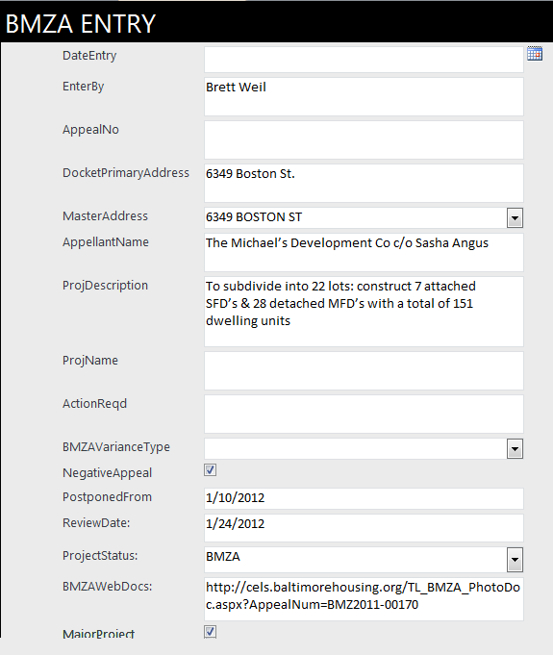
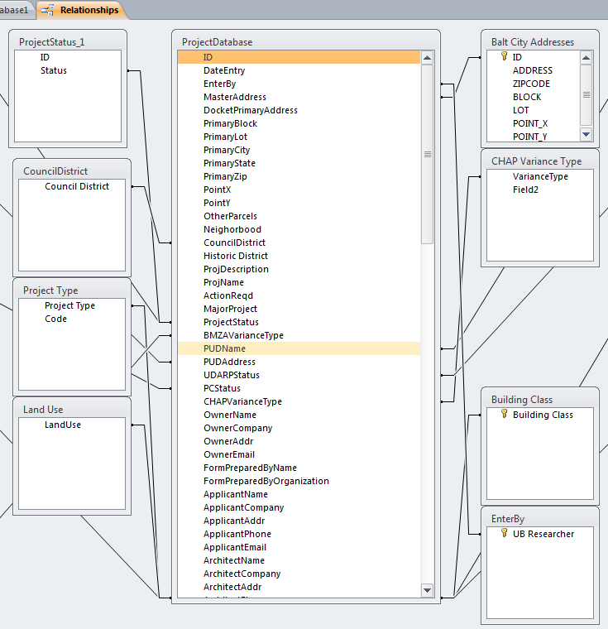
Database
Relational Database in Access

Slide 9
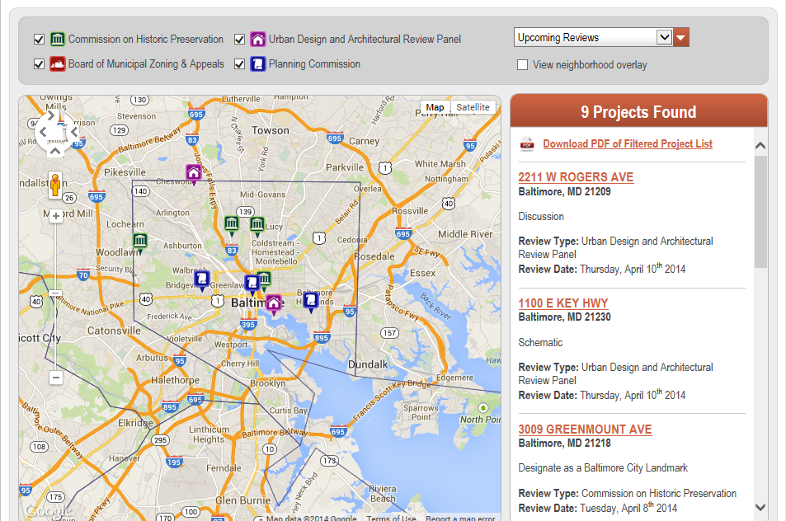

Slide 10
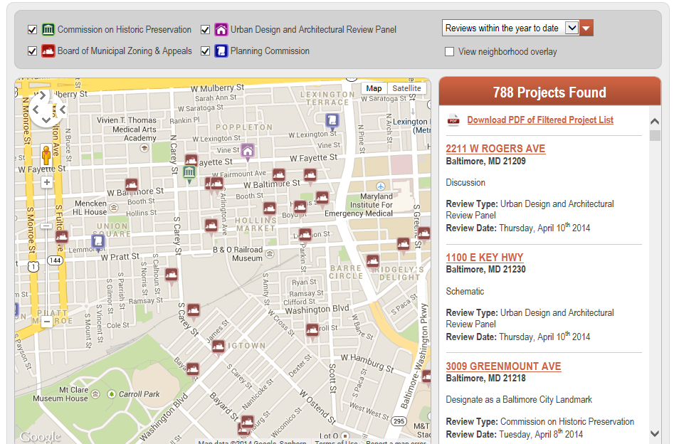

Slide 11
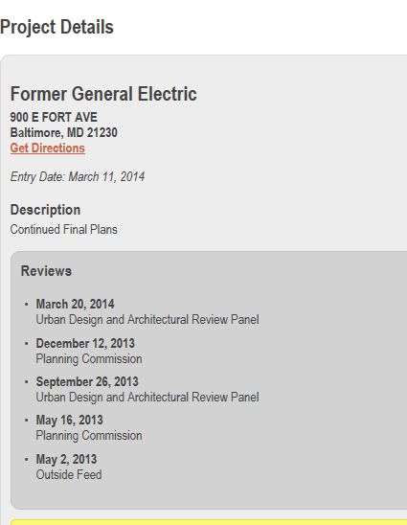
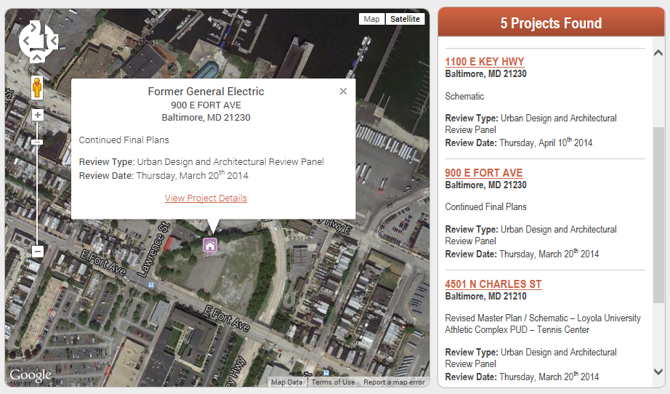

Slide 12
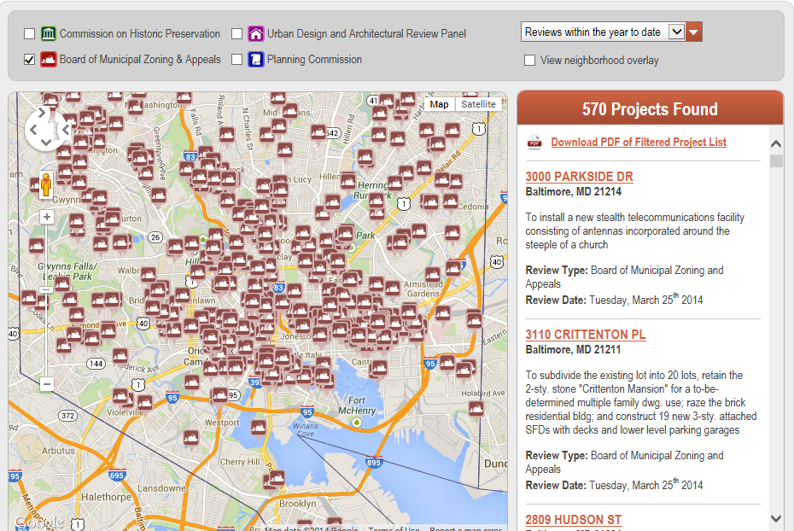

Slide 13
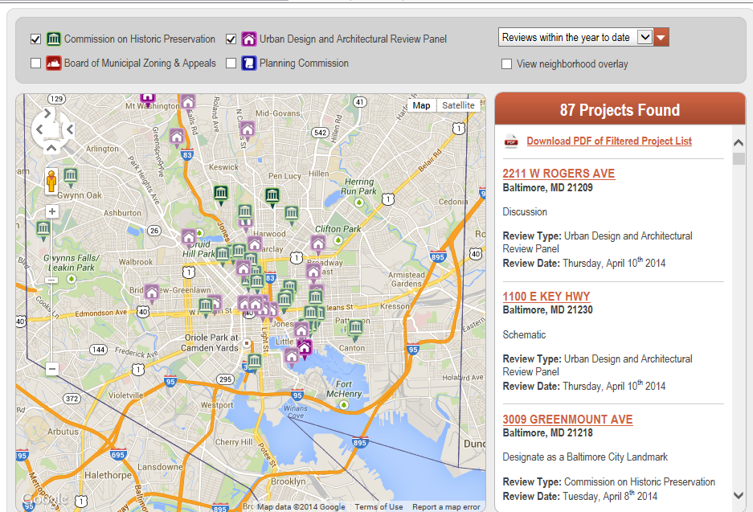

Slide 15
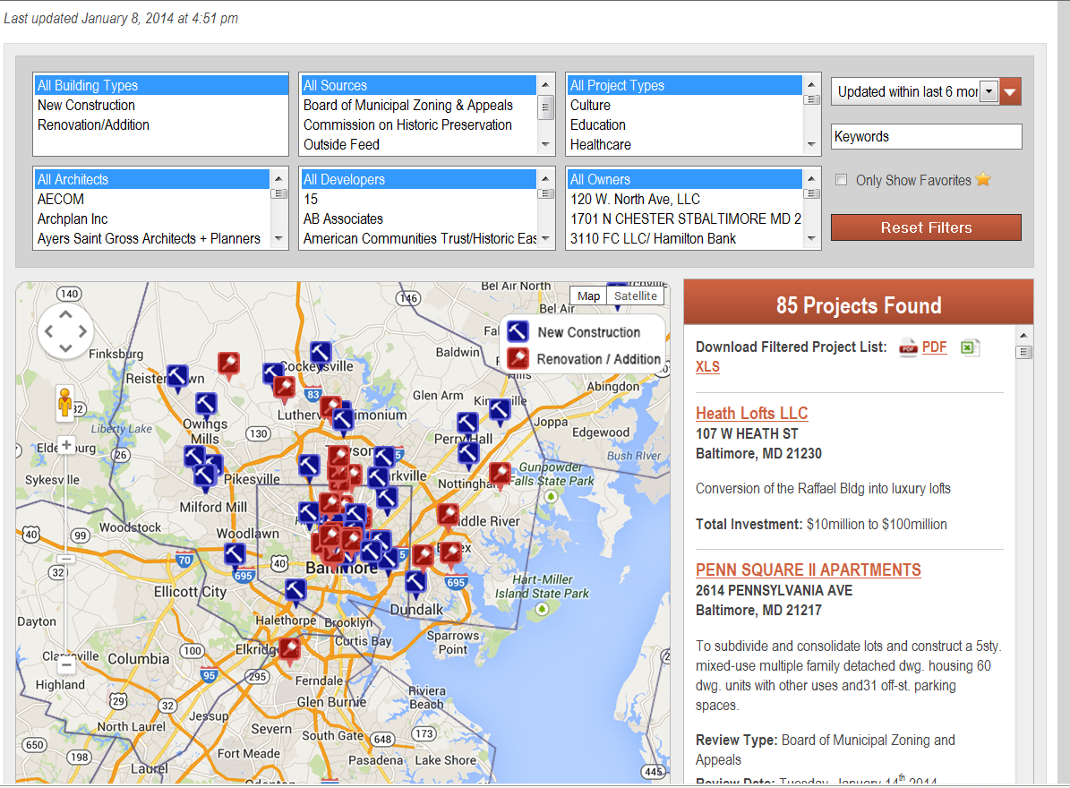


Slide 16
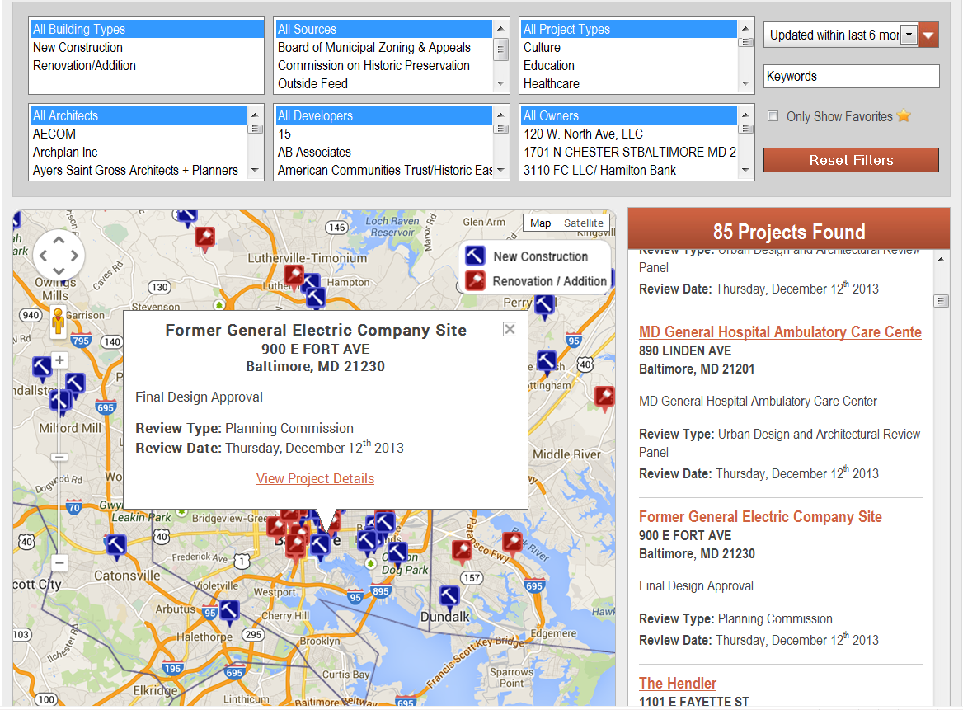

Slide 17
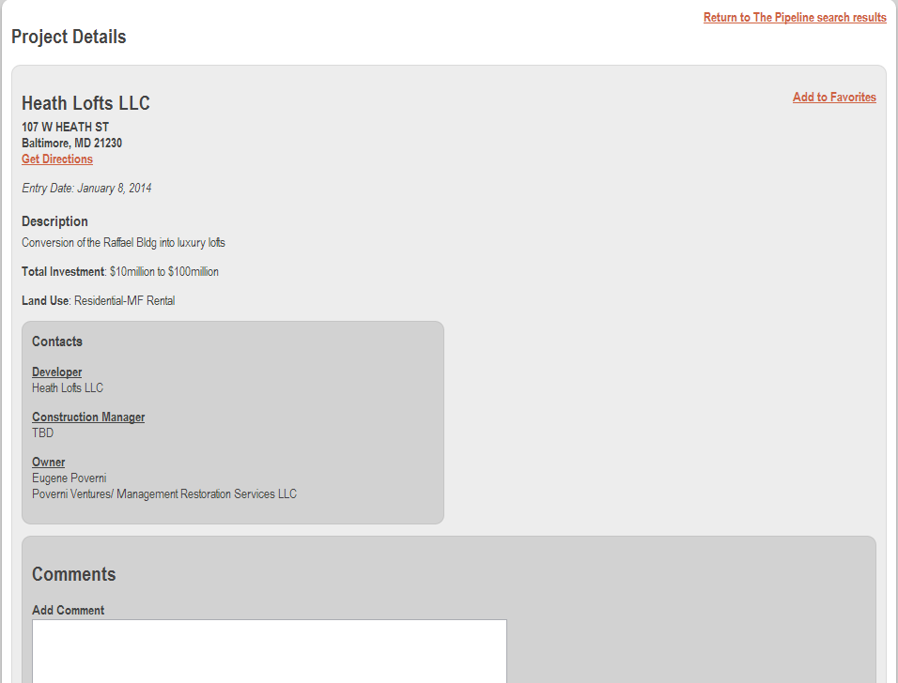

Slide 18
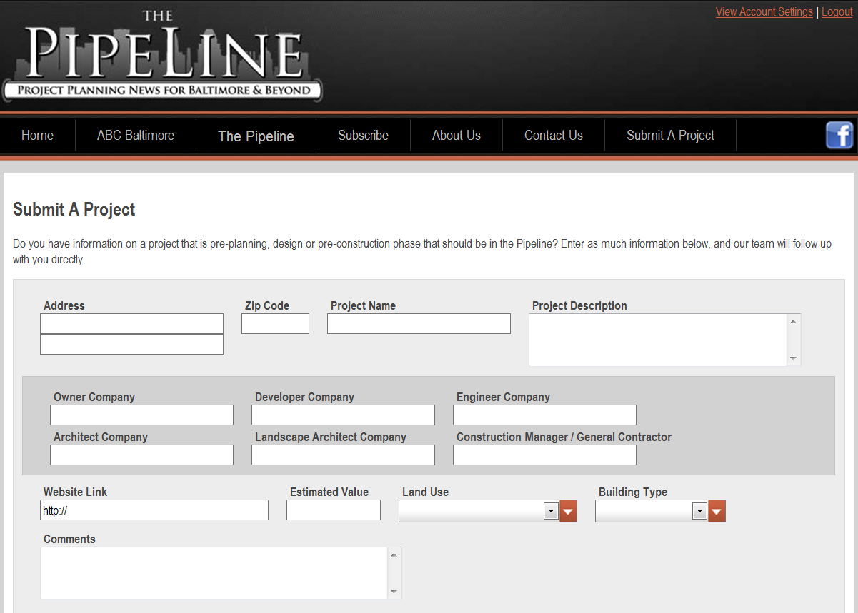

Slide 19
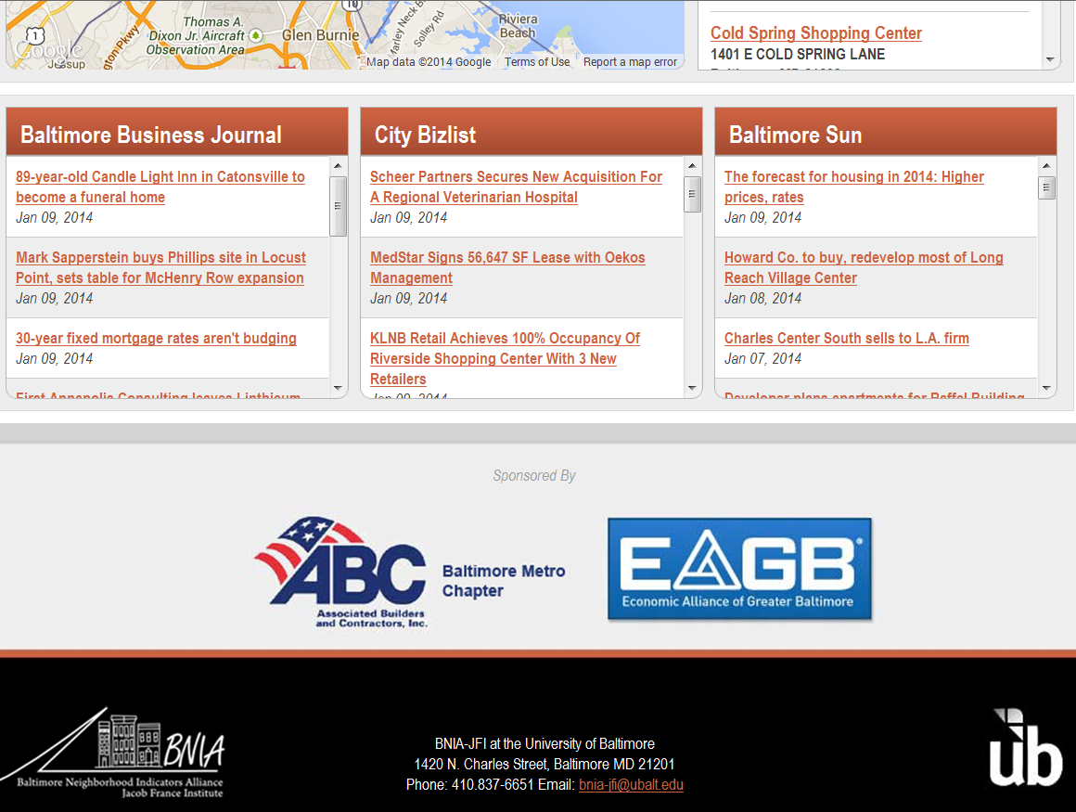

Slide 20
www.baltimorepipeline.com

