Slide 1
The Clumper: Finding Needles in a Property Haystack
Research Associate, Center on Urban Poverty and Community Development, Case Western Reserve University
Michael Schramm, Director of IT and Research
Cuyahoga Land Bank

Slide 2
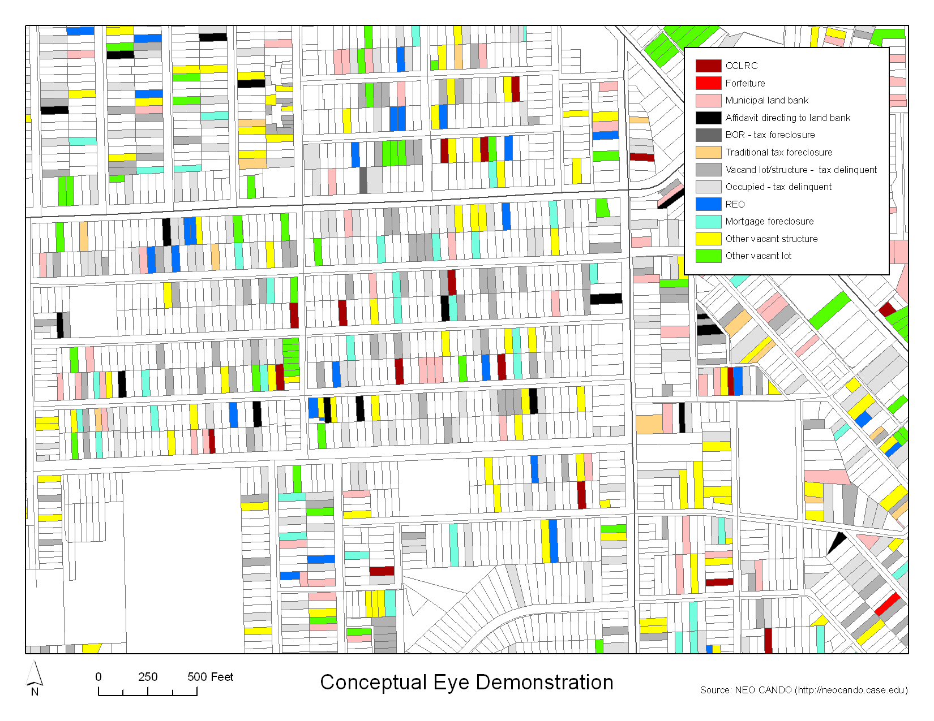
.6 acres
1.38 acres
1.2 acres
1.33 acres
Clumping!

Slide 3
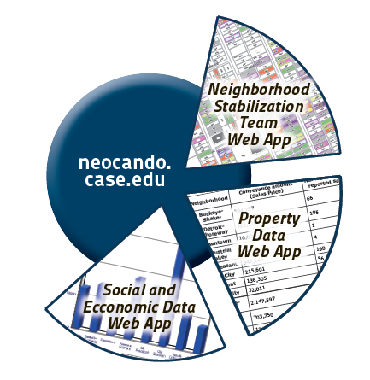
NEO CANDO Suite of Applications

Slide 4
What is the NST Web App?
Online, interactive, regularly updated property data interface
Searchable
Filterable
Sortable
Map-able
Downloadable
Geographically referenced
Wards, County council districts
Target areas (sii, nsp2, economic development)
Census (blocks, tracts, etc)
Municipal and neighborhoods
Parcel- level
Current snapshot (updated weekly)

Slide 5
Applications
Identify sites for projects
Urban agriculture
Storm water management
Solar farms
Economic development
Make tax foreclosure recommendations (grow the clumps!)

Slide 6
Data Sources
Cuyahoga County Fiscal Officer
City of Cleveland- Building and Housing
Cuyahoga Count Common Pleas Court
Foreclosure filings and court docket entries (weekly)
Cuyahoga Land Bank
Acquisitions, dispositions, demolitions (weekly)
City of Cleveland- Comm. Dev
Vacant and blighted survey (as conducted)
Property characteristics (yearly)
Permits (weekly)
Condemnations/Violation (weekly)
Demolitions (weekly)
Deed transfers (weekly)
Mortgage and other lien recordings (weekly)
Tax delinquency and property values (monthly)
Cuyahoga County Sheriff’s Department
Scheduled sheriff’s sales (weekly)
Rental registry (irregular)
Other sources
USPS vacancy data (every other month)
NPI Programmatic data
Suburban demolition data
Neighborhood assets
Section 8 vouchers

Slide 7
Added Value
Data mining- key text phrases like “confirmation of sale” and “decree of foreclosure”
Data proxies
Probable vacant lots
No building value
Not tax abated
Demolished by City of Cleveland, suburbs, Cuyahoga Land Bank
Foreclosure Type and Status
Probable vacancy
City of Cleveland’s vacant and blighted structure survey
USPS postal vacancy

Slide 8
Cuyahoga Land Bank – NEO CANDO – NST Data Trajectory Tiers
Tier 1 – UNDER CONROL
In Cuyahoga Land Bank Inventory
Properties pending transfer to Cuyahoga Land Bank
In Municipal Land Bank Inventory
State Forfeiture
Tier 2 – ABOUT TO BE UNDER CONTROL
Nuisance Demo (Municipal/Cuyahoga Land Bank)
Tax foreclosure Affidavit to Municipal Land Bank)
Tax foreclosure Affidavit to Cuyahoga land Bank
Fannie Mae
HUD
Tier 3 – CAN STEER TO PRODUCTIVE USE
Tax foreclosure affidavit – not sent to a Land Bank
Tax foreclosure (not dismissed)
Tax delinquency
Tier 4 – OTHER VACANT/BLIGHTED
Mortgage foreclosure (not dismissed)
Bank Owned (not HUD or Fannie Mae)
Other vacant lot
Other vacant structure

Slide 9
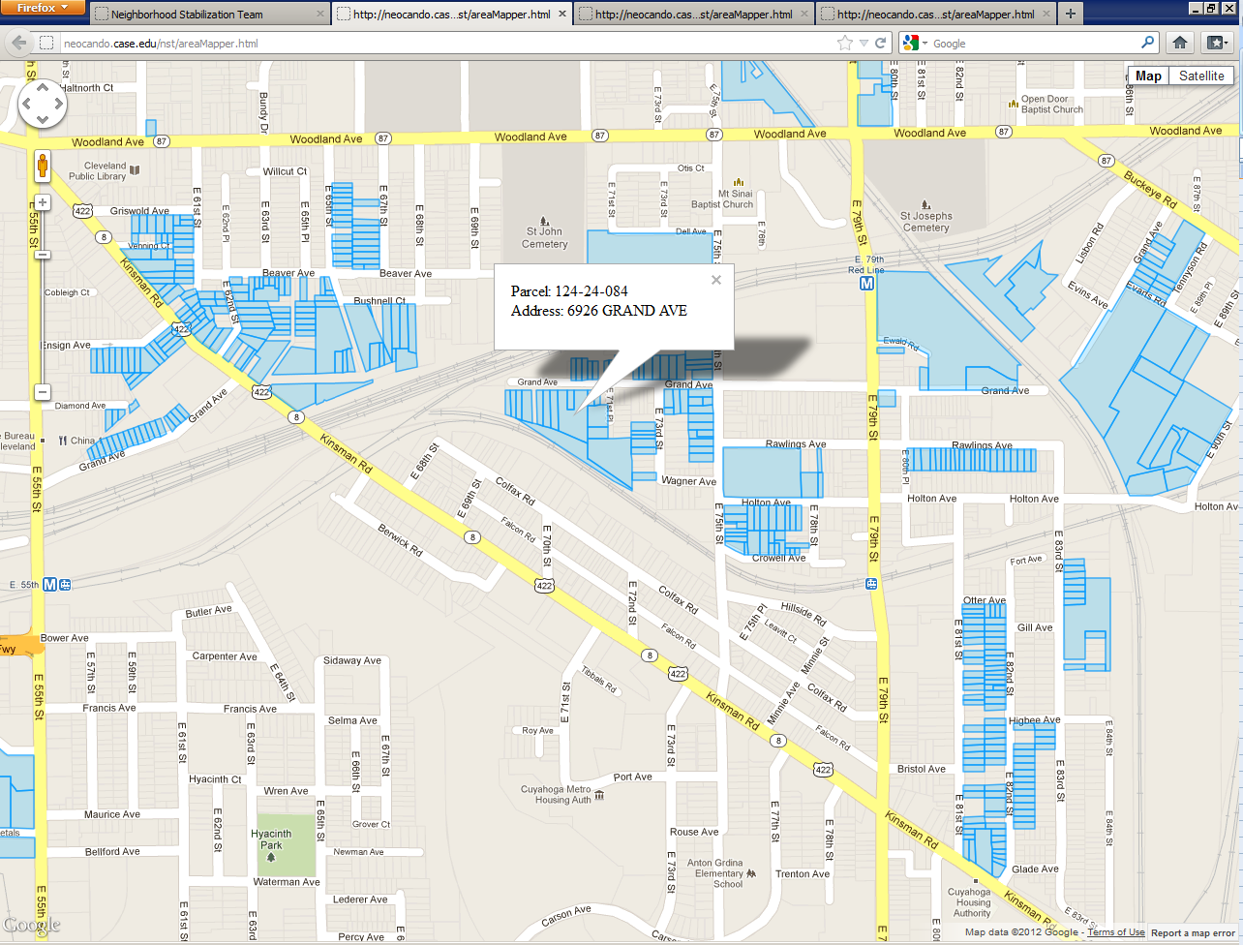
Tiers 1, 2, 3 adjacency analysis greater than 2 acres

Slide 10
Clumping – Step 1
Collect LOTS of administrative data property data across many sources

Slide 11
Clumping – Step 2
Create data tiers based on priority by looking across the administrative data sources to try to figure out the most recent status and/or ownership

Slide 12
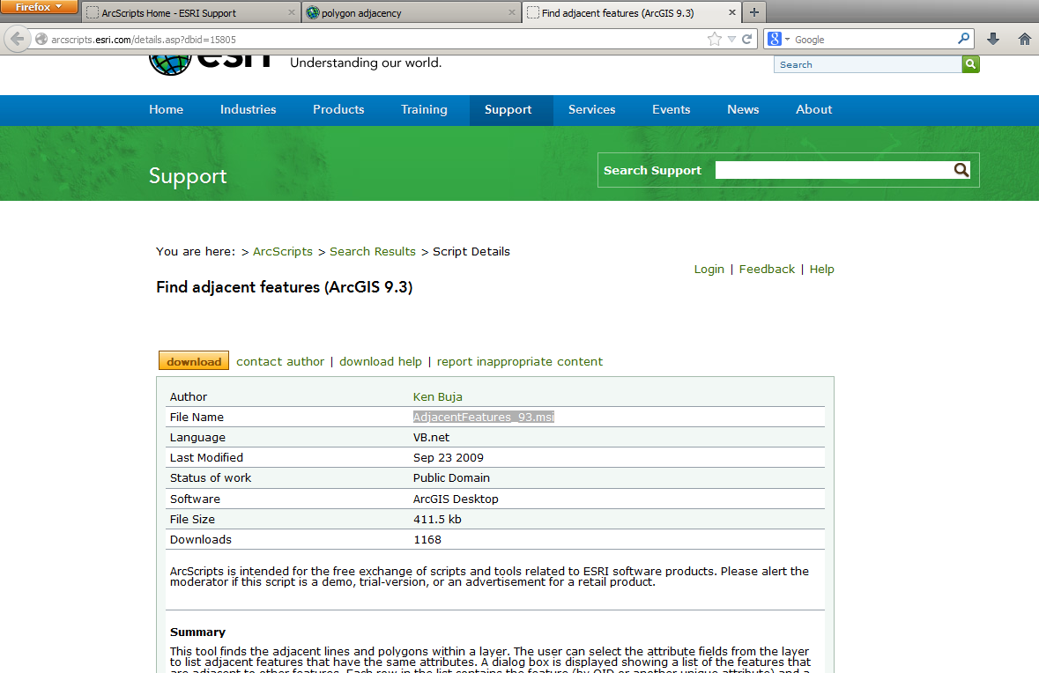
Clumping – Step 3
Create parcel adjacency matrix (there is an extension in ArcGIS [AdjacentFeatures_93.msi])

Slide 13
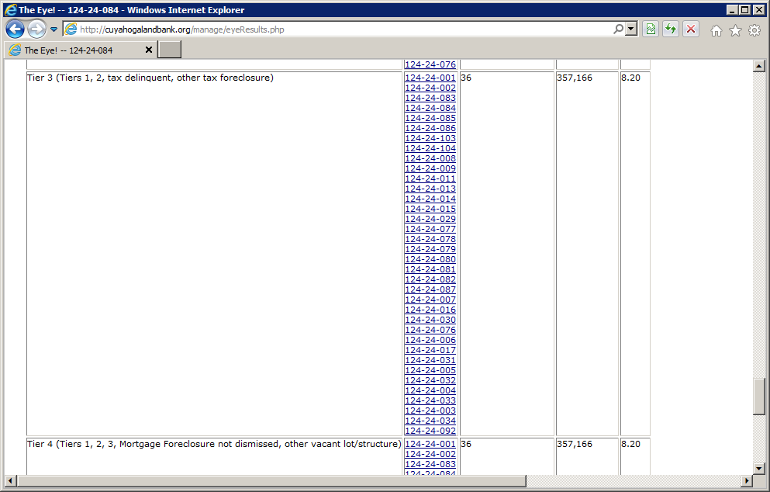
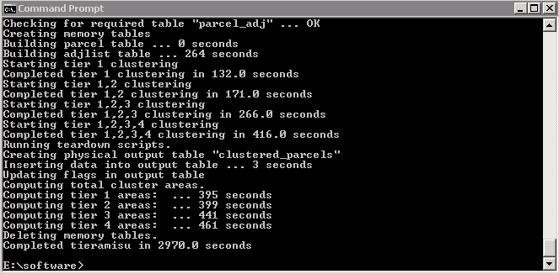
Clumping – Step 4
Write script that takes associates tier data with adjacency matrix (we used java and mysql)

Slide 14
Clumping – Step 5
Put clumped results in an interface to make results accessible

Slide 15
