Slide 1
Ohio Student Mobility Research
NNIP Meeting Columbus, OH
June 20, 2013
Notes:
1

Slide 2
The Ohio Student Mobility Project
First things first: What is “student mobility”?
Students in grades K-12 changing schools for reasons other than customary promotion
During school year or over summer break
Positive/choice-based or unplanned/destabilizing
Mobility impacts students, schools, communities, and public policy
Notes:
If it’s a move its student mobility.

Slide 3
Broad and diverse funder support
Thomas B. Fordham Institute
Siemer Institute for Family Stability
Cleveland Foundation
Nord Family Foundation
KnowledgeWorks
KidsOhio.org
School Choice Ohio
American Federation of Teachers/Ohio Federation of Teachers
United Way of Central Ohio
United Way of Greater Toledo
The Columbus Foundation

Slide 4
Data and products
First of its kind research in scale and scope
Massive dataset: 2 years of student level data from ODE
Statewide Student Identifier follows students through the public school system
5 million instances of enrollment in 2009-10 and 2010-11
Products:
5 metro area profiles
Statewide summary
Spreadsheets with data for all public districts, buildings, charters

Slide 5
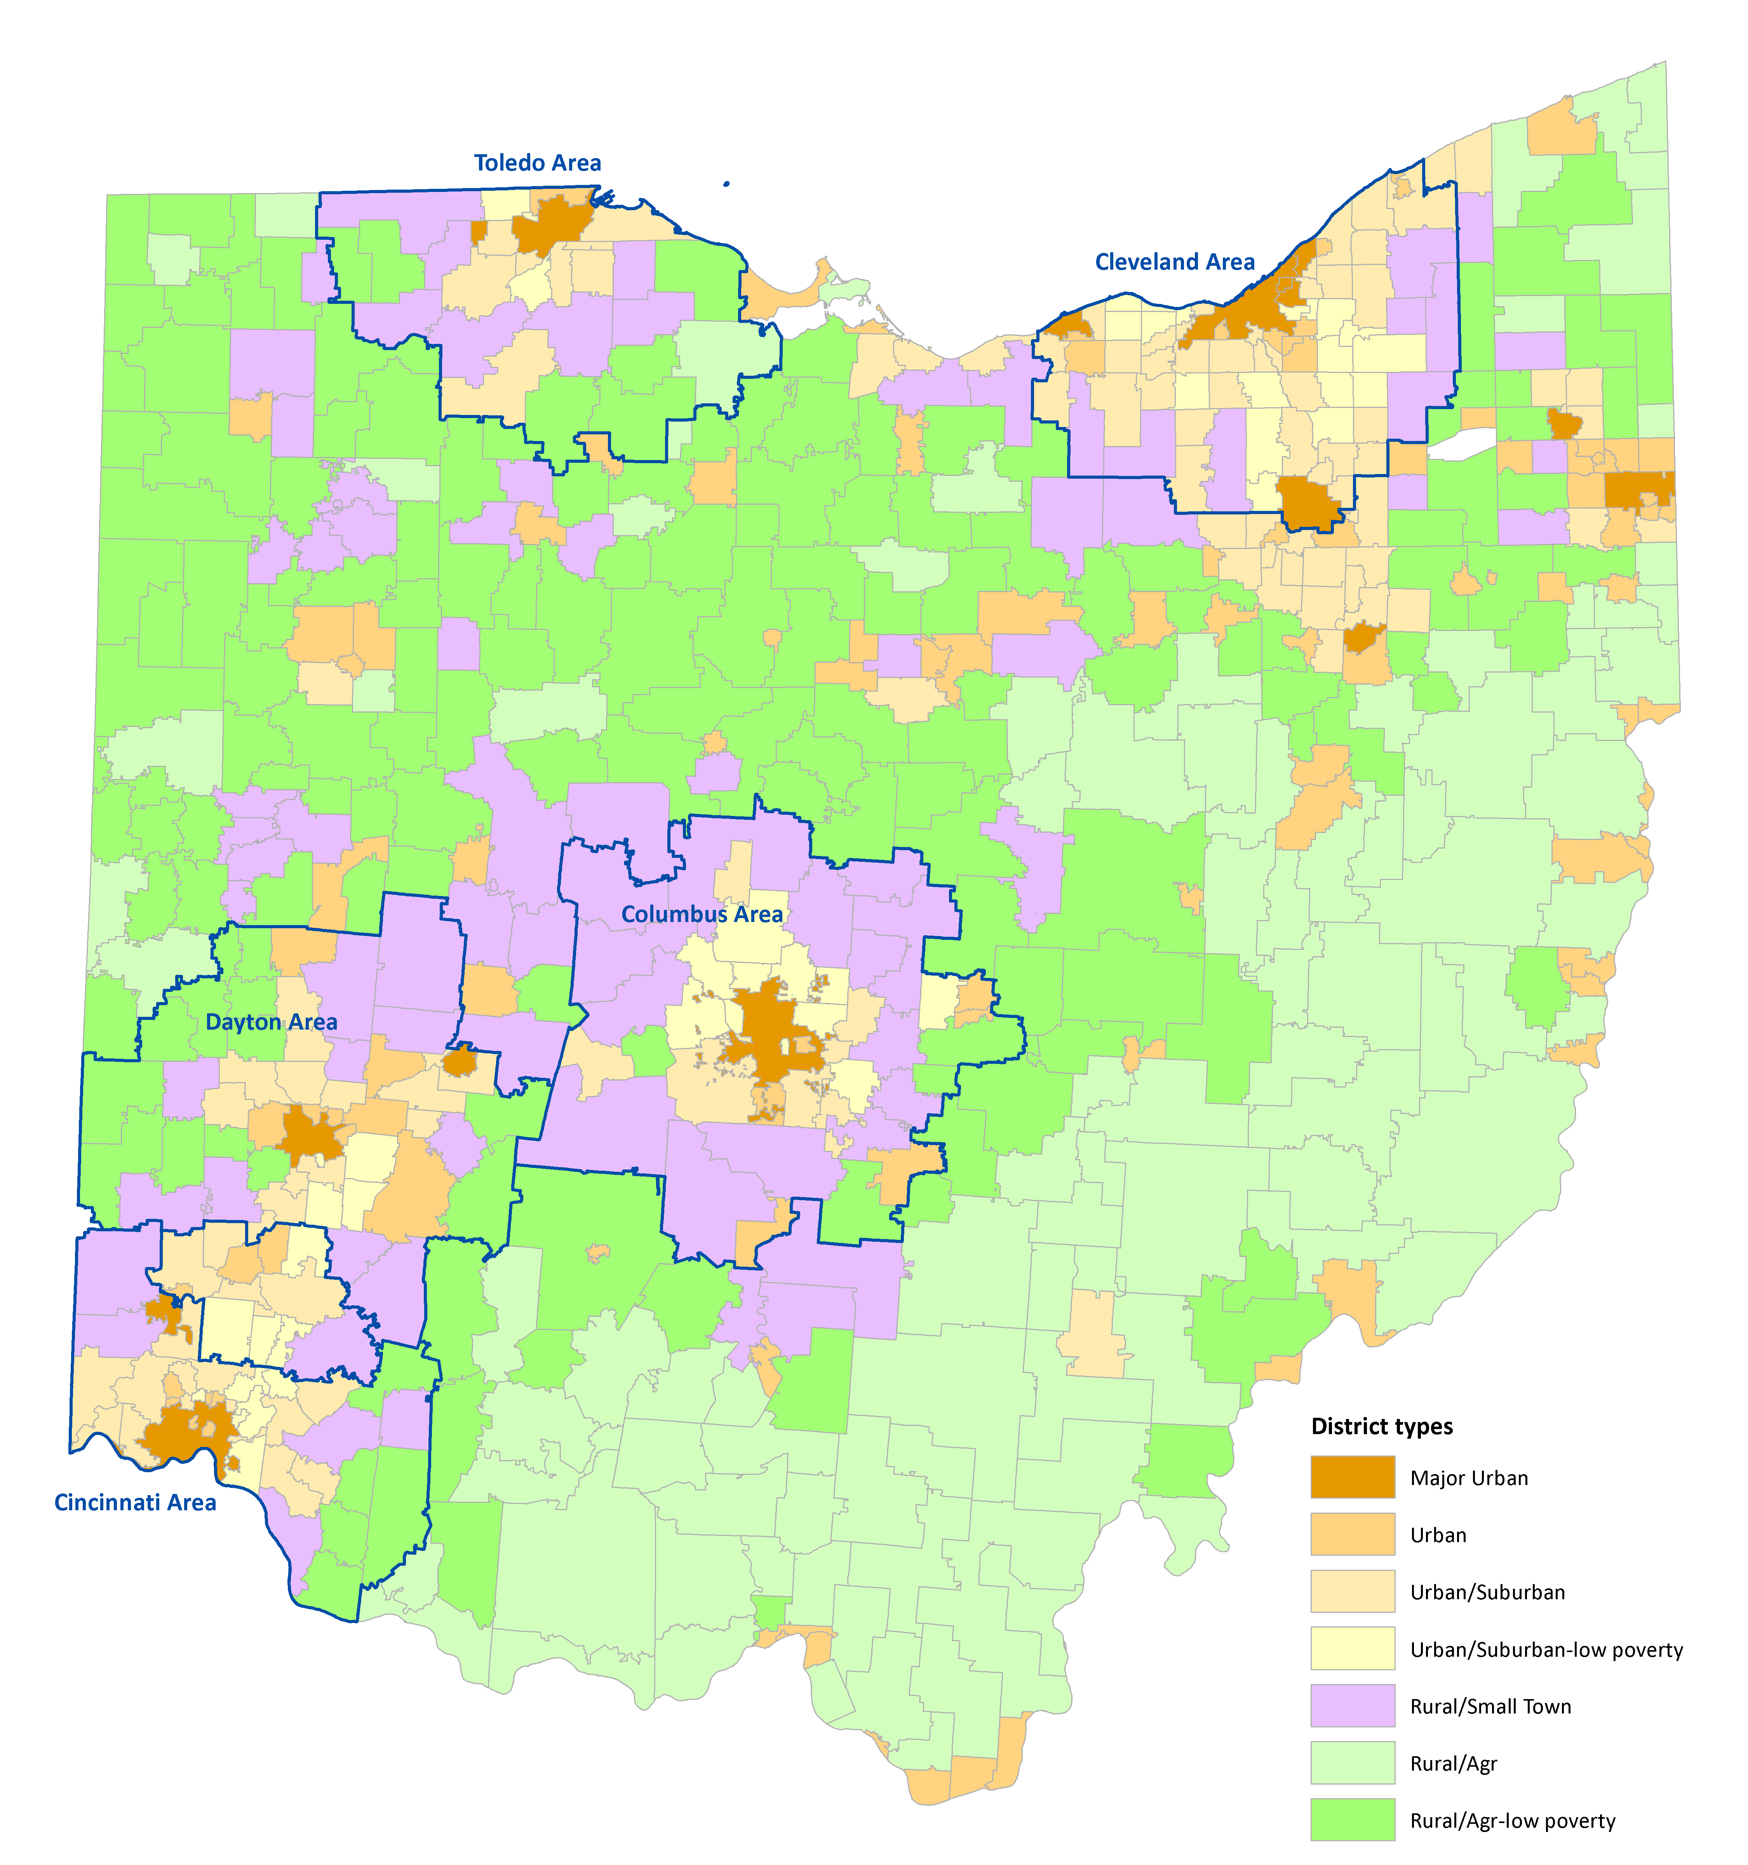
Ohio school district types
Metro area profile geographies

Slide 6
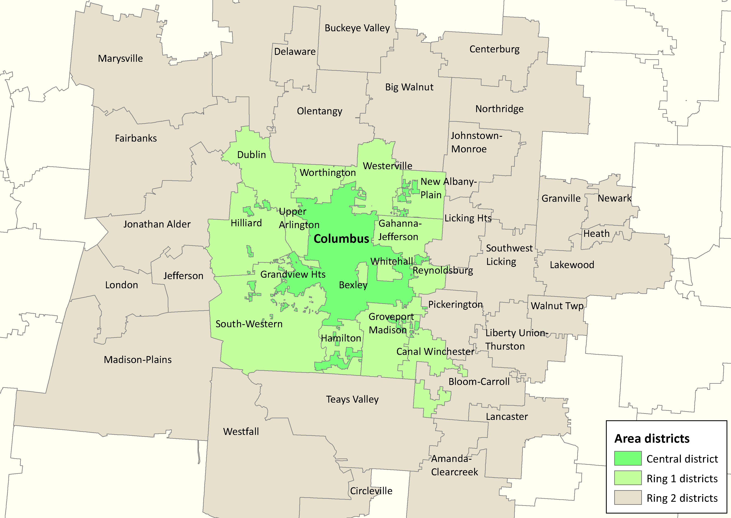
The Columbus Area
44 districts, 459 buildings, 69 physical charters, 280k students
Notes:
No use of attendance records
<30 days between withdrawal and reenroll in same building not counted as “mobility” in calculating churn
Analysis of “non-counters” and test rollup

Slide 7
Research questions
Address the “what” questions but not the “why”.
Magnitude of mobility
Mobility patterns
Mobility and students
Statewide policy issues
Notes:
Address the “what” questions but not the “why”.
Magnitude of mobility: How much movement is there?
Mobility patterns: Where are students moving to and from?
Mobility and students: How is mobility related to student demographics and student achievement?
Statewide policy issues
Open enrollment
Profile of “non counters”
Monthly enrollment for public districts

Slide 8
Magnitude of Mobility
How many students change schools?
Cohort stability: measures retention of students over time (higher number is better)
Churn rate: measures movements in and out of building or district (lower number is better)
Notes:
Cohort Stability:
2-year rate, October 2009-May 2011
K-7 and 8-11 analyses
Churn Rate:
1 year rate, October 2010-May 2011
K-8 and 9-12 analyses

Slide 9
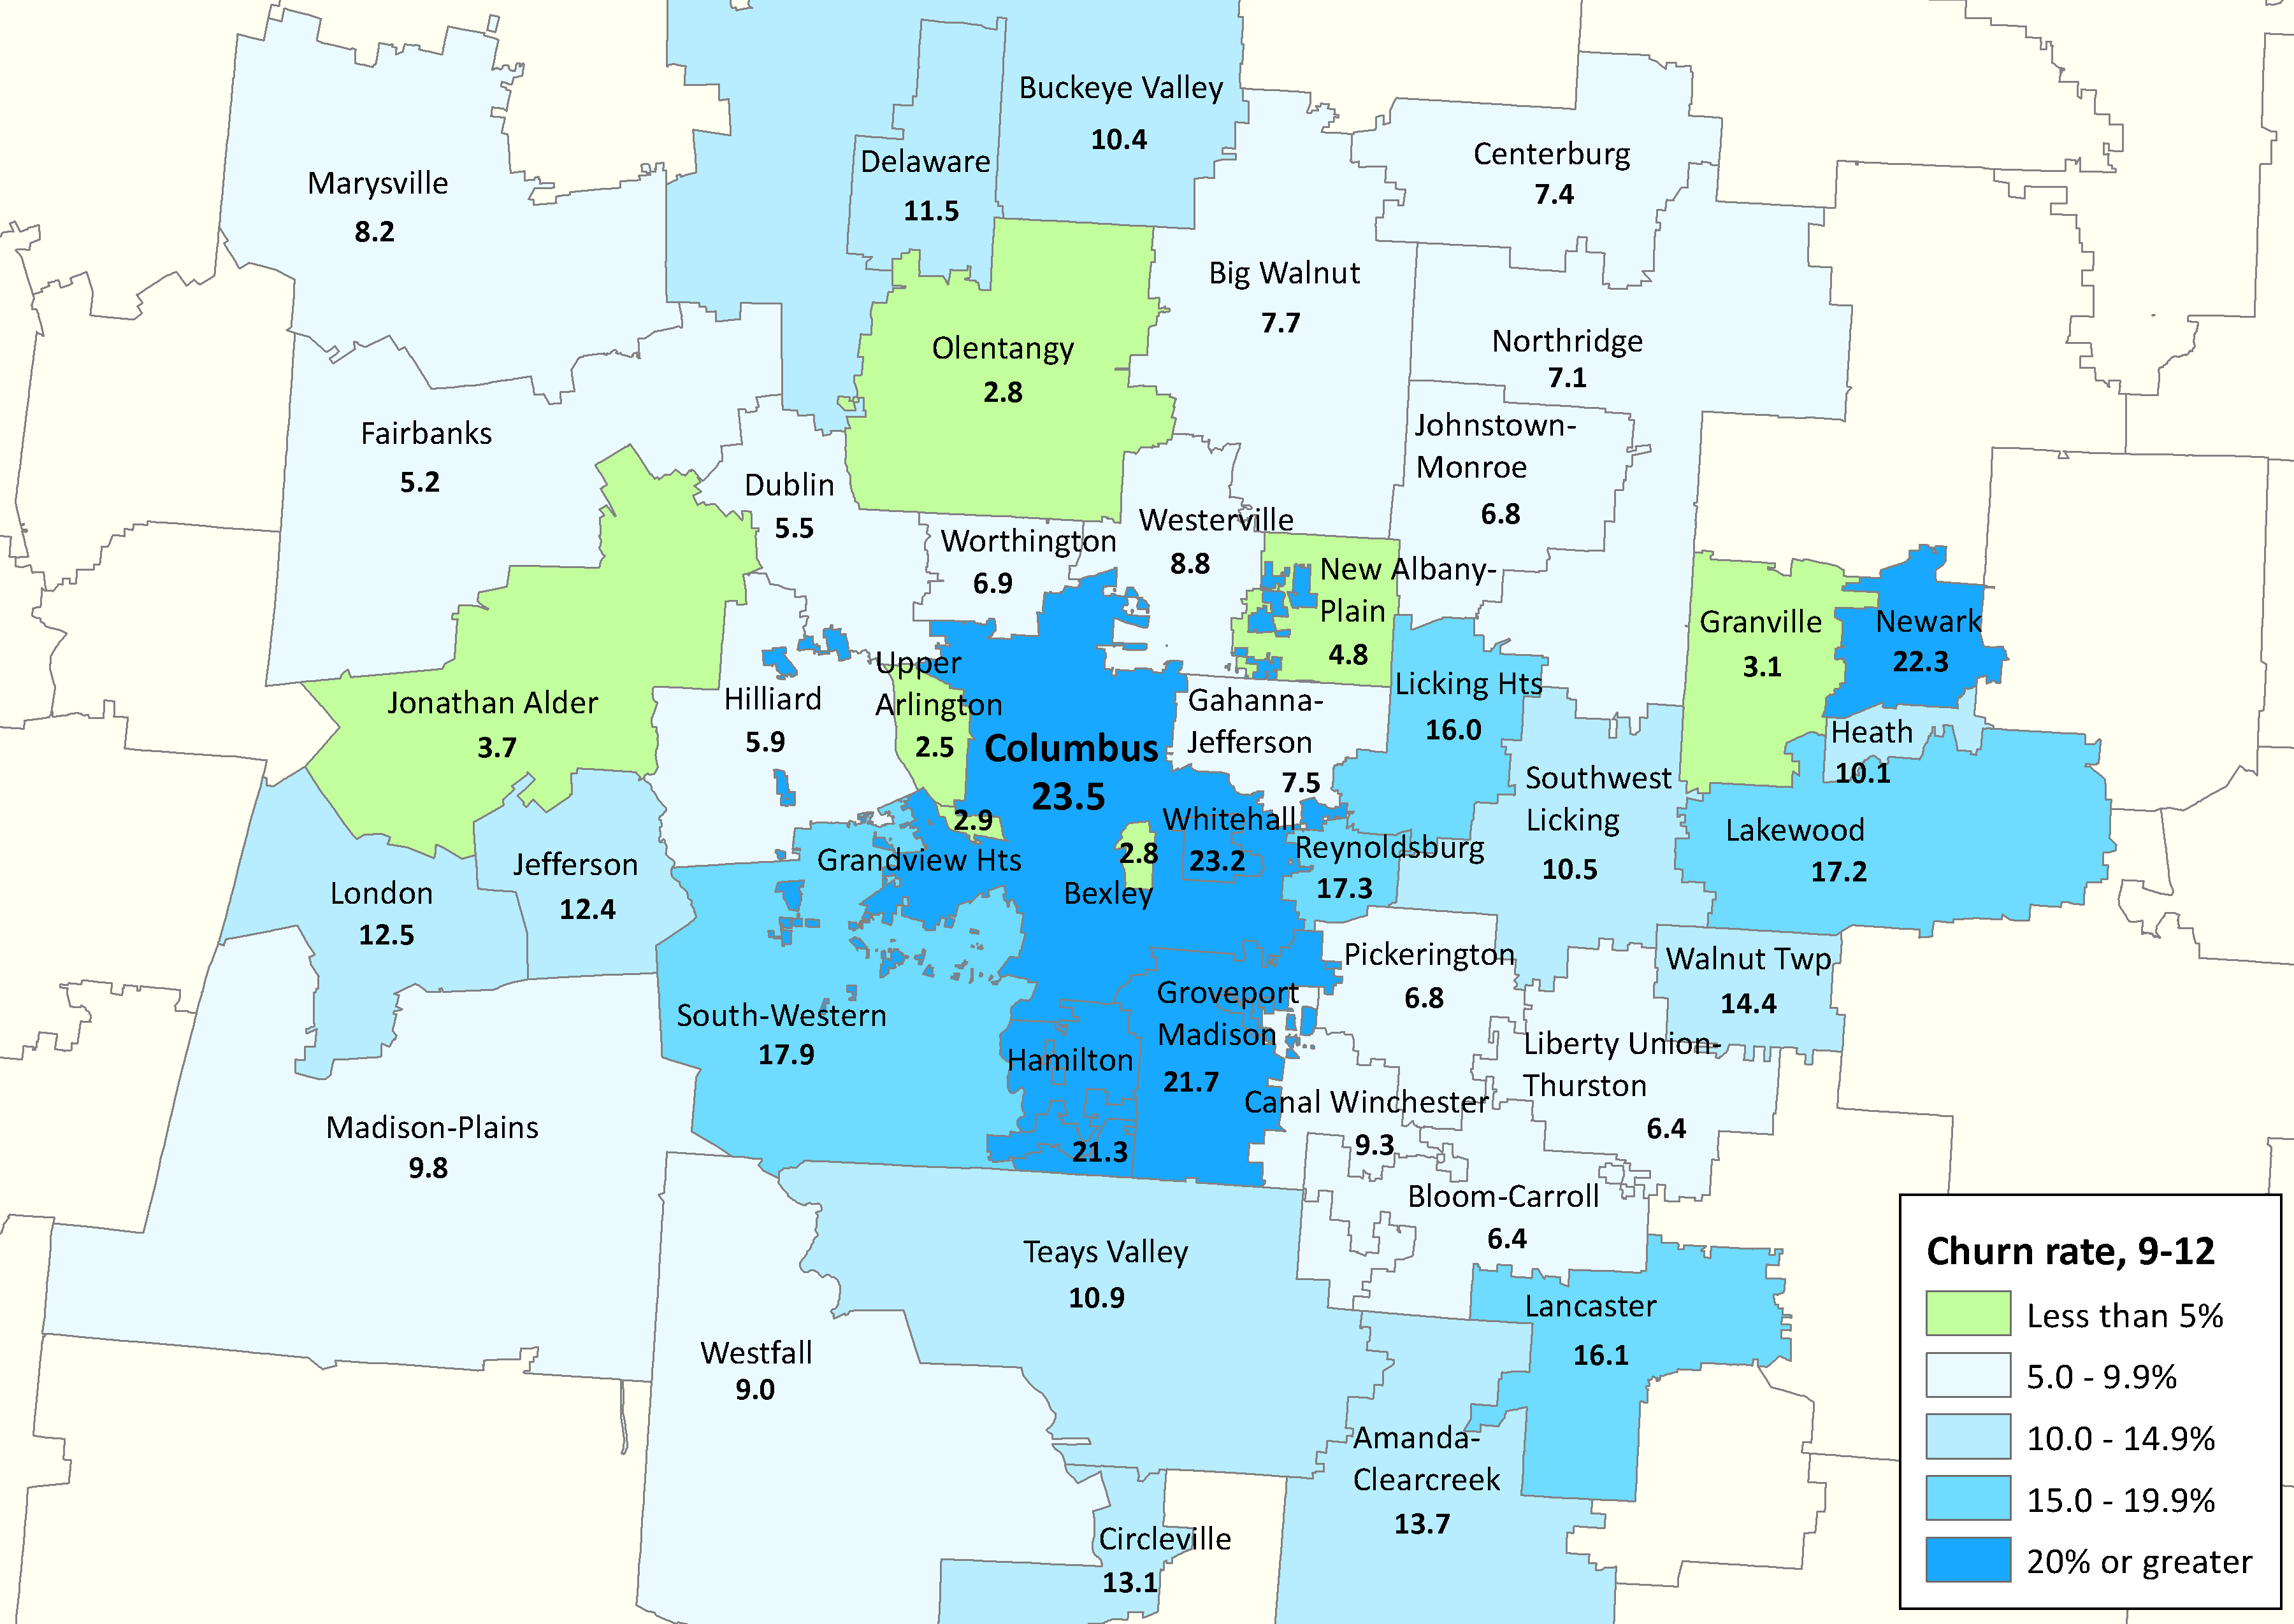
1-year churn rates, grades 9-12

Slide 10
Patterns of Mobility
How many unique students did pairs of buildings or districts have in common (student enrolled in both at some point in time) over two school years?
What was the direction of movement (last origin and destination) between the buildings or districts?
What is the performance rating of the destination school of mobile students, compared to the rating of the school of origin?

Slide 11
Most frequent district-to-district mobility patterns in Ohio, October 2009-May 2011
Columbus & South-western (2,034)
Columbus & Groveport Madison (1,196)
East Cleveland & Cleveland (1,083)
Cleveland & Euclid (903)
Columbus & Westerville (886)
Parma & Cleveland (773)
Cleveland & Cleveland Hts-University Hts. (764)
Toledo & Washington (684)
Cincinnati & Mt. Healthy (653)

Slide 12
Mobility and Students
The relationship of mobility and student characteristics and achievement in the five central urban districts
Mobility status: differences between stable and mobile students and between those staying, entering, and leaving
Destination school: difference in characteristics based on destination school
Proficiency test passage: relationship between mobility history and 3rd and 8th grade proficiency test scores

Slide 13
Mobility history and average test scores
Notes:
Based on average daily enrollment of building

Slide 14
Food for thought: High economic disadvantage and high stability
Economic disadvantage: 70%+ K-7 building stability: 77%+
District | Primary county | Perf. Rating | Enrollment
Manchester | Adams | B | 842
Perry | Allen | B | 832
Campbell | Mahoning | B | 1,261
Windham | Portage | B | 655
Western | Pike | C | 814
Alliance | Stark | B | 2,859
Eastern | Pike | B | 796
Barberton | Summit | B | 3,676
Ashtabula Area | Ashtabula | C | 3,936
New Boston | Scioto | C | 437

Slide 15
Food for thought: Low stability and high performance ratings
District performance rating: A K-7 building stability: less than 70%
District | Primary county | Economic Disadvantage | Enrollment
Madison | Butler | 27.7 | 1,568
Reading Community | Hamilton | 38.9 | 1,597
Willard | Huron | 57.2 | 1,767
Big Walnut | Delaware | 18.8 | 2,797
Cedar Cliff | Greene | 12.8 | 592
Southeastern | Clark | 27.5 | 798
Osnaburg | Stark | 41.5 | 869
Groveport Madison | Franklin | 58.0 | 5,746
Bloomfield-Mespo | Trumbull | 60.7 | 297

