Slide 1
MetaDash
Full lifecycle metadata tracking
Concept for an open-source metadata tracking tool
Chapin Hall at the University of Chicago
May 2014

Slide 2
Metadata tracking for government, academic and civic institutions
Chapin Hall is considering the creation of an open-source full-lifecycle metadata tracking system, tentatively named Metadash (see http://bit.ly/1gfFdOB)
Government, non-profit and academic institutions could freely download the MetaDash code base and install it on their network to track information about their data holdings
The metadata life cycle begins when when a data request is received or a data need arises
The project will build on the City of Chicago’s Metalicious data dictionary platform, which is maintained at Chapin Hall

Slide 4
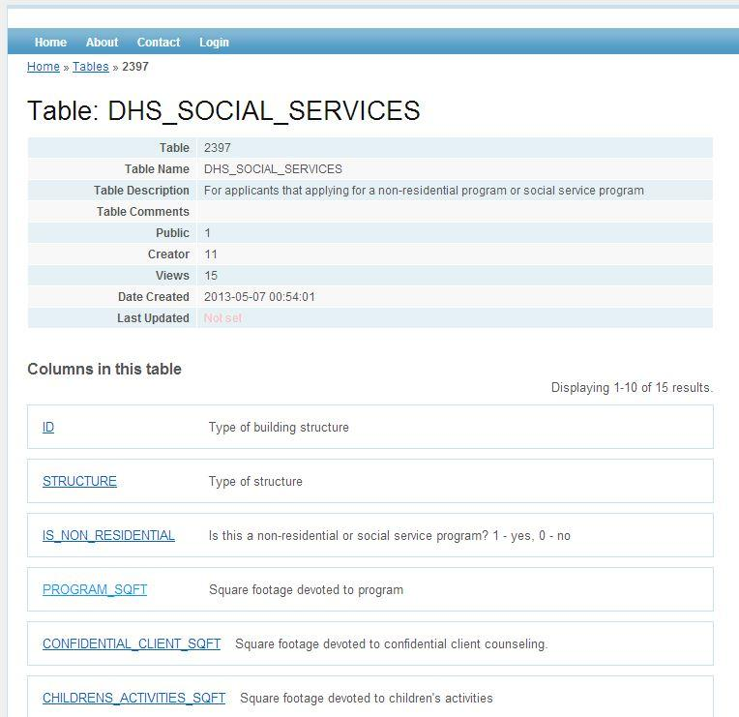
Data table information from the City of Chicago’s data dictionary

Slide 5
A predictable path
A data set is requested, often in vague terms and we:
Evaluate any “candidate” data sets that could meet the request
Acquire the selected data sets
Transform the data in stages (clean, aggregate, geocode, join, slice)
Load the resulting data into finished data tables, normally in RDBMS
Enter metadata about the data set into a metadata library (you do, right?)
Publish the data on an open data portal
Make the data available as machine-readable APIs
Loop back to step 3 and repeat every month/quarter/year/decade

Slide 6
Scattered fragments
Metadata and process documentation are scattered across many internal and external locations
Solution is an anchor app to pull linked web-based resources related to a specific data set (e.g., Chicago Public Schools data)

Slide 7
Stay tuned
Ideas, suggestions and other reactions are welcome!
Greg Sanders
gsanders@chapinhall.org

