Slide 1
Demystifying Data:
IHS’s Approach to Data Development and Applied Research
May 19, 2015
Presented by the Institute for Housing Studies for the Reclaiming Vacant Properties Conference

Slide 2
Institute for Housing Studies
IHS’s mission is to provide reliable, impartial, and timely data and research to inform housing policy decisions and discussions in the Chicago region and nationally
IHS accomplishes this through an applied research model
  Data collection and improvement
  Research
  Technical assistance
Today’s presentation
  IHS’s Data Clearinghouse development
  Using data to help stakeholders understand housing market conditions
  How analysis has been used to inform policy development
@housingstudies #chidata
Notes:
Thinking about the framing of this panel – We heard that sometimes the biggest barrier to using data is getting access to the data you need.

Slide 3
IHS Applied Research Model and Data Development
Core data sources
      Cook County Assessor – Data on all parcels in the County
      Cook County Recorder of Deeds – Transactions, mortgage recordings
      Cook County Clerk of the Court – Foreclosure filing activity
      Multiple Listing Service – Property listings and sales
Vendor and stakeholder relationships
    Understand collection channels, processes, and limitations
    Help to identify and deepen understanding of an issue
    Create and refine methodology
Connection to policy and practice
    Orients data development around real world application
    Helps structure and frame analysis
    Contributes to how information is delivered to users
@HOUSINGSTUDIES #chidata
Notes:
Challenge is making data useful for research and analysis – continued partnerships

Slide 4
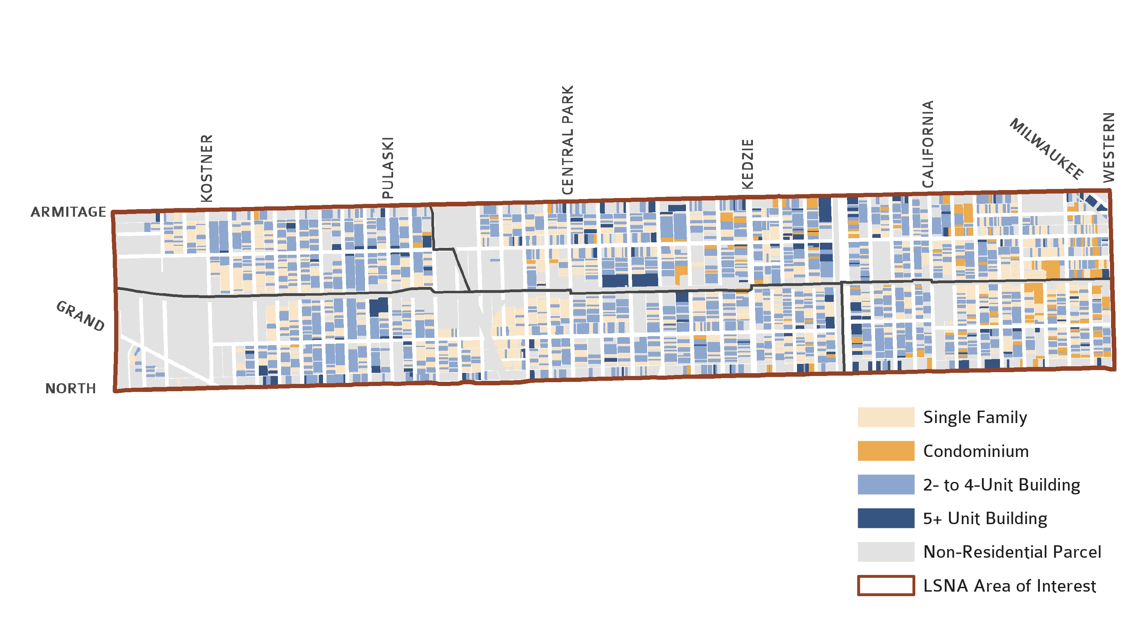
Data starts at the parcel
Diversity of neighborhood housing stock, residential parcels by assessor classification
*In the 606 area there are approximately 2,400 parcels with 2 to 4 units

Slide 5
Can be built to create indicators to highlight countywide trends
Quarterly Single Family House Price Changes in Cook County, 1997 Q1-2014 Q4
Source: IHS Cook County house price index, 1Q 2014

Slide 6
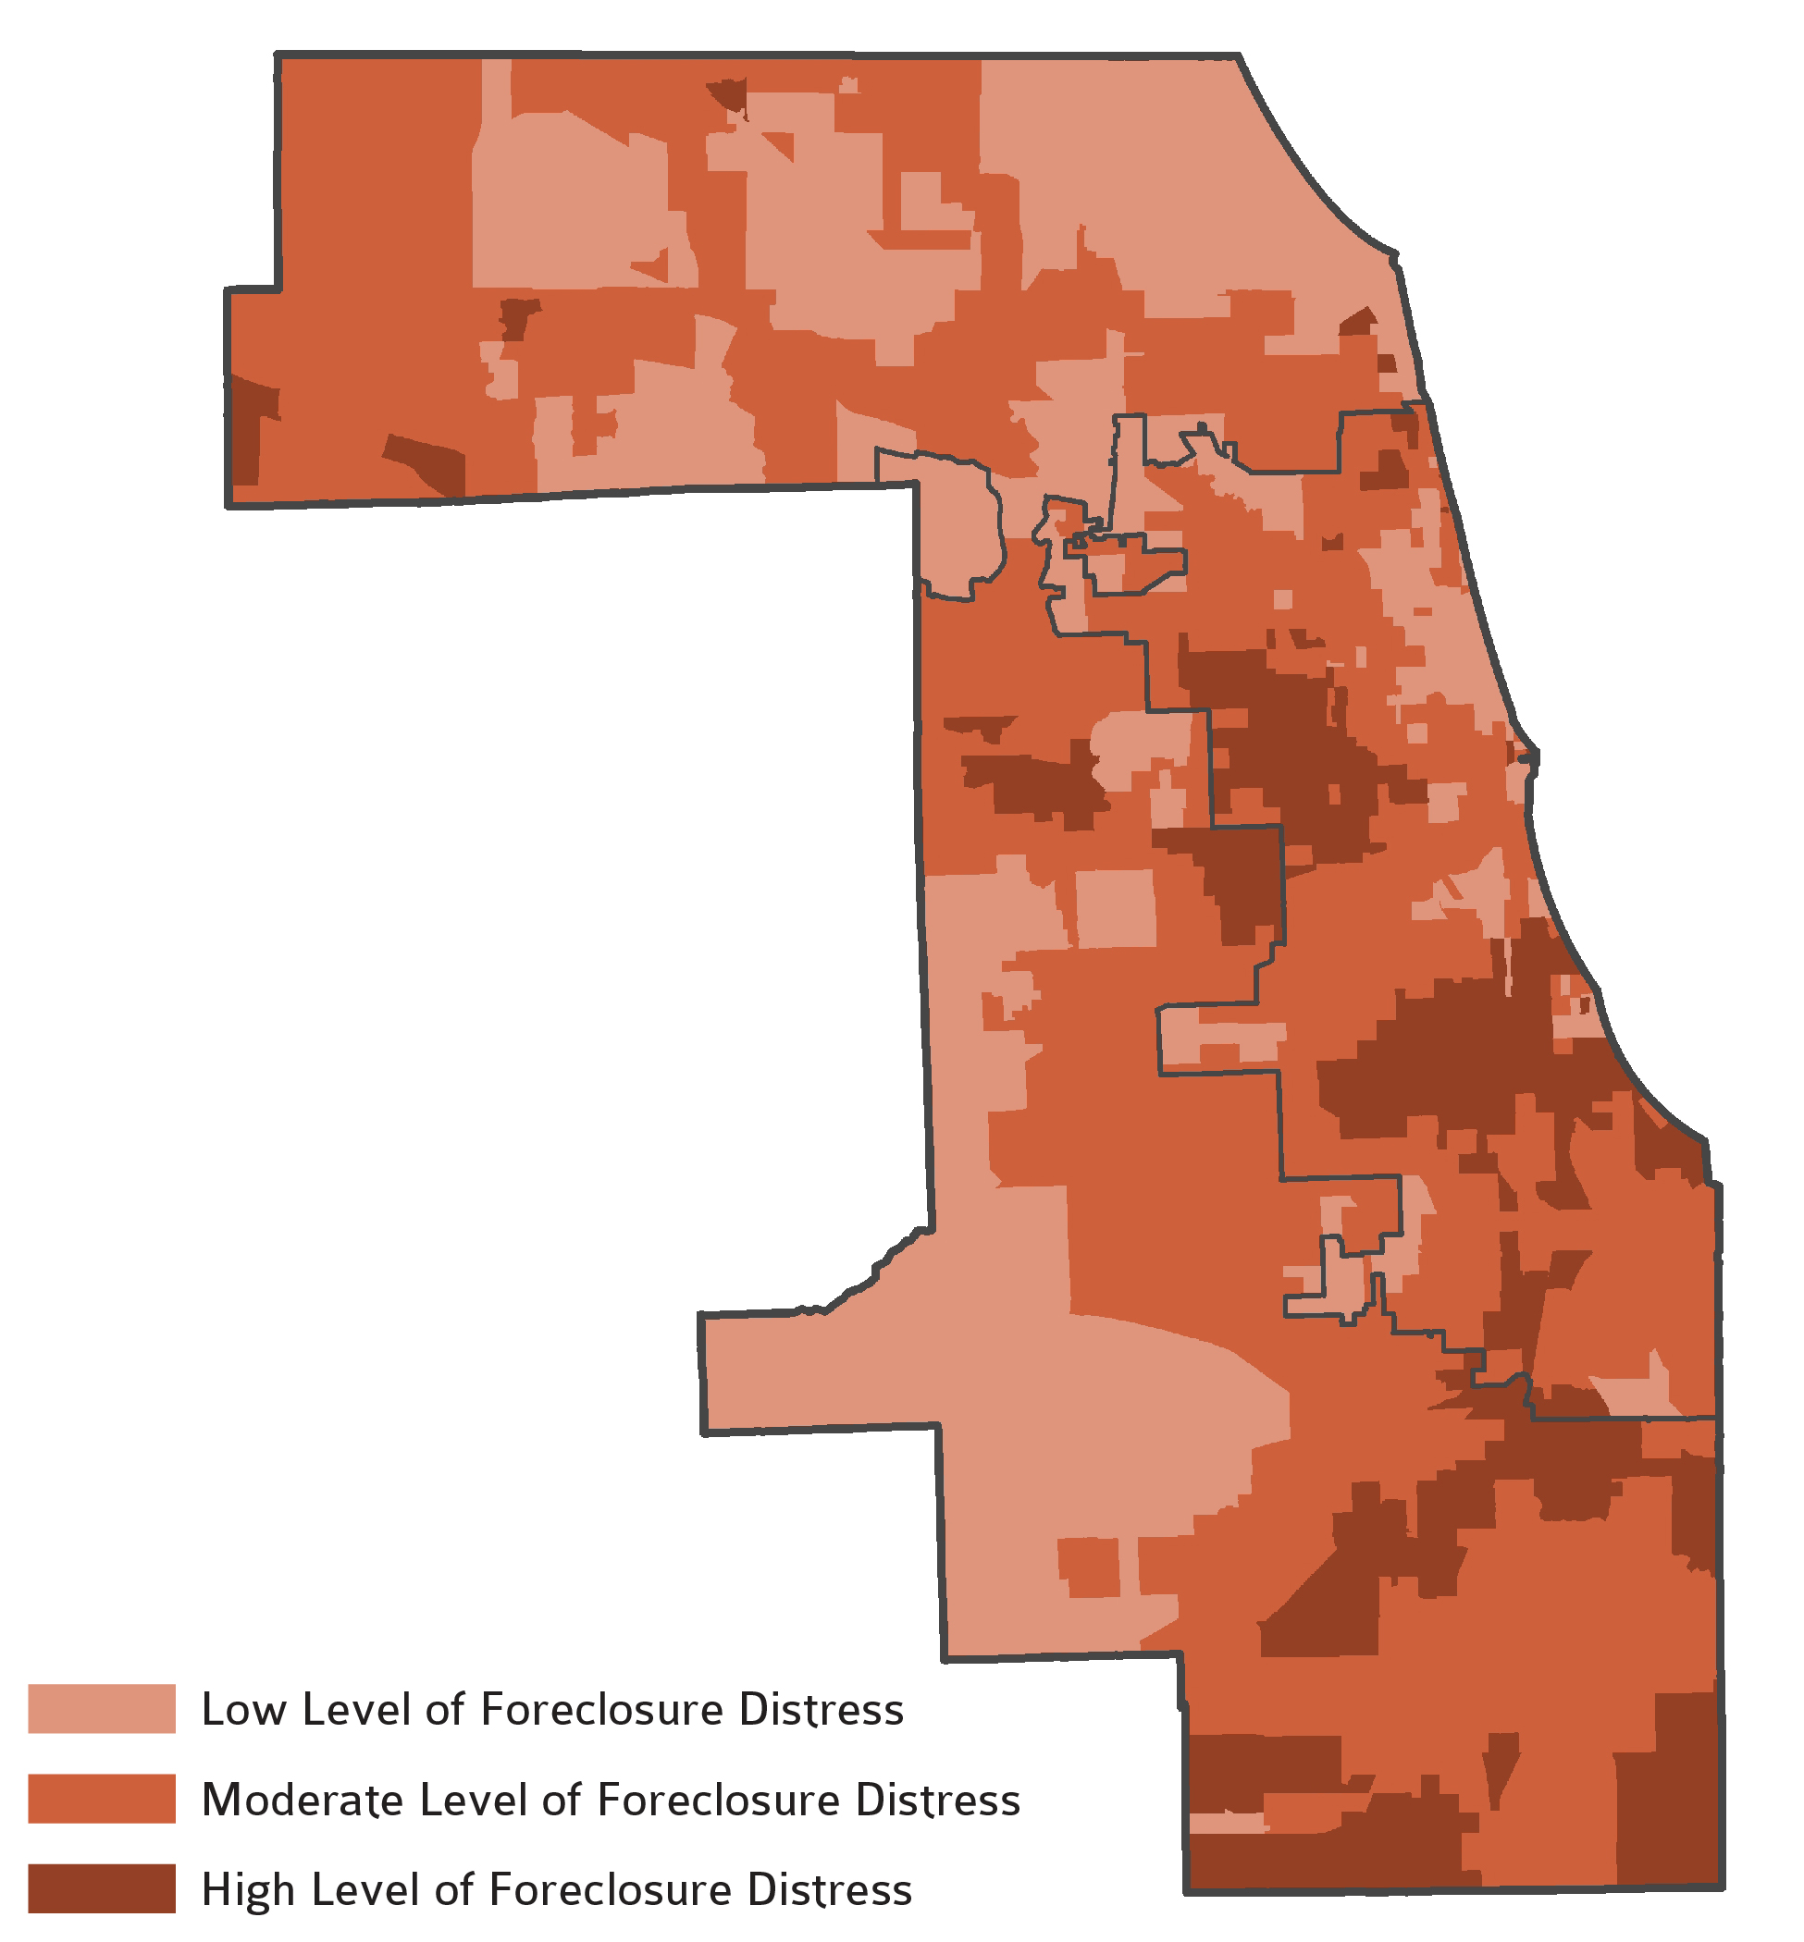
Variation in concentrated foreclosure activity
Source:
calculations of data from the ihs data clearinghouse

Slide 7
Market conditions vary across neighborhoods
House Prices - Quarterly Single Family House Price Changes by Distress Category, 1997 Q1-2014 Q4
Source: ihs cook county house price index, 2014Q4

Slide 8
Distressed areas have much higher concentration of vacancy
County Share of Total Active Addresses and Long-Term Vacant Addresses by Distress Category, Q4 2014
SOURCE: USPS/HUD Vacancy data

Slide 9
Foreclosure filing activity declines to near pre-crisis levels
Foreclosure filings per 100 Residential Parcels by Distress Category, 2005-2014
Source: calculations of data from record information services, cook county recorder of deeds via property insight, cook county assessor

Slide 10
Mortgage credit slows in 2014
Mortgages per 100 Residential Parcels by Distress Category, 2005-2014
Source: ihs data clearinghouse, calculations of data from cook county recorder of deeds via property insight, cook county assessor

Slide 11
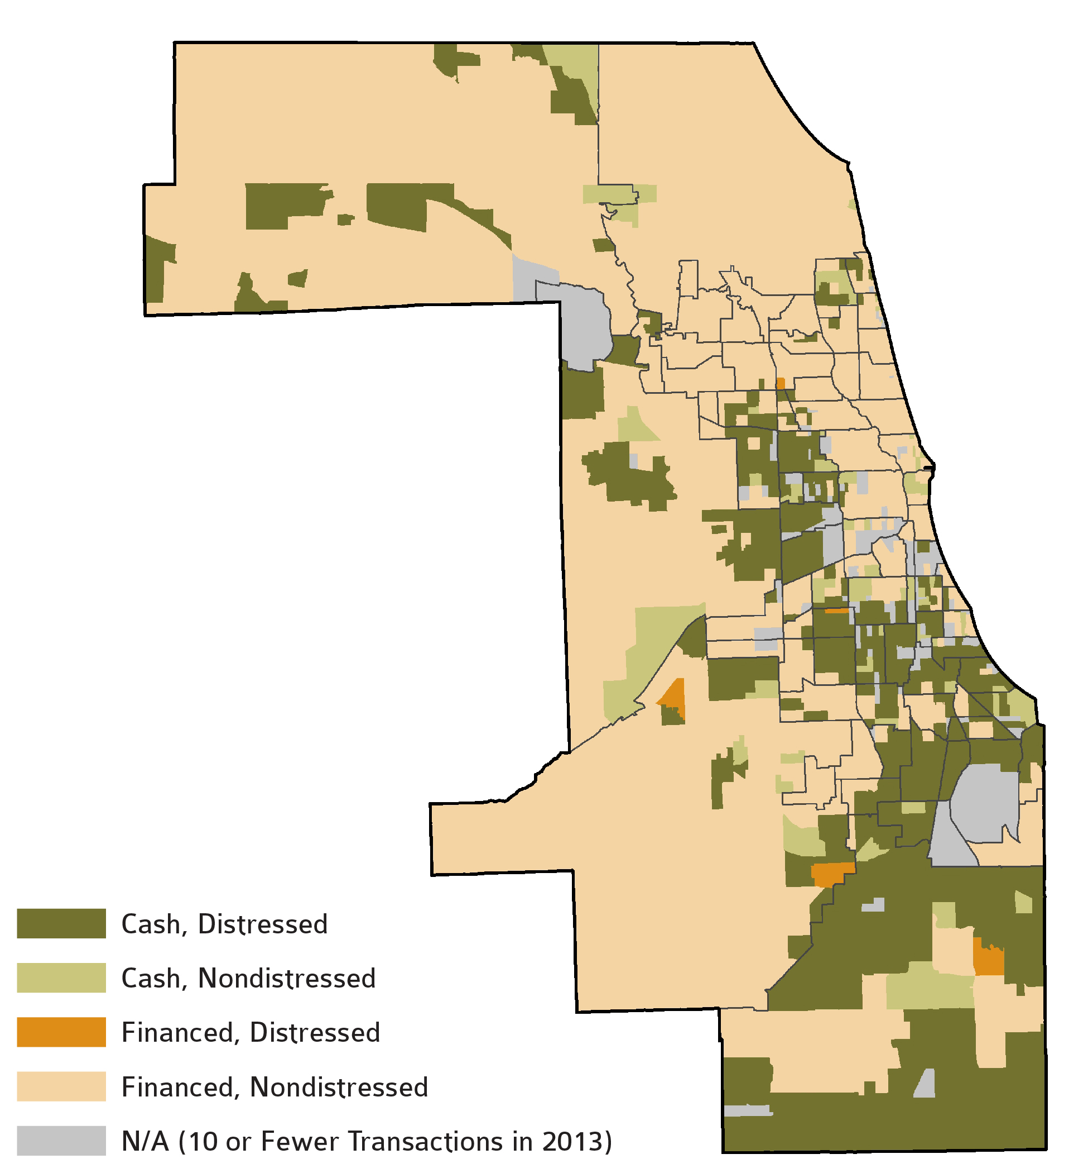
Cash buying remains common in many communities
Source:
calculations of data from record information services, cook county recorder of deeds via property insight, cook county assessor, midwest real estate data

Slide 12
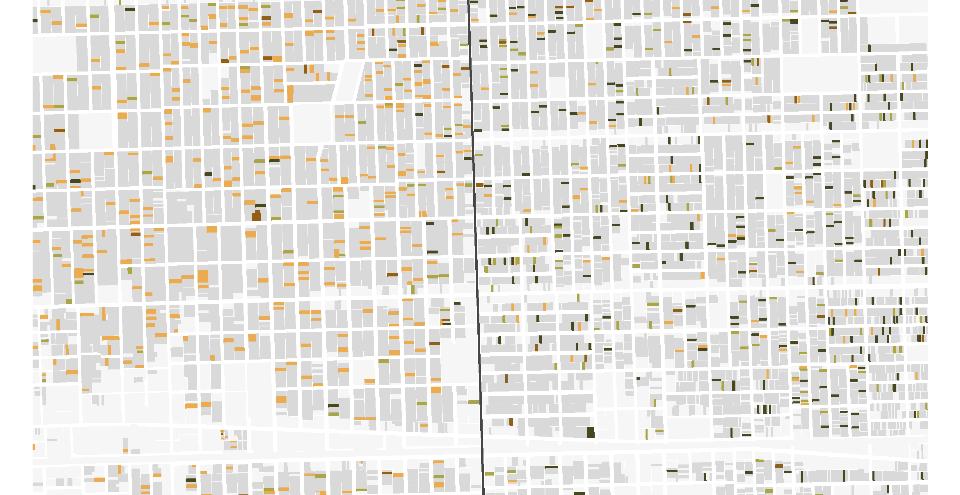
Two different housing markets
Predominant method of purchase in Oak Park (left) and Austin (right), 2012 and 2013

Slide 13
How has this data been used to inform policy development?
City of Chicago
  Challenge – The City of Chicago’s was updating its five-year housing plan and needed data to facilitate stakeholder discussions around housing needs in Chicago’s neighborhoods
  Analysis
    Created data book highlighting changes in Chicago’s demographic, economic, and housing market conditions
    Raised awareness of distinct policy challenges in strong, weaker, and transitional housing markets
    Presented to focus groups of stakeholders
  Solution
    The City of Chicago Department of Planning and Development adopted a market-focused approach to housing policy development.
    Example – Affordable Requirements Ordinance

Slide 14
How has this data been used to inform policy development?
Community Investment Corporation (CIC)
  Challenge – Certain neighborhoods were seeing a growing number of vacant and abandoned 2-4 unit buildings.
  Analysis
    Highlighted importance of these buildings to Chicago’s rental stock, particularly in lower-income communities
    Demonstrated higher levels of foreclosure activity on these types of properties
    Illustrated lack of lending options for potential buyers of 2-4 unit buildings
  Solution – CIC used data to highlight the need and secure funding for a financial product geared towards small investors in 2-4 unit buildings

Slide 15
IHS’s Approach to Data Development and Applied Research
May 19, 2015
housingstudies.org
@housingstudies
Contact: gsmith33@depaul.edu
Presented by the Institute for Housing Studies for the Chicago Housing Roundtable

